Slide 1
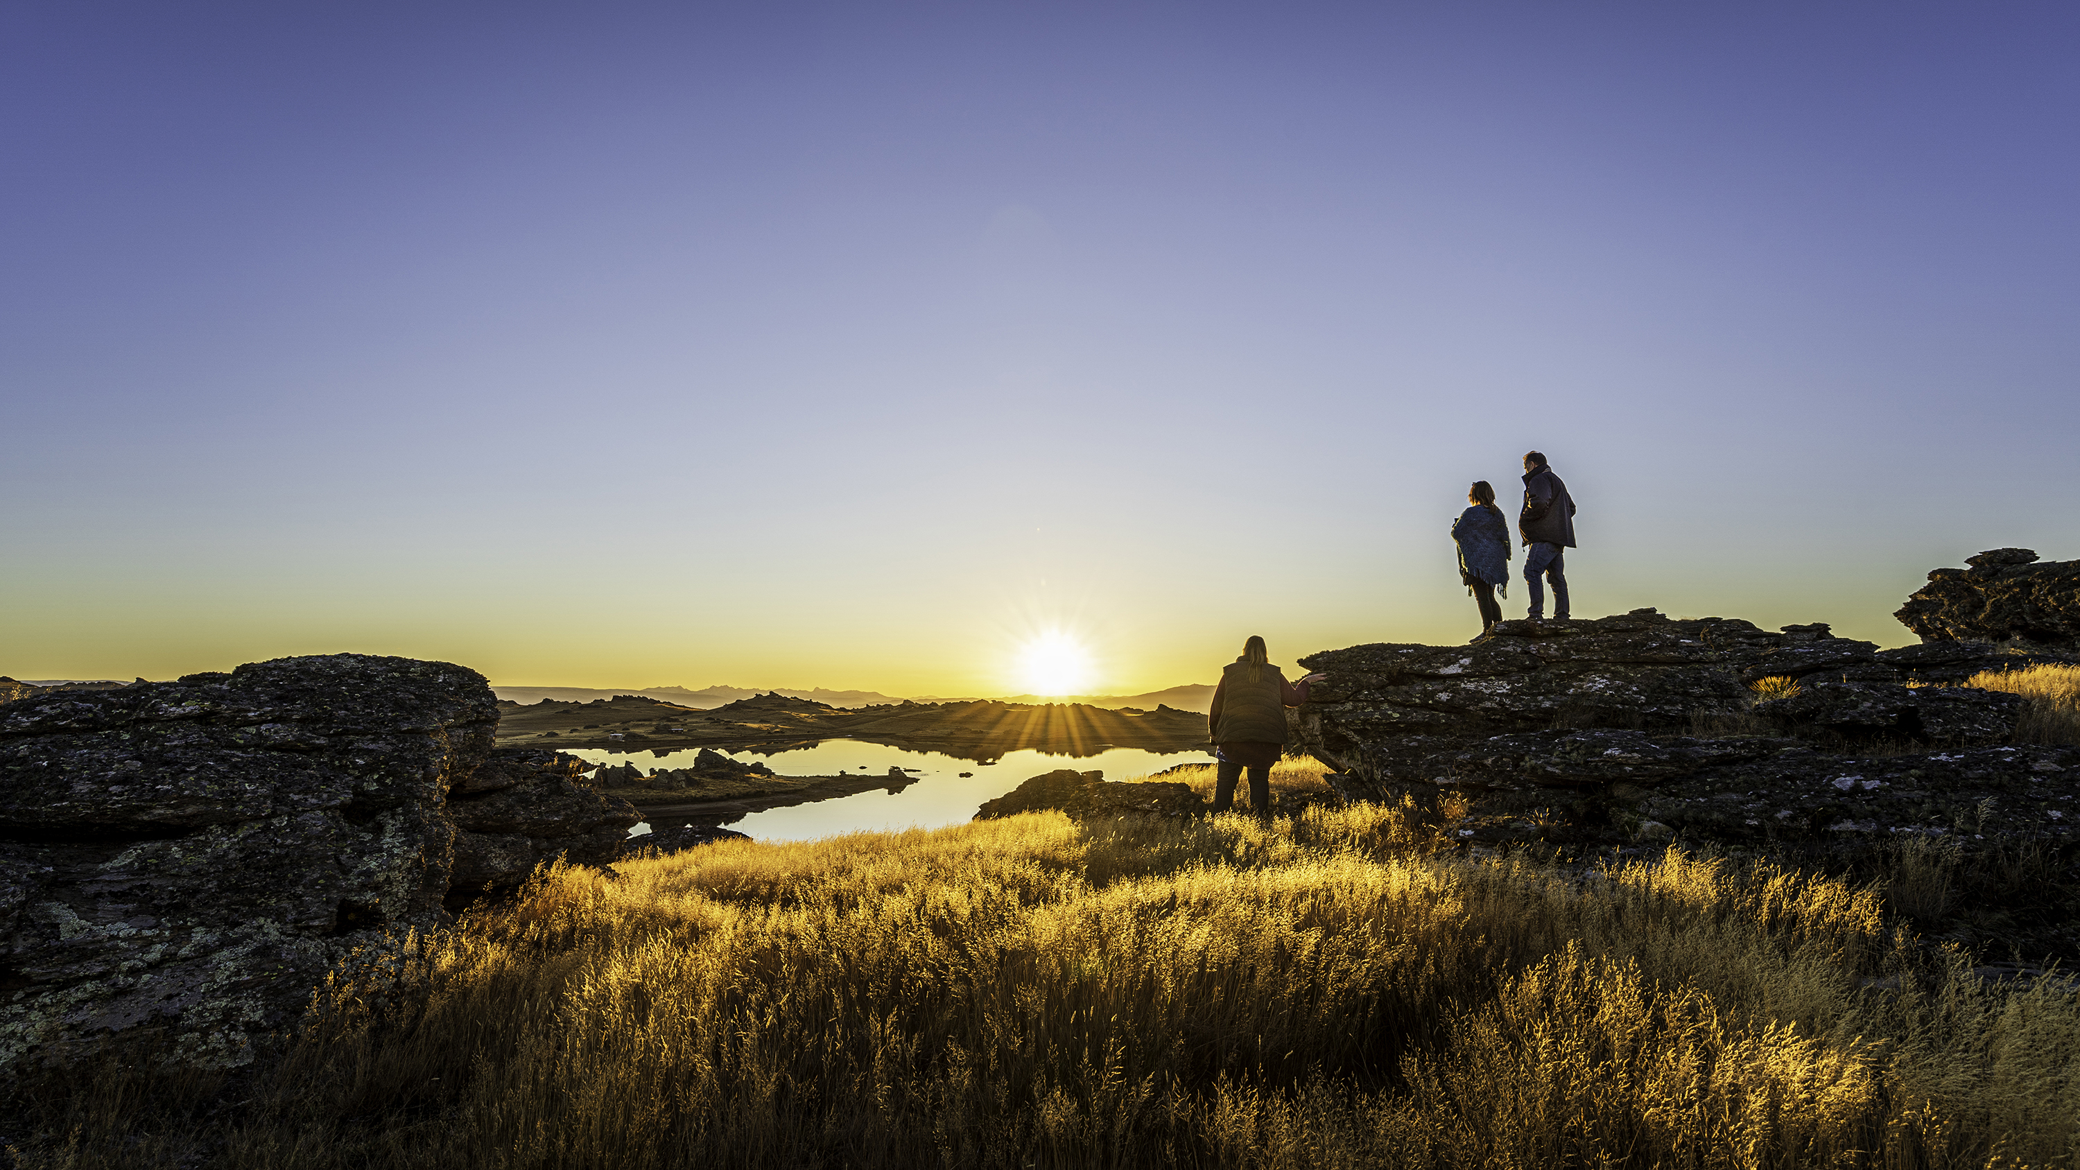
Reshaping our Leadership & Governance Structure for Destination Management
Wānanga Tuatoru, June 2023
Antz Longman, Head of Destination, Tourism Central Otago
Notes:
What is DM
Why is it important
How do we do it for CO

Slide 2
Where we came from
What we needed
How we changed
What does future success look like?
Notes:
What is DM
Why is it important
How do we do it for CO

Slide 3
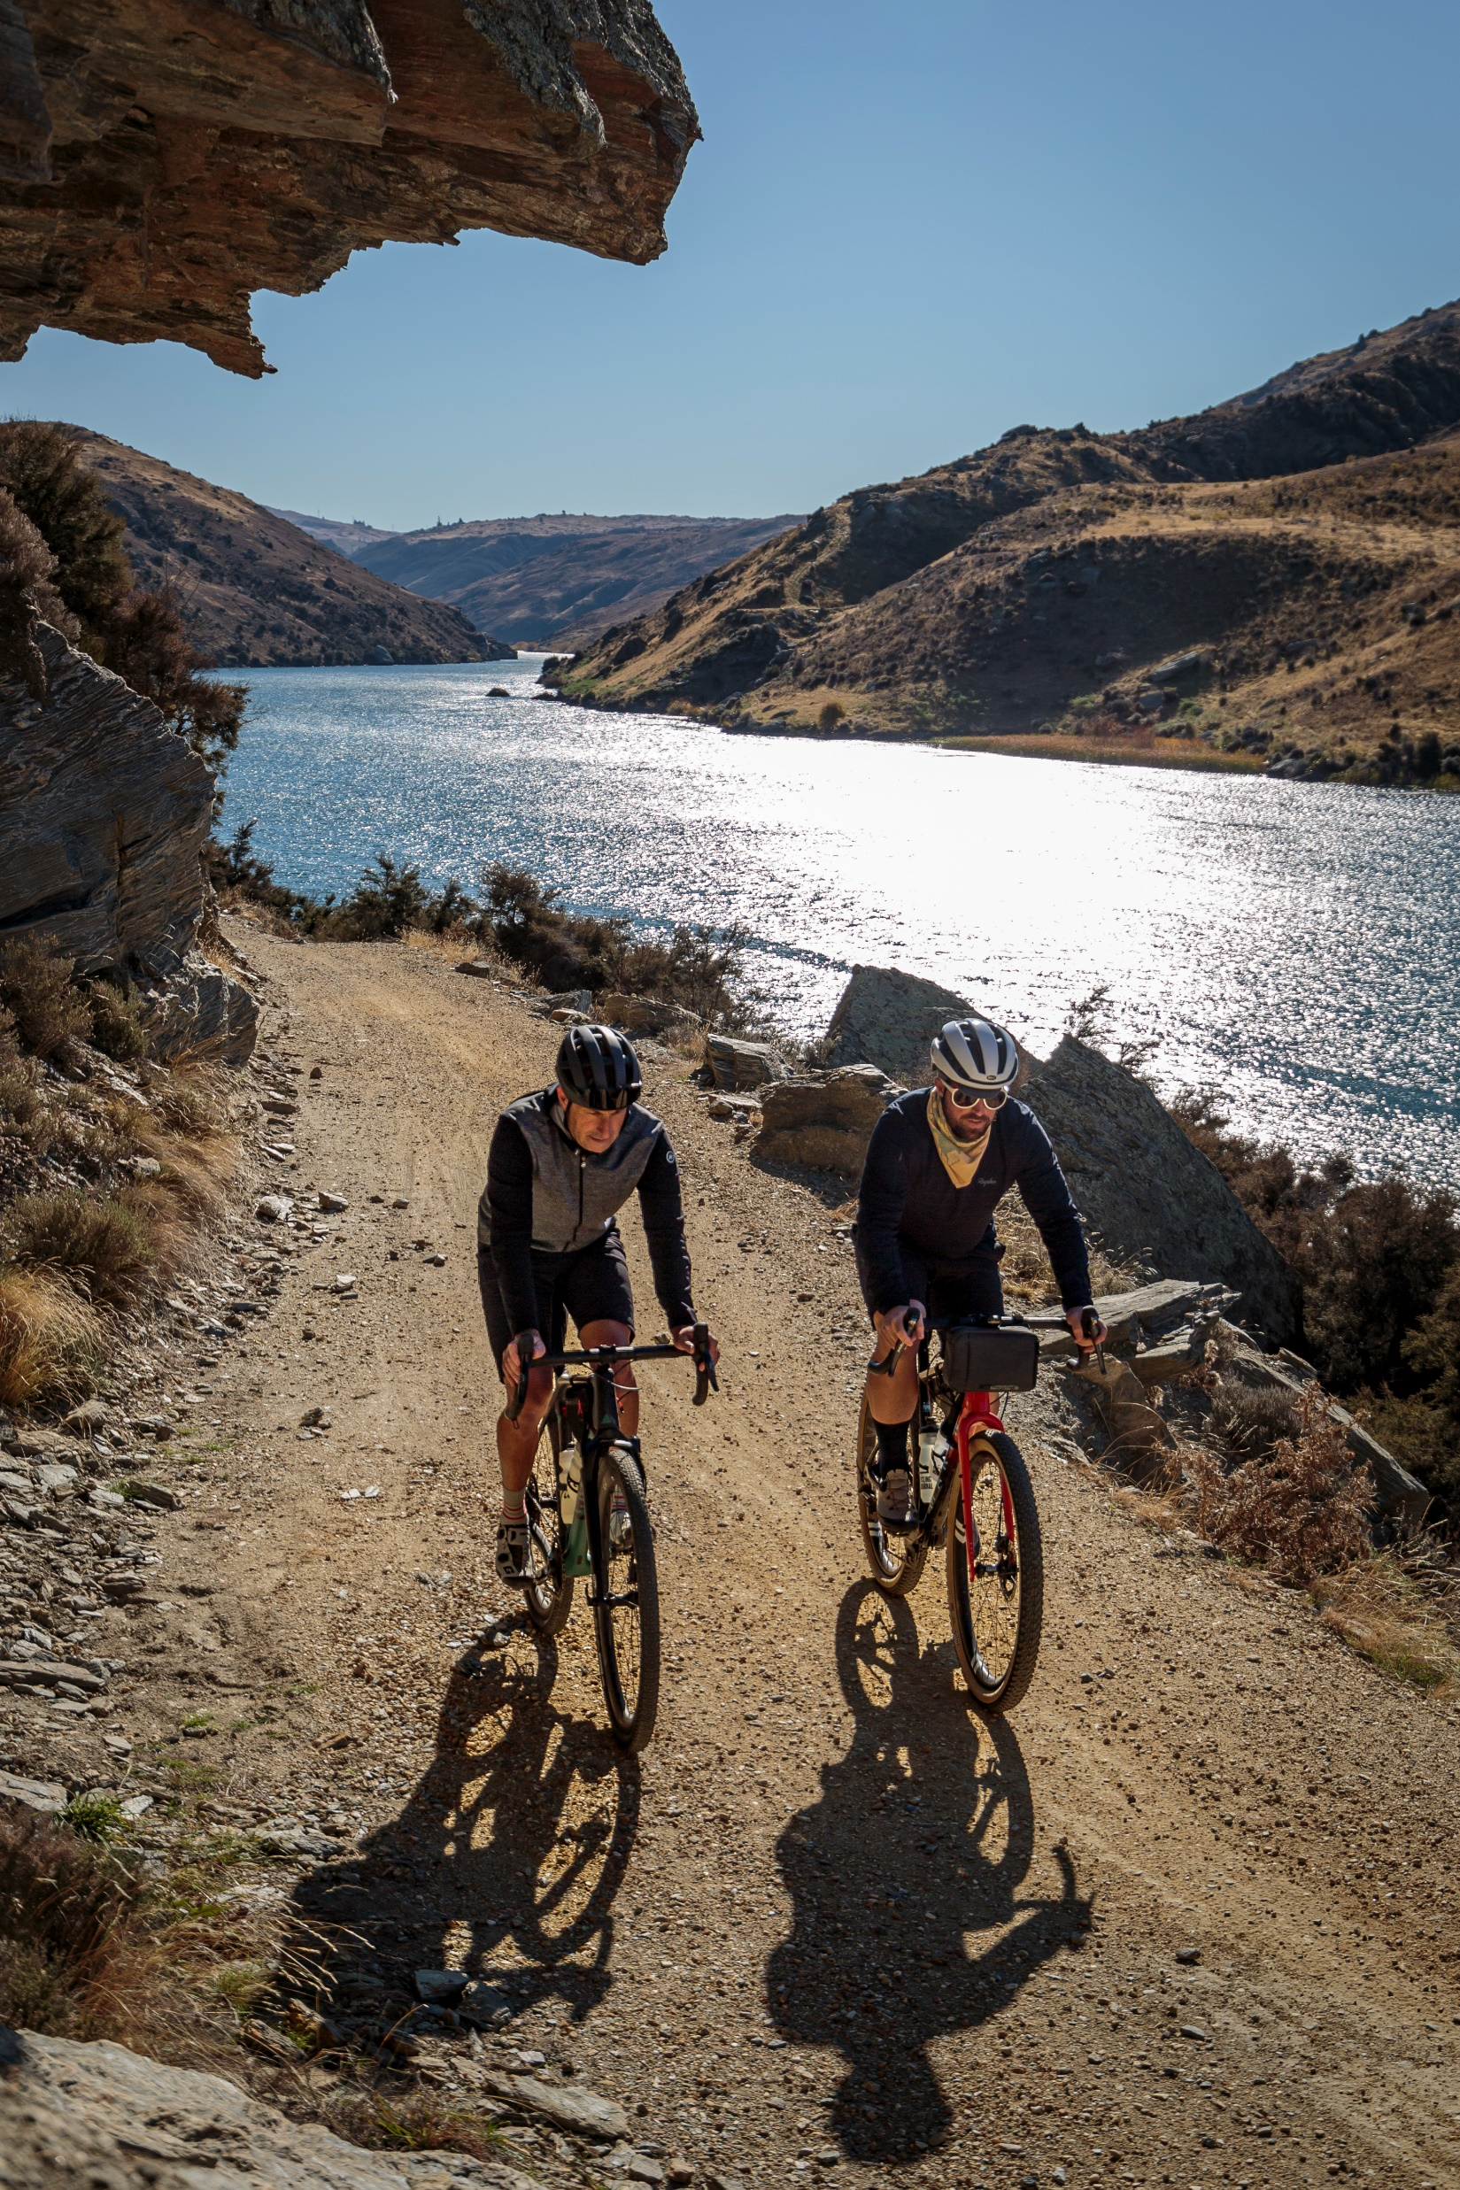
Where we’ve come from
Regional Identity Programme and 2018-2028 Tourism Strategy.
2018 review into how the tourism function of Council
The Tourism Advisory Board helped to strike balance between promotion and management, and in region and out of region tourism expertise.
The ‘TAB’ enabled the tourism team and region to thrive, bringing in significant connection to national and international initiatives and widening the view beyond Central Otago.
Notes:
Background
In 2018 a review and subsequent recommendations were made on how the tourism function of Council was managed and governed. The review found there was significant benefit to retaining the tourism function within Council, rather than pulling it out as a stand-alone RTO or EDA. There was continued support for the tourism function to remain in-house.
The significant change was introducing an external Tourism Advisory Board, which gave additional support and assistance to the existing tourism team in an advisory capacity. Councillors were still the key decision makers in regard to mandate and funding of the tourism function.
The ‘TAB’ enabled the tourism team to thrive, bringing in significant connection to national and international initiatives and widening the view of the collective to look at opportunities beyond Central Otago.
Sue Sullivan, Susan Hogue McKenzie, Karen Jefferson, David Ritchie, Rudi Bauer, Mayor Tim Cadogan
The function of the tourism team of council is primarily promotion and management of tourism in the district. The advisory board appointments have been made in a way to strike balance between promotion and management, and also in region and out of region expertise.

Slide 4
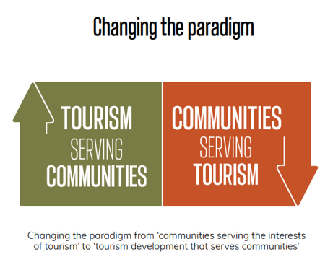
Future Thinking - What we needed
Take another look at the governance and leadership to reflect DMP
Discussion paper to existing Tourism Advisory Board
Consider standing in the community, strategic vision, funding, project management, knowledge of Central and local Government process, values of Regional Identity and Kāi Tahu, partnerships with mana whenua, youth leadership.
Preference to have the majority of the governance group live within region or affiliation to, but acknowledged the value of having an out of region view to bring balance.
Notes:
Future thinking – what we needed
As the tourism function set about delivering the Central Otago Destination Management Plan, the governance and leadership structure needed a review.
A discussion paper was put to the Tourism Advisory Board in July 2022. They supported the proposal to disestablish the existing board, and setup a new board with a renewed focus on supporting the implementation of the DMP. Our new governance structure is reflective of the Tourism Advisory Board’s preference from that time.
Considerations were standing with in the community, strategic vision for Central Otago, knowledge of funding functions, project management, knowledge of Central and local Government process, values of Regional Identity and Kai Tahu, partnership with mana whenua, youth leadership.
Preference to have the majority of the governance group live within region but acknowledge the value of having an out of region view to bring balance.

Slide 5
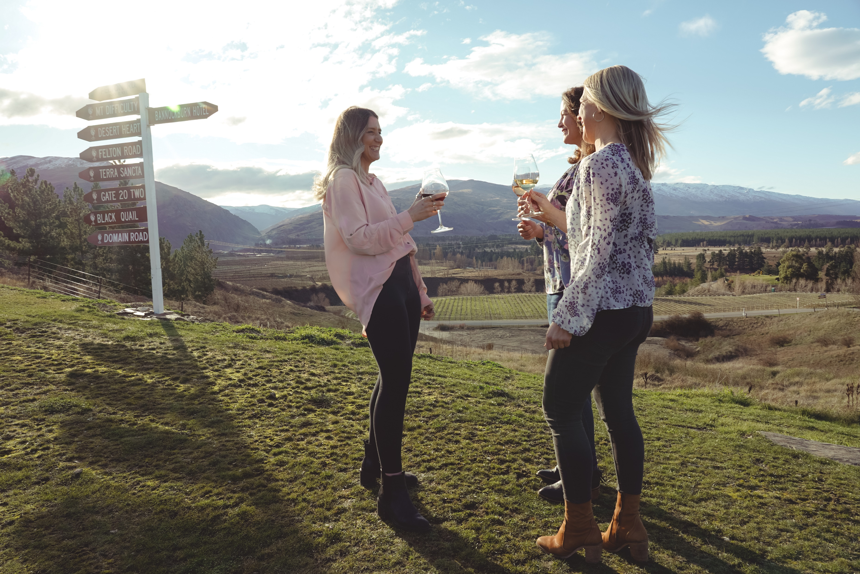
How we changed.
Destination Advisory Board
Mark Frood, Chair
Chris Roberts
Tara Druce
Shayne Forrest
Tamah Alley, Council Representative
Kate Hines, Youth 18-30 Representative
Mark Button, Operator Representative
Kāi Tahu Representative
Intern / High School Representative
Notes:
What is DM
Why is it important
How do we do it for CO

Slide 6
Why is diversity of thought and background important on the board?
I see diversity of thought as just as important as "diversity" - but a lot of this comes from having people around the table who happen to be diverse. Tamah Alley
Diversity is what makes up our community and gives us strength, so should be represented in a board, breadth of age, gender and experience gives our board incredible power, and makes for robust conversations that are fun and a learning experience for us all. Mark Frood
I think it is important to have at least one voice that doesn't come at the DMP with a "tourism" lens, because a large part of the DMP implementation is not about tourism. Tamah Alley
What is the Advisory Boards role in supporting implementation?
Board are helping to drive high level work plan priorities - there is a lot in the DMP!
Leveraging connections and relationships for cross-border collaboration where appropriate at a governance level (often the team are already in this space)
For the board we add differing experiences and skill sets for the Council, stakeholders and tourism team, we help set the strategy and advice on how to implement it, it is also trying to simplify what is an incredibly complex agenda.
Not only do we add collective experiences that have been done right, but JUST AS Importantly the things we have experienced that were done wrong
Notes:
What is DM
Why is it important
How do we do it for CO

Slide 7
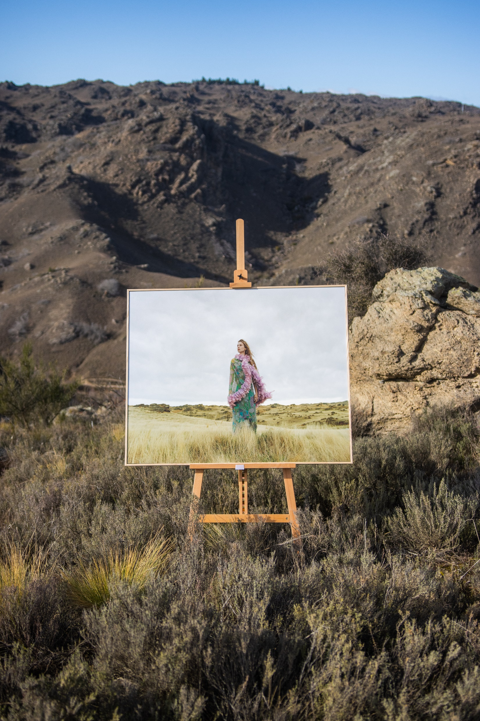
What it means for our team.
We’ve started a journey to realign roles and functions towards our future goals
Head of Destination role (previously GM Tourism)
Destination Co-Ordinator role (previously Marketing & Administration)
Digital and Content Advisor
Ensuring other existing/core functions of RTO are continued and supported to deliver upon the ambitions of the DMP.
  Media & PR
  Trade, Business Events and Consumer Marketing
  i-sites
  Industry Partnerships; Southern Way, Otago Trails Marketing
Notes:
What is DM
Why is it important
How do we do it for CO

Slide 8
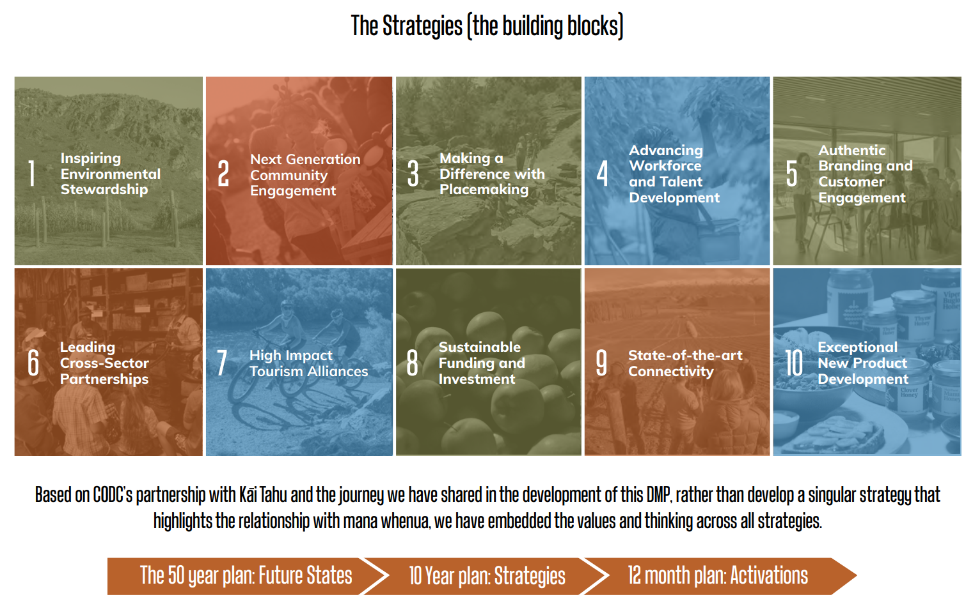
What does success look like? The future states
Each building block within our DMP has a 50 year future state, as we journey on the path towards these states – we need to:
Actively serve a more diverse group of stakeholders
Accommodate intergenerational and technological shifts
Be strategically aligned with other sectors, neighbouring regions and national partners, and able to flex with changes in policy and regulatory environments - locally, nationally and globally.
The complexity of planning in this environment is significant. That is where we believe that having both a compass and a road map can make a real difference.
Notes:
Each building block within our DMP has a 50 year future state, as we journey on the path towards these states – we need to:
Actively serve a more diverse group of stakeholders, balancing the demands of economic growth and development with the need for shared custodianship of the environment, the aspirations of mana whenua and the diverse communities of Central Otago.
Accommodate the intergenerational and technological shifts that are re-shaping both these communities, and the motivations and travel styles of visitors in the markets in which Central Otago competes.
Be strategically aligned with other sectors of the Central Otago economy, with neighbouring regions and national partners, and able to flex with changes in policy and regulatory environments - locally, nationally and globally.
The complexity of planning in this environment is significant. That is where we believe that having both a compass and a road map can make a real difference.

Slide 9
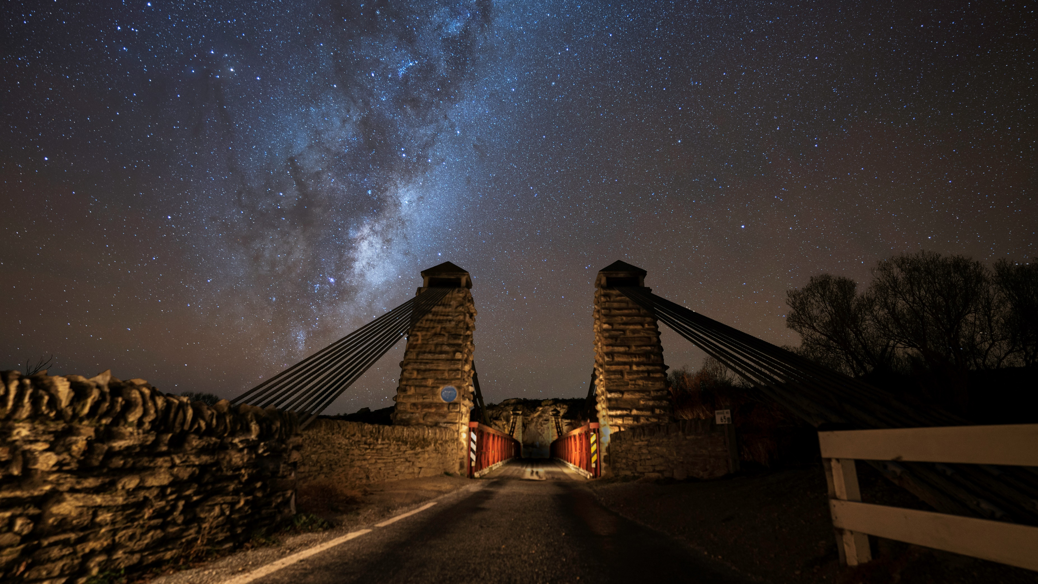
Honouring the past, embracing the present, navigating the future
Ko Te Toa i a Tini i a Mano o Te Takata
We possess the strength of many, it is the contribution of the multitudes that ensures success
Notes:
What is DM
Why is it important
How do we do it for CO

