Slide 1


Tourism Sector Climate Change Adaptation Roadmap
Wānanga Tuatoru
26th June 2023
Circle
Notes:
Kia ora Koutou
Ko Karangahake te maunga
Ko Waihou te awa
Ko Paeroa taku haukainga
Nō Manawatū me Ingarangi ōku tīpuna
E noho ana au i Tāmaki-makau-rau inaianei
Ko Jack Keeys ahau
My role is Director of Implementation at the Aotearoa Circle. With the pleasure of leading our Agri-food and Tourism workstreams. I Joined The Circle 4 months ago, originally as a agriculture and food specialist, but am very privileged to have been recently asked to lead our tourism sector work

Slide 2


The Aotearoa Circle
Notes:
The Aotearoa Circle is a public and private trust, with partners who fund us and collaborate with us including government agencies, corporates and NGOs across the New Zealand ecosystem.
We focus specifically on projects and initiatives that will improve the natural capital of New Zealand – restoring our environment.
Founded just four years ago in 2019, The Aotearoa Circle has rapidly delivered key reports, workstreams and impacts across a range of sectors including marine and native forestry – and today we’re focusing on the food system and agriculture.

Slide 3


Agenda
1
Introduction
2
Background, process, and involvement
3
Climate Scenarios overview
4
Adaptation Roadmap overview
5
Implementation and involvement
Notes:
I’ll be flying through these slides, mostly because they were written by PwC and despite cutting them down – they still have way too many words on them! (though will hopefully be a helpful guide for anyone who may like access to them after the presentation).
But also because there’s a few key areas to get across – what the work was, and why it was important, in addition to the climate scenarios themselves, the action roadmap, and the next steps

Slide 4
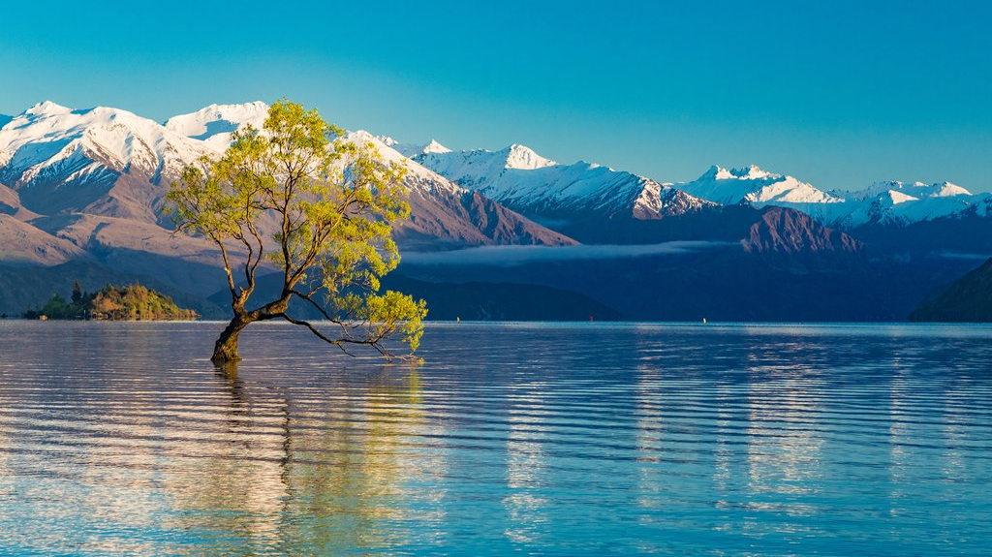
Background to the project
Notes:
Why this project?
Each sector has upcoming mandatory climate disclosure requirements through the XRB – external reporting board, which requires climate-related scenario analysis and strategic planning. This will be mandatory for organisations that meet certain criteria – such as being listed on the NZX.
However, we believe there is an opportunity to go wider and deeper in terms of delivering value to the sector. So we’ve sought to create the climate scenarios as an asset for all organisations to use, while also attaching key actions to the scenarios for outlining what climate change adaptation action needs to come next.

Slide 5
There are many risks to the sector from climate change, but that brings opportunity if you act now
Challenge
Environmental degradation is already impacting New Zealand’s clean, green reputation.
Increasing focus on visitors environmental impact including ‘travel footprint’ carbon emissions.
Climate change is directly impacting Tourism operations, and will continue to do so.
Opportunity
Tourism sector is recovering from COVID-19; there is a rare opportunity to refocus the sector’s strategy.
The sector can explore how it can leverage collaboration to ensure it is an adaptive, regenerative, value-driven industry.
Develop impactful initiatives to proactively approach climate change risks.
Objectives of this project
Develop a set of XRB aligned climate change scenarios
Develop an adaptation roadmap with clear objectives and tangible actions for Implementation
Notes:
And everyone in this room is likely aware of some of the key context – environmental and climate change related challenges such as….
And also the current opportunities…

Slide 6
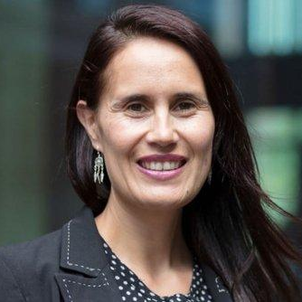
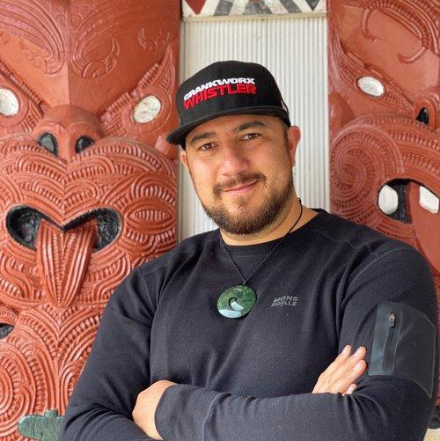


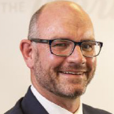








This kaupapa is led by a collaboration of industry professionals
Co-Chairs
Laurissa Cooney
Air New Zealand
Tak Mutu
MDA Experiences
Penny Nelson
DOC
Leadership Group
Claire Walker
*SkyCity Entertainment Group
Grant Webster
Tourism Holdings Ltd.
Heather Kirkham
MBIE
Jo Allison
Ngāi Tahu Holdings
Rebecca Ingram
TIA
Les Morgan
Sudima Hotels/Hind Management
John Morgan
NIWA
Kiri Goulter
Regional Tourism NZ
René De Monchy
Tourism New Zealand
Stephen England-Hall
*RealNZ
*Previously
Notes:
To complete this work, a diverse and experienced leadership group was established, supported by a wider set of Technical experts and key stakeholders, all of whom provided input into the process and content development.
Covered different tourism sub-sectors, different regions, and Government/Industry

Slide 7
Our approach has ensured we built an effective adaptation roadmap for the sector
Future climate scenarios are explored. Large-scale driving forces and how they manifest under each scenario create the basis for the development of scenario narratives. The narratives build the picture of what the world may look like under each scenario.
The key to looking forward is to pivot from the challenges to identify and articulate the opportunities that the changing climate may bring to the sector, including an opportunity to build in regenerative thinking.
Risk assessment
Scenario analysis
Impact, consequences and challenges
Opportunities
Adaptation Roadmap
A climate risk-identification exercise identified the most significant physical and transition risks for the sector. These are used to create the scenario framework.
The challenges experienced by industry participants are collated and articulated; including the impact and consequences of doing nothing about climate change on the sector and our economy.
The critical outcome for this work is to collectively agree pragmatic and tangible adaptation actions. These will support the tourism sector as it transitions with the effects of climate change and allow it to make decisions with confidence and coordination.
Notes:
A quick overview of the process…

Slide 8
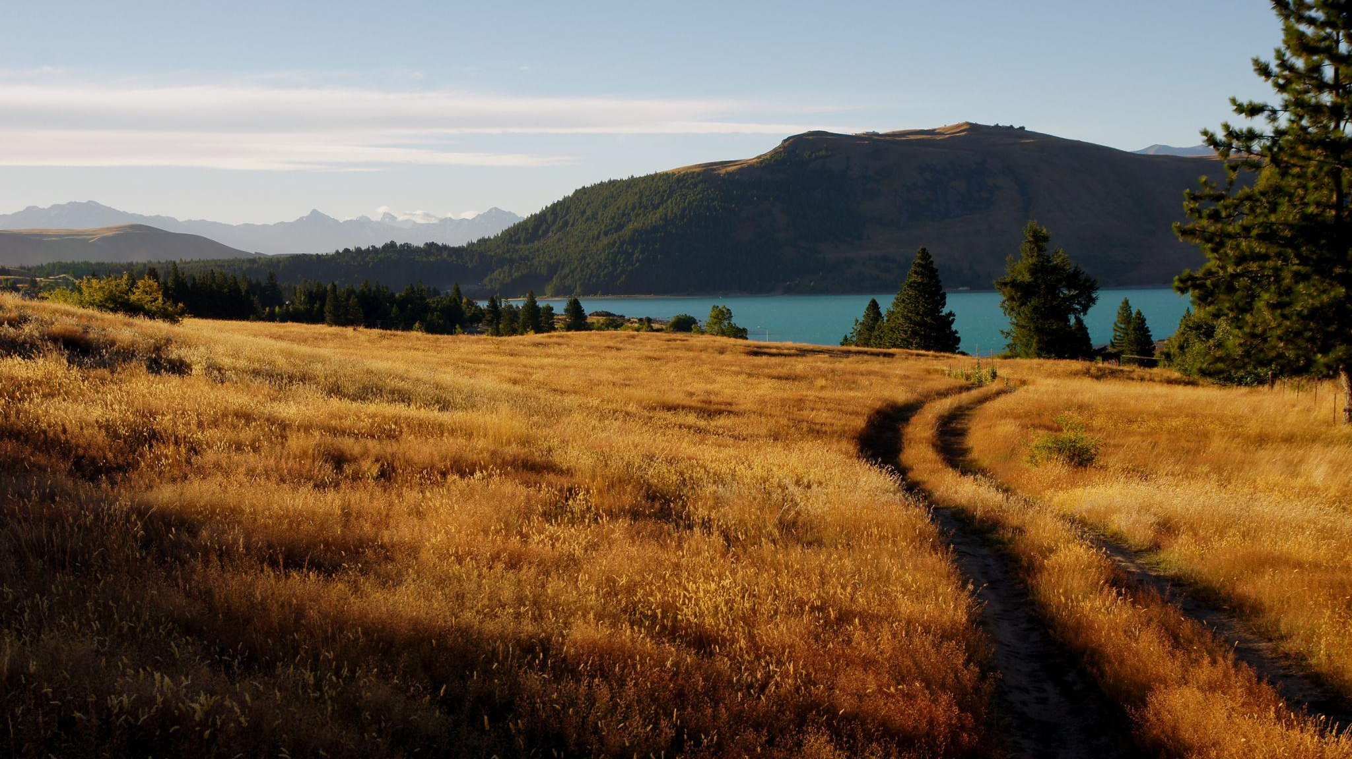
Climate Change Scenarios
Notes:
So now let’s jump straight into the first set of content – the climate scenarios.

Slide 9
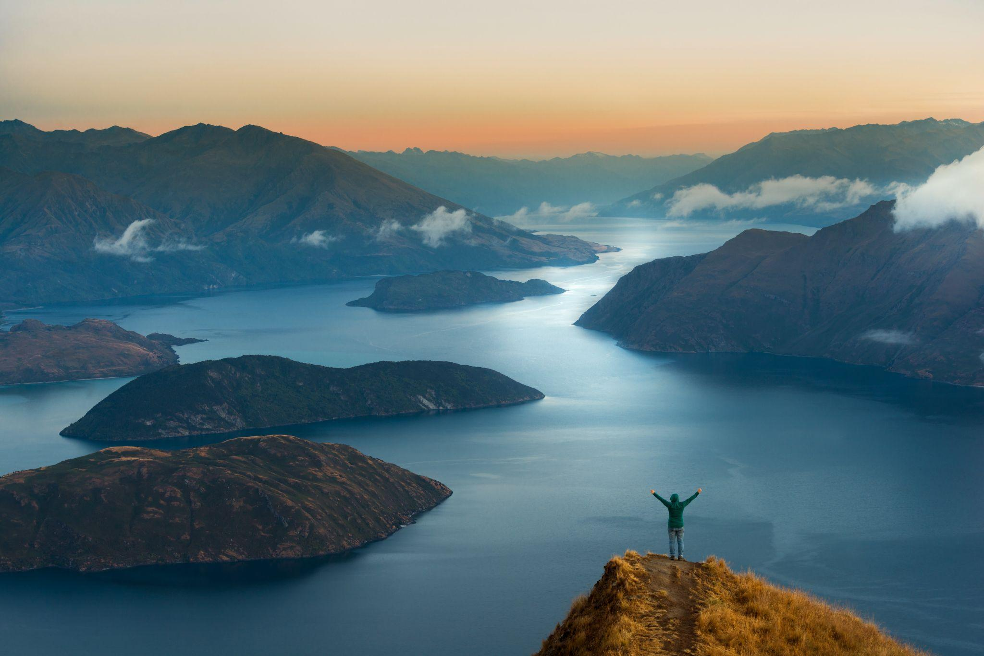
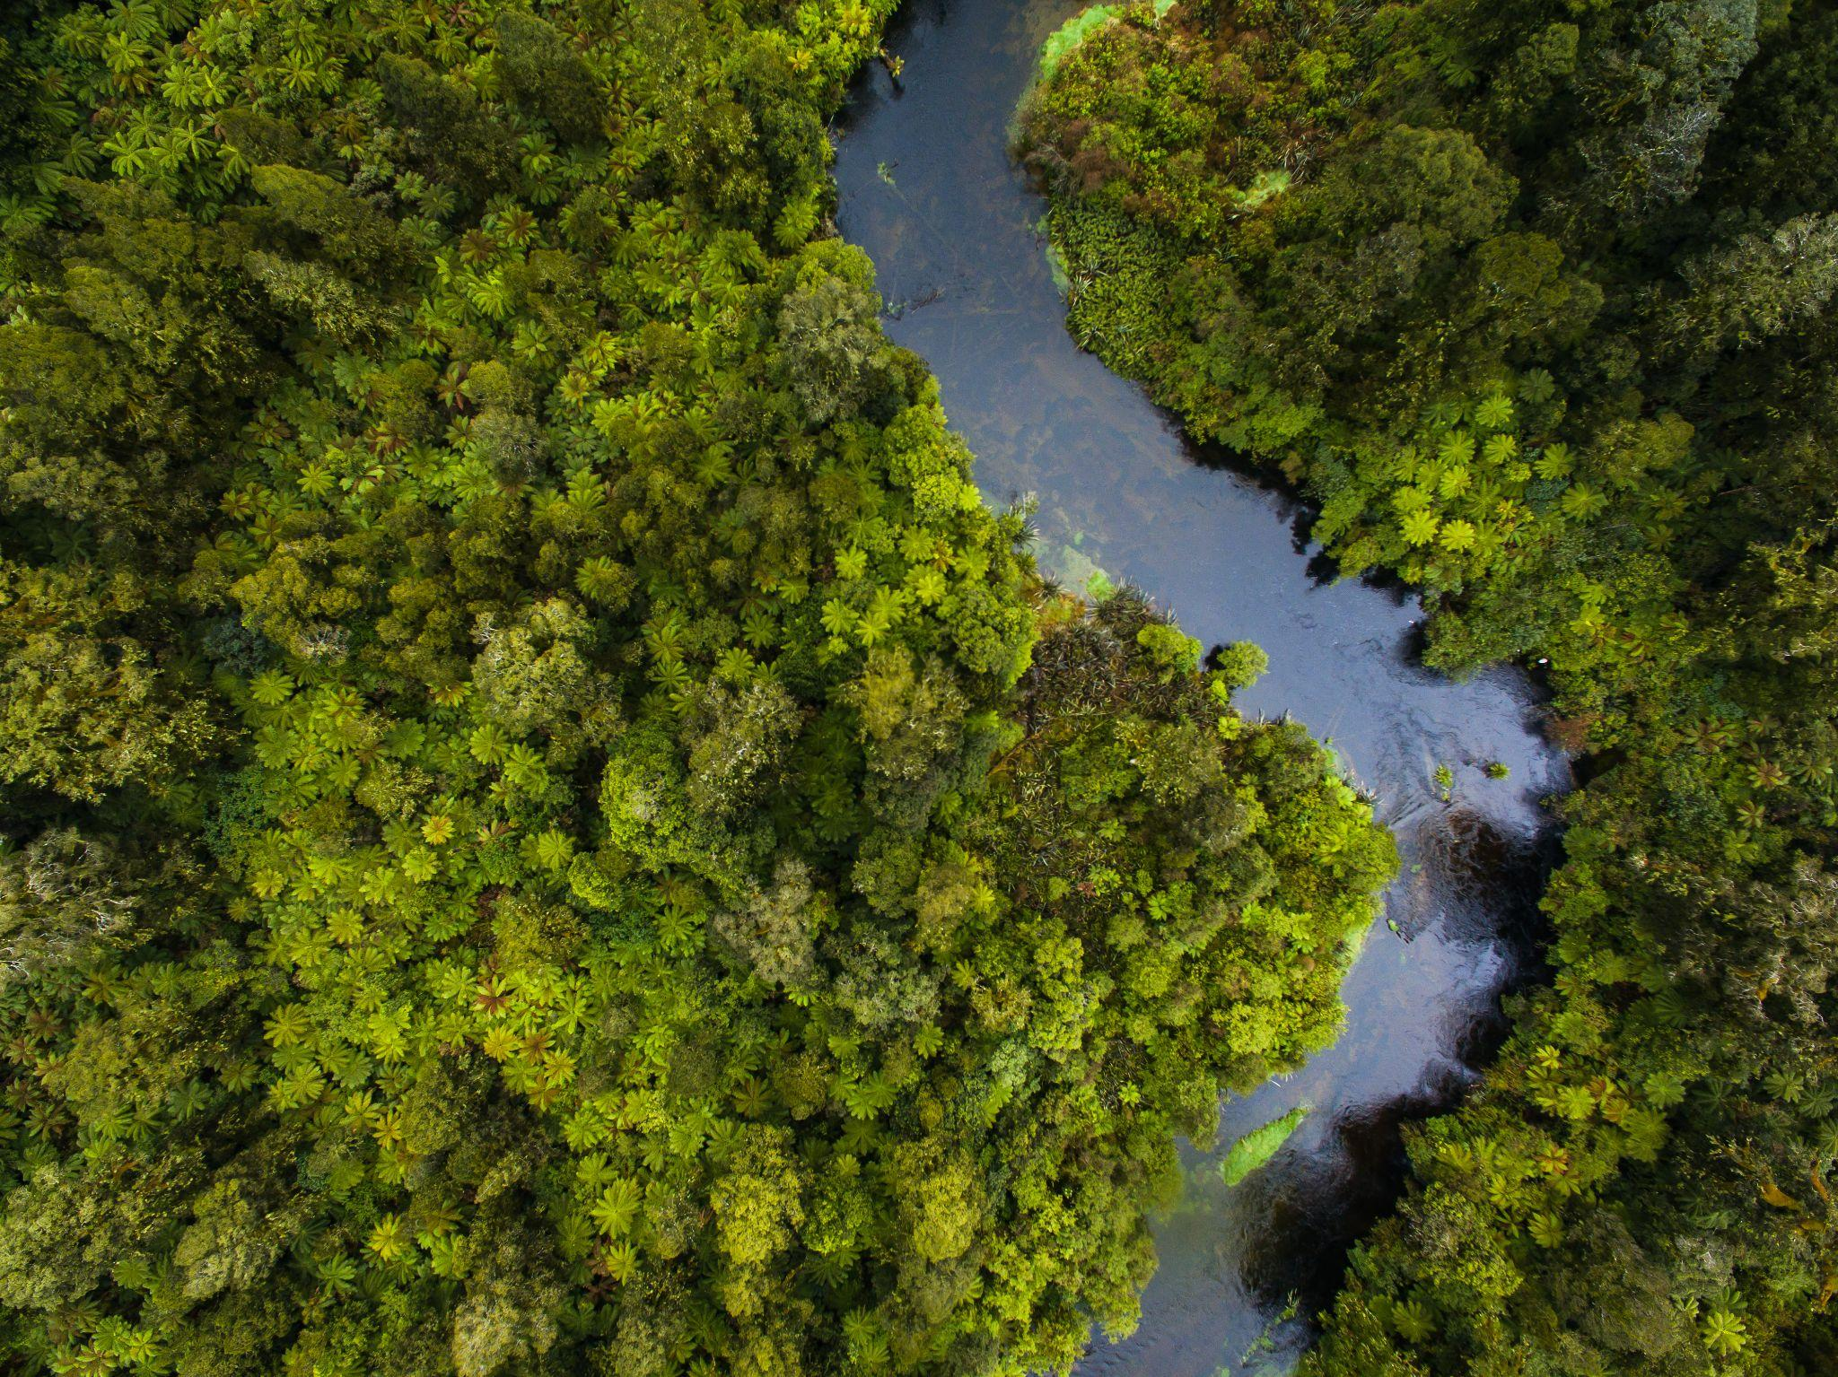

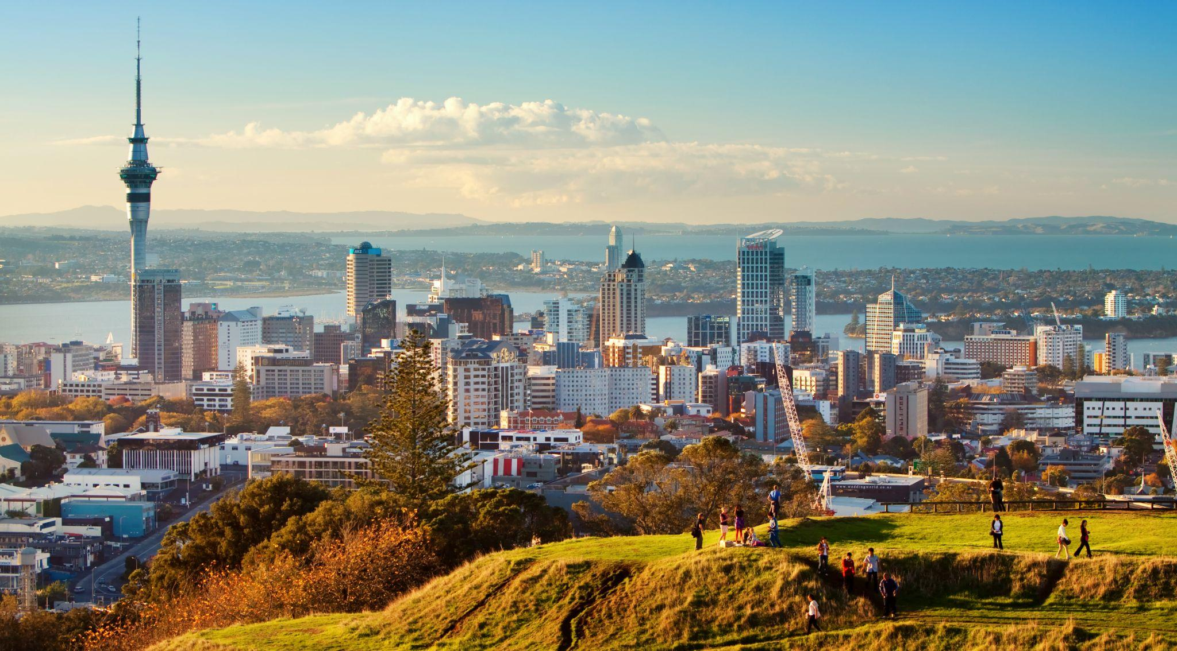
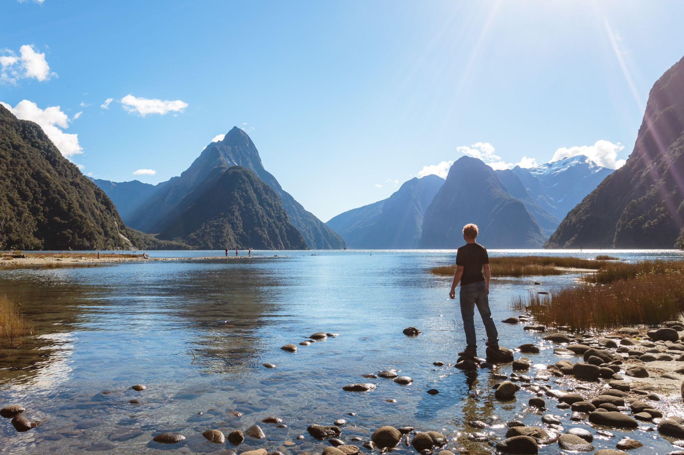

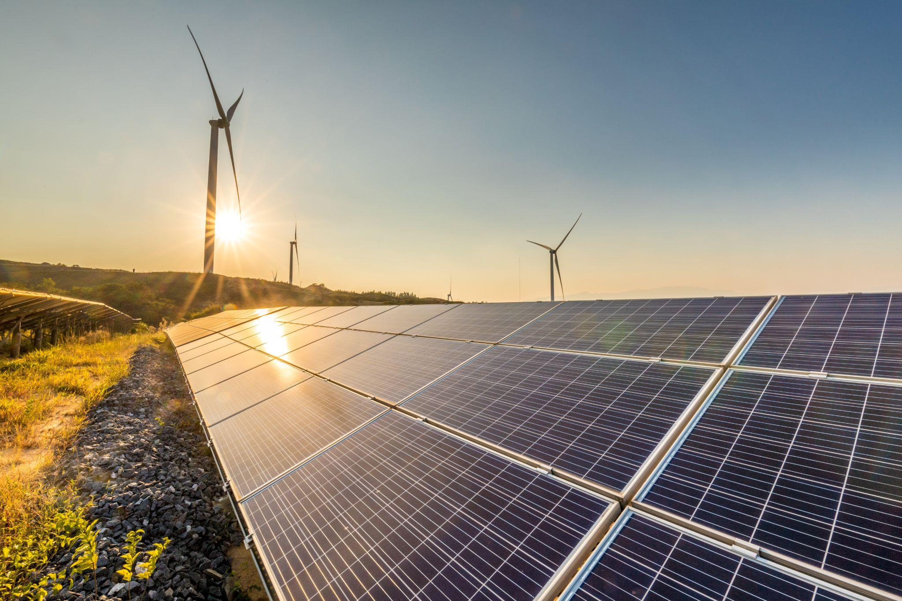
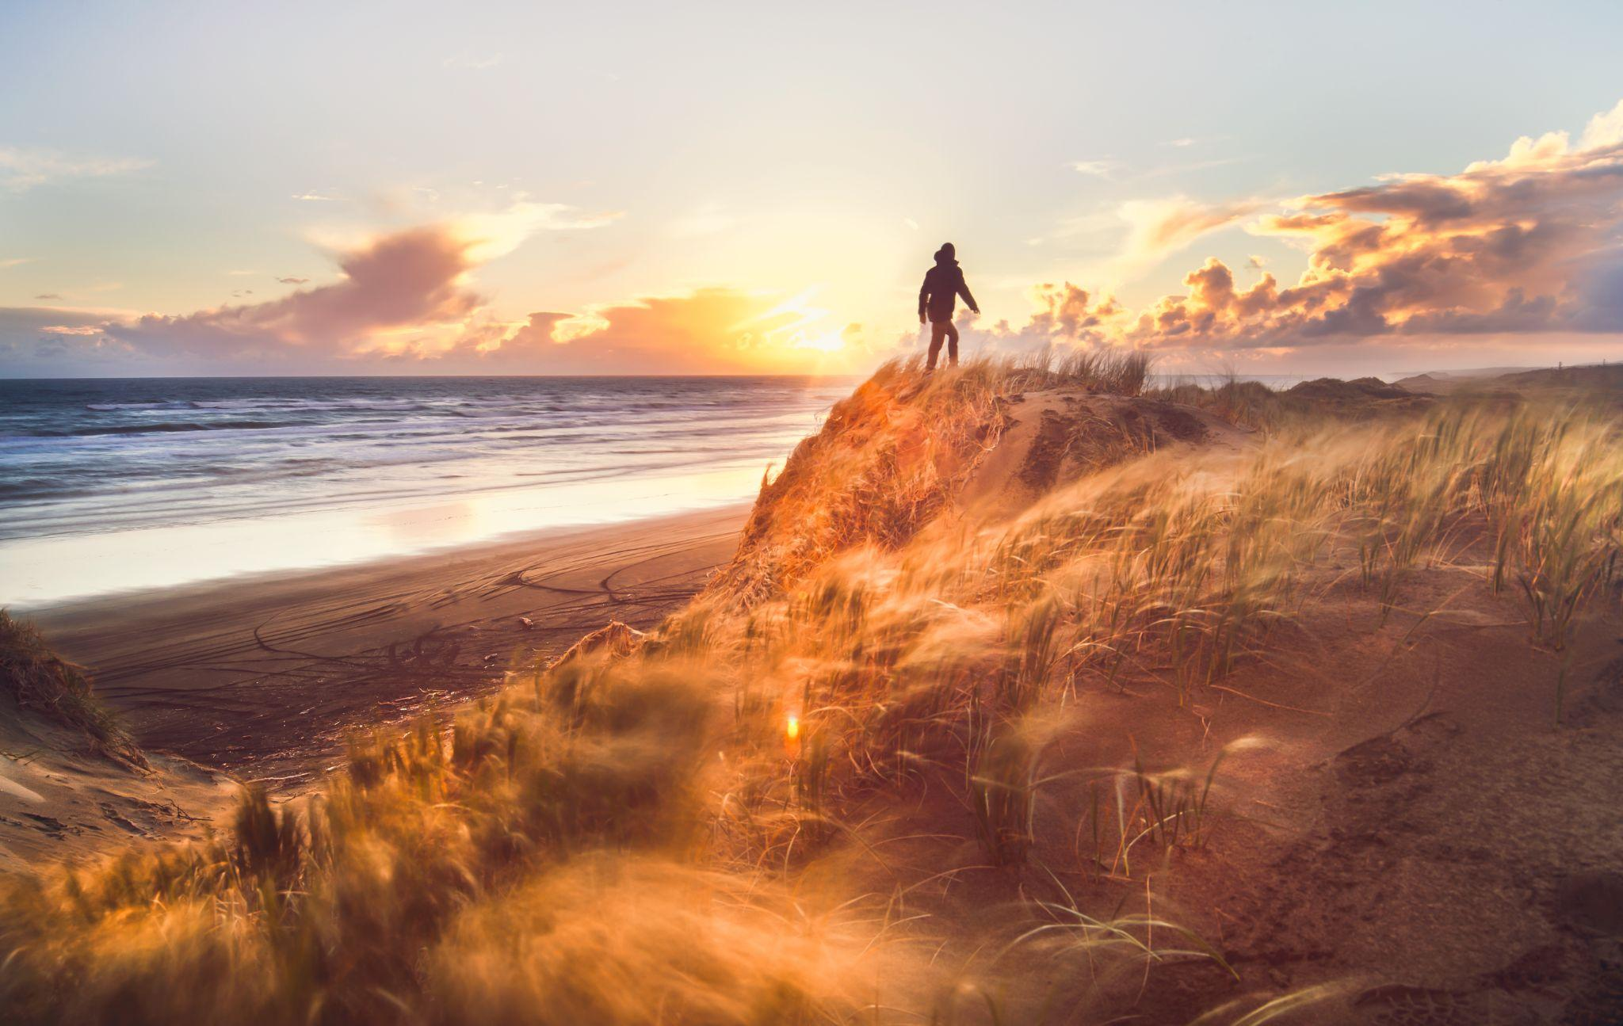
We established the following risk profile for the New Zealand tourism sector
Top Physical Risks
Top Transition Risks
Risks arising from changes to the climate or extreme weather events
Risks arising from the process of adjusting to a low carbon economy
Inability to maintain Aotearoa NZ as an attractive destination
Loss of species/biodiversity
Reduction in positive customer sentiment for Aotearoa New Zealand
Increase in climate regulation drives increased costs pressure on visitors
Inability to access attractions and locations
Reduction in operating days/opportunities
Inability for the tourism sector to keep up with the rate of change
Inability for operators to effectively conduct financially viable business
You will note that all these risks are at a sector level. If one was to perform a climate-risk assessment for their own organisation,
further detail and specificity would be required.
Notes:
Between PwC and the contributors, two types of risks were identified, as they relate to climate change, physical risks and transition risks, with the examples here…

Slide 10
The tourism sector climate scenarios tell a plausible story of the future
Hiahia - Net Zero 2050
Pokanoa - Disorderly 2050
Wharewera - Hothouse 2050
Hiahia represents a smooth transition to net zero CO₂ by 2050. Global warming is limited to around 1.5°C through stringent climate policies and innovation.
The orderly scenario assumes climate policies are introduced immediately and become gradually more stringent as the target date looms. Both physical and transition risks are relatively subdued. Getting to net zero by 2050 is an ambitious scenario.
International travel has been transformed and the tourism sector flourishes through a joining of nature and visitors in a regenerative approach. The tourism sector has become a world-leader for championing regenerative tourism with a low environmental footprint. Aviation has been largely decarbonised but still has climate impacts due to radiative forcing effects.
Pokanoa represents a delayed transition with little policy action until after 2030 when strong, rapid action is then needed to limit warming to 2°C.
This scenario assumes countries or territories recover from COVID-19 using fossil-fuel heavy policies so emissions increase and carbon budgets are not met. It is only after 2030 that new climate change policies are introduced, but not all countries take equal action. Physical and transition risks are also higher as a consequence. This is a costly and disruptive transition.
Tourism operating costs increase due to regulation-related prices. Emissions-intensive businesses face insurmountable challenges. Aviation has become very expensive and lost considerable popularity. Alternative transport methods are not sufficiently fast or cheap to replace lost long-haul travel, but are growing.
Wharewera describes a world in which emissions continue to rise unabated as no additional climate change policies are introduced.
Fossil fuel use continues to increase and so global CO₂ emissions continue to rise. Warming is expected to reach 3°C high by 2080. The physical impacts of climate change are severe. There are irreversible changes like glacial melt and sea level rise. Adapting to climate change has become the priority.
Severe weather causes frequent damage and disruptions to transport, infrastructure and food supply, making travel difficult and very expensive. Domestic travel is higher than pre-COVID-19 levels as New Zealand remains one of few destinations where warming is lower than the global average.
For 2040 relative to 1990
For 2050 relative to 2005
Notes:
Another slide with a lot of words !
And the detail can be found in the report. But the key takeaway here is the XRB requires three different climate change scenarios to be modelled out to 2050. We developed a 1.5, 2 and 3 degree scenario – each with a set of assumptions and climate impacts, which were then discussed with the sector experts to understand implications for the tourism sector.

Slide 11
It’s going to get tough for the sector depending on the path we follow
Hiahia - Net Zero 2050
Pokanoa - Disorderly 2050
Wharewera - Hothouse 2050
Increase in global temp
1.6°C
Compared to pre-industrial
NZ population
+16%
Compared to 2020
Increase in global temp
2.0°C
Compared to pre-industrial
NZ population
+22%
Compared to 2020
Increase in global temp
2.5°C
Compared to pre-industrial
NZ population
+26%
Compared to 2020
Per tonne carbon price (NZD)
$277 (2050)
NZ sea level rise
0.2m
For 2050 relative to 2005
Per tonne carbon price (NZD)
$369 (2050)
NZ sea level rise
0.22m
For 2050 relative to 2005
Per tonne carbon price (NZD)
$35 (2050)
NZ sea level rise
0.32m
For 2050 relative to 2005
NZ extreme heat
+15 days
For 2040 relative to 1990
NZ extreme rainfall
+15%
For 2040 relative to 1990
NZ extreme heat
+20 days
For 2040 relative to 1990
NZ extreme rainfall
+18%
For 2040 relative to 1990
NZ extreme heat
+30 days
For 2040 relative to 1990
NZ extreme rainfall
+22%
For 2040 relative to 1990
For 2040 relative to 1990
Notes:
A lot of the numbers came from the Climate Commission to base the scenario analysis. A few interesting points to mention here that often pop up in questions…
Population increase – climate refugees
Carbon price – whether or not it is used as an effective mechanism for mitigation

Slide 12



The tourism sector climate scenarios can form a key input into your own climate change adaptation and disclosure journey
Global climate change
This project is focused on the sector level
Global scenarios (socioeconomic, GDP, policy)
When assessing risks, developing scenarios and preparing the adaptation strategy we must take a broad view across the entire sector.
The outputs of this project will form a critical part of the inputs into individual businesses’ own risk assessments, scenario analysis and adaptation strategies.
This is a key step of the disclosure journey recommended by the XRB. Taking a sectoral view allows us to combine resources, develop consistent assumptions and establish a robust reference point for more detailed entity-level analysis.
Global emissions pathways
Sectoral risk assessment
Sectoral scenario analysis
Sectoral adaptation roadmap
Entity-specific risk assessment
Entity-specific scenario analysis
Entity-specific adaptation strategy
Disclosure
Notes:
And the so what… How can these actually be used?
The scenarios have been developed at a sector level, as an asset for use – over half a million dollar investment (for a few pages of a report!) but with a lot of thinking and consideration so that they can now be leveraged across the sector, and avoid each company having to invest in their own.
These scenarios can then be applied at an individual entity level, by using the information in the scenarios and imagining what they might mean for your organisation, and then the risk assessments and adaptation strategies you could apply based on each.

Slide 13
Climate scenarios can be used by business for both internal and external purposes
External uses
Meet disclosure requirements e.g. CRD
Meet regulatory requirements
Meet investor needs and conversations regarding strategy and portfolio resiliency
Enable engagement and communication to stakeholders of how the business may evolve over time
Scenario analysis enables businesses to assess their business models and strategies against different possible futures and better understand where work might be needed to improve business resilience.
Scenario analysis is also important to meet disclosure requirements, such as the CRD.
Internal uses
Understand strategic business resilience
Align with goals e.g. 1.5°C pathway
Inform strategic business decisions
Conduct sensitivity analysis
Manage risks and opportunities
Notes:
A bit more information on the ‘Why’, though we have covered a few of these….

Slide 14
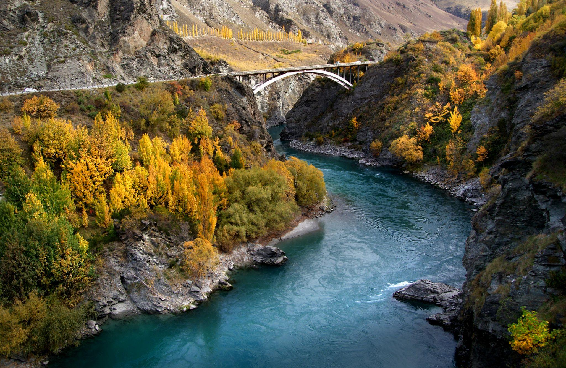
Adaptation Roadmap
Wānanga Tuatoru
26th June 2023

Slide 15

Key considerations when developing an Adaptation Roadmap
1
Identify gaps while complementing existing activity
2
Articulate impact
3
Empower implementation
The tourism sector has been engaged in the process including:
Co-chairs, Leadership Group and Technical Expert Group
Government agencies and sector specialists
Important tourism considerations
Notes:
All actions will either sit in a gap, complement, or bolster existing activity – direct duplication and overlap is avoided – and existing related activity included in the report.
The report will not just explain the actions, but also the impact of those actions for the audience to understand real-life implications.
Writing will strike a balance between giving enough detail to guide implementation, while also enabling those taking accountability to design the final action.

Slide 16

This kaupapa links with other existing industry and government actions
There are strong linkages between our Tourism Sector Climate Change Adaptation Roadmap and the Action Plan for the second phase of the Tourism Industry Transformation Plan (ITP).
External Reporting Board (XRB) Climate Related Disclosures
Tourism Industry Transformation Plan (ITP)
Central Government National Adaptation Plan
The Tourism Sector Climate Change Adaptation Roadmap
Tiwaiwaka Principles
Tiaki Promise Principles
Notes:
The overarching objective of the Tourism ITP is to create a regenerative tourism model. The scope of the ITP has three pillars:
climate change mitigation,
(2) fostering positive ecological outcomes and
Climate change adaptation, where our mahi in the Tourism Sector Climate Change Adaptation Roadmap aligns. The Leadership Groups for our Adaptation Roadmap and the ITP are committed to working closely together as we progress towards implementation.

Slide 17
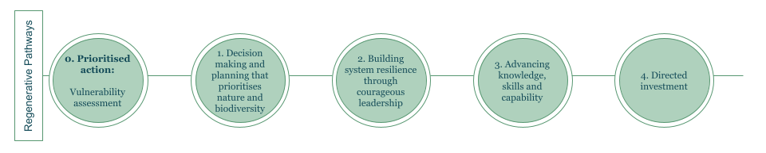
The Tourism Sector Adaptation Roadmap
The following regenerative pathways create the framework for the Adaptation Roadmap, with more detailed objectives, actions, time horizons, and key stakeholders for involvement falling under each.
The vision is an abundant regenerative tourism sector that ensures people, planet and prosperity are balanced
The mission is to ensure our sector is resilient and reducing the impacts of climate change
0. Prioritised action:
Vulnerability assessment
1. Decision making and
planning that prioritises
nature and biodiversity
2. Building system resilience
through courageous leadership
3. Advancing knowledge,
skills and capability
4. Directed investment
Regenerative Pathways
Notes:
As you will see in the final document, the roadmap has been split into five regenerative pathways. Each one outlines objectives, actions, the time horizon, and key stakeholders – and I’ll spend a few minutes now giving a high-level overview of each.
To frame these actions, we have the Vision an abundant regenerative tourism sector that ensures people, planet and prosperity are balanced
and Mission to ensure our sector is resilient and reducing the impacts of climate change

Slide 18
0. Prioritised action: Vulnerability assessment
Objective | Actions | Impact
Develop a clear baseline | Identify most vulnerable operators, experiences and regions | Mobilise actions to support those most at risk
2. Courageous leadership
0. Prioritised action
1. Decision making
3. Advancing knowledge
4. Directed investment
Notes:
At number zero which really reinforces the urgency and fact that this action gives us the start-line, is an objective of developing a clear baseline by identifying the most at-risk regions and businesses, so that action can be targeted where it’s most needed.
This provides a foundation for some of the remaining actions.
Next slide

Slide 19
2. Decision making that prioritises nature and biodiversity
Objective | Actions | Impact
Prioritise nature and biodiversity in decision making | Gather data Agree indicators to measure, track and report progress | Data leveraged to impact nature and biodiversity in climate change adaptation
2. Courageous leadership
0. Prioritised action
1. Decision making
3. Advancing knowledge
4. Directed investment
Notes:
Next is a set of actions that focus on leveraging data to prioritise nature and biodiversity – so that climate change adaptation indicators can be agreed upon for an Aotearoa context, and then measured, tracked, and reported against.
Next slide

Slide 20
3. Building system resilience through courageous leadership
Objective | Actions | Impact
Coordination to support and guide adaptation and proactive planning | Develop transition plans, climate change assessment criteria and integrated planning Governance group established Advisory body created Implementation of actions including data, toolkits, and guidelines | Tourism sector participants have transition plans in place Centralised guidance to drive climate adaptation action
2. Courageous leadership
0. Prioritised action
1. Decision making
3. Advancing knowledge
4. Directed investment
Notes:
A lot of critical pieces fall under this action set.
One is utilising the data to enable tourism businesses to create Transition plans, but also is the formation of the groups to deliver on climate change adaptation.
There are many really valuable industry groups and layers to the tourism sector, so the LG decided a cross-pollination of key representation centralised on this topic would be the most effective method of delivering the action we need, this includes:
Governance group - Purpose, vision and expectations of the advisory body
Advisory body – an activation group – responsible for tasks such as the guidelines, tools, business cases, actions in this adaptation roadmap

Slide 21
3. Advancing knowledge, skills and capability
Objective | Actions | Impact
Empowerment through skills and knowledge | Create climate data toolkits Develop a digital and in-person education programme Integrate with industry groups and health & safety measures | Enhanced understanding and assessment for adaptation
2. Courageous leadership
0. Prioritised action
1. Decision making
3. Advancing knowledge
4. Directed investment
Notes:
Climate data toolkits
Education programme – has to consider the diversity of the sector, providing online, in-person and tailored Maori business extension programmes.
Also really important to connect with existing activity so that groups aren’t left with such a huge list of separate requirements, so this is linked with Industry group collaboration for areas such as H&S and recovery plans

Slide 22
4. Directed investment
Objective | Actions | Impact
Funding available for innovation, supporting vulnerability, and delivering adaptation actions | Business case development Enabling public regulatory, policy and local funding mechanisms Identify additional capital sources | Capital available to enable innovation and adaptation across the sector
2. Courageous leadership
0. Prioritised action
1. Decision making
3. Advancing knowledge
4. Directed investment
Notes:
Finance and resourcing is obviously crucial to the delivery..
The important actions include:
Develop a business case outlining costs of adaptation and importance of regenerative sector investment.
Regulatory and policy incentives
But also, rather than relying on the setting up of new funds, Seek to leverage existing funding mechanisms.
Discounted access to capital through banks green loans / climate change adaptation funding

Slide 23
Next steps
Initiate implementation
Establish bodies
Action
Transition to implementation - The Aotearoa Circle, Government and the sector
    Establishment of implementation bodies, governance body, and advisory body
Begin to action immediate priorities within the Adaptation Roadmap
Notes:
Transition to implementation is key
Over 250 attendees across our launch events which included an Aotearoa Circle launch webinar, TIA webinar focused on 30 RTOs, and a TIA Public webinar, all late May, early June.

Slide 24

Thank you
Questions or further input?
Jack Keeys
LinkedIn
jack@theaotearoacircle.nz
021 0237 1476
Notes:
What is important/impactful/resonating and not resonating.
What will make a difference on the ground?
Stay connected!

