Slide 1
Reinventing paradise
Embracing climate change
t
…and some sources to help you
Rod.Oram@NZ2050.nz / +64 21 444 839
Blog - NZ2050.nz / Newsroom.co.nz Twitter @RodOramNZ
Rod Oram’s presentation to Te Ūnga Mai’s Wānanga Tuatoru Wellington, June 26th, 2023
Rod Oram’s breakfast presentation to PHD’s Clients Auckland, July 31st, 2018

Slide 2
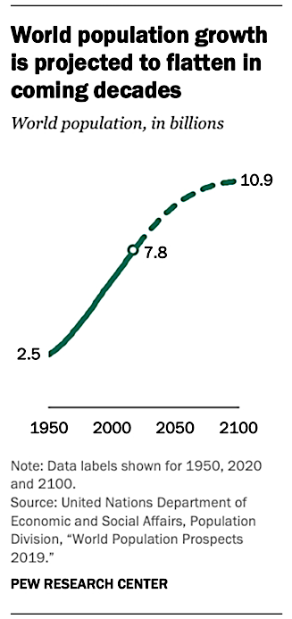
Stockholm Resilience Centre

Slide 3
Stockholm Resilience Centre https://www.stockholmresilience.org/research/planetary-boundaries.html

Slide 4
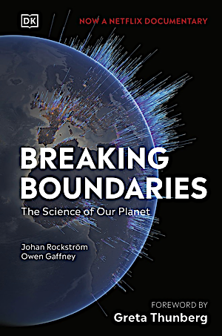
Breaking the Planetary Boundaries
On Netflix
Click here
And in a book

Slide 5
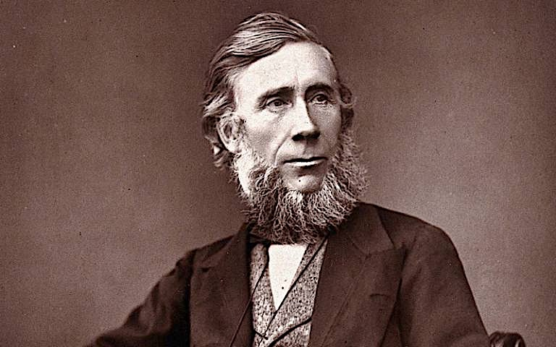
1859 – John Tyndall, first to prove warming impact of CO2
https://en.wikipedia.org/wiki/John_Tyndall
https://theconversation.com/john-tyndall-the-forgotten-co-founder-of-climate-science-143499

Slide 6
1896 – Svante Arrhenius – first to prove climate warming science

Slide 7
1977 – First climate memo to a US President
https://www.theguardian.com/environment/2005/jun/30/climatechange.climatechangeenvironment2

Slide 8
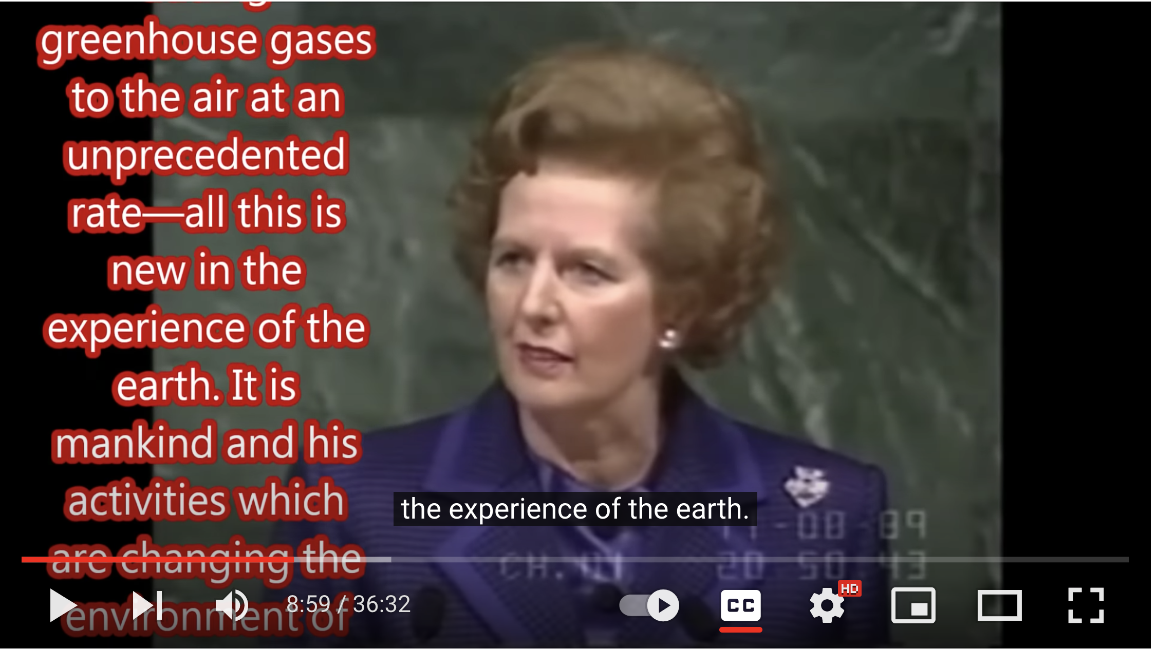
1989 – PM Margaret Thatcher’s climate speech to the UN
Speech text: https://www.margaretthatcher.org/document/107817
Video: https://www.youtube.com/watch?v=7U2L86QGKec

Slide 9
1992: UN’s Earth Summit, Rio de Janeiro / PoP: 5.4bn
Established UN conventions on climate change and biodiversity
Most countries signed…and have met most years since

Slide 10
2012: UN’s Rio+20 Summit, Rio de Janeiro / PoP: 7.1bn
“Longest suicide note in history’ – Kumi Naidoo, Greenpeace International

Slide 11
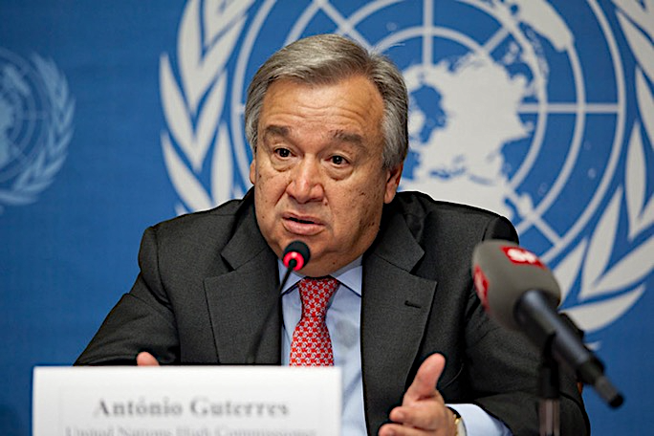
“Humanity is waging war on nature. This is suicidal.”
“We are facing a devastating pandemic, new heights of global heating, new lows of ecological degradation and new setbacks in our work towards global goals for more equitable, inclusive and sustainable development.
To put it simply, the state of the planet is broken.
Dear friends, humanity is waging war on nature. This is suicidal.”
UN Secretary General António Guterres’
State of the Planet report, Dec 2020
https://www.un.org/sg/en/content/sg/statement/2020-12-02/secretary-generals-address-columbia-university-the-state-of-the-planet-scroll-down-for-language-versions

Slide 12
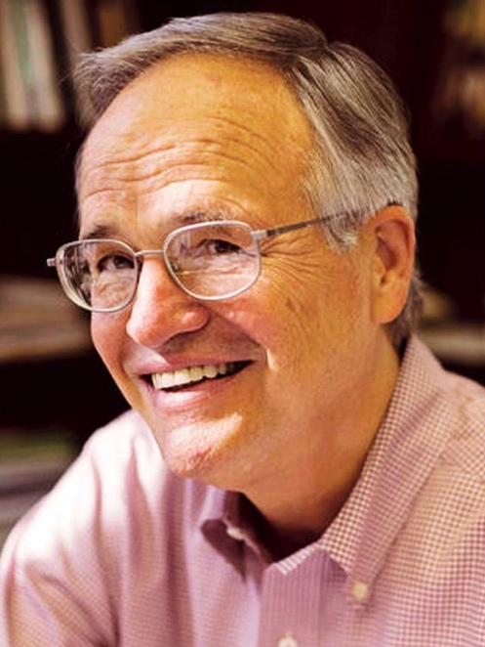
“We scientists don’t know how to do that”
“I used to think the top environmental problems were biodiversity loss, ecosystem collapse and climate change.
I thought that with 30 years of good science we could address those problems.
But I was wrong. The top environmental problems are selfishness, greed and apathy…
…and to deal with those we need a spiritual and cultural transformation
and we scientists don't know how to do that.”
Gus Speth

Slide 13
Complex…yet simple
We can solve the climate crisis…and achieve inter-related benefits to nature & people
Paramount guide: We must work with nature, not against it
Massively cut emissions
Massively improve health of ecosystems and biodiversity
Collaborate widely
Bring everyone on the journey, in equitable ways
Overcome vested interests and other beneficiaries of the destructive status quo
Never give up on change or hope

Slide 14
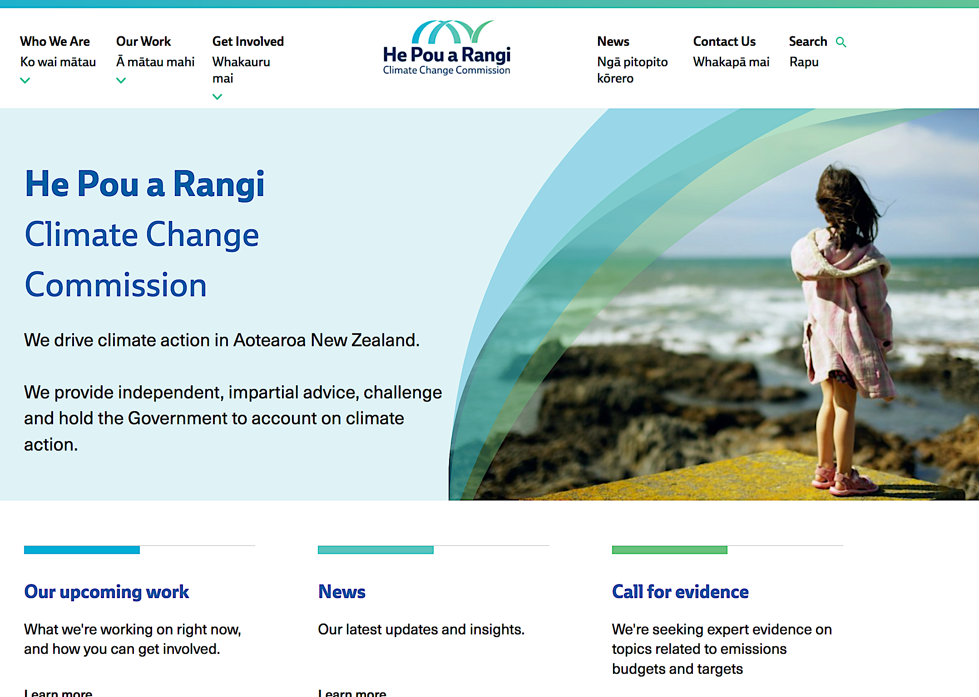
https://www.climatecommission.govt.nz/

Slide 15
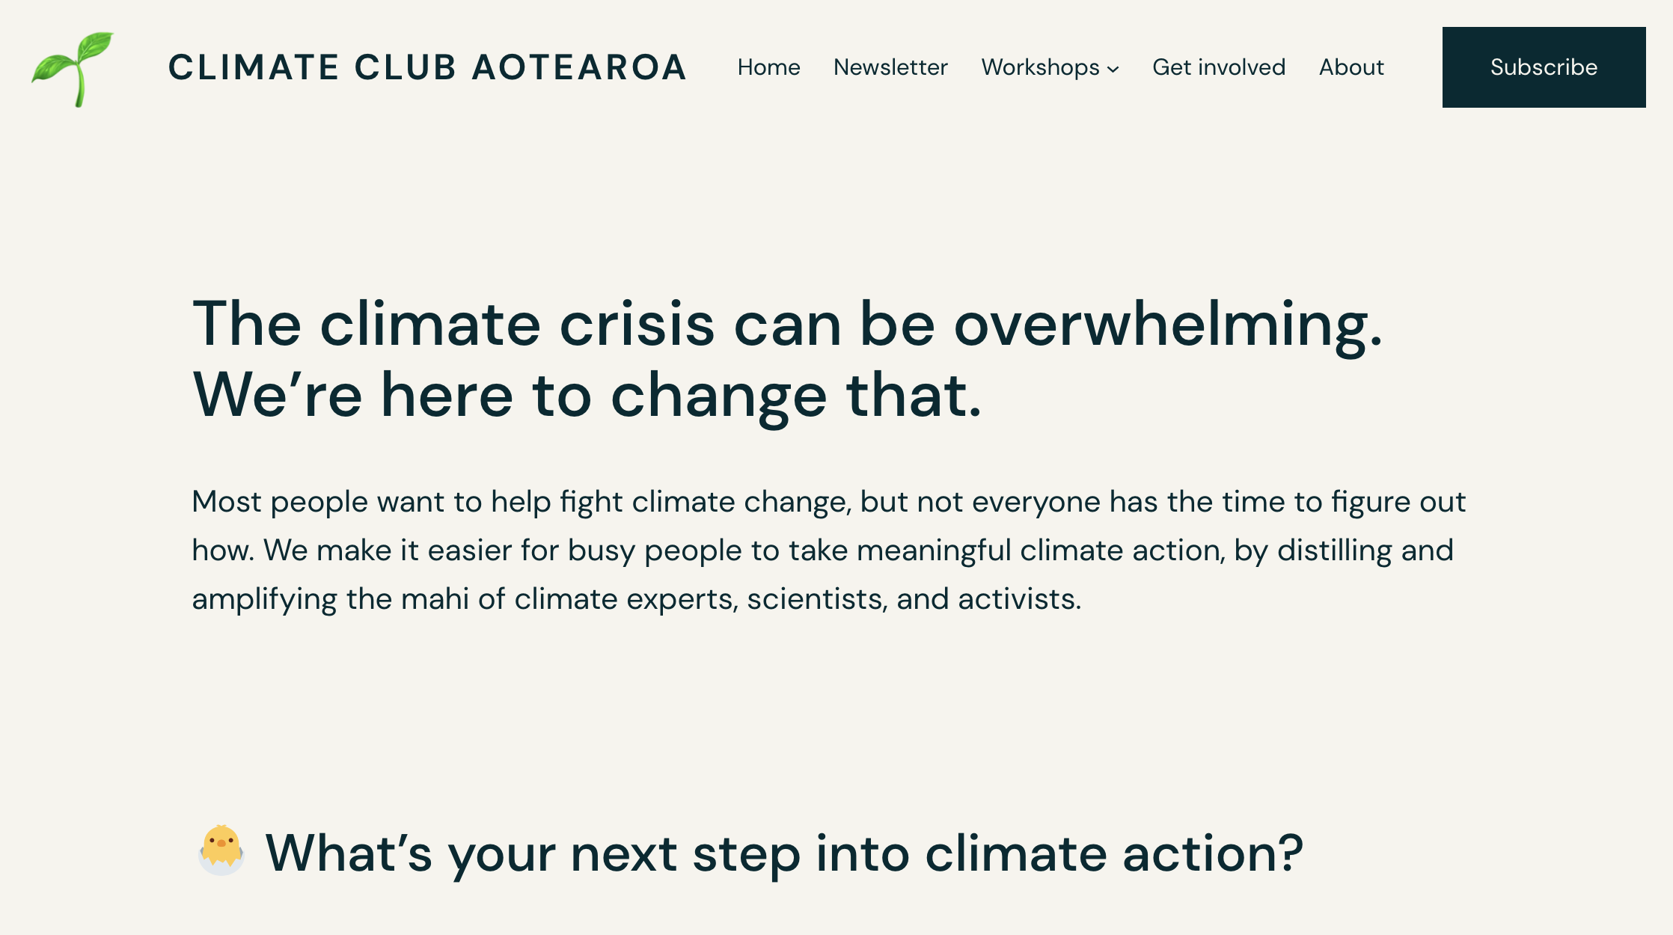
Climate Club Aotearoa
https://climateclub.nz/

Slide 16
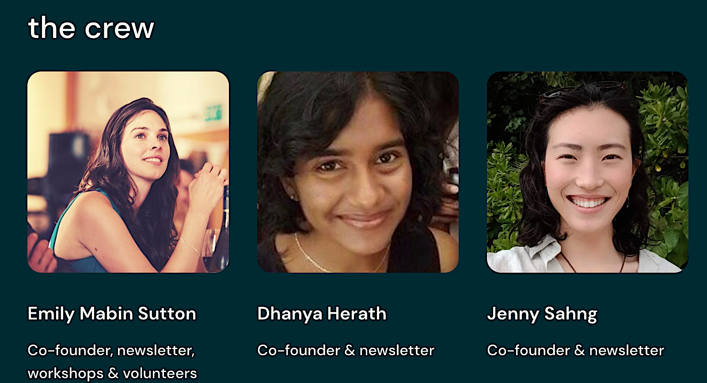
Climate Club Aotearoa
https://climateclub.nz/

Slide 17
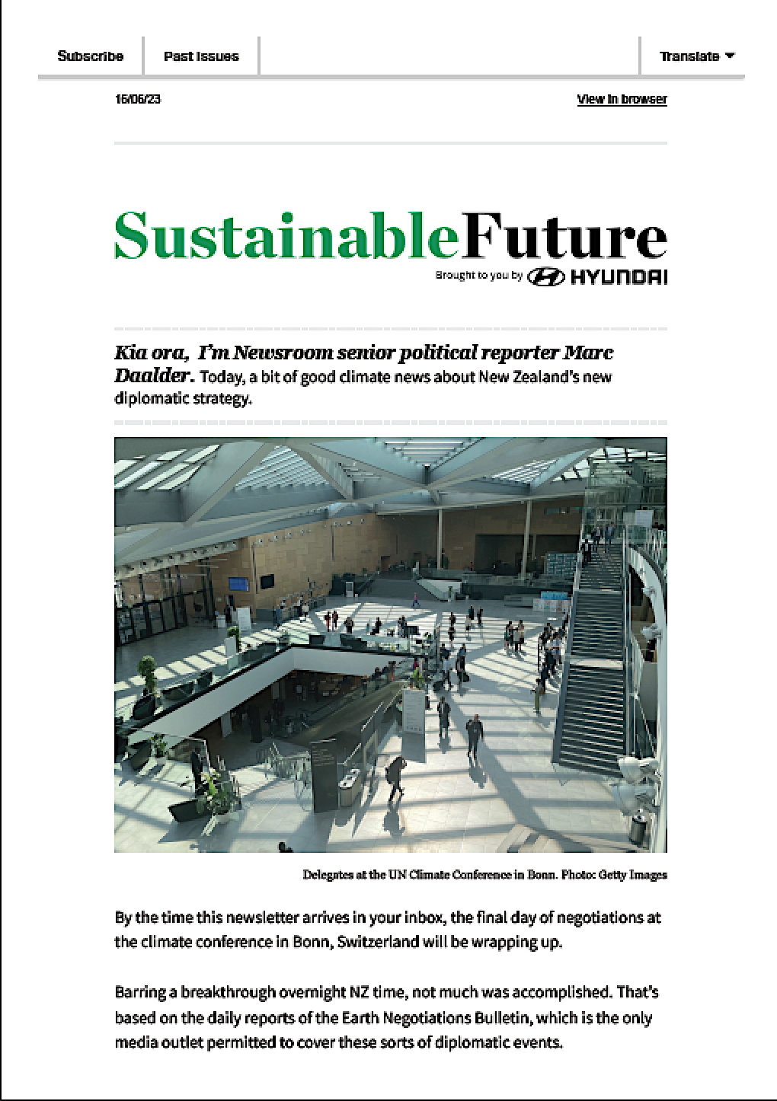
https://www.newsroom.co.nz/signups?newsletter

Slide 18
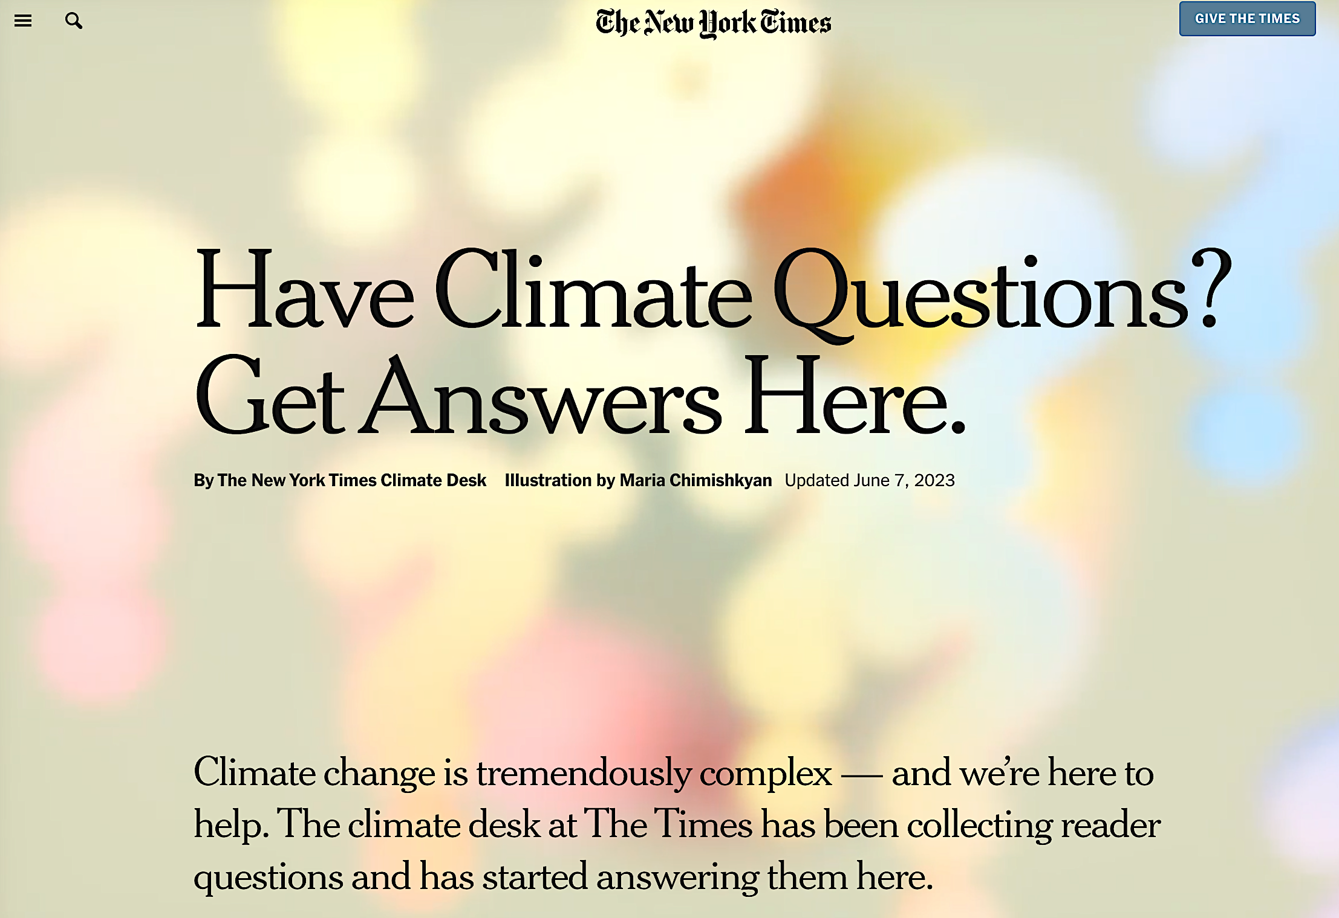
https://www.nytimes.com/interactive/2023/climate/climate-change-faq.html?searchResultPosition=1

Slide 19
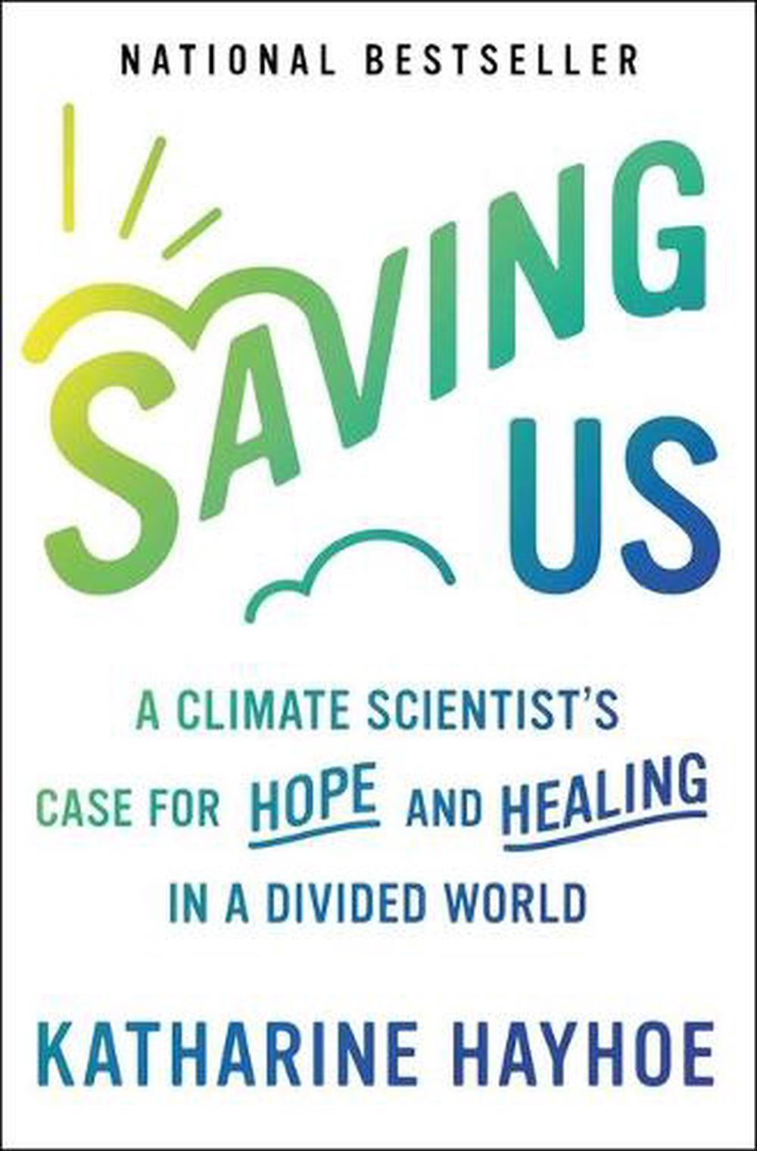
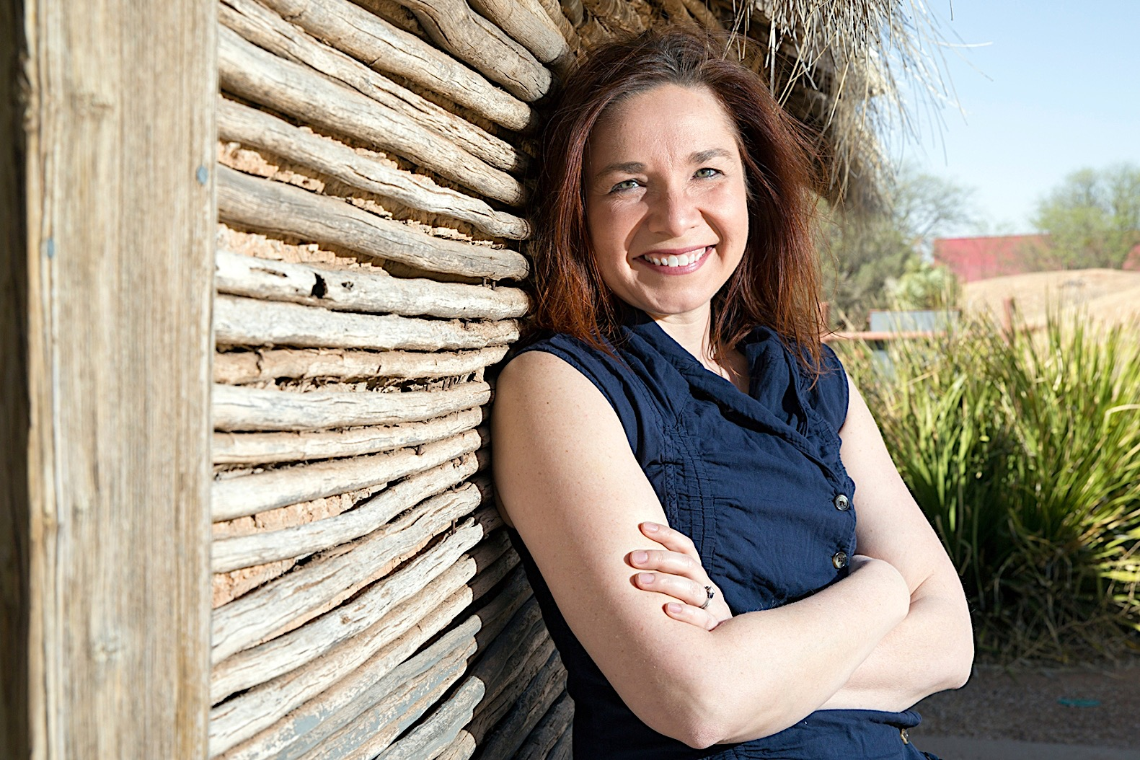
Saving Us
Hayhoe draws on interdisciplinary research and personal stories to show that small conversations can have astonishing results
She gives us tools to open dialogues with a wide range of people about how we all can play a role in pushing for change

Slide 20
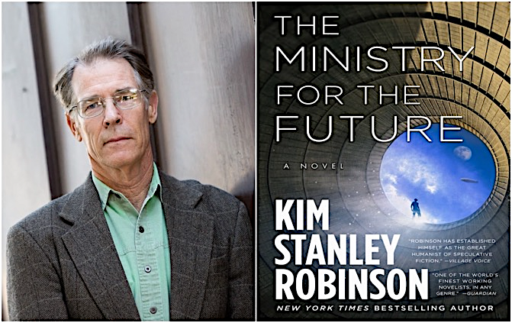
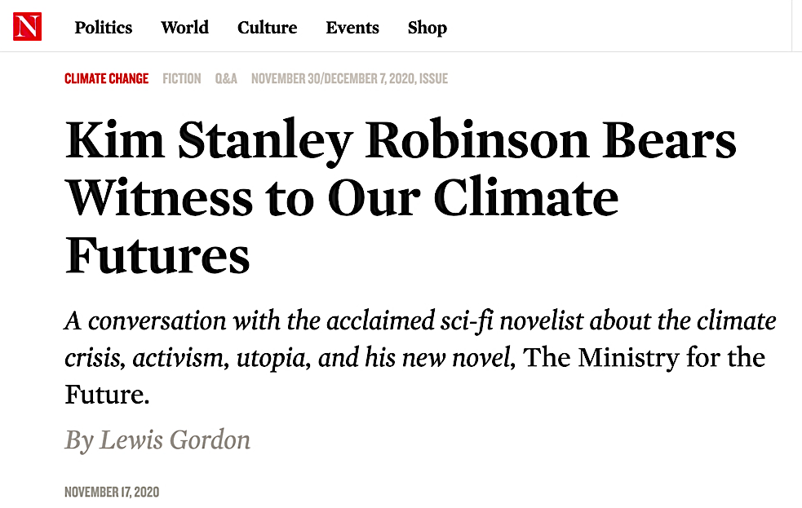
Cli-fi
A new international climate-crisis body has been “charged with defending all living creatures present and future who cannot speak for themselves”, and is quickly dubbed the Ministry for the Future. It is led by our protagonist, Mary Murphy, former foreign minister of Ireland.
“Have you heard,” one asks, “that the warming of the oceans means that the amount of omega-3 fatty acids in fish and thus available for human consumption may drop by as much as sixty percent? And that these fatty acids are crucial to signal transduction in the brain, so it’s possible that our collective intelligence is now rapidly dropping because of an ocean-warming-caused diminishment in brainpower?”
The other replies: “That would explain a lot.”
https://www.thenation.com/article/culture/qa-kim-stanley-robinson/

Slide 21
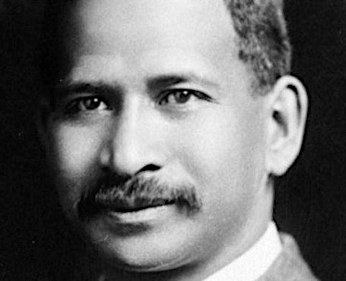
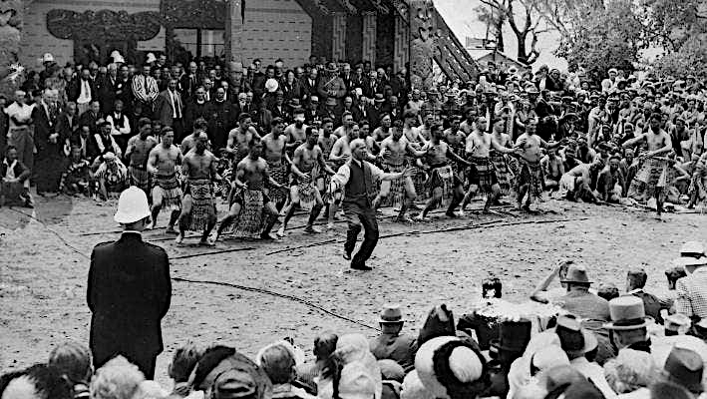
“Casting our nets”
Back in 1900, Āpirana Ngata, the Ngāti Porou leader and scholar, wrote of mātauranga Māori and mātauranga Pākeha…
…and the great benefit of "casting our nets between them,” rather than fishing in one or the other

Slide 22
Community
Issues are increasingly global…solutions are increasingly local
...to achieve an unprecedented speed, scale and complexity of change
Solutions require very strong, learning communities…some attributes:
Common sense
Common purpose
Common wealth
Places where individuals are valued, helped, encouraged…
…in return, we all participate, change
We each can only do our infinitesimally small part…
…but if an infinitely largely number of do so, we can change the world
…beginning in our own backyards

Slide 23
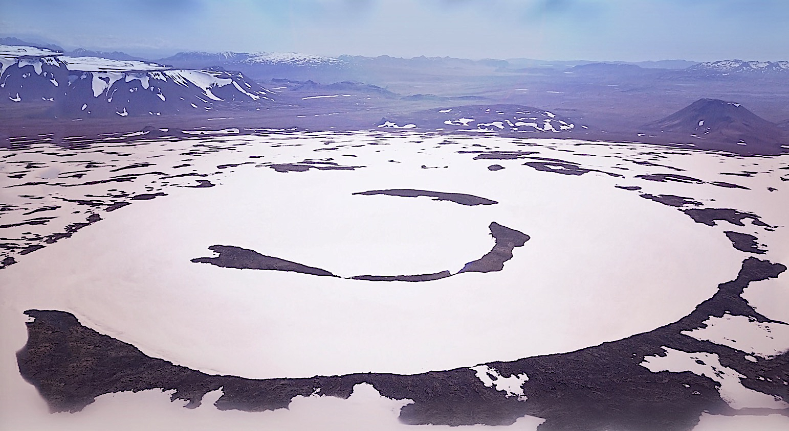
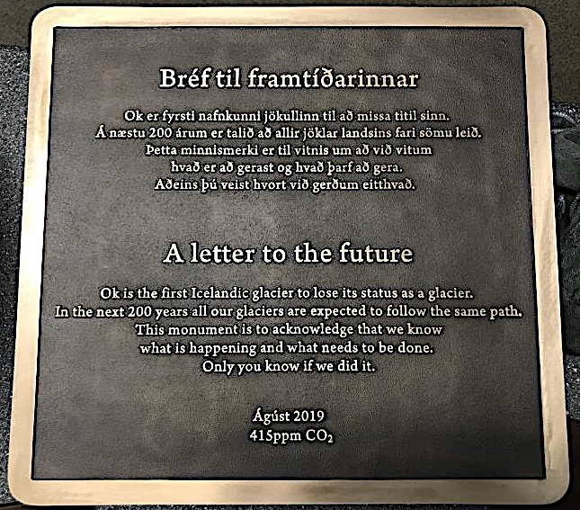
https://www.notokmovie.com/

Slide 24
Reinventing paradise
t
Rod Oram’s breakfast presentation to PHD’s Clients Auckland, July 31st, 2018

