Slide 1
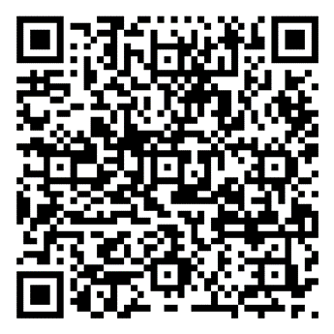
Draft Tourism Environment Action Plan
He Āhurutanga Taiao
A cloak of protection for the environment
Scan here for a digital copy of the Action Plan and survey

Slide 2
Ka huihui, ka ranea I te mauri tū, te mauri ora
Abundance comes from thriving mauri
Te Taiao / Nature exhibition, Museum of New Zealand Te Papa Tongarewa, 2019

Slide 3
The journey so far…
The Tourism ITP is taking a phased approach:
Phase one: Better Work Action Plan launched March 2023
Phase two: Draft Tourism Environment Action Plan launched June 2023
Environment phase scope covers three pillars:
*
Understanding and adapting tourism to the impacts of climate change ‘(Aotearoa Circle)
Transforming Aotearoa New Zealand’s visitor economy to a low carbon emissions industry
Restoring our biodiversity and eco-systems through tourism

Slide 4
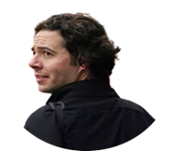
Tourism Environment Leadership Group
Industry Co-chair Laurissa Cooney
(Ngāi Tai ki Tāmaki, Aotearoa Circle, Bay of Plenty Tourism, and Air New Zealand)
Government Co-chair Heather Kirkham (General Manager, Tourism Branch, MBIE)
Union Co-chair John Crocker (National Secretary, Unite Union)

Slide 5
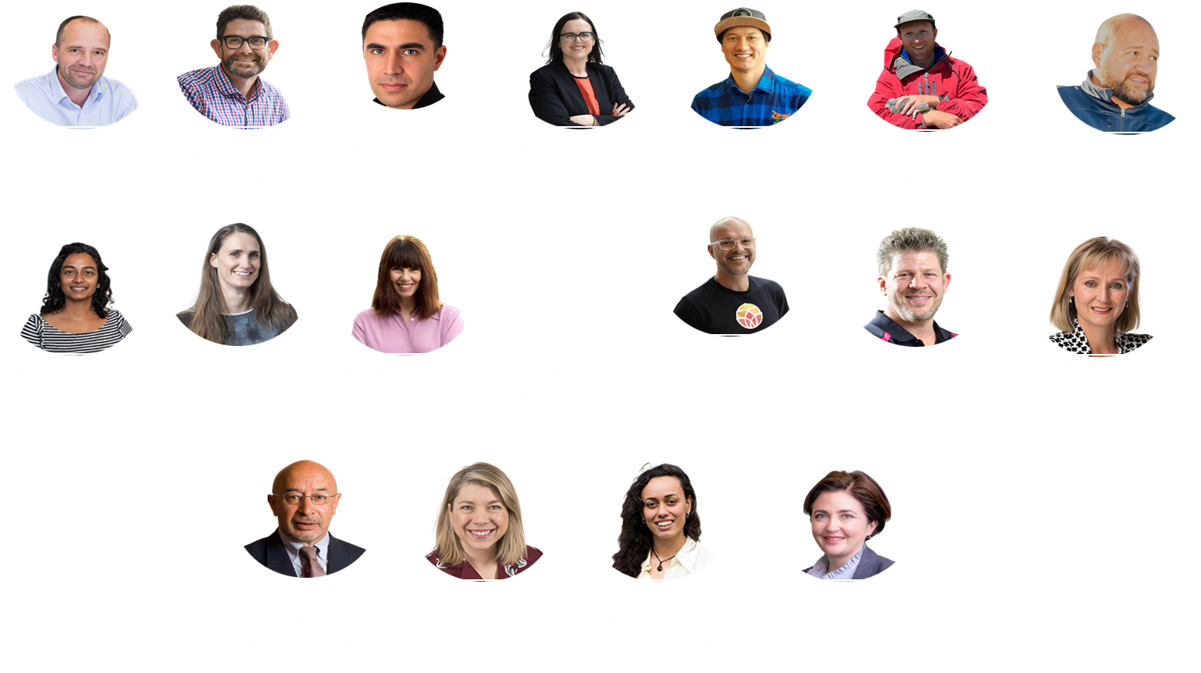

Slide 6
Introducing the Tirohanga Hau
Tourism journeys are decarbonised
Visitor management is optimised for te taiao
Tourism businesses are incentivised and enabled for sustainability and regeneration
Tourism champions biodiversity
Accelerated technology uptake and innovation enable regeneration
Tourism system and its levers are optimised and resourced to support regeneration

Slide 7
Tourism journeys are decarbonised
Explores how we can achieve net zero emissions tourism by 2050 and uphold our commitments under the Paris Climate Agreement (to limit global warming to 1.5 degrees Celsius)

Slide 8
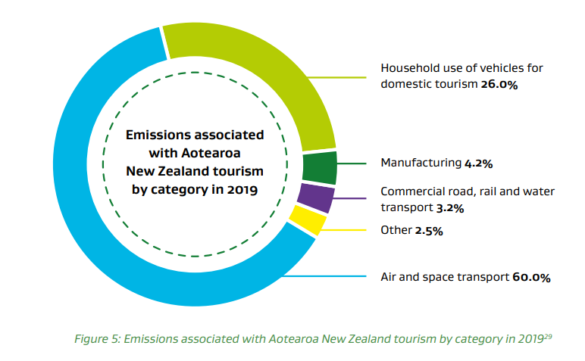
1. Develop a Tourism Decarbonisation Roadmap
2. Rapidly invest in low-carbon technologies for long-haul air and cruise travel
3. Leverage tourism to advocate for rapidly decarbonising domestic transport used by visitors
4. Assess the environmental impacts of the current mix of visitors and the impact of levers to shape demand and visitor behaviour
IMAGE HERE

Slide 9
Tourism champions biodiversity
Seeks to make Aotearoa New Zealand’s tourism industry a champion for our unique biodiversity and to support tourism operators to understand and minimise their impact on biodiversity.

Slide 10
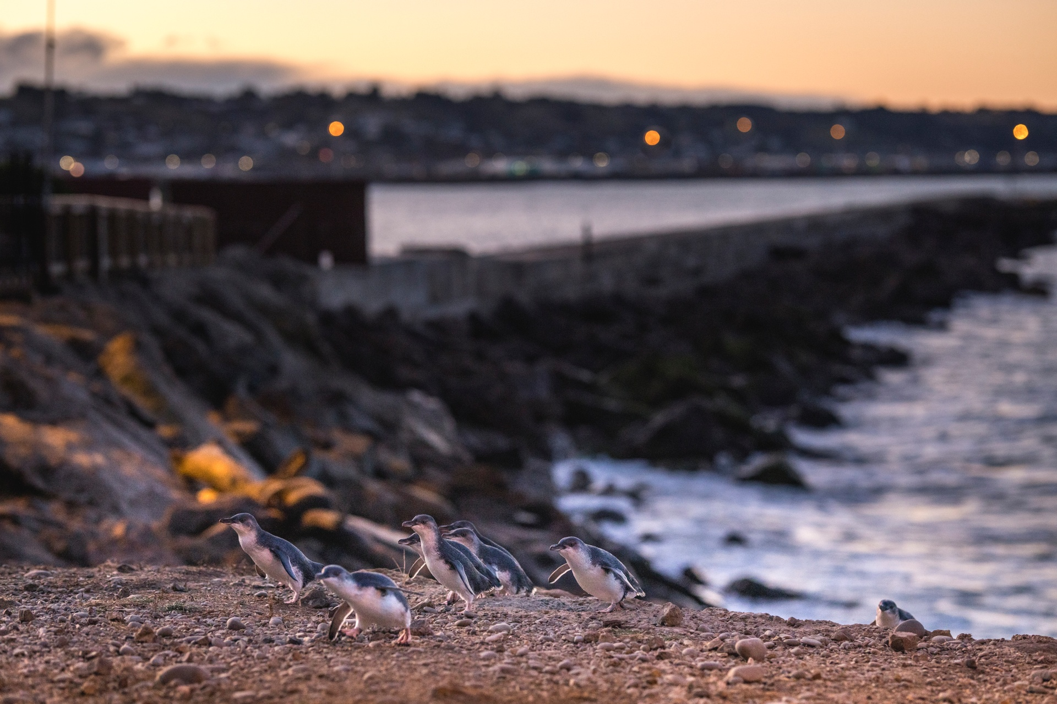
Establish and support collaborative regional environmental projects
Develop measures for regenerative tourism
Ensure green assessment schemes include criteria and standards related to biodiversity
Advocate and educate on biodiversity matters at a local and national level
Image: Miles Holden

Slide 11
Visitor management is optimised for te taiao
Seeks to reduce tourism’s impact on te taiao by managing visitor volumes at particularly sensitive sites and to highlight environmentally friendly activities in marketing.

Slide 12
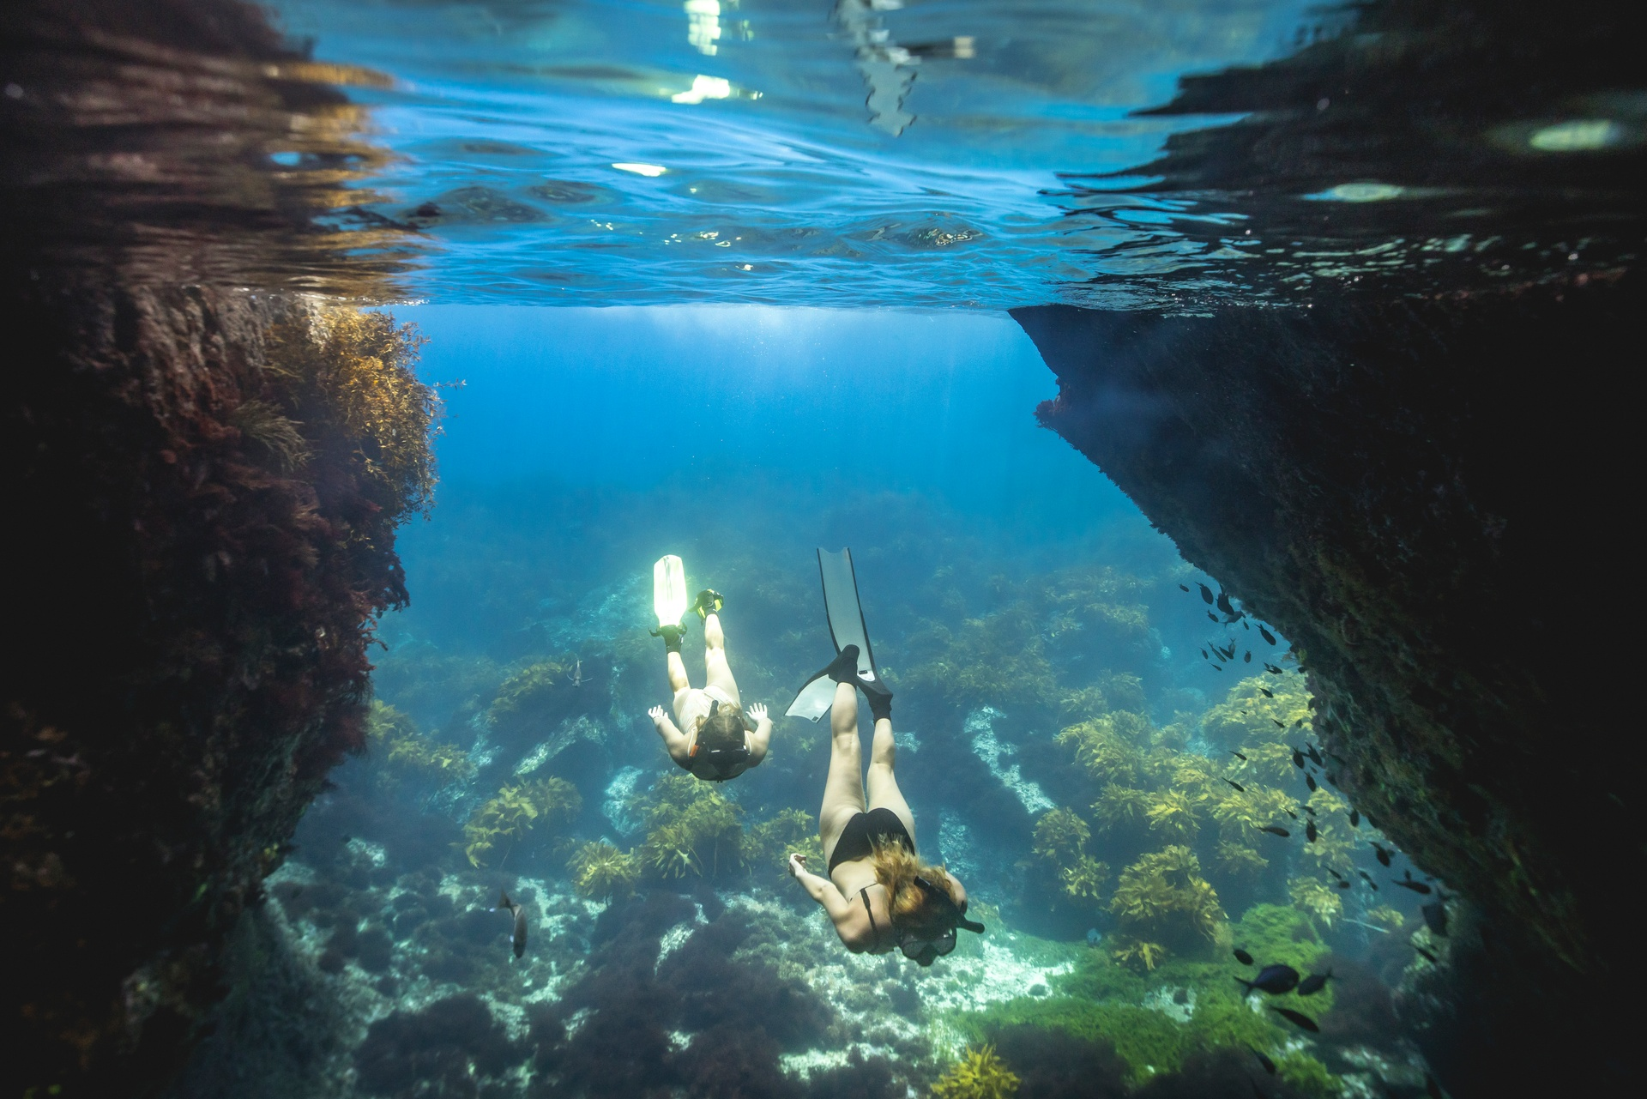
1. Assess ideal minimum and maximum visitor numbers at specific sites. Develop and promote a suite of levers to maintain visitor numbers within these parameters.
2. Highlight regenerative activities and operators in marketing campaigns

Slide 13
Accelerated technology uptake and innovation enable regeneration
Lift technology uptake and embed a culture of innovation to enable tourism operators and the industry to shift to a regenerative model more rapidly.

Slide 14
1. Harness emerging technology within the tourism system
2. Organise an in-person event showcasing existing and emerging technology
3. Establish a tourism innovation lab
4. Contribute tourism perspectives to economy-wide innovation programmes
IMAGE HERE

Slide 15
Tourism businesses are incentivised and enabled for sustainability and regeneration
Lift awareness and accelerate adoption of practices that protect and enhance the natural environment.

Slide 16
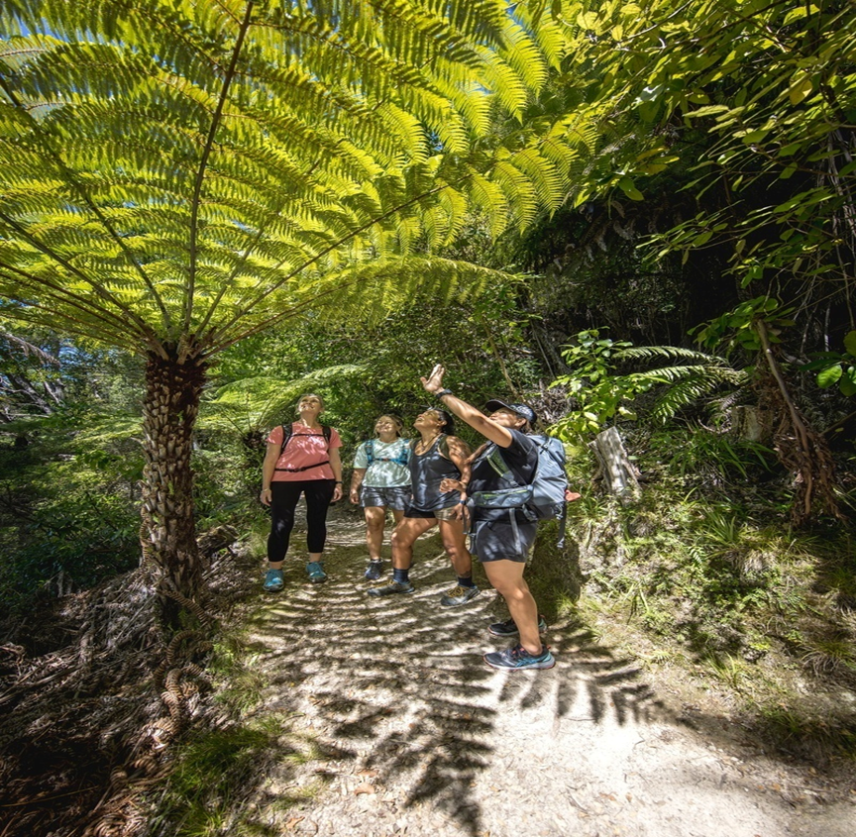
1. Ensure online toolkits on sustainable and regenerative practices are widely available
2. Designing and delivering personalised regenerative support programmes to tourism operators
3. Foster a collaborative approach between tourism operators
4. Respond to research on understanding tourism operators’ adoption of regenerative policies
IMAGE HERE

Slide 17
The tourism system and its levers are optimised and resourced to support regeneration
Ensure that Aotearoa New Zealand’s tourism system, and its various structures and levers, can enable the actions in this Plan and reinforce the priorities that will drive the transition.

Slide 18
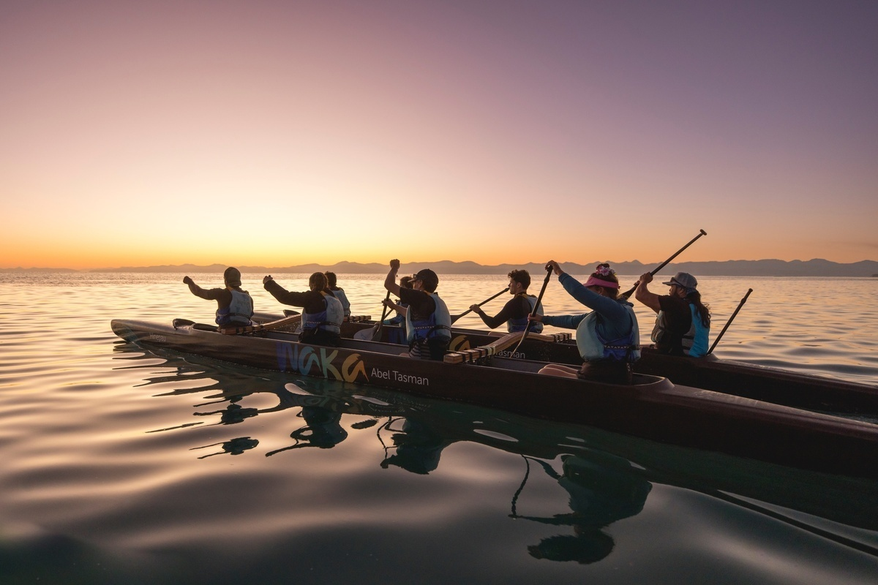
1. Undertake a high-level assessment of the tourism system
2. Refresh the MBIE Destination Management Guidelines
3. Recommend a regular national tourism strategy
4. Review funding structures and mechanisms that will enable a regenerative tourism system
IMAGE HERE

Slide 19
How can you help?
Have your say by 19 July through the online survey on the QR code or a submission
Attend a workshop before 14 July
Encourage your local operators to engage – attend workshops, complete the survey etc.

