Slide 1
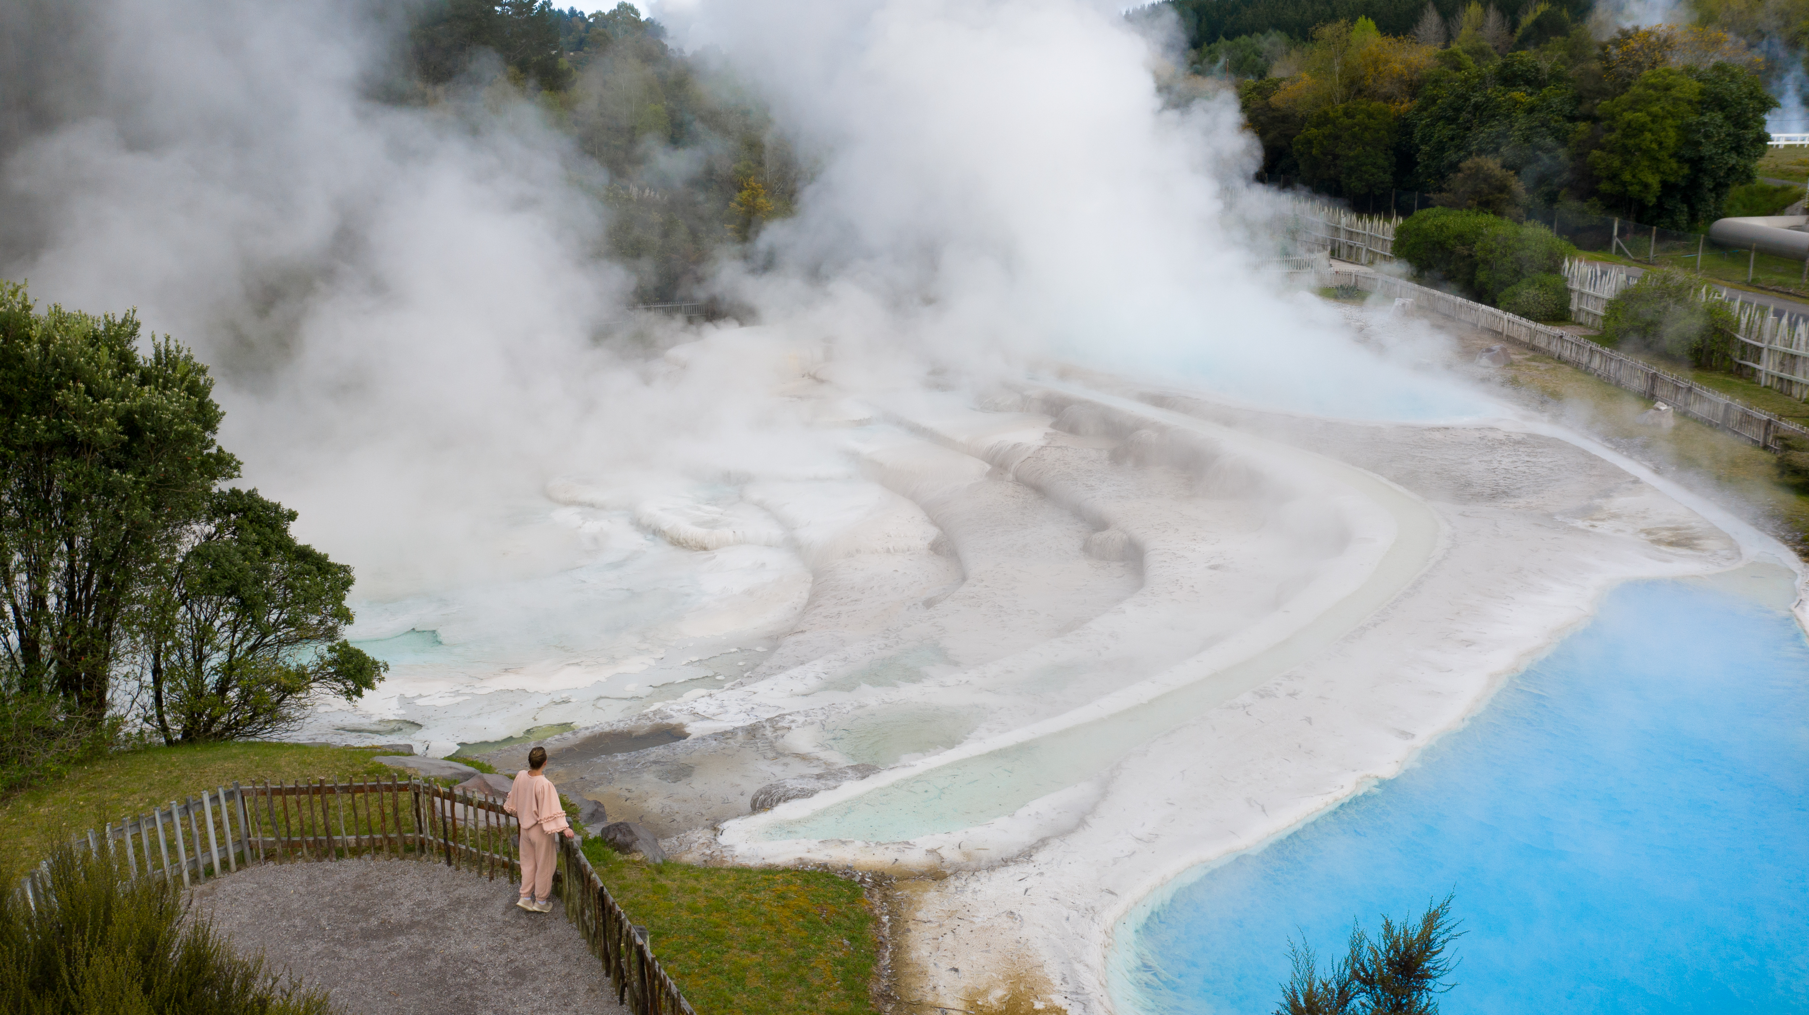

Slide 2
Taupō District
Product Audit Mapping Tool

Slide 3
Why did we need a Product Audit?
IDENTIFY GAPS IN PRODUCT OFFERING
CREATE OPPORTUNITIES FOR THE FUTURE
UNDERSTAND EXISTING SUPPLY
IDENTIFY PRODUCT GAPS
DEVELOP A TOOL TO DRIVE INSIGHTS
COMMUNITY NEEDS FROM TOURISM
EVIDENCE BASE FOR THE DESTINATION MANAGEMENT PLAN
OPPORTUNITIES FOR GROWTH & DEVELOPMENT
Notes:
Why we undertook this piece of work
Opportunities
To understand what we currently have - our supply of tourism product ?
To identify product gaps in our market
Complete Tourism Product audit
Destination management Plan
To create opportunities and Growth for our region

Slide 4
Provide a mapping tool that would provide a comprehensive overview of the current tourism product mix, identify product and capability gaps and have the ability to be updated over time
COLLABORATION - DGLT and Amplify
FOCUS - primarily on commercial and short-term accommodation (e.g. AirBnB), tourism activities and experiences with a secondary focus on retail, food & beverage and supporting tourism services across the district.
GOAL
WHAT
Notes:
Why We Completed the Tourism Audit
The goal of the audit was to produce a comprehensive database of the current tourism products in the market, where potential gaps in Taupō's tourism offerings are and opportunities and aspirations for the region.
The Taupō tourism product audit was a project undertaken by Destination Great Lake Taupō (DGLT) and Amplify
Geographically the project focused within the Taupō district boundary.
The focus was primarily be on commercial and P2P accommodation, activities and experiences with a secondary focus on retail, hospitality, events and access to the region.
What This Audit Provides
This audit provides us with a substantiated database and a greater understanding of our Tourism product mix, it is a foundational piece of work informing the Destination Management Plan for the Taupo Region.
As part of the audit the tourism tool was developed and provides a database of tourism product and a visualisation of that data.
The database provides an understanding of the number of commercial properties, room numbers and the types of rooms we have. The capacity of commercial and our peer-to-peer (Airbnb) accommodation in the district.

Slide 5
What process did we take?
1
Defined a clear framework of categories, data sets and the geographical boundaries to be captured
2
Web scrapes from online tourism platforms. Data collected, cleansed, aggregated & analysed
FRAMEWORK
DATA COLLECTION & ANALYSIS
4
Process of iterations to capture feedback & tweak tool design & build. Ability to update.
3
Tourism Tool designed and data represented in the Tableau platform
FEEDBACK
VISUALISATION
Notes:
How - We designed it
Data Methodology & Tool Design
Defined a clear framework of categories and datasets we needed to capture and the geographical boundaries of the audit.
At a high level there were 5 categories
Commercial Accommodation
Peer 2 Peer accommodation
Tourism product including - experiences & activities, operators, locations & points of interest
Food & beverage offerings
Retail offerings
And supporting Services
The data was sourced via Web Scrapes from online platforms including - booking.com, hotels.com, google & Tripadvisor,
The data was then collected, cleansed and aggregated and represented in the Tableau platform
The Tourism Tool went through a number of iterations to capture feedback and tweak the design & build
Data will be updated at 12 months to determine movement and allow for trend analysis - Q2 April/ May 2022

Slide 6
Taupō Tourism Audit Summary 2022
149
Properties providing 2,501 commercial rooms
70% of accommodation located in Taupō
COMMERCIAL ACCOMMODATION
3,646 rooms
SHORT TERM
ACCOMMODATION LISTINGS
1,372
216
146 Outdoor & Adventure Attractions
15 Geothermal Attractions
40 Sightseeing & Tours
EXPERIENCES & ATTRACTIONS
187
74% of operators are in Taupō township
14% of operators are in Tūrangi-Tongariro
9% Mangakino & Kinloch
OPERATORS
196 Food & Beverage Providers
145 Retail
299 Services
SERVICES
640
Notes:
Commercial Accommodation
58 Motels which equate to 41% of available rooms in the Taupo District
23 Lodges, 16 Hotels, 23 BnB’s, 11 Holiday Parks, 10 Hostels
71% of properties are in Taupo Central
24 properties or 17% in Turangi-Tongariro area
Peer to Peer (Air B&B, Batch care ++)
1372 properties available in the district with, 3,646 rooms
With just over 46% of the districts private dwellings unoccupied, there is a large supply of properties available for the peer to peer market. But not when looking at comparative markets
70% of properties are whole houses, 16% are apartments, 13% rooms, 0.6% other (house boats, yurts!)
Location wise Taupo has 67.5%, Mangakino & Kinloch 10%, Western Bays 9.3%, 7.5% Turangi-Tongariro, Eastern Bays 5.9%
Experience and Attractions
146 Outdoor & Adventure Attractions
15 Geothermal Attractions
40 Sightseeing & Tours
74% of operators are in Taupo township,14% of operators are in Turangi-Tongariro, 9% Mangakino & Kinloch
Services (F&B etc)
196 Food & Beverage Providers - 44 Cafes, 98 Restaurants, 11 Bakeries,
145 Retail - 12 activity and adventure supplies, 62 fashion, 11 gift shops
299 Services - 11 EV charging stations, 12 Car rental services,

Slide 7
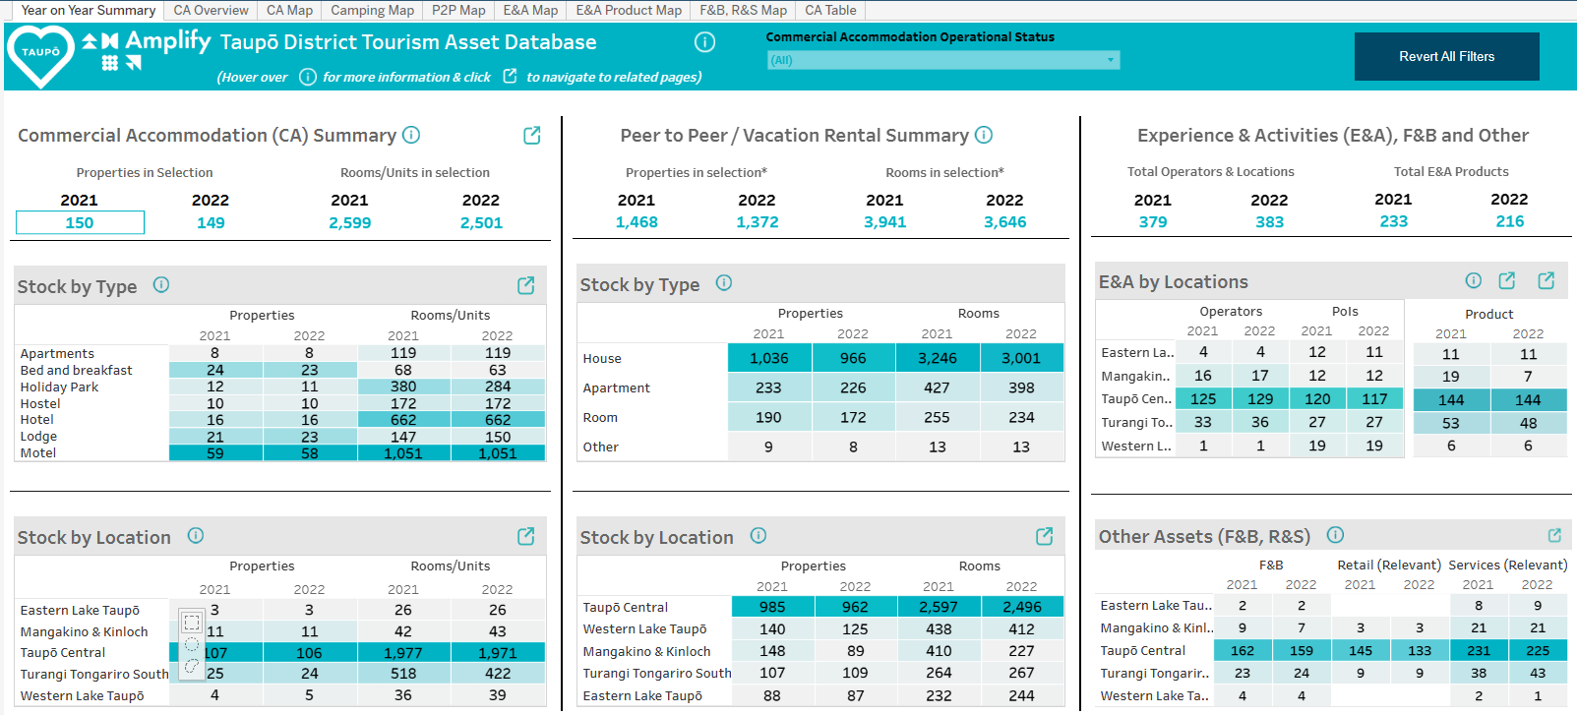
Taupō Tourism Dashboard 21 v 22
Notes:
Decrease in commercial property rooms - of 98
Peer to Peer Accommodation - decrease of - 6% in available properties , and a decrease of 8% in room numbers

Slide 8
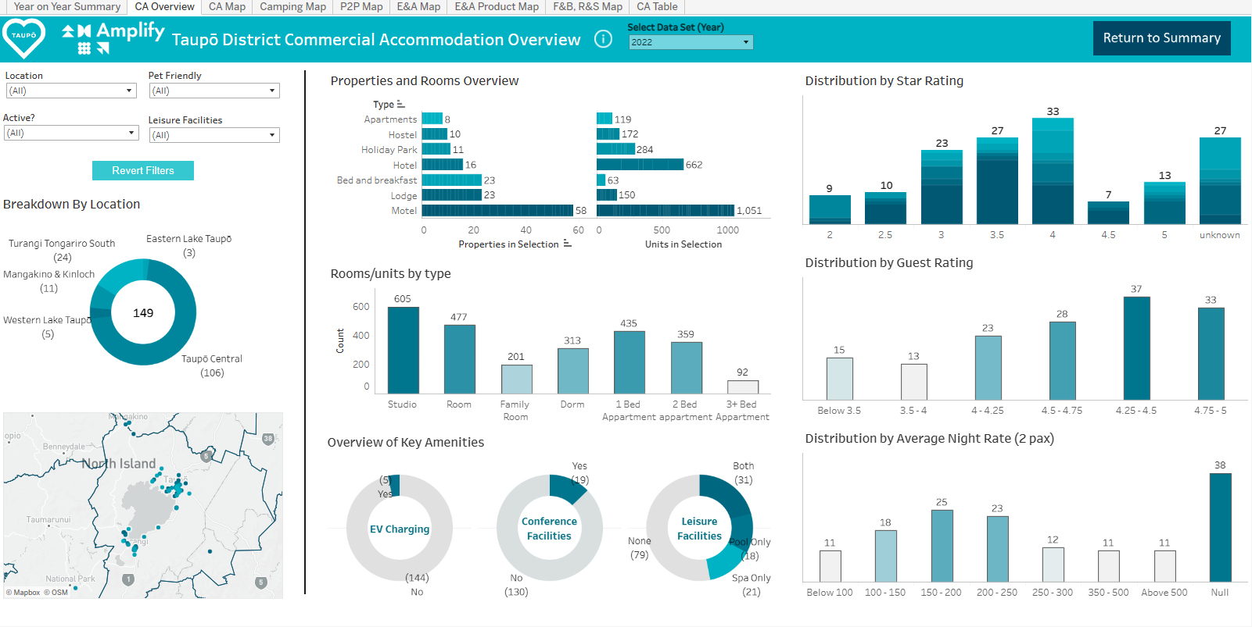
Commercial Accommodation
Notes:
Information Captured
Number and type of commercial properties
Breakdown of number and types of rooms
Location breakdown to understand the geographical split
If the properties have Conference facilities, Pools, Spas, Pet Friendly,
Ratings and review counts from multiple sources
Avg Price
Amenities
Social media channels, If google listings are claimed

Slide 9
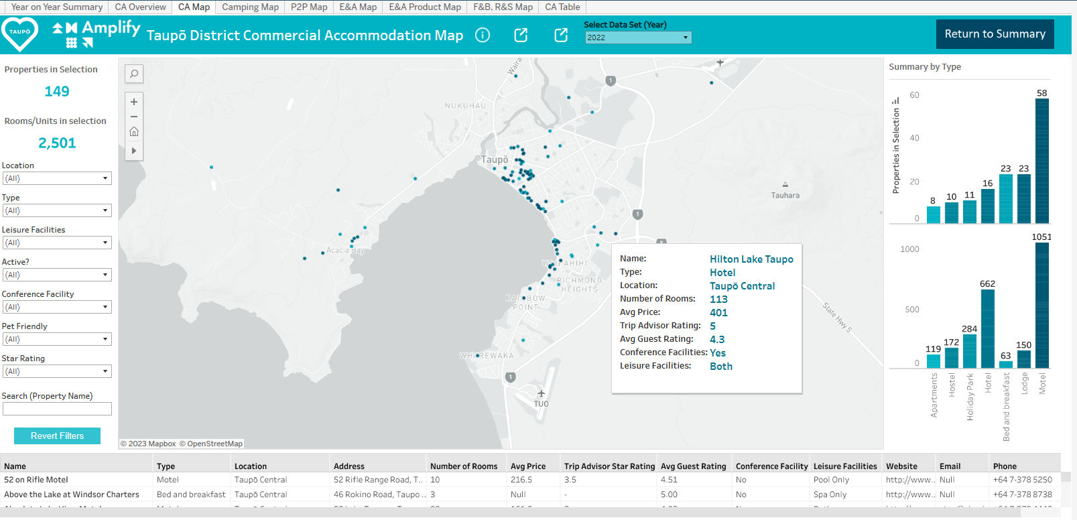
Commercial Accommodation
Notes:
Overview
This page provides a snapshot of the commercial accommodation in the Taupo District
Provides a number of criteria to sort by - location, type of accommodation, facilities, even if its pet friendly!
It provides a summary of the number of properties, rooms and types of accommodation in the bar graphs on the right
You can hover over the map and a call out will pop up e.g. Hilton Lake Taupo, it provides information on the location, number of rooms, Avg Price, Trip advisor rating, avg guest ratings, conference facilities, leisure facilities (pool/spa pools)
Example - Hotel Developer
If we had a developer come to us wanting to develop a motel in the region we are able to provide a detailed overview of the market they would be operating in
Direct competitors - product type, size, room types,
Room configurations that would suit their target market
Geospatial overview

Slide 10
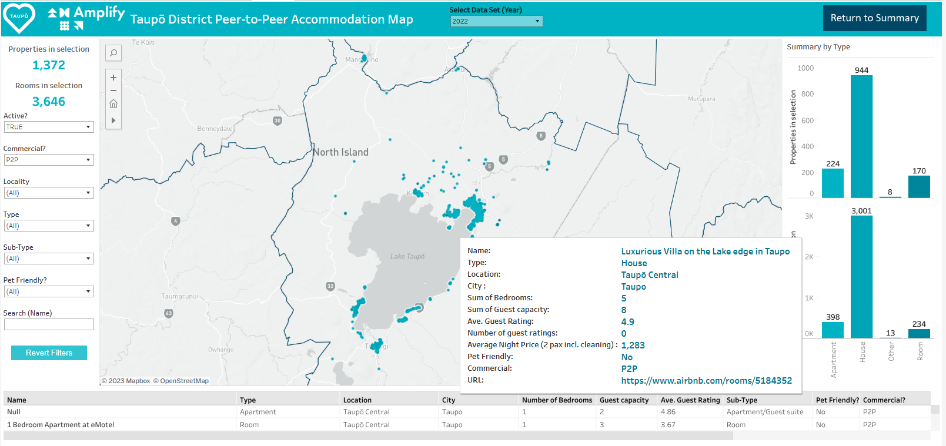
Short–term accommodation
Notes:
Air Bnb, Bach care and VRBO

Slide 11
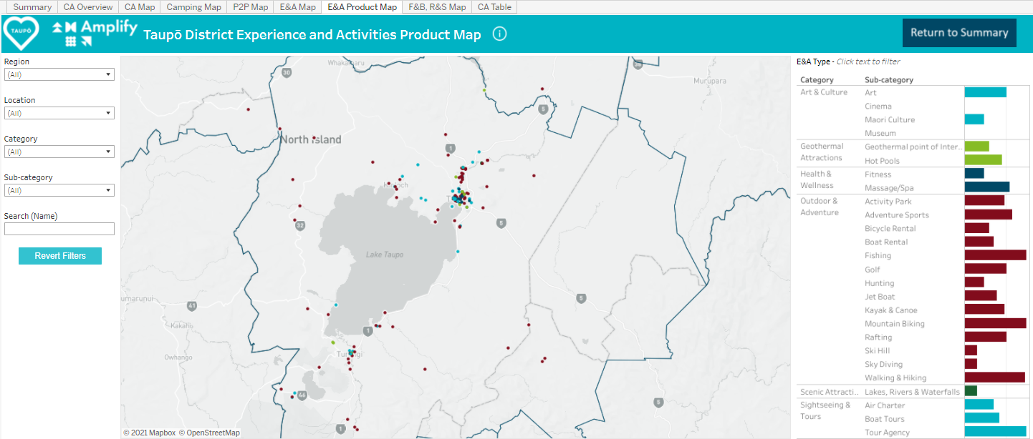
Experience and Activities
Notes:
Product Development
If we had someone come and wanted to set up a fishing tourism business
We are able to provide the following information and competitive analysis and do a deeper gap analysis of fishing products within the regions supply and help identify opportunities to differentiate their product/offering
30 fishing tour products within the region
Across 25 operators
Geographical map of fishing product in the region
61% in Taupo, 20% Turangi, 13% Eastern LT, 3% in Western LT & Kinloch
Pricing - Avg price $425, lowest $25 highest $1300 (Huka Lodge)

Slide 12
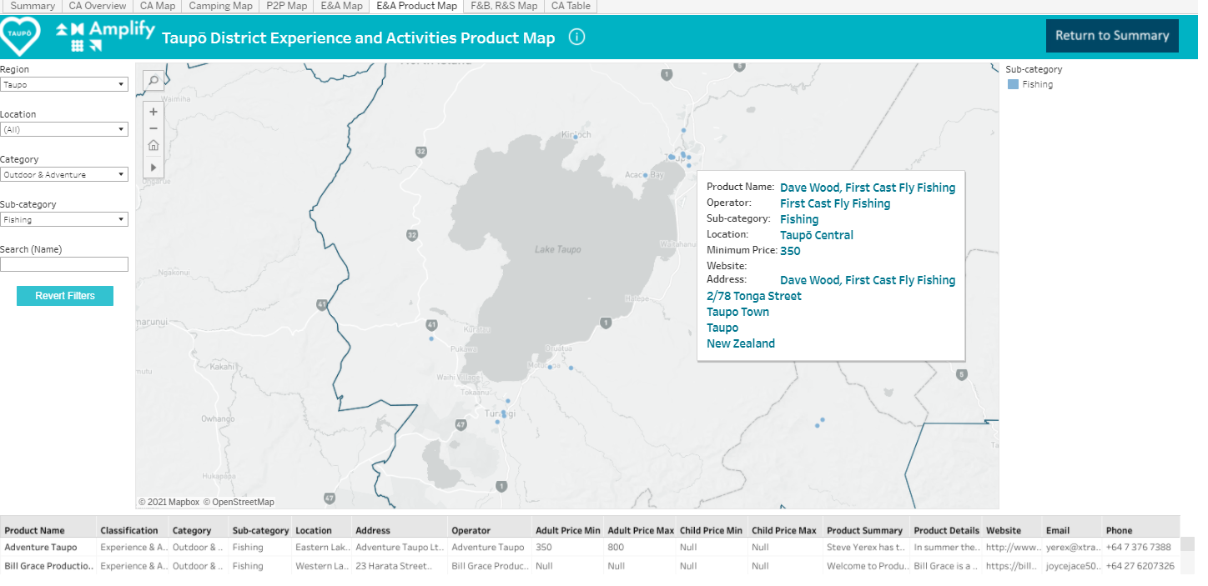
Experience and Activities
Notes:
Information Captured
Number and type of experiences and activities
Product name
Operator name
Classification and category
Locality
Product summary & Details
Adult price Min/max, Child price min/max
Location

Slide 13
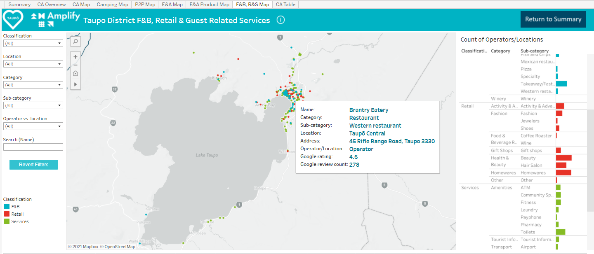
Food & Beverage, Retail & Guest Related Services

Slide 14
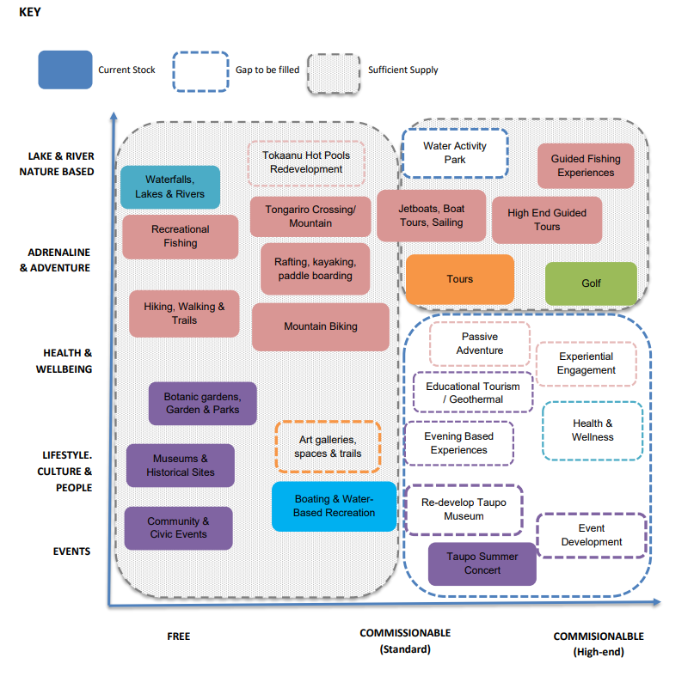
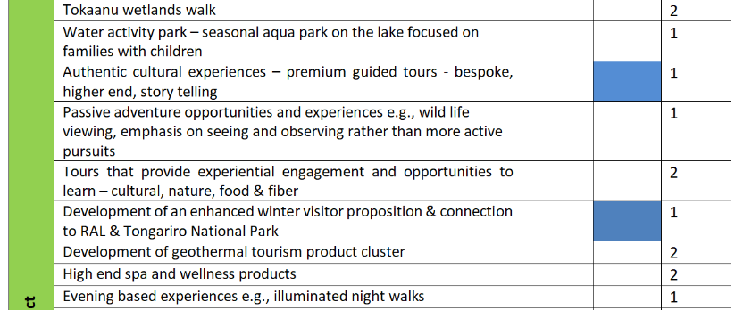
Experience and Activities
Gap Analysis
Notes:
Over 50 opportunities identified.

Slide 15
How do we use the tool?
INSIGHTS & DECISION MAKING
01
Produce powerful insights for a range of audiences to assist with decision making
02
An evidence base to identify product gaps and development opportunities
DEVELOPMENT
DMP
03
Feed into the Destination Management Plan
SUPPORT
04
Deeper insight for one-on-one support
CAPABILITY
05
Building industry capability
Notes:
HOW WE WILL USE THE TOOL IN THE FUTURE
Ability to drill into the data in many ways and produce powerful insights for a range of audiences
Developers, Council, ED, property owners, product businesses.
We are able to use specific validated data to make decisions
Feed into the Destination Management Plan
The Supply data, gap analysis and in depth overview from the audit report provide a substantiated evidence base for the DMP
Provides a deeper understanding and insight for one-on-one support
Ratings data - deeper insight and understanding of the competitive environment
Capability development
Social Profiles amd visibility in the market, Qualmark certification
Google Business listings - 28 commercial accommodation providers haven’t claimed there listings
And this can lead into Business Support for DGLT or Amplify to help businesses be better
5. New data scrapes will enable analysis of changes within the market over a period of time - price, ratings, who has come in or out of the market
6. Opportunity to build more dashboards and develop and expand the platform in the future
For example - ongoing consolidation of tourism analytics into one database for the region
Sentiment & ratings
Pricing analysis
tourism spend, occupancy, length of stay,

Slide 16
QUESTIONS?

