Slide 1
The future of tourism is regenerative
and resilient, delivering benefits
environmentally, socially, culturally
and economically, enriching the
lives of the people who live here
and the people who visit.

Slide 2
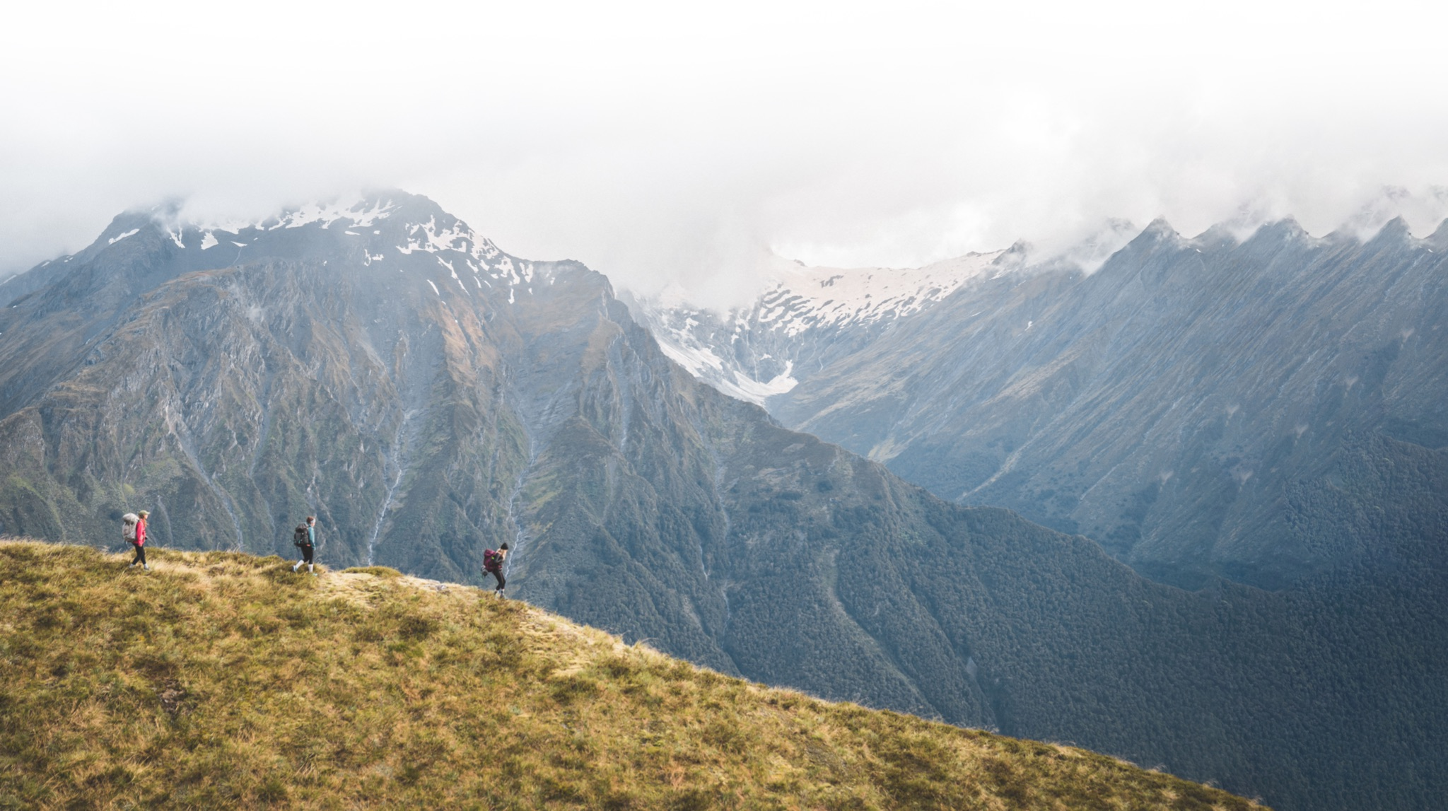
Travel to a Thriving Future
Haereka whakamua ki te ao taurikura
A regenerative tourism plan for Queenstown Lakes
Notes:
Title slide.

Slide 3
TRAVEL TO A THRIVING FUTURE – Plan on a page
Goal | Regenerative tourism by 2030
Keystone project | The visitor economy of Queenstown Lakes reaches carbon zero by 2030
Strategic pillar | PILLAR 1: Enrich communities and enhance the visitor experience | PILLAR 2: Foster a visitor economy that restores the environment | PILLAR 3: Build economic resilience, capability and productivity
Objectives | Align actions with the core values and guiding principles. Positive community sentiment. Strong visitor satisfaction. | Greenhouse gas emissions (Queenstown Lakes District Council (QLDC) data/Otago Regional Council (ORC) data). Biodiversity health. | Total value of the visitor economy that stays in the district, net of all costs. Income equality and affordability. Workforce availability and low turnover. Maintain tourism business satisfaction.
Projects | Project 1: Community engagement Project 2: Tiaki Promise: Lead by example Project 3: Preserve and celebrate Māori culture Project 4: Place-based marketing plans Project 5: Welcome programme Project 6: Arts, culture & heritage development … | Project 7: Measure environmental footprint Project 8: Measure greenhouse gas emissions Project 9: Decarbonisation Plan Project 10: Zero environmental footprint Project 11: Restoring ecosystems … | Project 12: Leakage assessment and cost-benefit analysis Project 13: Direct funding for infrastructure Project 14: Love Wānaka / Love Queenstown Project 15: Remarkable experiences programme Project 16: Tourism business excellence programme Project 17: Thriving workforce programme Project 18: Technology adoption Project 19: Green tourism innovation Project 20: Environmental preparedness Project 21: Economic development: innovation
 | Foundations for success
 | Objectives Complete the projects listed under this pillar. Establish a cadence for reporting and plan review | Projects Foundational project 1: Framework for governance and review Foundational project 2: Operationalise projects Foundational project 3: Data and measurement framework Foundational project 4: Update Queenstown Lakes brand and marketing strategies
Notes:
Strategic pillar
Pillar 1: Enrich communities and enhance the visitor experience
Pillar 2: Foster a visitor economy that restores the environment
Pillar 3: Build economic resilience, capability and productivity
Objectives
Under pillar 1
Align actions with the core values and guiding principles.
Positive community sentiment.
Strong visitor satisfaction.
Under pillar 2
Greenhouse gas emissions (Queenstown Lakes District Council (QLDC) data/Otago Regional Council (ORC) data).
Biodiversity health.
Under pillar 3
Total value of the visitor economy that stays in the district, net of all costs.
Income equality and affordability.
Workforce availability and low turnover.
Tourism business satisfaction.
Projects
Under pillar 1
Project 1: Community engagement
Project 2: Tiaki Promise: Lead by example
Project 3: Preserve and celebrate Māori culture
Project 4: Place-based marketing plans
Project 5: Welcome programme
Project 6: Arts, culture & heritage development
Under pillar 2
Project 7: Measure environmental footprint
Project 8: Measure greenhouse gas emissions
Project 9: Decarbonisation Plan
Project 10: Zero environmental footprint
Project 11: Restoring ecosystems
Under pillar 3
Project 12: Leakage assessment and cost-benefit analysis
Project 13: Direct funding for infrastructure
Project 14: Love Wānaka / Love Queenstown
Project 15: Remarkable experiences programme
Project 16: Tourism business excellence programme
Project 17: Thriving workforce programme
Project 18: Technology adoption
Project 19: Green tourism innovation
Project 20: Environmental preparedness
Project 21: Economic development: innovation
Foundations for success
List objectives under foundations for success
Complete the projects listed under this pillar.
Establish a cadence for reporting and plan review.
List four Foundational projects
Foundational project 1: Framework for governance and review
Foundational project 2: Operationalise projects
Foundational project 3: Data and measurement framework
Foundational project 4: Update Queenstown Lakes brand and marketing strategies

Slide 4
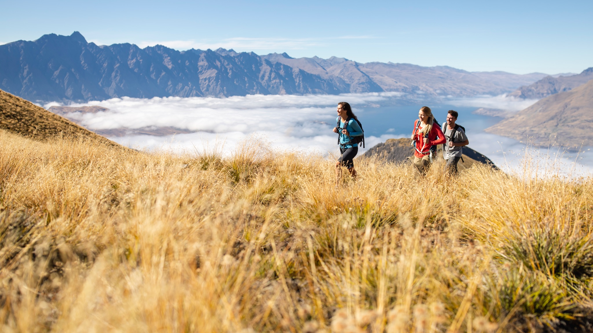
Keystone project
Kaupapa matua
Ka kore waro te taiōhanga manuhiri ki Queenstown Lakes hei te tau 2030
The visitor economy of Queenstown Lakes reaches
CARBON ZERO BY 2030

Slide 6
Projects that give us confidence with this Goal

Slide 7
What would an RTO know about Climate Change?

Slide 8
Visitor mix and optimal visitation
We define high contributing visitors as
“visitors that take the time to get to know and appreciate our people and place, forging connections and giving back to the region.”

Slide 9
Notes:
Click to make Globe move

