Slide 1


Data Leadership Governance Group Overview
David Perks

Slide 2

PURPOSE
To create a consistent, reliable, and trusted tourism data system that meets the information needs of a diverse set of tourism data users, delivers wide benefits for New Zealand.
The vision to be achieved over the next three to five years.
$5 million allocated from IVL to support initial work programme, sector contributions will be sought in terms of co-funding.
Leadership Group Members
Chairs: Dr Keri-Anne Wikitera, Steve Armitage (Chris Roberts)
Dr Susanne Becken
Dr Antony Kennedy
Justin Kimberley
Graeme Osborne
David Perks
Wiremu Stone
Bruce Bassett
MBIE secretariat

Slide 3

RECOMMENDATIONS
Improving the quality and usefulness of existing tourism data sets.
Developing new data sets & bundling together regional tourism indicators.
Investigating ways of measuring the full impact of tourism activities.
Designing a data capability-raising programme for tourism stakeholders.
Notes:
The strongest observation made from writing this paper is that the current tourism system is not tōnui, but rather taurangi (incomplete).
From interviews with industry leaders and key stakeholders, we identified the key current constraints and challenges facing regional tourism as lacking:
Shared value and governance
Dedicated sustainable funding for impact
Shared long-term vision and strategy
Knowledge and resilience for action in a changing world
The land in Aotearoa | New Zealand is considered taonga tuku iho (a treasure handed down) and innate Māori wisdom understands the balance of manaaki (welcome) and kaitiaki (stewardship). This wisdom, combined with legendary kiwi science and innovation, would be a powerful antidote to the significant issues facing the tourism eco-system today.

Slide 4
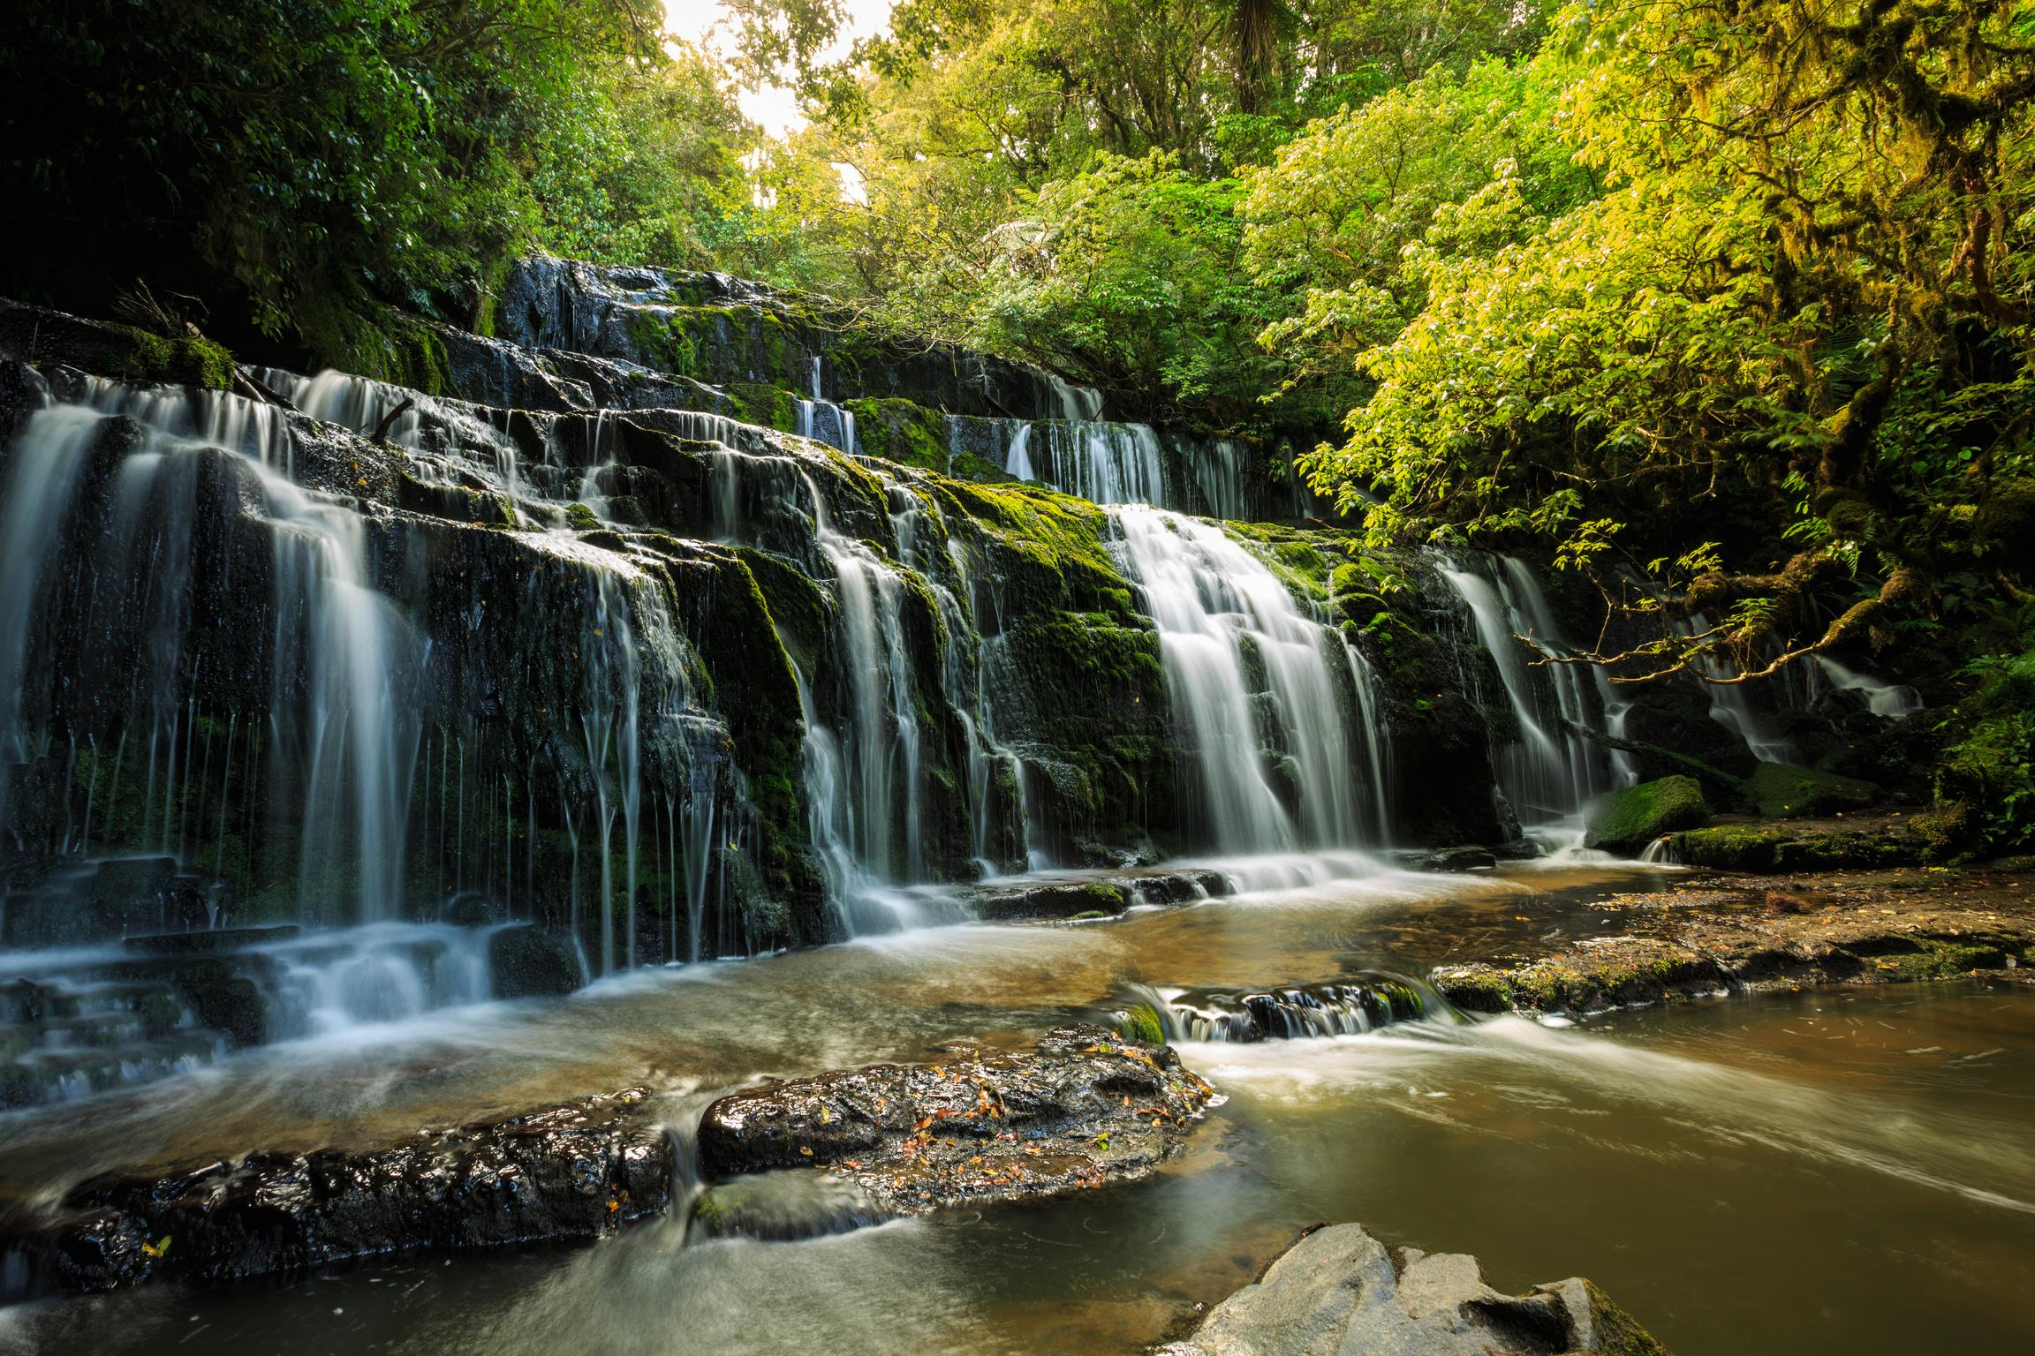
PACKAGE OF INITIATIVES
Improving existing data sets – IVS, ADP, MRTEs
New data sets – domestic, visitor flows, volumes, well being
Impacts of tourism - community, environment, capacities, net benefits/costs
Data accessibility – tools, hubs, other stakeholders DOC, Immigration, TNZ, private sector
Understanding and using data – capability, Maori needs

Slide 5

NEXT STEPS
Data Group Leadership Team reappointed, new Chair Steve Armitage, updated Terms of Reference.
Finalising feedback from consultation
Investment partnership
Prioritisation & procurement
Workshop – David Ermen
Use the next hour to look at regional data sets that are important for Regional Tourism, RTOs and a DM approach.

