Slide 1
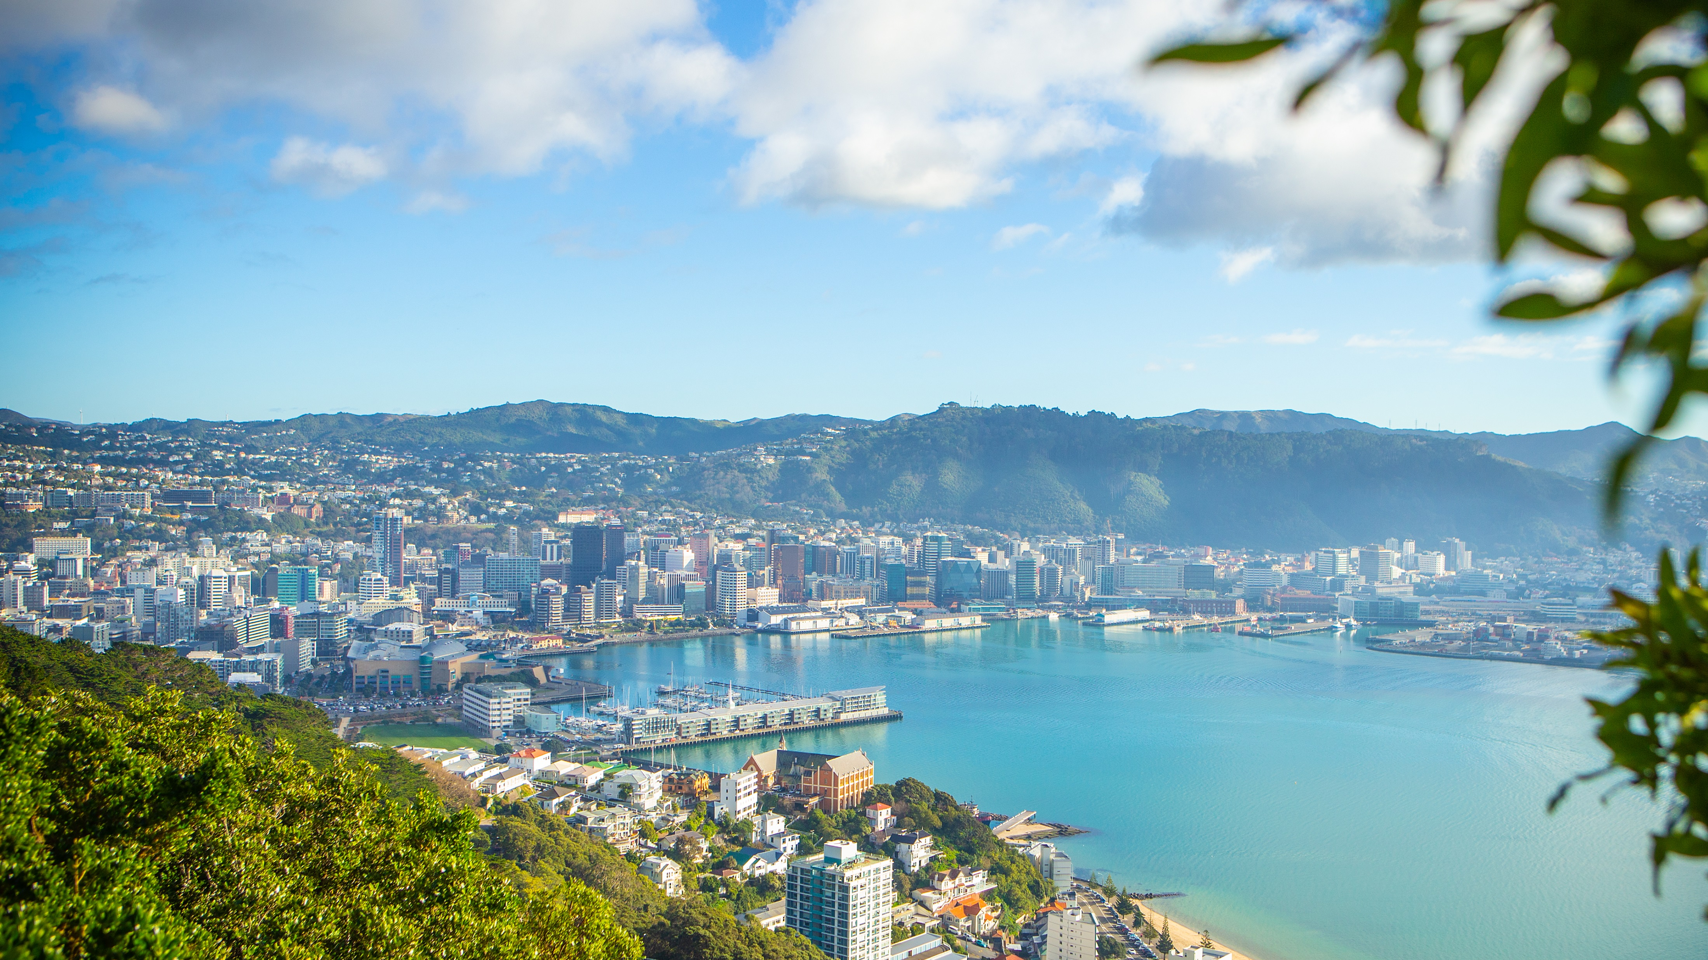
Destination Poneke
Civics Experience

Slide 2
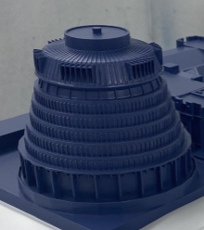
Civics Experience
Leveraging our capital city status

Slide 3
We will not be defined by this…
But seriously,
just how hard can this be....

Slide 4
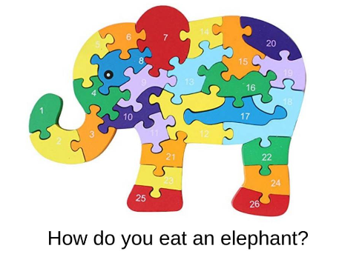
Steps to Success
Story Telling Conceptualisation Phase
Feasibility / Proof of Concept stage
Build out the content through Stakeholder workshops
Develop the self-guided product through co Funding model

Slide 6
Process
WHY?
WHAT?
WHO?
HOW?

Slide 7
Questions…

Slide 8
No Elephants were harmed in the making of…

