Slide 1
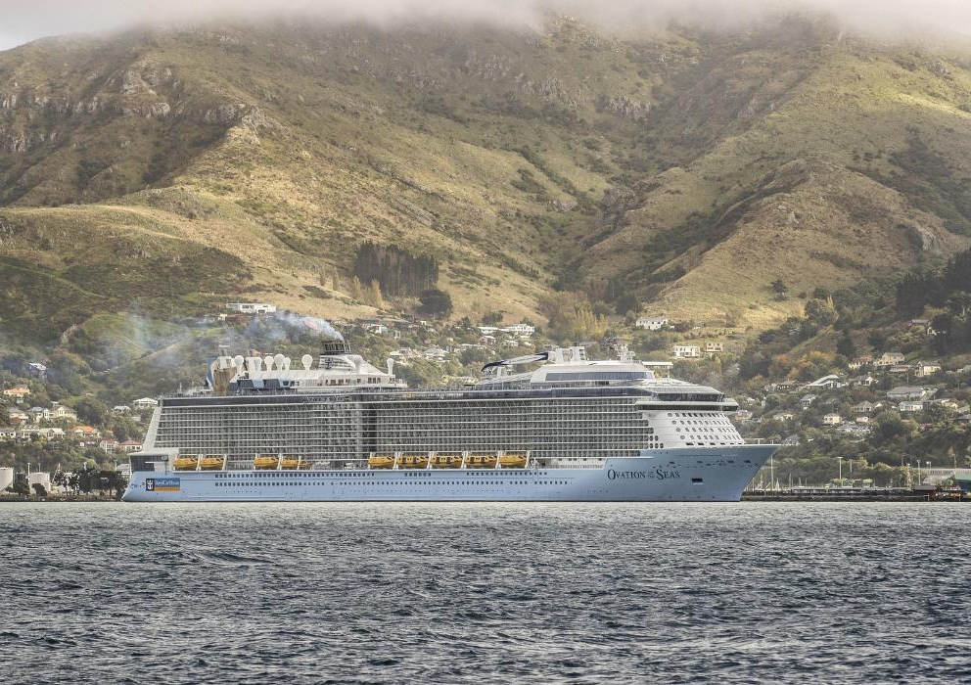
Christchurch Cruise Tourism
Navigating the choppy waters of social licence
Patrick O’Sullivan

Slide 2

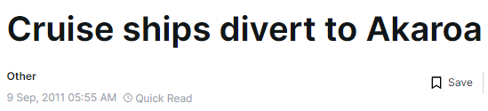
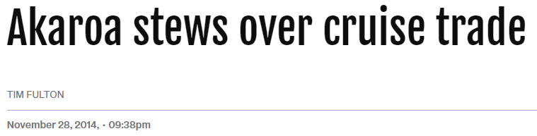
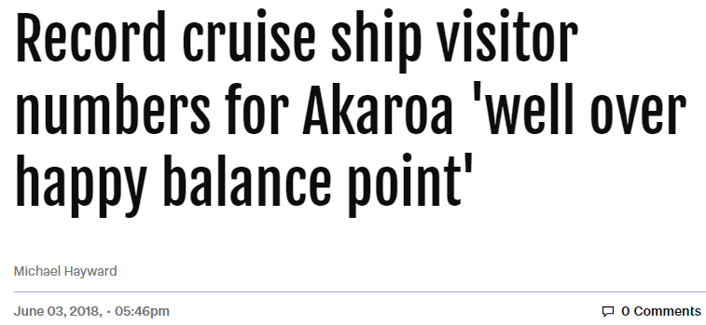
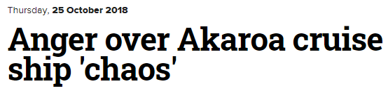


History in headlines

Slide 3
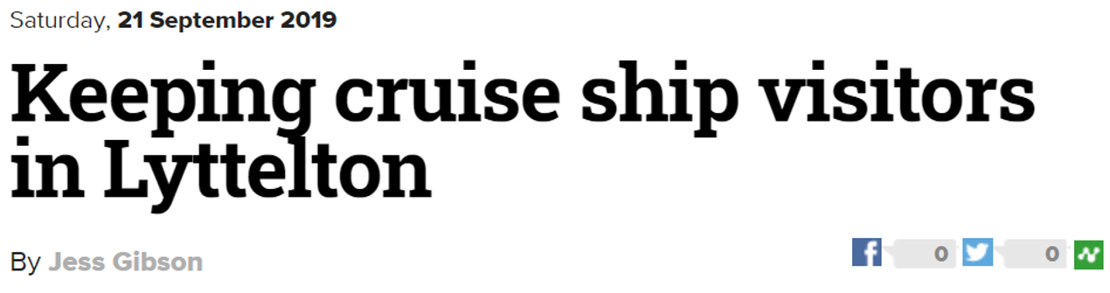

History in headlines

Slide 4
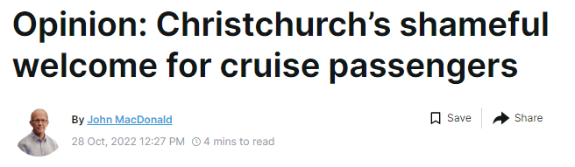

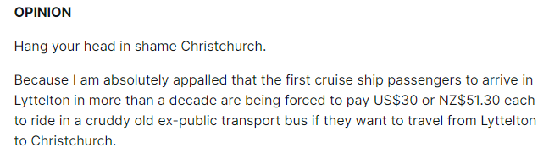
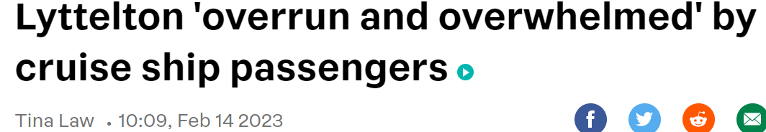
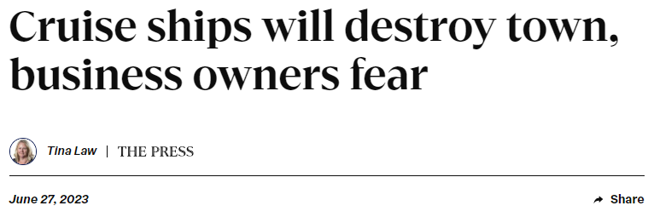
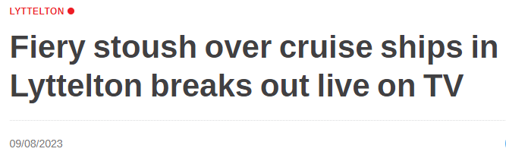
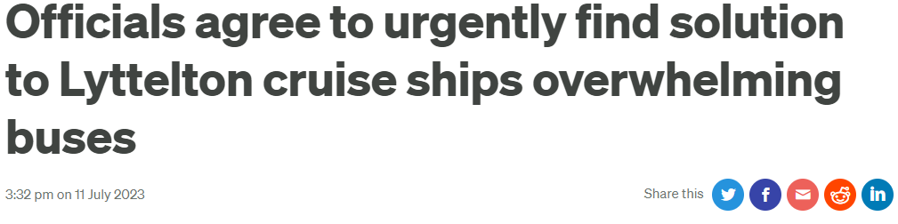
History in headlines

Slide 5
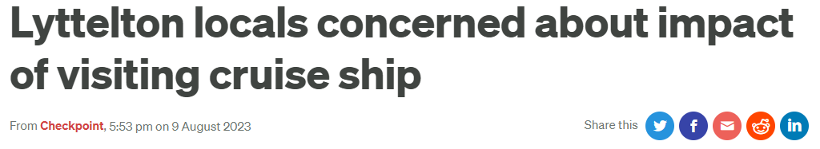
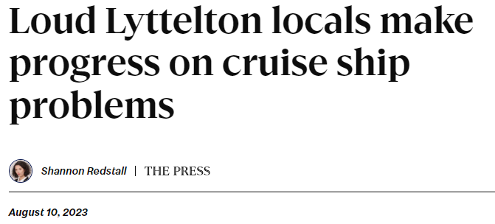
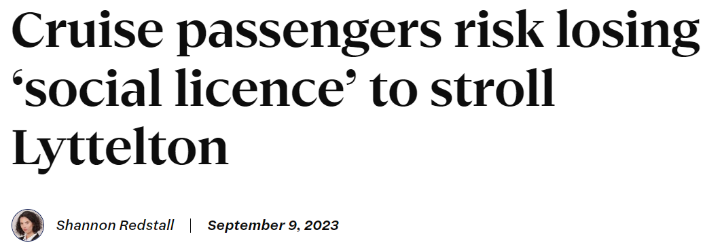
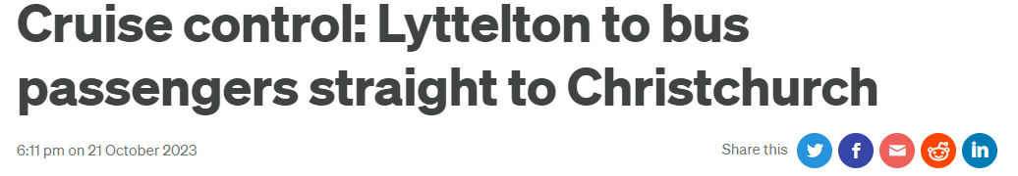
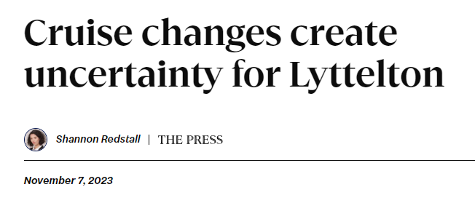
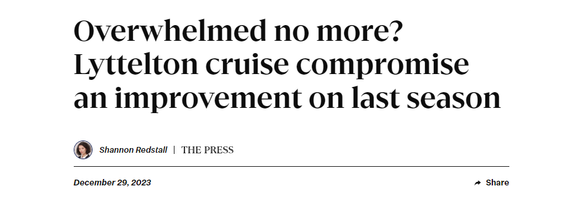
History in headlines

Slide 6
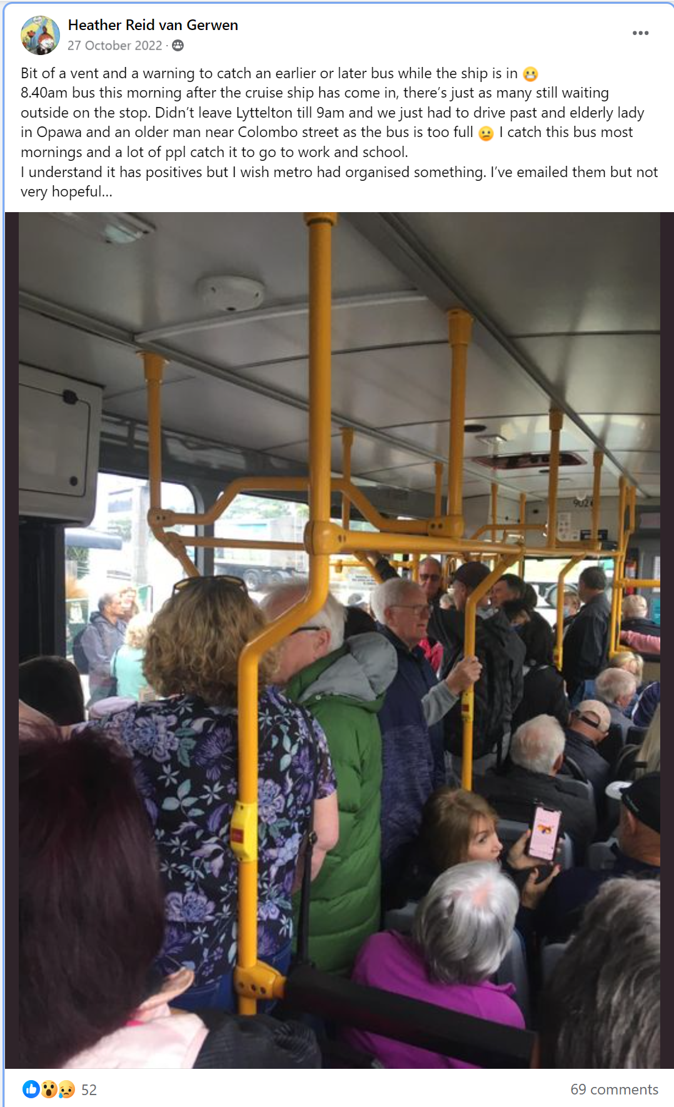
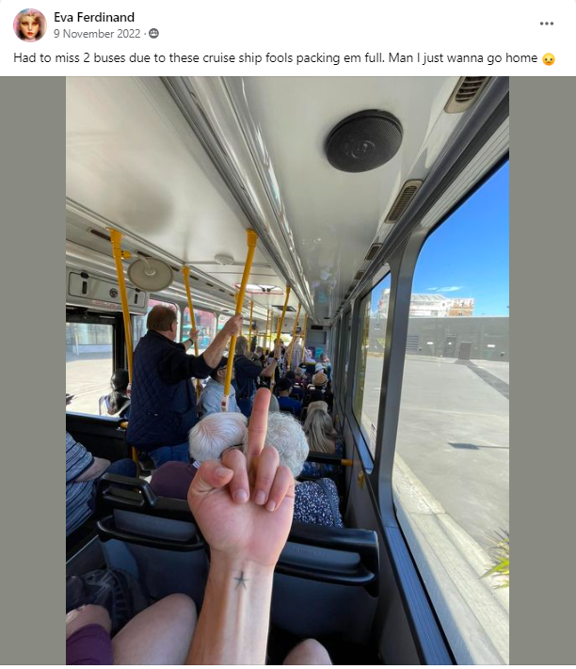
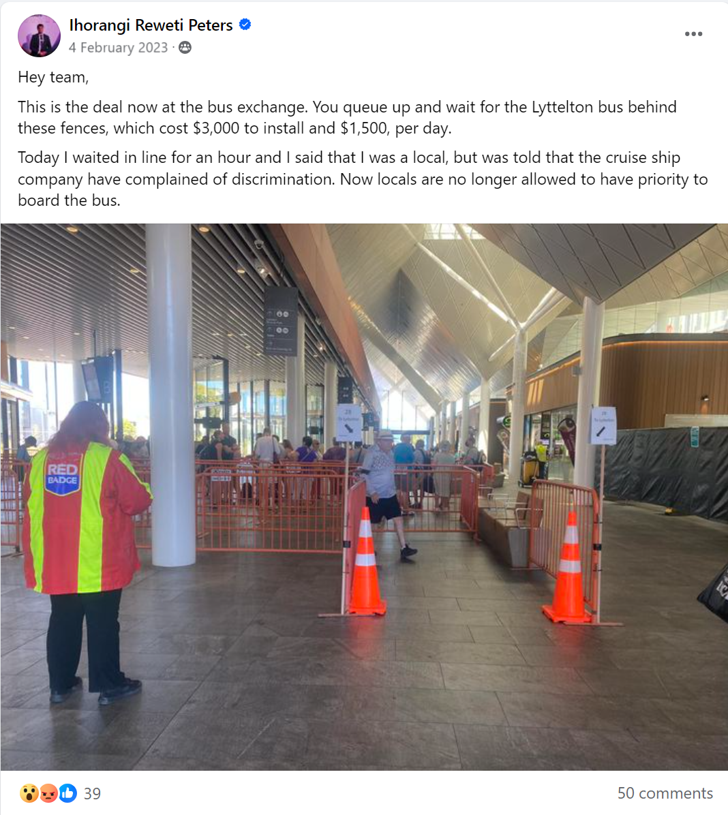
Community impact

Slide 7
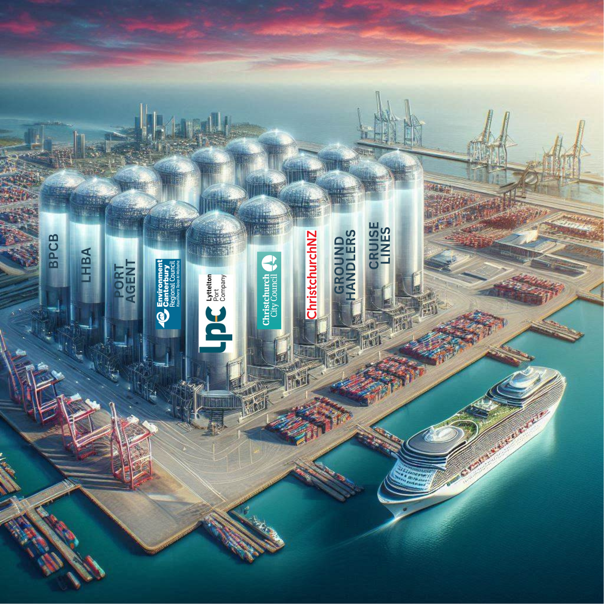
Silos (and breaking them…)
  Lyttelton Port Company
  Management of cruise berth
  Manages relationship and communications with cruise lines
  Role stops at port gates
  Ground Handlers
  Passenger management onto shuttles & shore-excursions
  Cruise Lines
  Set shuttle pricing
  Environment Canterbury
  Funds and operates public bus service
  Port Agent
  Liaises between ship and port
  Lyttelton Harbour Business Association
  Advocates for Lyttelton businesses
  Christchurch City Council
  Traffic managment, signage, shuttle stops
  Banks Peninsular Community Board
  Advocates for residents
  ChristchurchNZ
  Visitor experience
  Local Champions (ambassadors)
  Other parties
  NZ Cruise Association
  Cruise Lines International Association

Slide 8
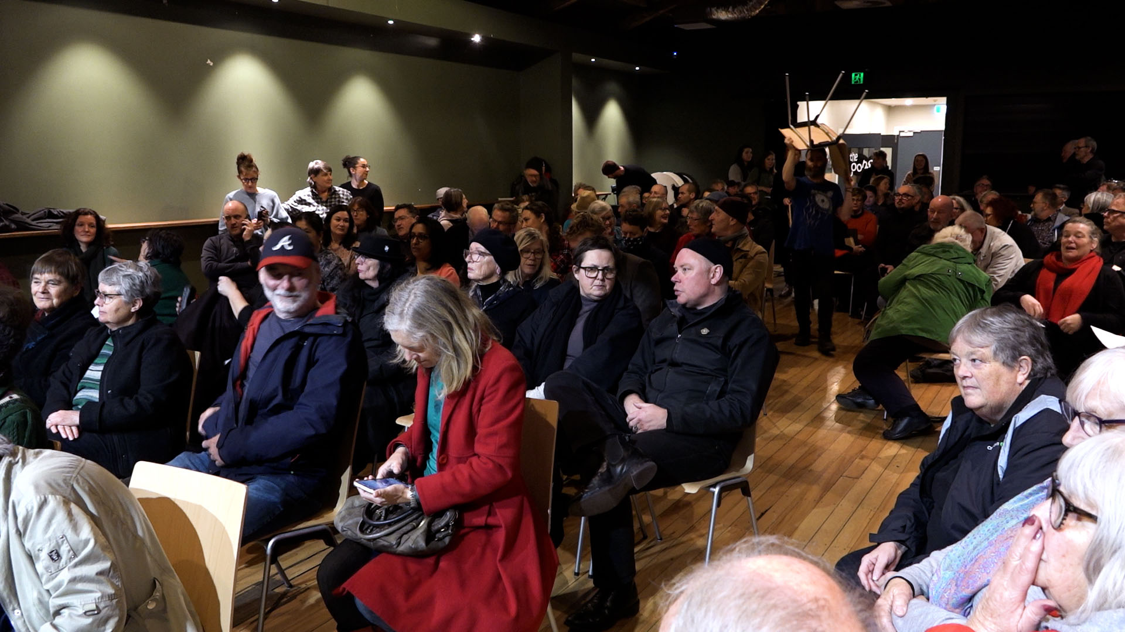
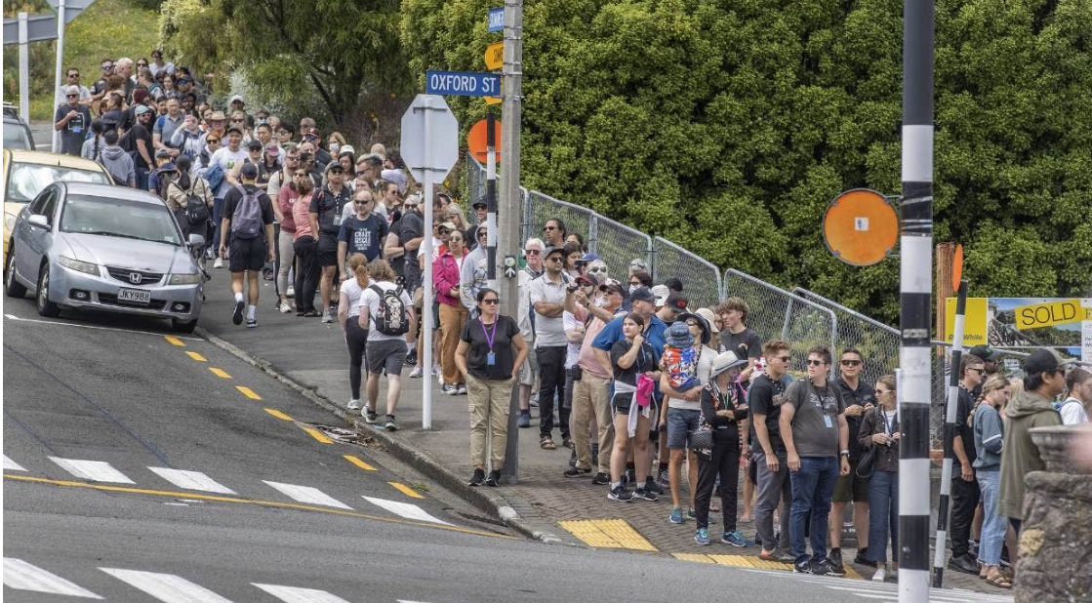
ChristchurchNZ’s role in smoothing the waters
Engagement and consultation with residents
  Community meeting in Lyttelton to hear issues
  DMP Consultation and incorporation of a pillar within the DMP to “Strive for better managed cruise tourism”
  Systems-led approach
    Mapping of customer (passenger) journey
      High city shuttle costs set by cruise lines results in avoidance
      Free Lyttelton shuttle a necessity, however results in a poor customer experience as Lyttleton is small and some businesses were not welcoming
    Mapping of customer (resident) journey/concerns
      Frustration with passengers overwhelming Lyttelton main street
      Capacity issues and delays on the public bus service
      When things aren’t going well, residents are less likely to overlook other negative impacts such as environmental effects – social licence trade-off
    Co-ordination of stakeholders and breakdown of the silos
      Working together to look at the entire system
    Commissioned research piece into the impact of cruise
      Passenger, business and resident sentiment
      Investigate perception that cruise tourism is of low value

Slide 9
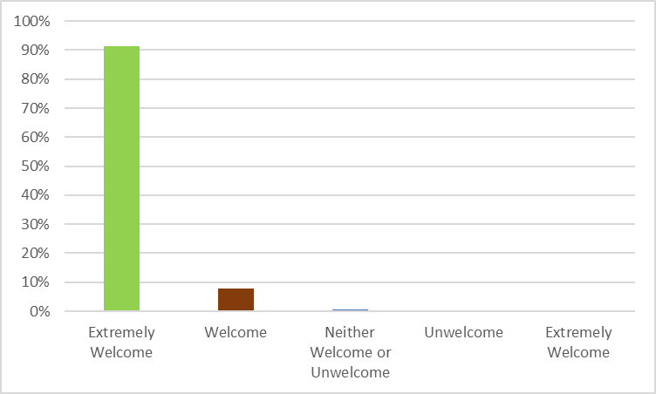
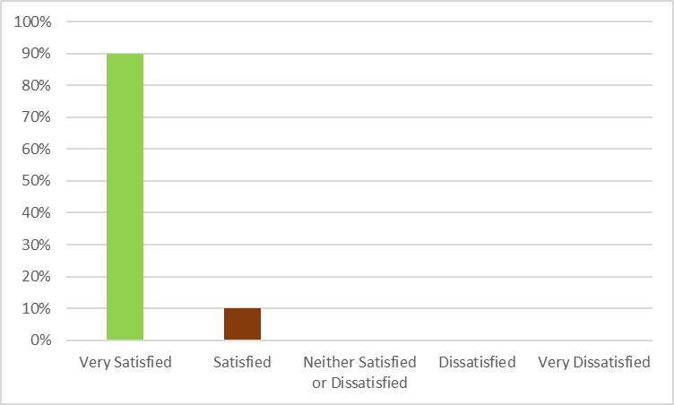
Impact on Cruise to Christchurch – Key Findings: Passenger Survey
Overall, how satisfied were you with your visit to Christchurch?
How welcome did you feel in Christchurch?

Slide 10
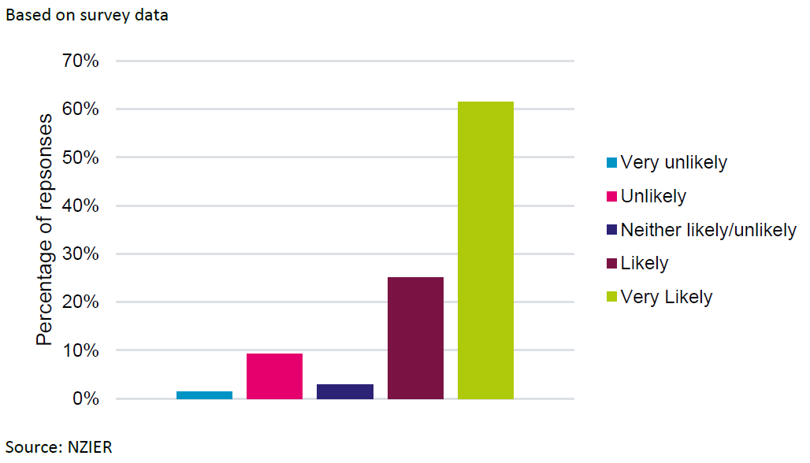
Impact on Cruise to Christchurch – Key Findings: Passenger Survey
Likelihood that cruise visitor would consider returning to Christchurch

Slide 11
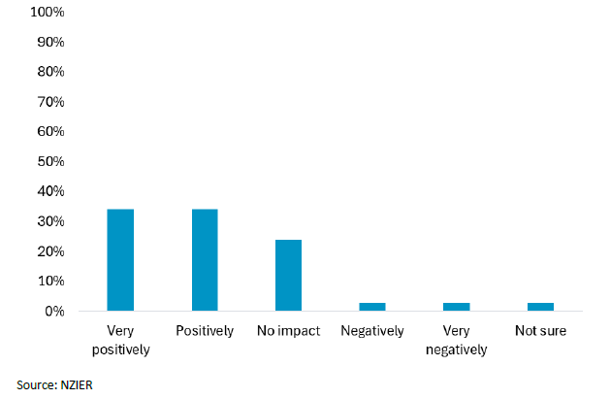
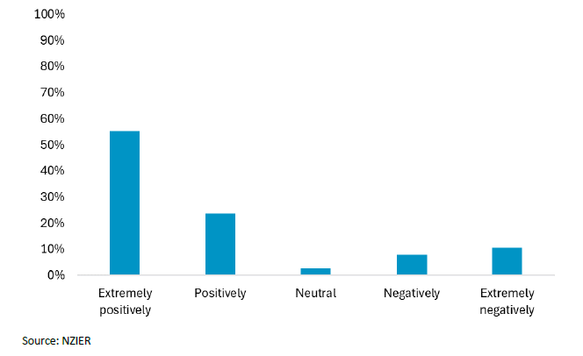
Impact on Cruise to Christchurch – Key Findings: Business Survey
Cruise tourism impact on business revenue
Cruise tourism overall impact on the local region
  18% of businesses view cruise tourism as having a negative or extremely negitive impact, with the key reasons being:
    "Crowds out local customers"
    "Damages the environment"
    "Puts pressure on local amenities

Slide 12
Impact on Cruise to Christchurch – Key Findings: Resident Survey
Overall impact of cruise tourism on residents

Slide 13
Impact on Cruise to Christchurch – Key Findings: Resident Survey
Perceived positive impacts of cruise tourism
Perceived negative impacts of cruise tourism

Slide 14
Impact on Cruise to Christchurch – Key Findings: Resident Survey
Cruise tourism puts pressure on community infrastructure and services
Planning can help mitigate the challenges tourism generates

Slide 15
Impact on Cruise to Christchurch – Key Findings: Economic Impact
  Expenditure per passenger calculated using three sources of data (CNZ survey, International Visitor Survey & Tourism Satellite Account)
  Estimated passenger expenditure in Christchurch/Canterbury: $23 - $35 million
  Direct Contribution: $5.3 million
  Indirect Contribution $0.86 million
  TOTAL Impact: $29 - $41 million p.a.

Slide 16
Is it all plain sailing ahead?
  There will always be areas outside our direct control and we need the organisations that control the levers to pull them, our job is to ensure that we are at the table to continue the dialogue
  We champion our destination but need to do more to champion our own organisation and the work
  As with everywhere, funding models are a challenge

