Slide 1
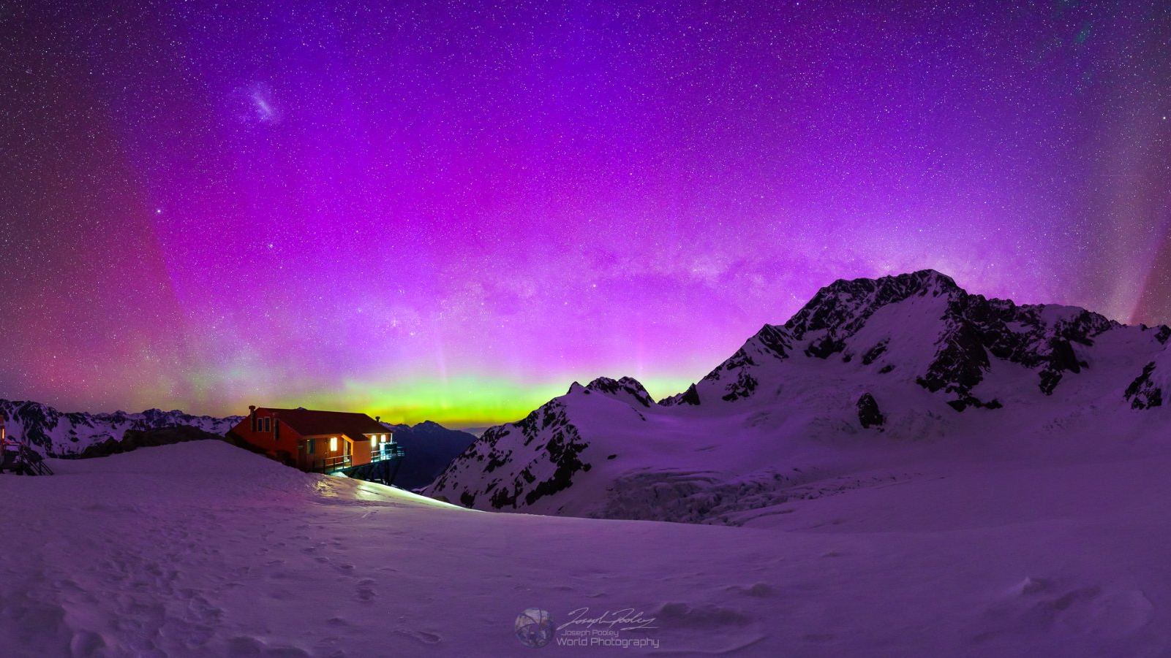
Dark Sky Tourism:
the Mackenzie story
Nā te pō, ko te ao, ko te ao mārama
From the darkest depths of the night we become enlightened
Photo: Joseph Pooley

Slide 2
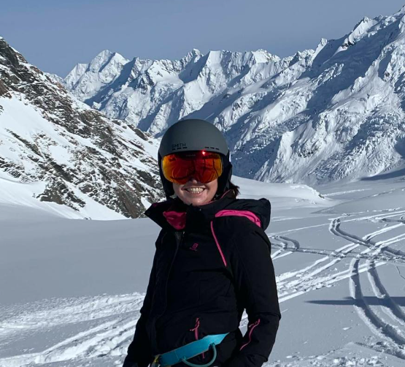
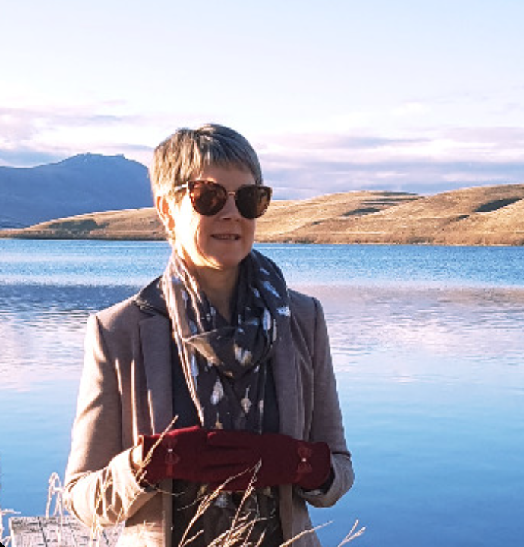
Lydia Stoddart
Mackenzie Tourism Manager
Earth & Sky / Dark Sky Project, 2018-2020
Margaret Munro
Chair, Mackenzie Tourism Industry Association
GM Earth & Sky (now Dark Sky Project), 2008-2018
Notes:
Quick introduction – introduce Margaret as having extensive background in this space in her ten years as GM of Earth & Sky. We’re both happy to answer any questions in panel discussion as well as talk to anyone who wants to have a chat during this wananga.

Slide 3
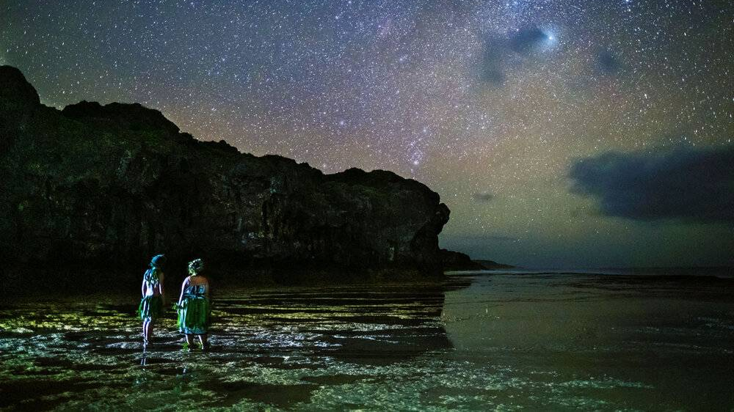
Congratulations Niue:
world’s first Dark Sky Nation
Notes:
Firstly – want to acknowledge and congratulate Niue as the world’s first dark sky nation which it achieved in 2020. There have been many discussions about NZ becoming the first dark sky nation but it’s great that that honour went to one of our Pacific friends. We also want to acknowledge that there are other regions represented in this room that have dark sky status – so plenty of knowledge in this room.

Slide 4
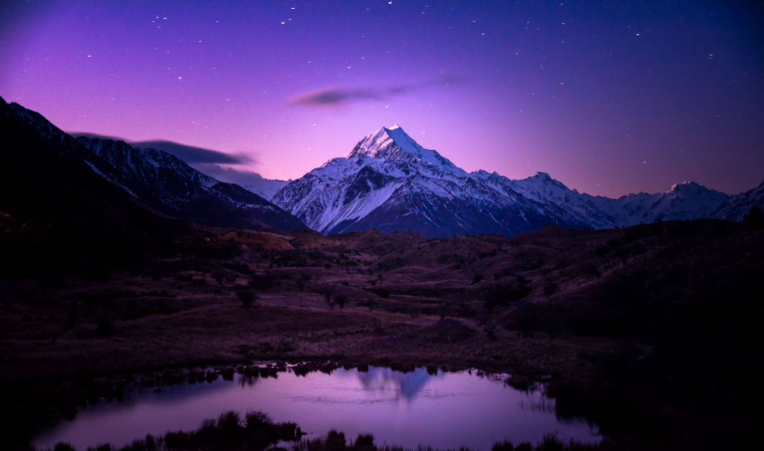
Today
Dark Sky Places
Mackenzie’s story
Factors to our success
Key learnings
Notes:
Today I’m going to very quickly take you through a bit about

Slide 5
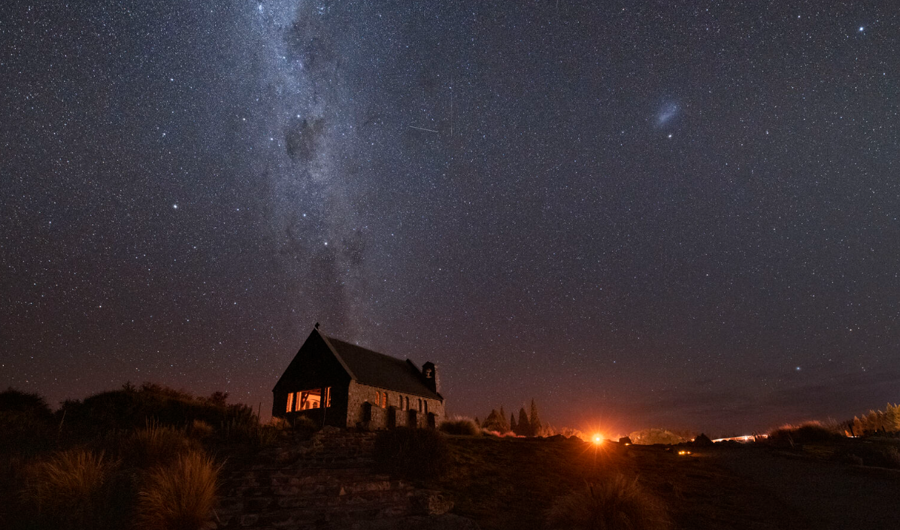
Dark Sky Place
Certification programme for areas that preserve and protect dark sites through responsible lighting policies and public education.
Types: Parks, Sanctuaries, Reserves, Urban Night Sky Places, Communities, Lodging.
Over 200 dark sky places in 22 countries since first certification in 2001. Lots more aspiring places.
Annual accreditation – ongoing reporting.

Slide 6
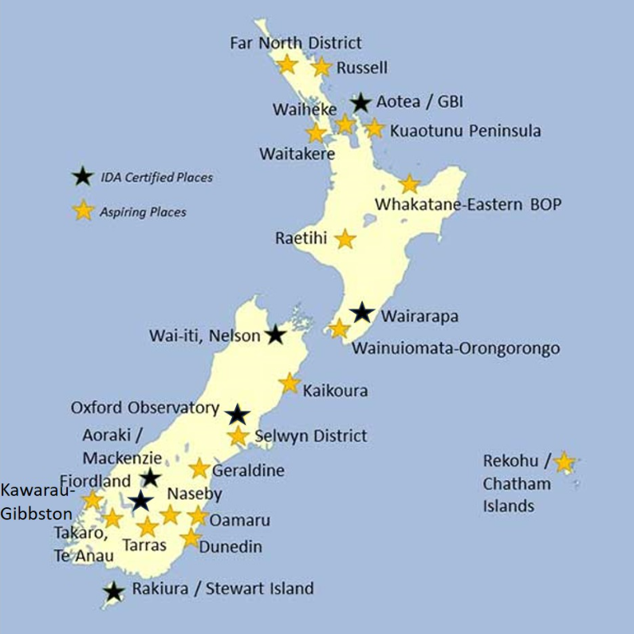
NZ Dark Sky Place
7 certified
18 aspiring (& growing)
Source: Dark Sky Network NZ

Slide 7
Dark Sky Benefits
Environmental – biodiversity
Wellbeing
Cultural
Scientific
Economic

Slide 8
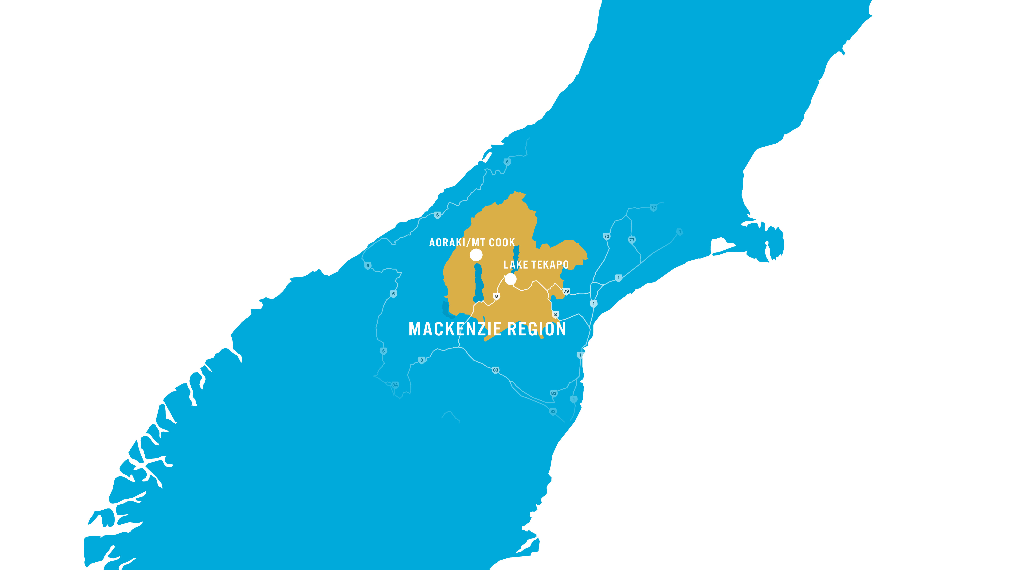
Mackenzie Region
Approx 2.5 hours on the main highway between Christchurch and Queenstown
CHRISTCHURCH
QUEENSTOWN

Slide 9
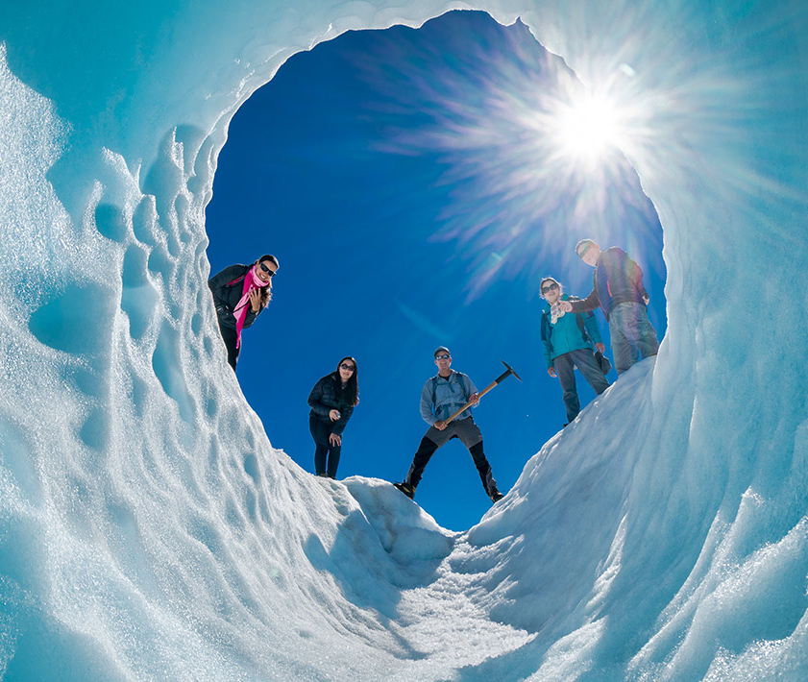
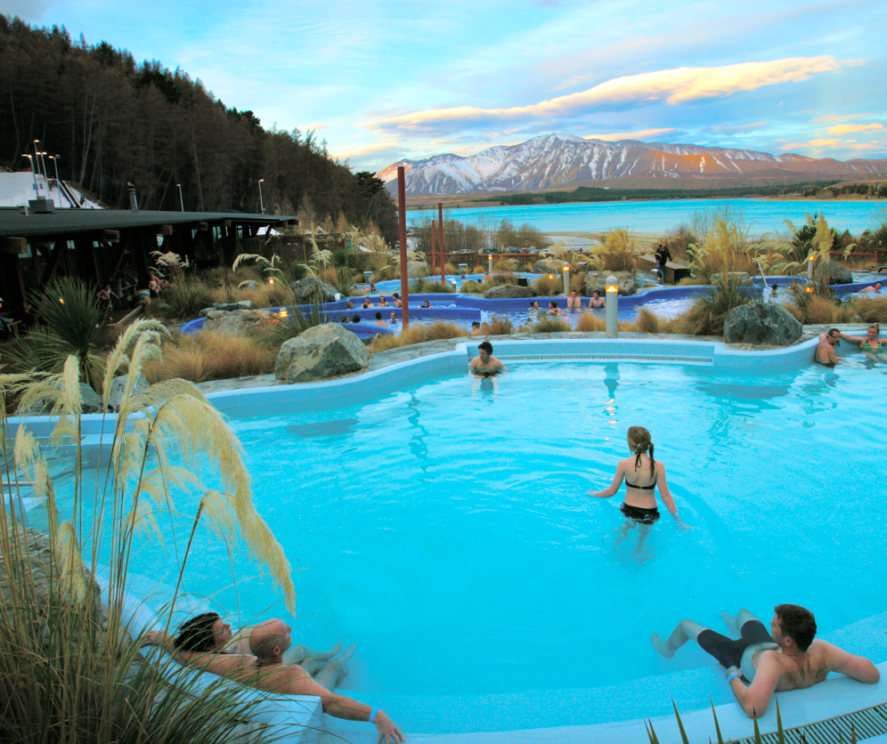
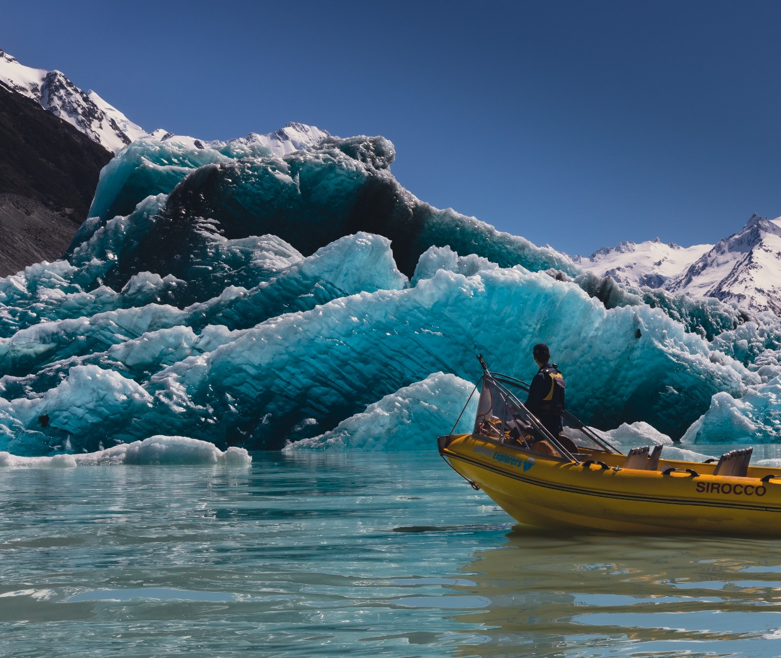
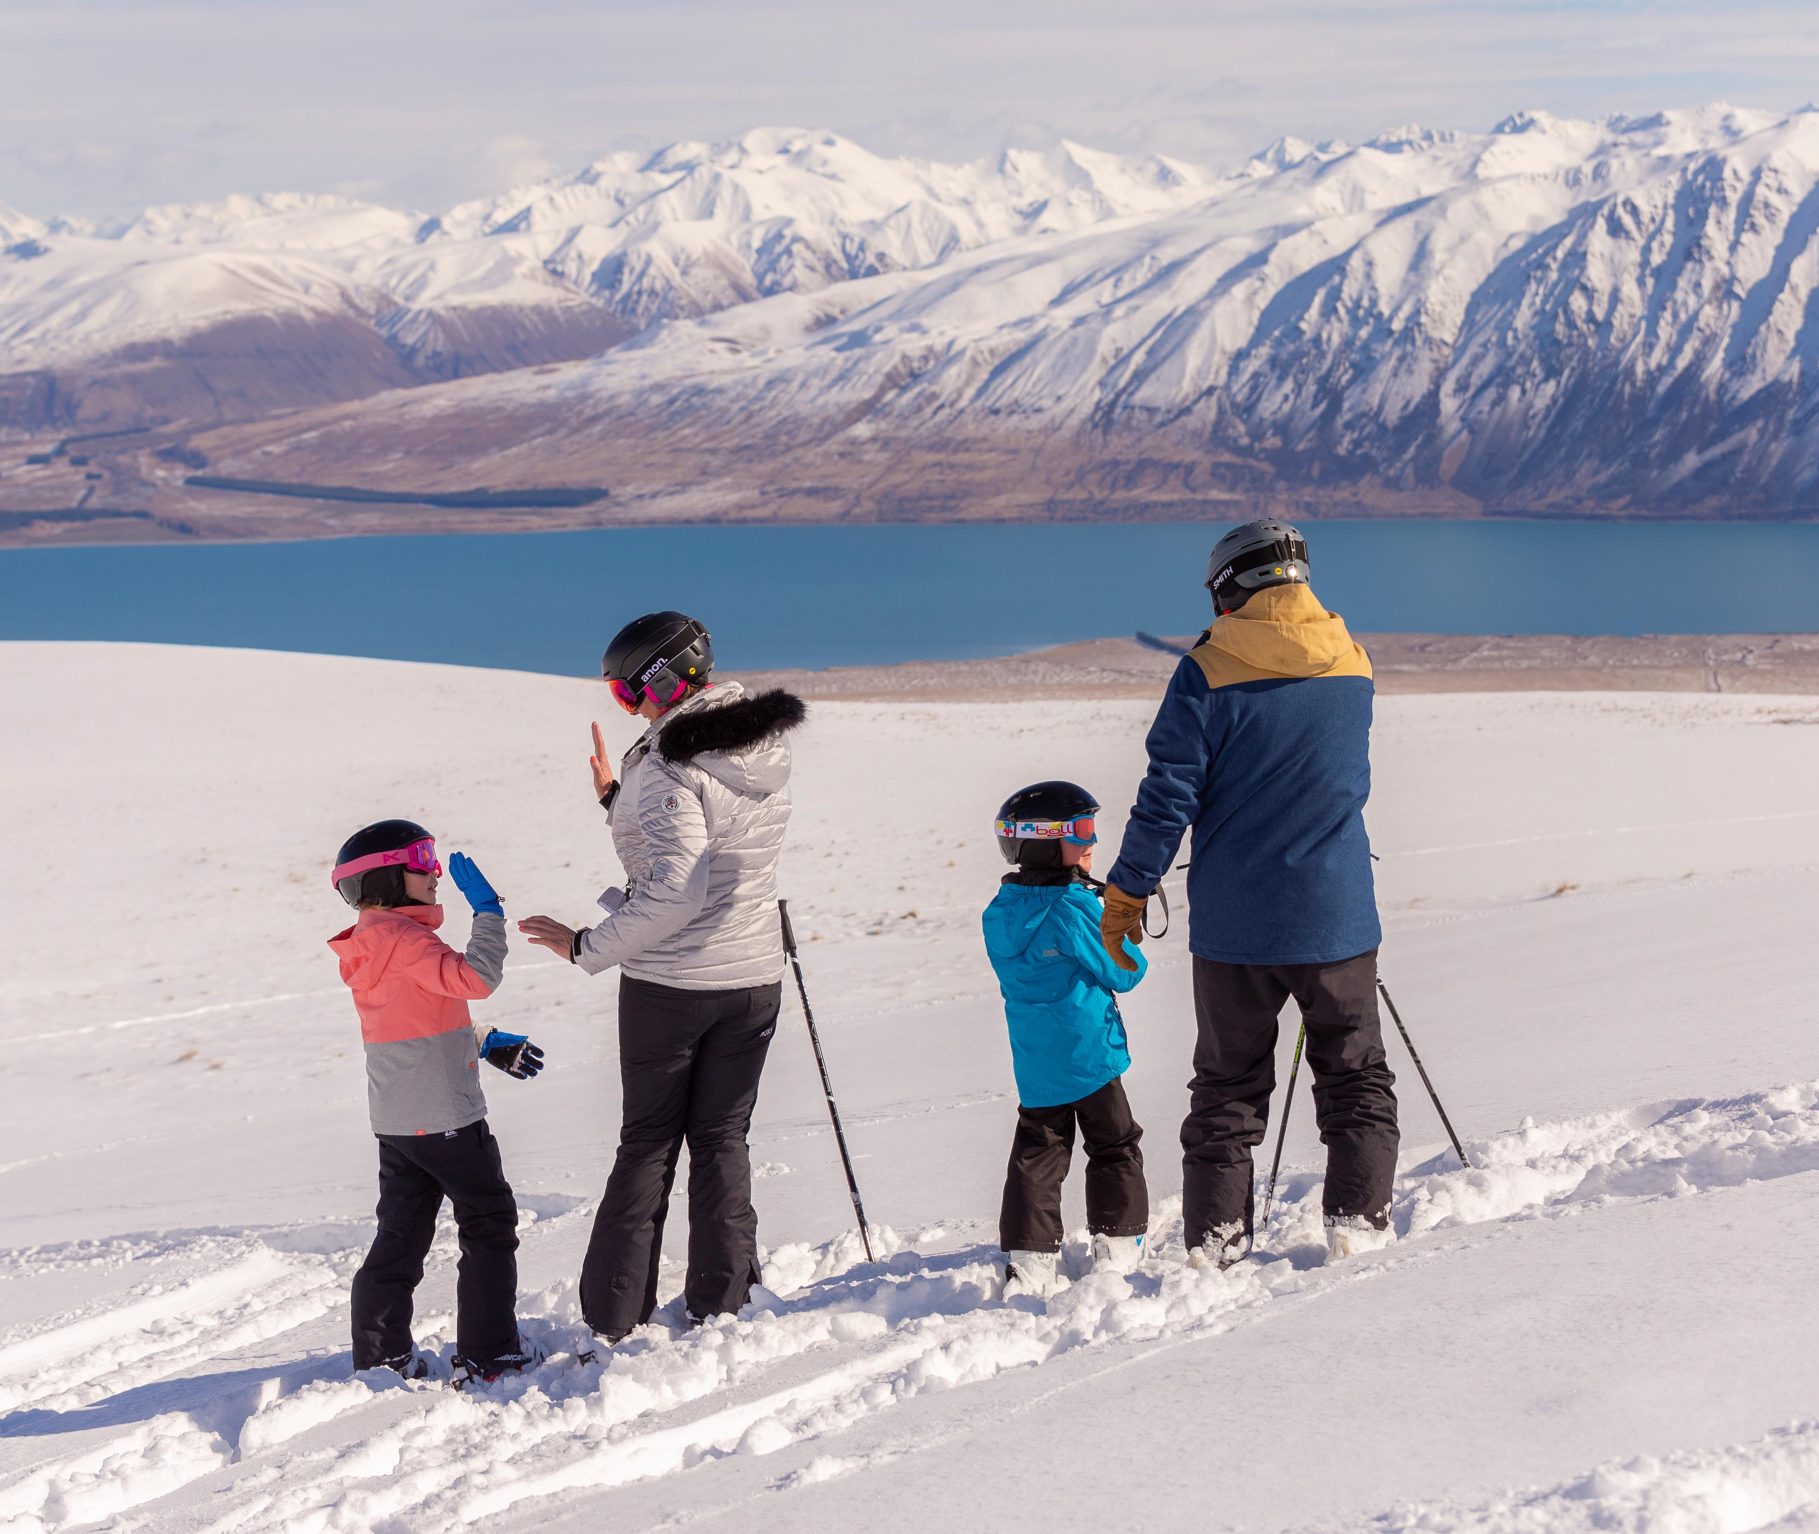
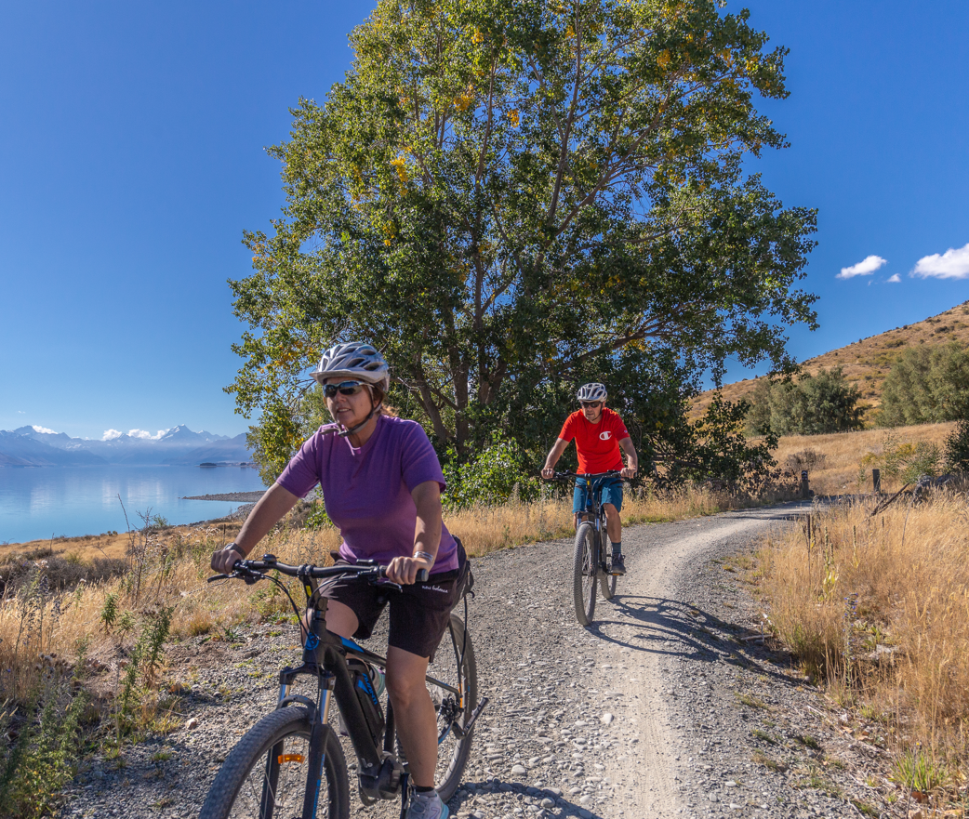
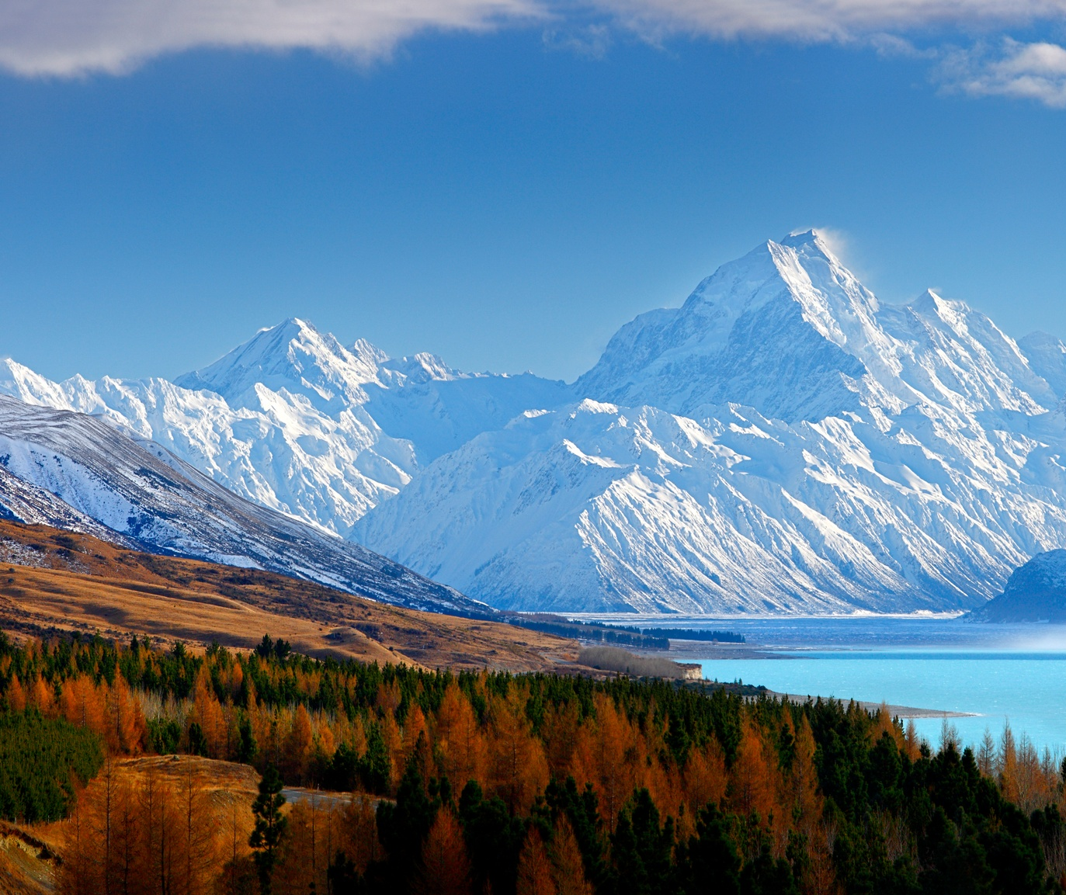
Notes:
In addition to our night skies, we are known for:
Home of Aoraki/Mount Cook – New Zealand’s highest mountain
New Zealand’s largest glacier and most diverse glaical experiences
Incredibly seasonal climate – last year we had the most sunshine hours yet we also have NZ’s coldest temperatures and snow to the ground right now
Lots of outdoor nature activities
Incredible iconic NZ scenery – the church, the lupins, the golden grasslands and turquoise lakes
Church of Good Shepherd
So what I’m trying to build a picture of is that we have a lot of international attractions without our night sky activities.

Slide 10
Mackenzie’s Dark Sky Journey
1965
1981
1991
2004
2012
2018
2024
Mt John Observatory established
District Plan changes limiting blue light emission &
requiring streetlights to be shielded, no floodlights after 11pm
First stargazing operator
(Japanese market)
Earth & Sky established (stargazing at Mt John Observatory)
Southern Hemisphere’s first Dark Sky Reserve
Awarded Dark Sky Place of the Year by IDA
At least 8 operators offering standalone stargazing product
Notes:
Not included:
Late 2000’s: exploring UNESCO status before discovering IDA
2010’s: extensive offshore marketing to grow profile of the region as a stargazing destination – particularly Asian markets

Slide 11
District Plan Changes
The original ordinance in 1981 required:
Lights must be shielded and shine only below the horizontal
Floodlights for sport or other purposes must be turned off by 11 pm
Lights must have no more than 10% of their emission in the blue
Low pressure sodium lights were favoured; fluorescent, metal halide, mercury vapour and incandescent lights were not allowed.
In 2019, all the streetlights were changed to 2200 K pc amber LEDs with low blue emission (λ < 500 nm, blue emission <15%).
Further changes in 2023 impacting outdoor lights, skylights and signage.

Slide 12
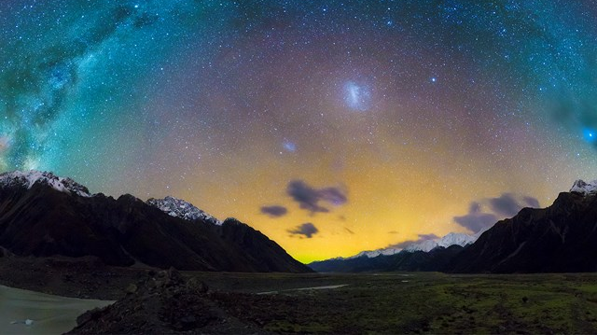
Economic Benefits
Platform to build brand
Aligns with conservation values
Increased visitation
Increased average night stays
Assists with seasonality
Employment

Slide 13
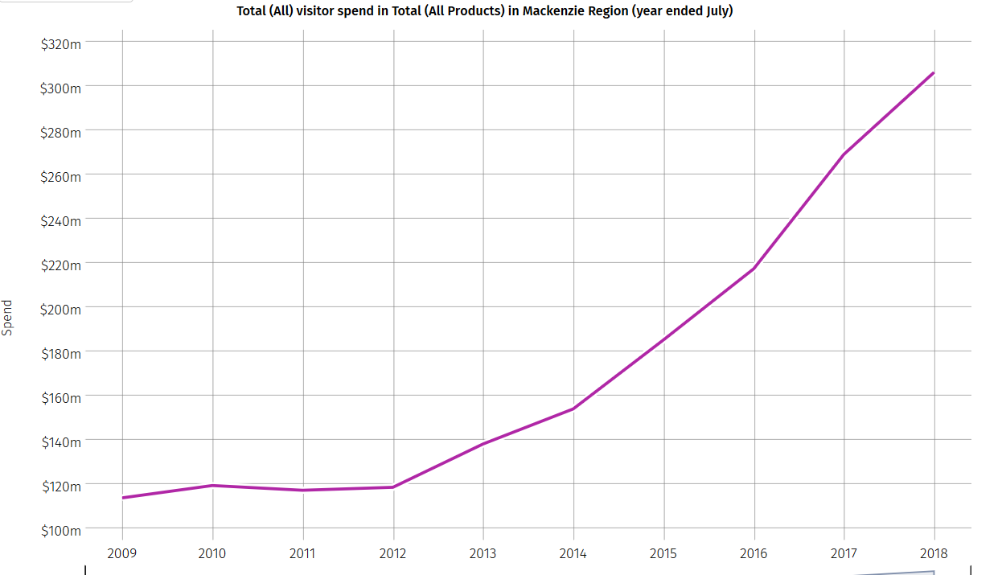
Visitor Spend
Significant investment in offshore marketing & product development
Christchurch Earthquakes
(itinerary re-routing to Tekapo)
Dark Sky status

Slide 14
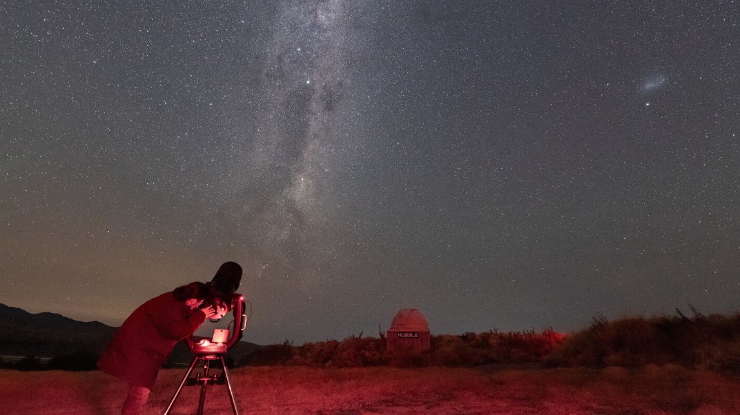
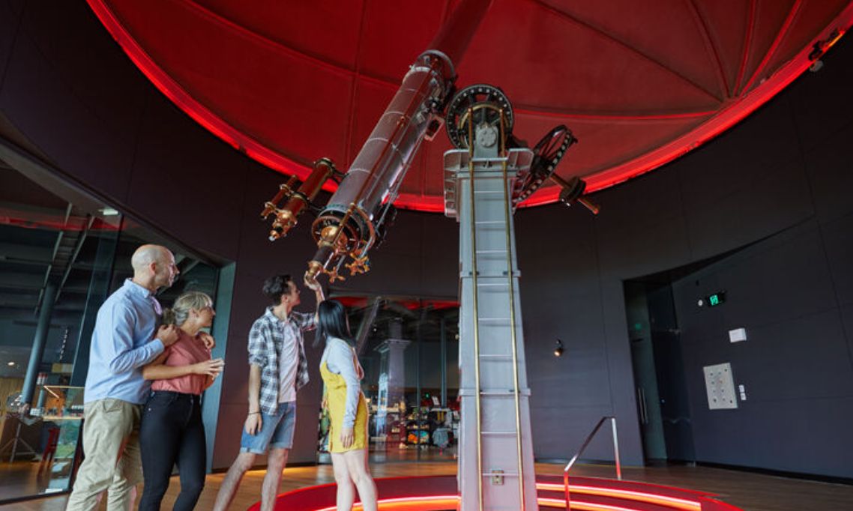
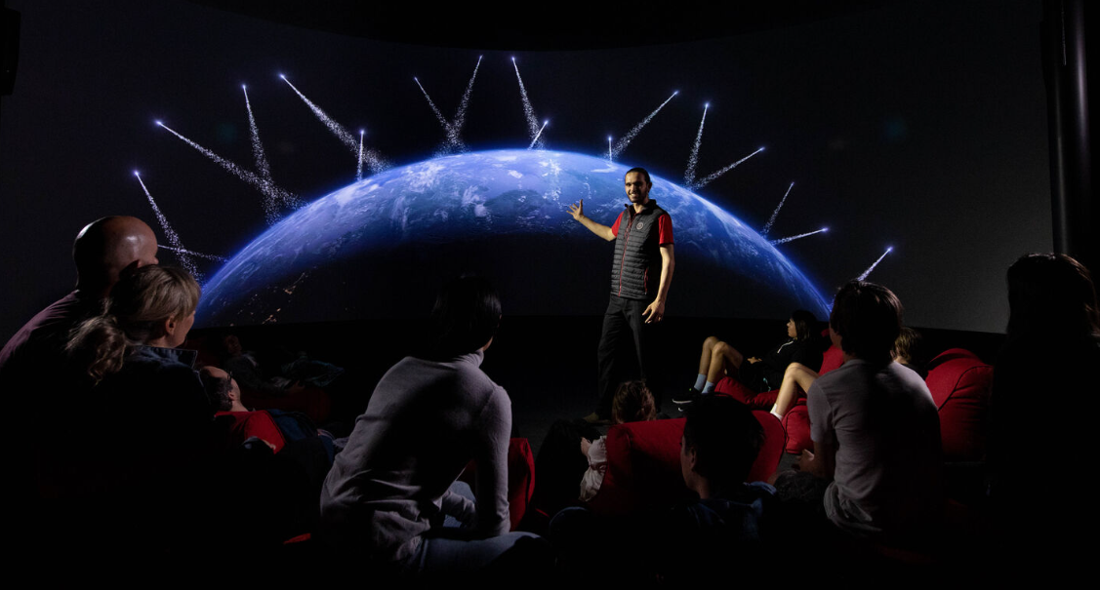
Astro Tourism Product
Notes:
Looking at the commercial product – we have 8 operators who offer standalone astro-tourism product, and quite a varied range. I won’t go into anything in great detail but just to give you a feel for what we have:
Dark Sky Project – Mt John Observatory Summit Tour, Crater tour in their own purpose-built private observatory, Dark Sky Experience

Slide 15
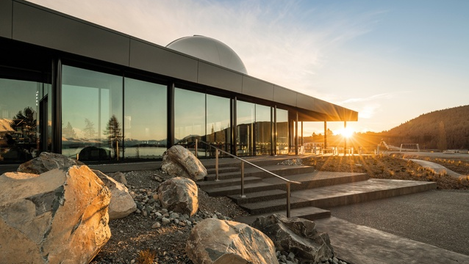

Slide 16
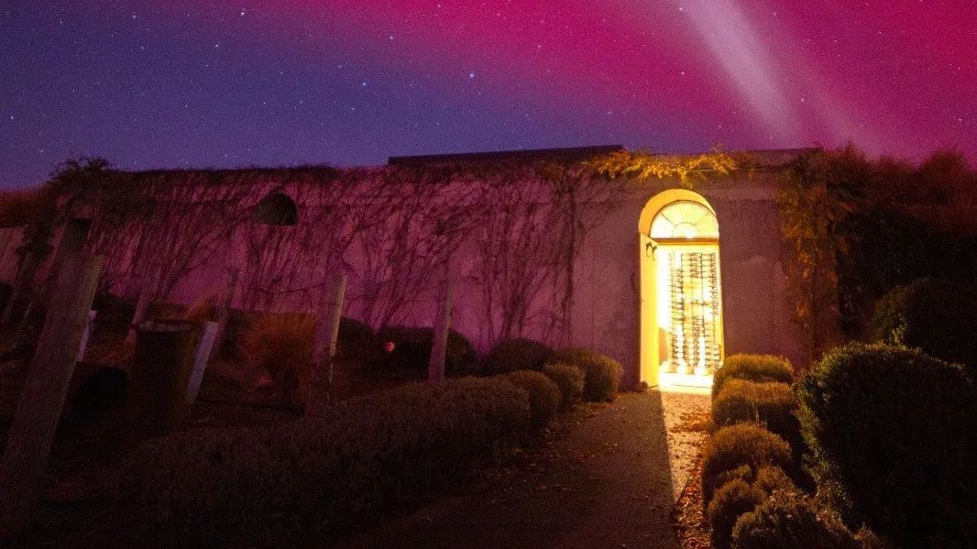
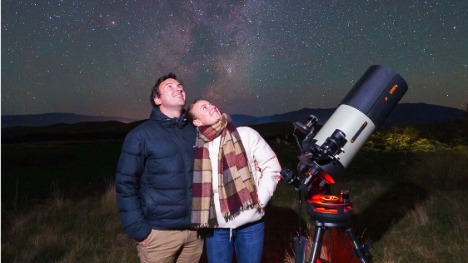
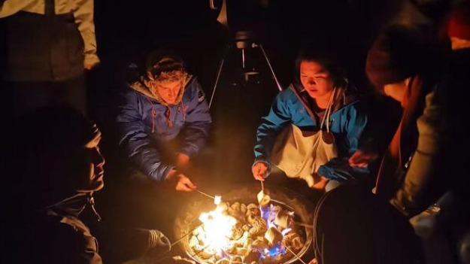

Slide 17
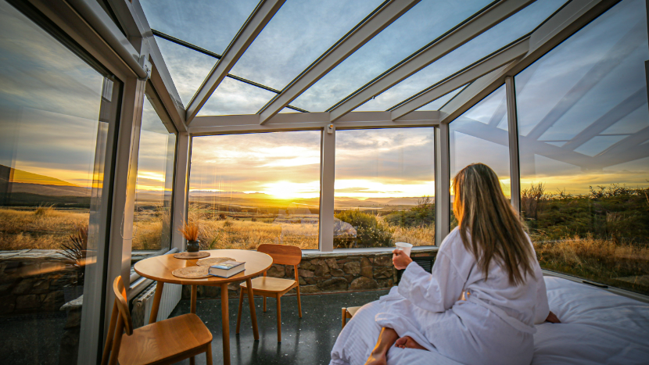
Related Product
Accommodation designed to maximise the stars
Ancillary product – e.g. add on for accommodation
Astrophotography tours and packages
Events – Matariki Mackenzie

Slide 18
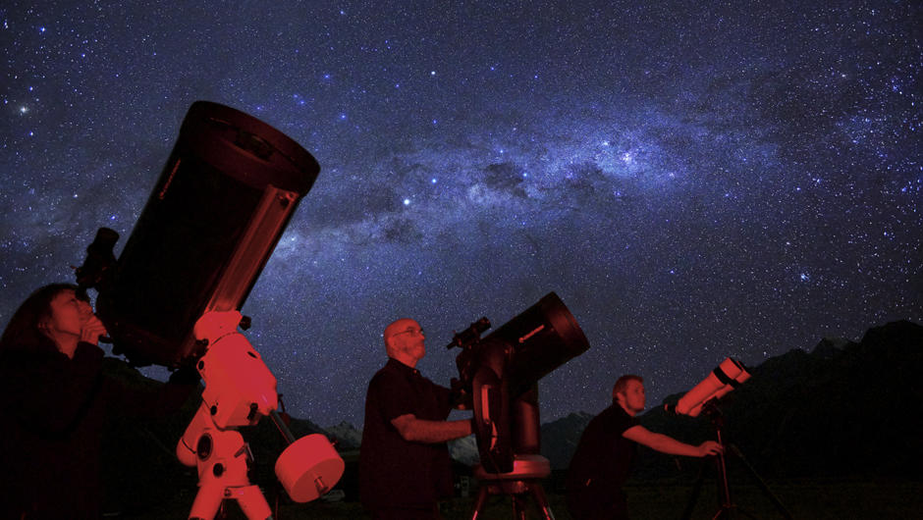
Success Factors
Dark, clear night skies (low light pollution)
Community driven – separate governance to RTO and Council
Working observatory and other existing tourism product (Aoraki/Mount Cook, glacier products etc)
Timing – Southern Hemisphere’s first, Christchurch Earthquakes
Location – between Queenstown & Christchurch
Motivated private sector - strong offshore marketing to build regional profile, investment in product and infrastructure
Access to guides - University of Canterbury relationship

Slide 19
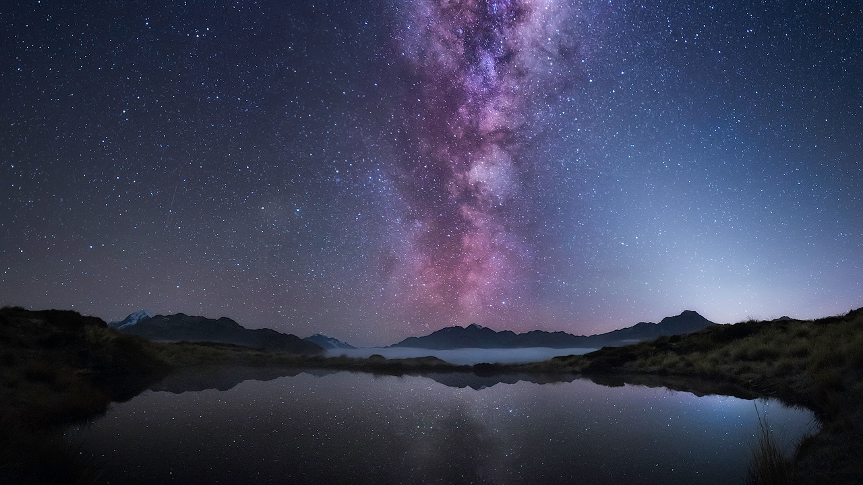
Learnings
Weather impact (60% nights operational)
Limited operational hours esp summer months. Hard to scale. Not many want 3am tours. Freezing over winter months.
Strong appeal amongst Asian markets. Growing appeal amongst Western markets.
One paid night sky experience on their NZ itinerary
Different cultures consume night skies differently
Not core motivator for travel to NZ but on bucket list (TNZ research 70% visitors want to do a stargazing experience in NZ)
Community led – separate governance to manage annual certification and monitoring
Dark Sky status alone won’t bring the numbers

Slide 20
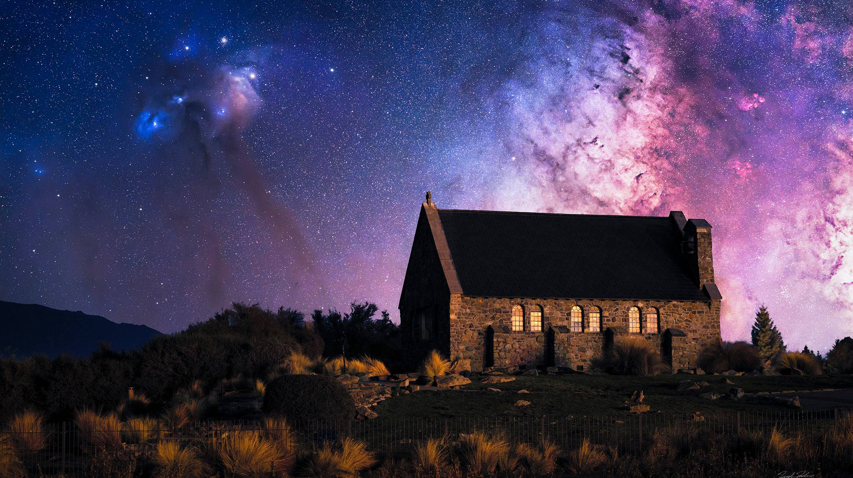
New Zealand Starlight Conference
20-23 October, Lake Tekapo
starlightconference.co.nz
Notes:
On a final note – if anyone is wanting to know more, we have the NZ Starlight Conference happening in Lake Tekapo in October. It’s a great opportunity to learn more about dark sky accreditation – you’ll have all the experts in one room

