Slide 1
Envisioning 2030
What will a decarbonised & thriving tourism economy look like in New Zealand?
Jeremy Sampson, CEO, the Travel Foundation
Picture: Timon Studler, Unsplash

Slide 2
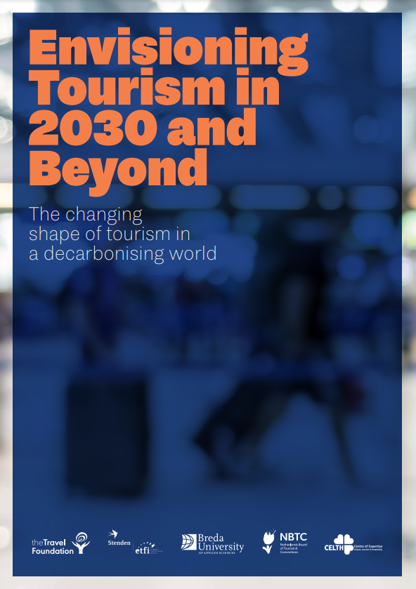
Download the full report from:
www.thetravelfoundation.org.uk/envision2030
Notes:
Invited here today to speak about the research report we published last year, in collaboration with the Centre of Expertise in Leisure, Tourism and Hospitality, Breda University of Applied Sciences, the European Tourism Futures Institute, and the Netherlands Board of Tourism and Conventions. Paul Peeters and Bernadett Papp were the principal authors.

Slide 3
oneplanetnetwork.org/glasgow-tourism-climate-declaration
Notes:
Why did we start this project? Context of Glasgow Declaration (for which we are an implementation partner for UNWTO) and Paris Agreement. Targets to halve emissions by 2030 and reach net zero by 2050 at the latest. But what does that actually look like – can we envision a decarbonised and thriving travel and tourism economy?
How the industry is responding – Glasgow Declaration

Slide 4
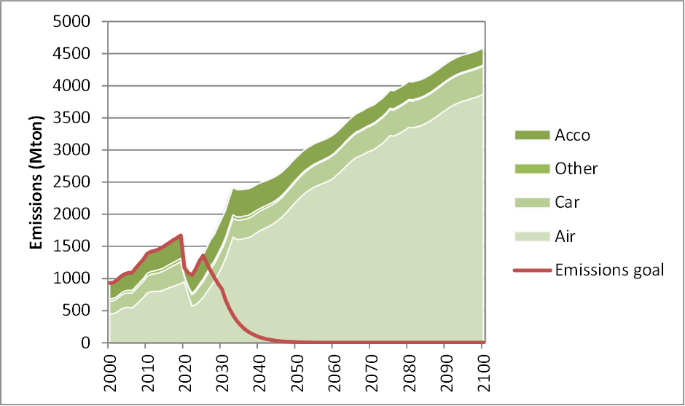
Business As Usual
Accommodation
Rail, coach, “other”
Car
Air
Emissions goal
?
Tourism is growing without consideration that emissions are growing as well.
Notes:
You can see from the model of BAU the scale of the task ahead! Emissions set to rise steeply, not fall. By 2050, tourism related emissions will increase by 73% from 2019 levels. In such a scenario, tourism will use a staggering 66% of the world’s remaining climate budget between 2023 and 2100.
Of course, this is completely incompatible with reaching 50% emission reduction by 2030 and net zero in 2050. The challenges are enormous.

Slide 5
40 different interventions
7 categories
Offsetting
Taxes and subsidies
Travel behaviour
Electrification and efficiencies
Travel speed
Infrastructure
Sustainable Aviation Fuels (SAF)
Notes:
Our approach
Within the model, there are 40 different interventions you can “dial up” or “dial down” based around 6 categories:
Carbon offsetting
Electrification and efficiencies
Infrastructure
Sustainable aviation fuel
Taxes and subsidies
Travel behaviour
We sought scenarios which could retain the anticipated future growth in revenue and trips while still meeting decarbonisation targets. The reason for seeking to retain growth in trips was because this is forecast to happen (to double by 2050) based on factors such as population growth and increase in income/affordability of travel - particularly outside western economies. Of course it would be possible to cut emissions by cutting travel, but this would require some Covid-like measures that curtail freedoms. Whilst this should not be out of the question, we were looking for scenarios that avoid this and support travel and tourism – and in particular the destinations which rely on tourism.

Slide 6
The single decarbonisation scenario
Notes:
Our aim was to identify a few different scenarios for net zero pathways. However we soon realised every aspect of travel would have to throw all it has got behind climate action without delay to make a dent in emissions. And so we found just one scenario. Inaction means our options have narrowed and we must now do “everything, everywhere all at once” as UN secretary general António Guterres put it.
By combining all of the measures and adding a policy of reducing the rate of growth of aviation, keeping total distance travelled by air to about 2019 levels, we did get close to net zero by 2050 (while still not reaching 50% reduction by 2030 – we get there in Spring 2036 – dotted red line in the graph. The fact that we cannot hit the 2030 target demonstrates the urgency of the task ahead and the problems created by not acting soon enough.

Slide 7
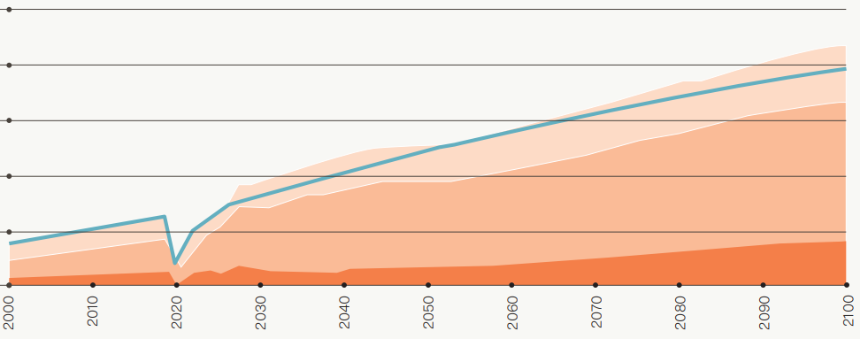
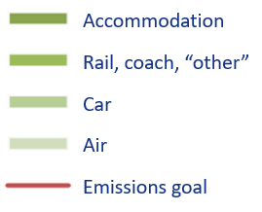
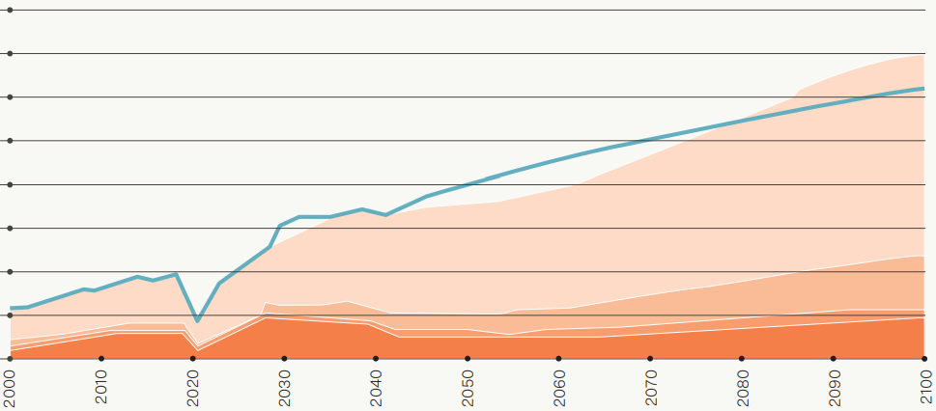
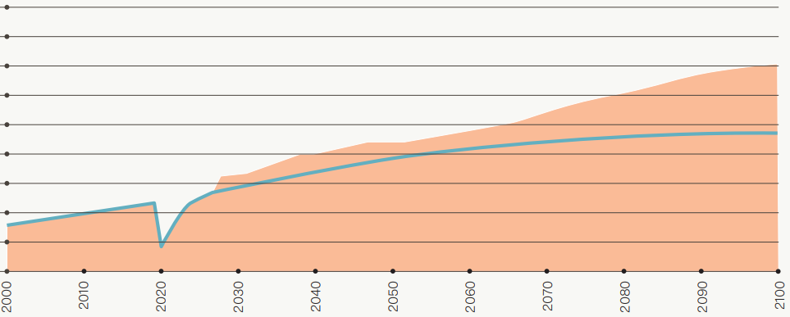
The good news
Emissions (mtons)
Trips
Revenue
Guest nights
Notes:
But there is good news. We find it is possible for the world to travel, and tourism to thrive in 2050 a net-zero world. In our decarbonisation scenario:
Overall number of trips increases in line with BAU scenario.
Total revenue also increased in line with the BAU scenario.
Overall guest nights increase at a greater rate than BAU.
Overall distance travelled grows but at half the rate of the BAU scenario.

Slide 8
How did we achieve net zero?
Notes:
Put simply, we must only grow the areas of tourism that are most ready to decarbonise, and stop growing those that are hardest to decarbonise, if we are to have any chance of reaching net zero by 2050. Electrification coupled with 100% renewable energy will be the route to net zero for most accommodation and transportation modalities over the coming decades.
Of course, that is a huge task ahead, but with the right policies and investments, it can happen. The difficulty comes with aviation.

Slide 9
Aviation is particularly polluting
Trips Emissions
Trips Emissions
23% of trips but 55% of ALL tourism emissions
1.9% of trips but 19% of ALL tourism emissions
Longest haul the most polluting
Notes:
Aviation is particularly polluting: So we know that flying was responsible for 55% of all tourism’s emissions in 2019 - but was only 23% of all trips taken. And long haul flights are particularly polluting. Longest distance trips (over 16,000kms return trip, equivalent to flying from Auckland to Singapore- or further - and back), were responsible for 19% of all tourism’s global carbon emission, yet accounted for just 1.9% of all trips. So clearly, any plan for decarbonising travel and tourism needs to grasp this nettle.

Slide 10
Electrification
Notes:
Aviation is also a “hard to abate” activity: Decarbonisation won’t be easy for anyone, but at least road and rail transport providers, ferry and hotel companies understand they can decarbonise through electrification and investment in renewable energy – solutions that are readily available. Unfortunately we are many decades off from having global fleets of electric planes, especially for long haul trips.

Slide 11
Offsetting
Notes:
Worth just flagging this point. The term used in this conference is “Climate Neutral”. This term is often used by organisations that rely on offsetting to make green claims while still polluting the atmosphere with CO2. We’ve seen how such terms and similar greenwashing claims have been challenged recently – KLM “Fly Responsibly” lawsuit, and Intrepid Travel which is a leader in sustainability had to retract advertising which claimed its tours were planet friendly.
Net zero basically means zero, or as close to that as humanly possible. Simply relying of offsets is hugely problematic and at worst (and increasingly more likely) a diversion of investment from longer term emission reduction strategies that keep the fossil fuels in the ground. We don’t use offsetting in our scenario.

Slide 12
It’s not easy to fly green
In 2019 the total amount of SAF produced globally would only be enough to power commercial aviation for less than 9 hours
(0.1% of fuel was SAF)
Notes:
An alternative to electrification of aviation – and one already in use - is to use so-called sustainable aviation fuels (SAF) which can be used with existing fleets. But in 2019 the amount of SAF produced globally was only 0.1% of the 300 million tons of jet fuel used in commercial aviation. As Delta airlines puts it: "Sustainable aviation fuel (SAF) is the most promising lever known today to accelerate progress toward a net zero future... Unfortunately, there isn’t enough SAF today to fuel the world’s commercial airlines for even a single day.” Increasing biofuels is problematic, as there are limitations around land use and availability of organic waste. So in our model we use synthetic e-fuels – the main limitation here will be availability of the renewable energy needed to create sustainable synthetic kerosene, particularly in a decarbonising world where demand for renewable energy will increase across all industries.
As the distance travelled by air (and fuel demand) is set to triple by 2050 under BAU, there is no possibility of covering this with 100% sustainable aviation fuel. It was only by capping the distance travelled by air to something close to 2019 levels that this could be achieved - to allow time for SAF to catch up.

Slide 13
If this is how much dirty jet fuel we are set to burn between now and 2050 under BAU…
(1 tanker = 1,000 billion gallons)
This is how much
dirty jet fuel we can actually
burn to stay within 1.5°C
And this is how much
synthetic efuel (SAF)
we could produce,
with significant investment
Notes:
Keeping to the orange and green tankers means no growth in aviation. – it would cover us if we stick to current levels.

Slide 14
An Evolved Paradigm
Huge investments are not just an expense – they deliver ROI
Travel and tourism thrives when it grows without polluting.
We discover new adventures closer to home, and we only fly sometimes
We spend more time and money deep diving into destinations
Multi-modal, multi-stop travel is easy, fun,and even luxurious…!
NEW!
products
markets
places
solutions
Notes:
We can continue to travel – and fly - and continue to see the world without killing it. In fact, in terms of distance travelled, around 90% of trips from the BAU scenario are unchanged.
Increased cost of flying – but alternatives will be available and cheaper (e.g. high speed trains).
New destinations created and discovered. We challenge the current perception that further-flung trips are of greater value. Frequent fliers are no longer incentivized/glamorized
Less short hops, more longer, slower holidays and vacations. (We have a lot more flexible working practices so we can go slower and go away for longer.)
Each long haul journey is a genuine “trip of a lifetime” and maximised – seeing more, staying longer.
It’s easy to book end-to-end travel with multiple stops and modes of transport – with new partnerships created and digital innovation making this possible.
investment required is no more than 2-3% of overall T&T revenue across the same period (and that investment is likely to yield good returns for the investors).

Slide 15
So, what’s the catch?
Political will
Industry commitment
Huge investments
Notes:
Right now you are probably wondering – what’s the catch? And indeed there are many. We cannot say this scenario is likely – only possible. We need political will, industry commitment and huge investments, starting immediately, to have any chance of making this scenario a reality.
We do know that, if we do not achieve this Tourism Decarbonisation Scenario, the alternatives are much worse. It will mean either more draconian restrictions on global travel and mobility, or missing science-based international targets and exceeding 1.5 degrees warming, with all that this implies for the world and our industry – reputationally and operationally – and the destinations and communities it relies on.

Slide 16
Global growth
Green growth
Sustainable growth
Better Growth?
Degrowth
Notes:
Growth in global tourism is practically inevitable, but growth in emissions can’t be.
At about the same time as we published our report WTTC published their Global Travel & Tourism Climate Footprint data. They lauded what they described as a “decoupling” of emissions from growth, because emissions grew at a slower rate (2.4% pa) than economic growth (4.3% pa) between 2010 and 2019. But there’s no getting away from the fact that this is an increase in emissions every year when we need emissions to be falling. If we can’t grow tourism without growing emissions, then we should really question whether growth is what we need.
https://wttc.org/news-article/wttc-unveils-industry-leading-and-ground-breaking-global-travel-and-tourism-sustainability-data-291122

Slide 17
The world will decarbonise with
or without you
Notes:
The world will decarbonise with or without you - tourism will need to fit into that world. Some examples of emerging policies:

Slide 18
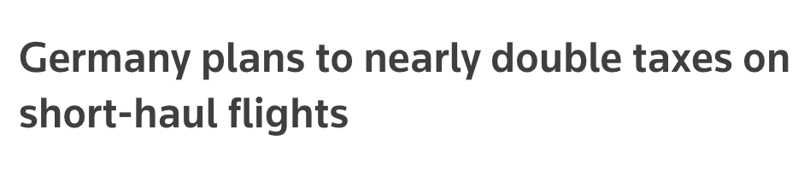
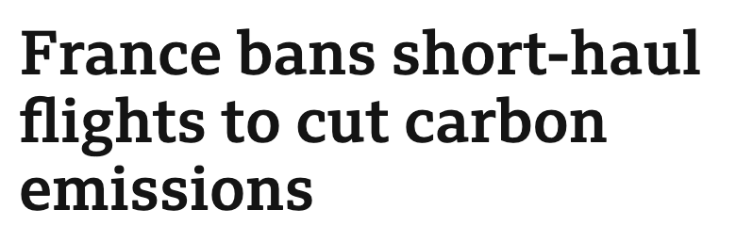
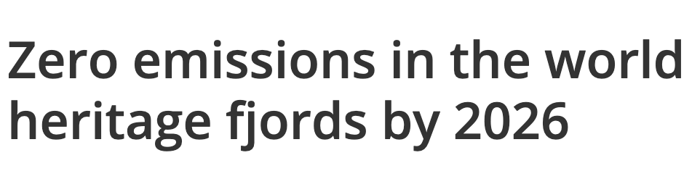
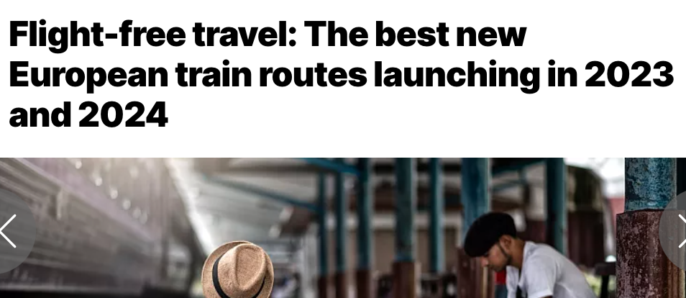
Emerging Policies (Europe)
Notes:
The French government recently banned short-haul flights on routes where other, less polluting alternatives are available. Austria has introduced similar policies, eliminating domestic flights where alternative travel options (under 3 hours) are available. Spain and Germany are considering taking similar steps.
Germany has doubled taxes on tickets for short-haul flights, and in 2021 a government-industry agreement was made to ramp-up Power-to-Liquid e-fuel. Creating enough to power the equivalent of 1/3 of domestic flights by 2030.
In June 2022, the Dutch government became the first in the world to announce a reduced cap on airport capacity for environmental reasons.
Several new routes have been launched for night-train journeys in Europe.
By 2026, western Norway’s fjords will only allow zero-emission electric ferries, cruise ships, and tourist boats.

Slide 19
Let’s get real
Earth doesn’t care about emissions intensity, “decoupling” and whether it’s in your scope 1, 2 or 3. It only cares that emissions are going up.
Will Aotearoa NZ Tourism emissions go up?
Time for leadership.

Slide 20
(at least) 89% of emissions come from transport
Is it sensible to grow long haul further?
Not accounting for aviation’s emissions in tourism strategies sounds like greenwash…
Notes:
Stats NZ calculates that transport emissions represented 89% of tourism’s emissions in 2019, and 60% of total emissions came from “air and space” transport. However, this figure does not include international aviation, except via New Zealand operators, and aviation emissions from international tourism will therefore be significantly underrepresented.
So not accounting for aviation’s emissions in tourism’s targets and actions would be greenwash, no?
We understand that by December 2024 the Climate Change Commission will recommend whether emissions from international shipping and aviation should be included in Aotearoa New Zealand’s 2050 carbon targets. We hope the CCC will choose to recommend this, but regardless, it is vital that tourism takes leadership and responsibility for all its emissions, and with international travel such a significant part of this, its omission would be negligent.
How connected are your plans to a sustainable aviation roadmap?
And do you believe that roadmap credible?
Is it sensible to grow long haul further or even continue to rely heavily on long haul markets?
Long haul the most polluting and least likely to become “green” in the coming decades.
Promoting to markets such as North America, Europe, China, Japan could soon become a legal issue.
Undermines resilience, as regulation and prices are set to soar – e.g. SAF, frequent flyer levy.
Becomes increasingly unpalatable, as travel to and between wealthier continues to impact on low-income countries.

Slide 21
Proposal for international rail route development…
Notes:
Ok, so we have an issue here.
As a relatively remote island nation, New Zealand does not have the option to invest in easier-to-decarbonise international transport options (in particular, international rail and road transport). Therefore it might be argued that other countries should be required to decarbonise international transport at a faster rate than New Zealand. However, island destinations with less developed visitor economies and a desire to grow might use a similar argument against New Zealand! Such a discussion on what is fair, and how we plan to decarbonise international Travel & Tourism country by country, is not currently happening on the global stage. And, ultimately, everyone must reduce emissions as quickly as possible.
So what can be done?

Slide 22
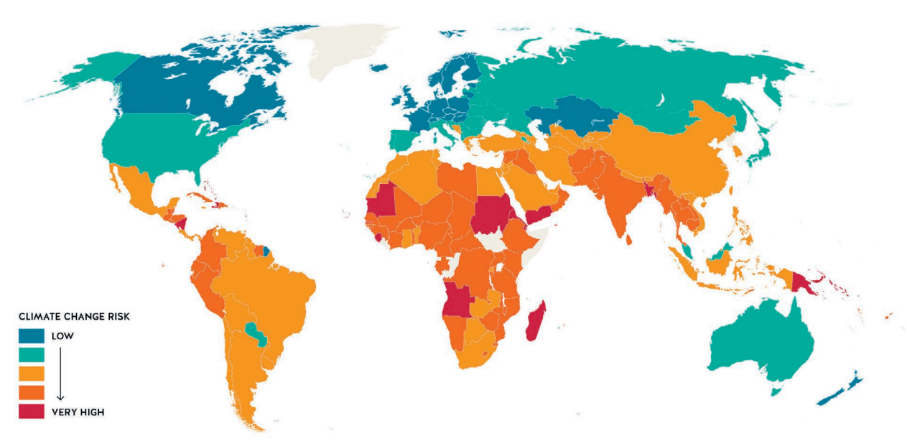
Global climate risk for tourism
(Global South)
Source: Scott/Gossling (2018)
Notes:
However, island destinations with less developed visitor economies and a desire to grow might use a similar argument against New Zealand! Such a discussion on what is fair, and how we plan to decarbonise international Travel & Tourism country by country, is not currently happening on the global stage. And, ultimately, everyone must reduce emissions as quickly as possible.
This map shows the tourism destinations that are most at risk from climate change (based on indicators linked to tourism assets, operating costs, market demand, capacity to adapt). The division is striking.
Small Island Nations are particularly vulnerable and also economically dependent on tourism. Pacific islands such as Vanuatu, Fiji and Kiribatu are on the most at-risk list. I’ll come back to climate justice shortly…

Slide 23
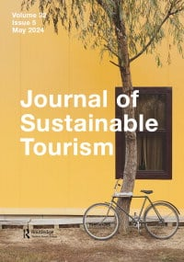
Doing all we can?
“
”
We identify two key initiatives on which DMOs can have the most influence, yet they are rarely considered: optimizing the marketing mix for low-emission groups and setting a growth threshold.
Notes:
Guix, M., Babakhani, N., & Sun, Y. Y. (2024). Doing all we can? Destination management organizations’ net-zero pledges and their decarbonization plans. Journal of Sustainable Tourism, 1–21. https://doi.org/10.1080/09669582.2024.2357377

Slide 24
Optimizing value per tonne of CO₂
Not all spend is equal:
Which spend supports small businesses/equity and inclusion/the local economy (vs leakage)?
Which spend supports the most jobs?
Which spending is most reliable/resilient to shock?
Which spending is distributed well across time and place?
What is the cost behind the spend?
Domestic: $26.9bn
International: $10.8bn
Notes:
International tourism is about 29% of all tourism value in New Zealand. (www.tia.org.nz/the-industry/quick-facts-and-figures)
For each kg of CO2 emitted, how much did NZ earn from international visitors vs domestic? We know it will be considerably higher for domestic.
Need to start factoring in costs to understand true value – as is happening elsewhere.
Norway has analysed the carbon intensity of its tourism sector, and found that business travel was the most carbon intensive segment, producing 44.3 t CO2 per million Norwegian Krone (NOK) revenue, two times higher than both domestic and international leisure tourism
Furthermore, one study of US visitors to Barcelona found US visitors spend 70% more than Europeans, but they have a bigger carbon footprint. They would need to spend 3x as much to match the average "income-to-carbon" ratio, or stay an extra 3 weeks to have the same daily footprint as Europeans. Of course duration of stay is a significant factor which affects overall carbon intensity of a market segment – the longer a visitor stays in a destination, the lower their “per day” average emissions.

Slide 25
Why we need caution with “value”
High spenders
Ignores net value
Value = ?$?
X-Y=Z
And rather than focusing on “quality” tourists, how about focusing on quality tourISM?
Notes:
Want to focus specifically on this idea of focusing too narrowly on value. why is it problematic?
conflation with high spending individuals – visions of 5*, yachts, golf…
need to see the whole picture (net-value) including costs.
“value” can come from more than spend, and is subjective.
While a visitor impact analysis should be encouraged, we caution against overly focusing on quality tourists, and instead recommend a focus on quality tourism. “By default”, some types of tourism product and experience will bring more of the desired value to New Zealand than others, regardless of visitor origin, attitude, intention or knowledge. This may be, for example, through the way that hotels procure their goods and services, or how well-developed the infrastructure is for visitors.

Slide 26
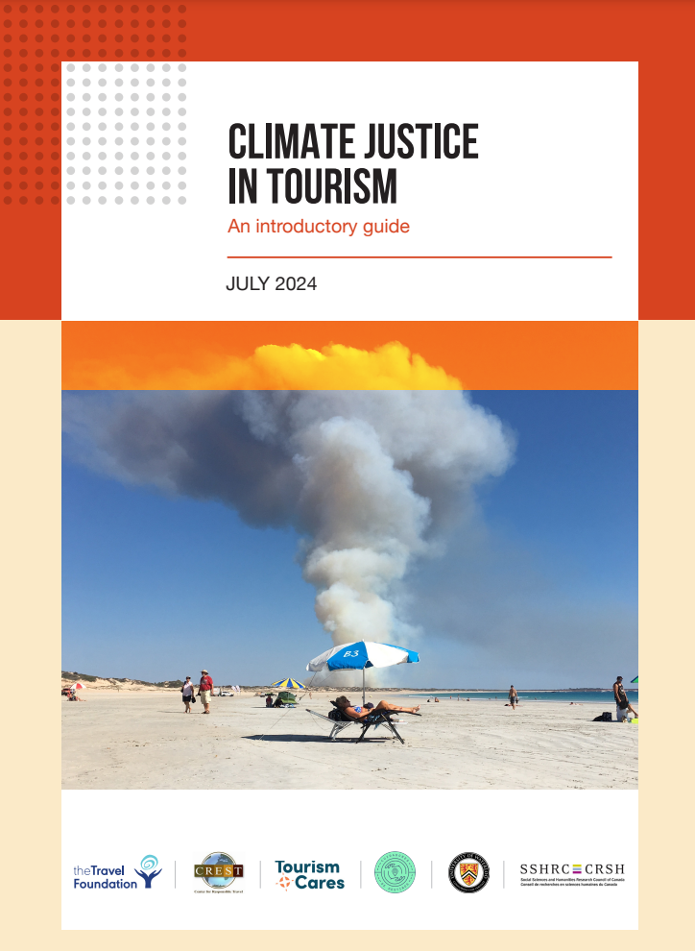
Doing all we can? Climate justice
Unequal (unfair):
Emissions Climate impacts Resources
Tourism operations can further exacerbate risk and undermine resilience:
\
Risk/costs of extreme weather disruption
Pushing climate action down the supply chain
Prioritising visitor needs over locals
Disinvesting in “at-risk” businesses & destinations
Notes:
In the last few days we have published our latest report with the University of Waterloo and other NGO partners whose logos you can see on the report cover here, to begin an overdue conversation about climate justice in tourism.
So we’ve already described how the world is unequal (and unfair) when it comes to:
tourism emissions
impacts from climate change
capacity or resources to adapt and decarbonize
Added to this, tourism operations can further exacerbate problems:
Heightens risks/costs for tourism-dependent communities with increased disruption & uncertainty.
Further undermines destination resilience if visitor needs (e.g. food, water) are prioritized over local.
global companies can push climate action demands down the supply chain – to local businesses without sufficient capacity.
Some businesses and some destinations might be abandoned by investors if considered at risk from climate change, affecting local livelihoods.
So how should the tourism industry respond?

Slide 27
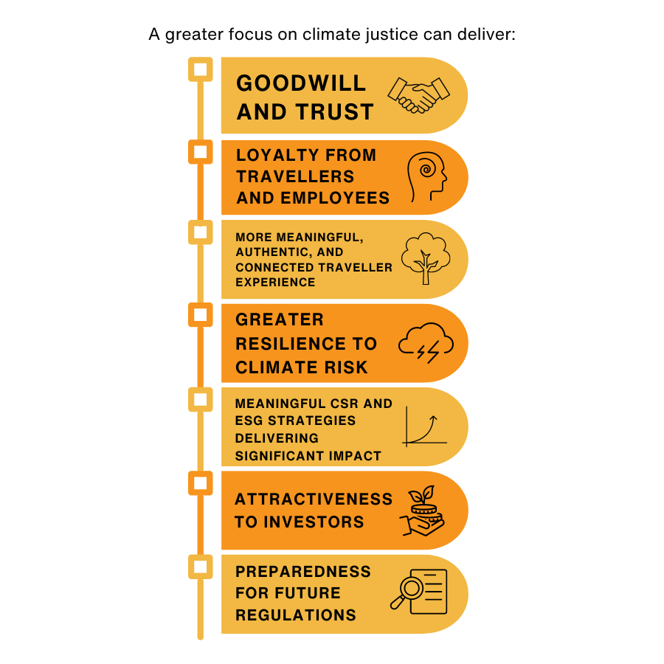
Business reasons to use a climate justice lens
=
managing risk and building resilience in the supply chain and product
Climate
Action
Plan
Notes:
A greater focus on climate justice can deliver a whole range of business benefits, including managing risk, strengthening supply chains and enhancing reputation.
While more travel companies are significantly increasing investment in climate action, our report finds that published plans show little evidence of action to address climate risks, either to businesses or the communities where they operate, nor are they taking account of the perspectives of those communities. Yet businesses working with their suppliers and the wider community in vulnerable destinations are likely to emerge stronger, with resilient supply chains and enhanced reputations.
Our report sets out how businesses can take a climate lens to their climate action efforts – working with communities to respond better to the challenges of decarbonisation and adaptation, so that no destinations are left behind.

Slide 28
Risk assessments and scenario planning
Funding mechanisms
Destination-based collaborative pilots
Fair regulation and incentives
Partnerships with DMOs and NTAs
Tourism first responders
Collaboration to support shared suppliers
Fair emissions allocation
Destination resilience index
Framework for investment and resilience
Climate justice needs… collaboration
10 ideas…
Notes:
The report concludes with 10 ideas “that could be rapidly brought to life” to scale collaborative action for climate justice in tourism. For example:
A new global climate fund to direct for travel and tourism to support green transitions and resilience-building in vulnerable destinations.
Pilot projects focused on key destinations and their critical climate-related issues, such as heat stress, water security, or catalysing a green energy transition.
Mobilising the travel industry as a first responder in times of crisis, supporting humanitarian agencies and local leaders by repurposing hotels, kitchens, resources and logistical expertise.

Slide 29
Unprecedented Collaborations
Break traditional formats and siloes
Address tension between growth targets and climate goals
Focus on solutions that cross borders and boundaries
Notes:
Collaborations that break traditional formats don’t look at climate separate from marketing, cross border, thinking as a living system, thinking out of the tourism system.
Through collaboration, leadership and action, each one of you can have an impact not just on your organisation, but on this industry that must adapt to the realities we face. We are currently building partnerships with tech innovators, behaviour change specialists, capacity building specialists, tour operators, destination authorities and others to bring about action at scale.
For instance, we are working with we are working with several tour operators to align their Environment, Social and Governance ESG reporting, to reduce the burden and maximise the usefulness for everyone involved but particularly the supply chain which is everyone’s business. And we are working with the Organisation of Eastern Caribbean States (OECS) to help define the role of destination managers in adapting to mitigate climate change risk and impacts.
Glasgow Dec.

Slide 30
Lighthouse Example
VisitScotland & The Travel Corporation:
The road to net-zero in tourism
Notes:
As a lighthouse example: The Travel Corporation and Visit Scotland have both committed to achieve net zero emissions as soon as possible before 2050. With support from The Travel Foundation, they joined forces in 2022 to explore public and private collaboration towards operationalising low, or zero carbon travel and tourism products and services. They are now collaborating in identifying ways to decarbonize existing travel itineraries, explore what policies, investments and infrastructure and other enablers are needed to develop new low or zero emissions itineraries and bring these to market. They will use the collaboration as a way of demonstrating global leadership to inspire net zero transformation of tourism more broadly, in Scotland and beyond.

Slide 31
Five Potential Milestones
Global emissions accounting levels the playing field
Net zero experiences and itineraries become the norm
Unprecedented collaborations deliver on-the-ground action at scale.
Tourism unites to bolster the most vulnerable destinations
Reducing absolute emissions is an integral part of every business
Notes:
Ask for this to be kept on screen for the panel debate?

Slide 32
Right-sized solutions
Systems
E.g. Global climate fund,
Emissions policies
E.g. Climate Action Planning
Data on footprint of tourism types
Global
Local
E.g. Collaborations for investing in low carbon supply chains
Travel tech platforms
E.g. Capacity building for SMEs
Climate change risk awareness
Behaviours

Slide 34
Thank you!
jeremy.sampson@thetravelfoundation.org.uk
Notes:
https://unsplash.com/s/photos/Rosewill-Valley-Road%2C-Rosewill%2C-New-Zealand

