Slide 1
Responsible Tourism Programme
Northland Inc
Te Ūnga Mai presentation – August 2024

Slide 2
The Challenge
Shift in the industry towards more sustainable and regenerative practices
Changing traveller expectations and values
Community sentiment changes towards environmental impact of Tourism
Development of the Taitokerau Northland Destination Management Plan
Budget!
In a vast region – how do we reach everyone?
Notes:
- Pre-pandemic there was a shift underway within the Tourism Industry towards more sustainable and regenerative practises
To keep the industry progressing and readying for the return of visitors, central government provided a directive for tourism to move to a regenerative model where tourism provides better value for communities that it operates in. (in Northland we have seen this particular pressure around the cruise industry in the BOI)
Further pressure to limit the tourism industry’s environmental impacts and reduce their carbon footprint, while also adapting to climate change is seen through changing consumer behaviour:
As the Taitokerau Northland Destination Management Plan was developed, the need to assist operators to build capability, learn sustainability principles and embed practises into their businesses became increasingly apparent.

Slide 3
The Outcomes
Educating Taitokerau Northland’s visitor industry
Four well-beings framework
Ensuring a Te Ao Māori world view was reflected throughout the programme
Destination management ethos supported and adopted through the journey
Create action and change for the industry
Provide Leadership
Notes:
With many sustainability frameworks available, the programme was intentionally designed to align with Northland Inc and local government strategies, focussing on the four well-beings of environmental, cultural, social and economic. Workshops were run across these themes, while also providing attendees with practical tools and resources to help along the journey, with key goals of driving action and change on climate-related issues.
Included in the design of the programme were several outcomes that Northland Inc aspired to achieve as a result. These included:
Educating Taitokerau Northland’s visitor industry
Ensuring a Te Ao Māori world view was reflected throughout the programme
Destination management ethos supported and adopted through the journey
Create action and change for the industry
Provide Leadership
Northland Inc also took inspiration for the programme from other initiatives active in the country, such as the WellingtonNZ Sustainable Tourism Programme and the Bay of Plenty Green Room.
Adopting innovation and creativity, and working with experts in their fields, a low-cost, high-impact programme was designed and delivered by Northland Inc.

Slide 4
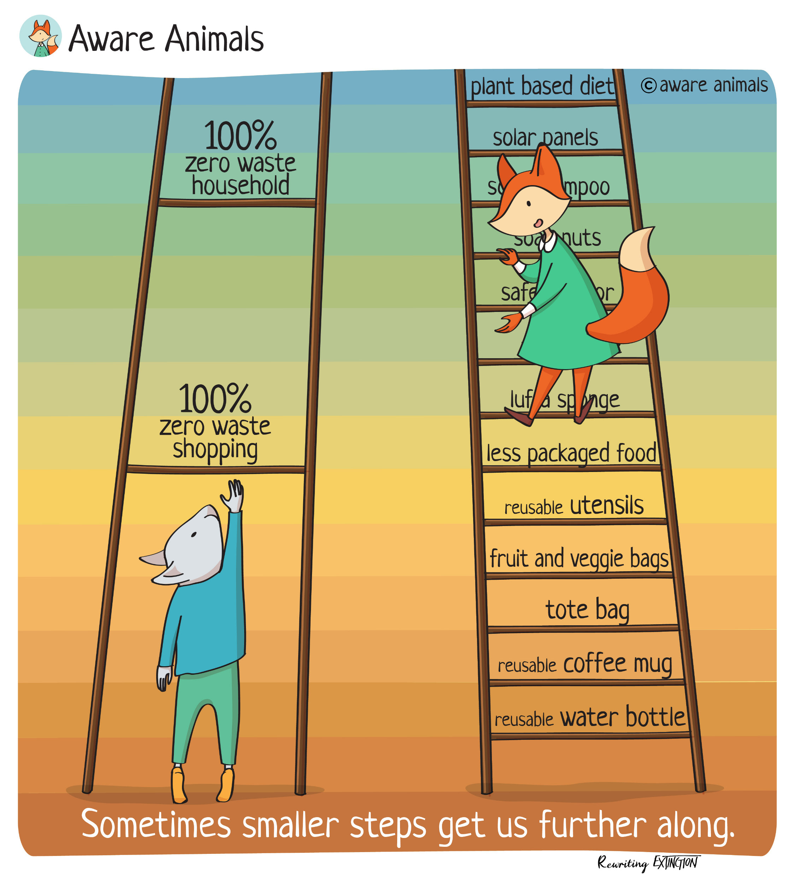
The Programme
Low-cost, high-impact model
One to many style workshops with local experts
Range of online and in-person events
Responsible Tourism Hub built with links to all resources and additional learning material
Started in May 2022 with an ‘Introduction to sustainability’
Notes:
such as the WellingtonNZ Sustainable Tourism Programme and the Bay of Plenty Green Room.
Adopting innovation and creativity, and working with experts in their fields, a low-cost, high-impact programme was designed and delivered by Northland Inc.
The Responsible Tourism Programme was delivered in a workshop format to ensure that it could reach as much of the visitor industry as possible. This format also supported the desire to create a community of like-minded operators on the same journey that could support each other, share ideas, and collaborate on solutions.
Started with environmental well-being as most well recognised
During the first 12 months of the programme the following workshops were delivered:

Slide 5
The Topics
Waste management
Predator Free 2050
Role of people
Pricing and packaging
Supply chain and procurement
Regenerative Storytelling
Understanding Destination Management
Tiaki Promise
Accessible and inclusive tourism
Qualmark
Notes:
We have worked with a range of stakeholders to help us deliver these works
Also want to point out that our event partners have jumped on board as well – this spread above was put on by Waitangi treaty grounds for our Supply chain and procurement workshop, where they used as much local produce as possible

Slide 6
The Highlights
10 workshops across 2 years
188 participants in the programme
90% of participants have implemented positive change
25% of businesses have implemented new waste management processes
Almost 30% have committed to a new environmental cause
Created a community for idea sharing
Finalist in the Economic Development NZ Best Practice Awards 2023 for Inclusive Development and Wellbeing Outcomes
Notes:
Introduce the video rather than go through all the points in the highlights slide
Topline results of the initiative to date
During the programme, 136 individuals engaged with at least one of the workshops. Following the final workshop in June, these attendees were asked for their feedback on the programme, providing details on their impressions of the programme and what actions they have now implemented into their business. These included:
25% of businesses have implemented new waste management processes.
Almost 30% of attendees have committed to an environmental cause (such as PF2050 work) or working directly with a local community group on environmental issues.
Only 10% of businesses who attended are yet to make action.
“I really enjoyed and gained a lot from this workshop” Moana Cross, Operations Manager Parahirahi Ngawha Waiariki Springs
At the recent Holiday Parks New Zealand Awards, Ngapae Holiday Park, who attended multiple workshops, have been recognised and commended for their sustainability effort, announced as runner up in the TIA Sustainable Innovation Award - Holiday Park Awards 2023 - Holiday Parks New Zealand
A key component to the Responsible Tourism Programme has been building a community of like-minded tourism operators who are keen to collaborate collectively to move forward in their sustainability journey, as well as share their learnings with one another.
One example of this has been the ‘pre-recycling’ concept used by The Rock BOI adventure cruise (Precycling on The Rock – BOI adventure cruise). This was shared in the first workshop in May 2022, and has now been adopted by several other operators in the programme.
The programme has also built a good foundation of knowledge on the topic for Taitokerau tourism operators to continue their individual sustainability journeys.

Slide 7
Notes:
https://youtu.be/I1HpCwITsM8?si=-n-SeQVQhCToRHCx

Slide 8
The Learnings
The power of connection and collaboration
Be prepared to adapt
Start with a baseline measurement
Small steps add up to big gains
Walking the talk
Notes:
We had envisioned a cohort of businesses that would continue through the programme together, however what we saw is that industry engaged with workshops that were relevant to them and were connected on common ground on particular comments
At the end of the first 12 month we did survey the businesses to get feedback on the programme going forward and adapted to this feedback
Although we got some lovely stats from the feedback on businesses taking action following the workshops and we have a little detail on what type of action, we didn’t capture a starting point to truly measure what we were looking to achieved through this programme which was mainly around lowering carbon emissions - doing this again I would start with capturing this measurement which we could then use throughout the programme to capture its effectiveness more accurately
Important to recognise that any step forward no matter how small is a step forward and try to break this down a little more for participants – I think we went a little too big on some of our workshop topics
Need to ensure that our own actions of the RTO are reflective of what we are trying to achieve through the programme (how do we lead this internally – align priorities of wider EDA & RTO)

Slide 9
What’s next?
Combining Responsible Tourism with marketing
Changing the way we talk about climate change and the impact this has on businesses
Opportunity to capture our collective carbon footprint as an industry
Leaning into National programmes
Notes:
We have started this year strong presenting 3 workshops with just over 50 attendees, in these times industry are focused on driving demand how do we integrate responsible tourism within this
We also need to look at how we talk about climate change shifting from customer wants focus (think about all the Expedia data, booking.com reports etc.) and move towards how this is benefiting businesses directly i.e. it makes financial ‘cents’ (better for the bottom line) to save money on power, cut down expenses on petrol and waste etc. through efficiencies mixing the environmental with economic wellbeing
Due to this we are looking at ways that we can work with businesses on an individual basis to capture data and work to improve their businesses
We also realise that there has been a few more national programmes roll out since we started this journey that are looking to build capability in the same way, so without duplicating our efforts we need to ensure that this going forward to relevant to Taitokerau

Slide 10
Ngā mihi nui
Amy Simpkin
Destination Management Lead
Amy.Simpkin@northlandnz.com
www.northlandnz.com

