Slide 1
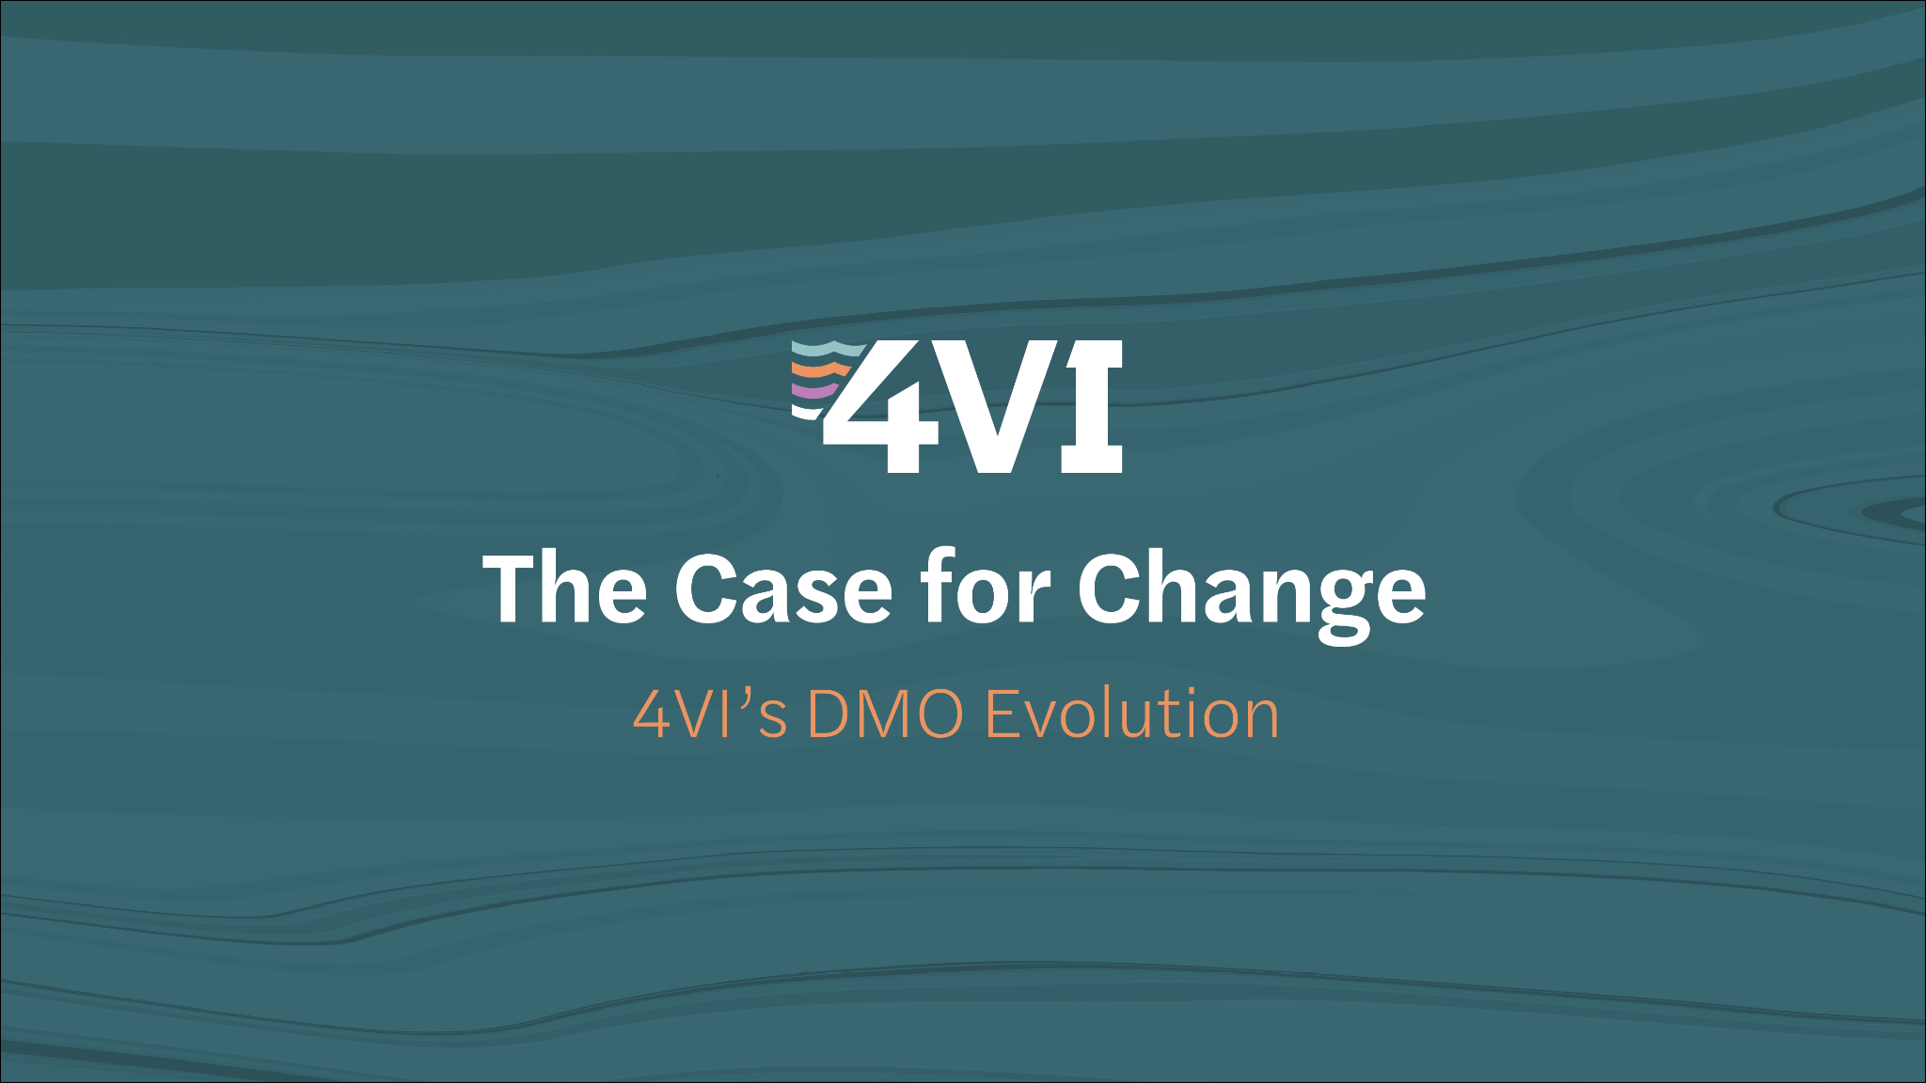

Slide 2
Notes:
Territory acknowledgement - acknowledgement of where I come from (1 min)
Add 4VI’s new statement

Slide 3
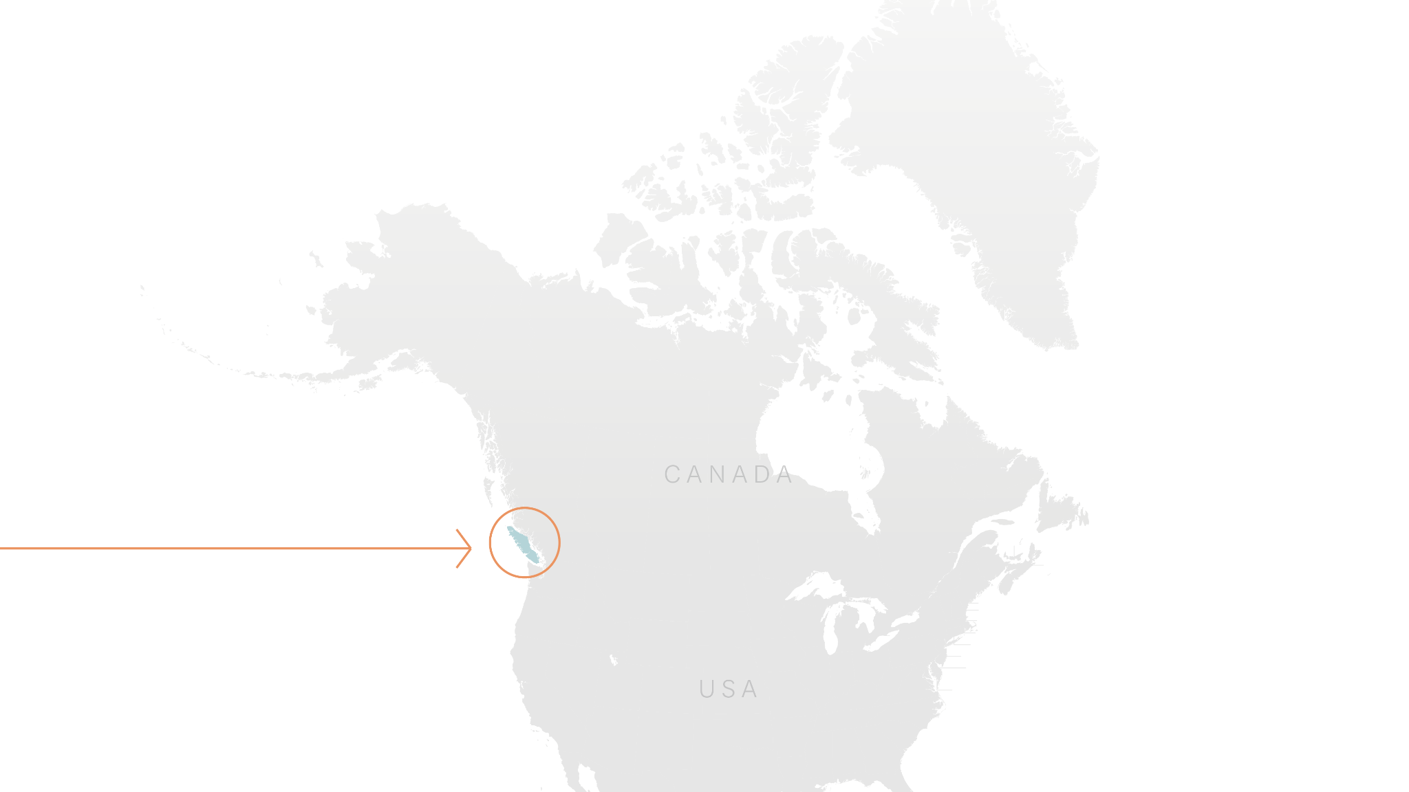
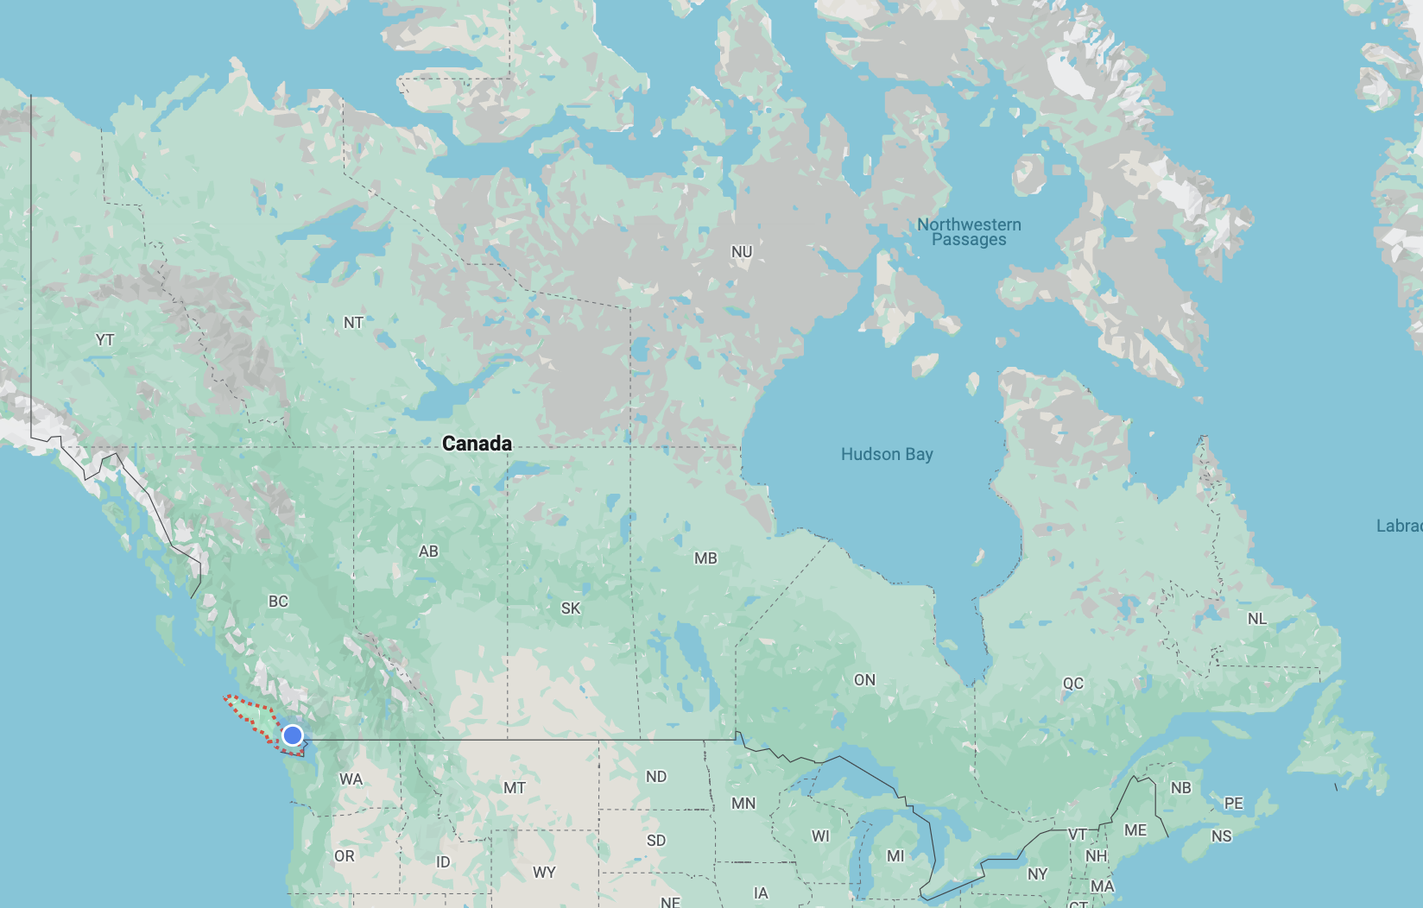
Notes:
Geographic context (10 seconds max)

Slide 4
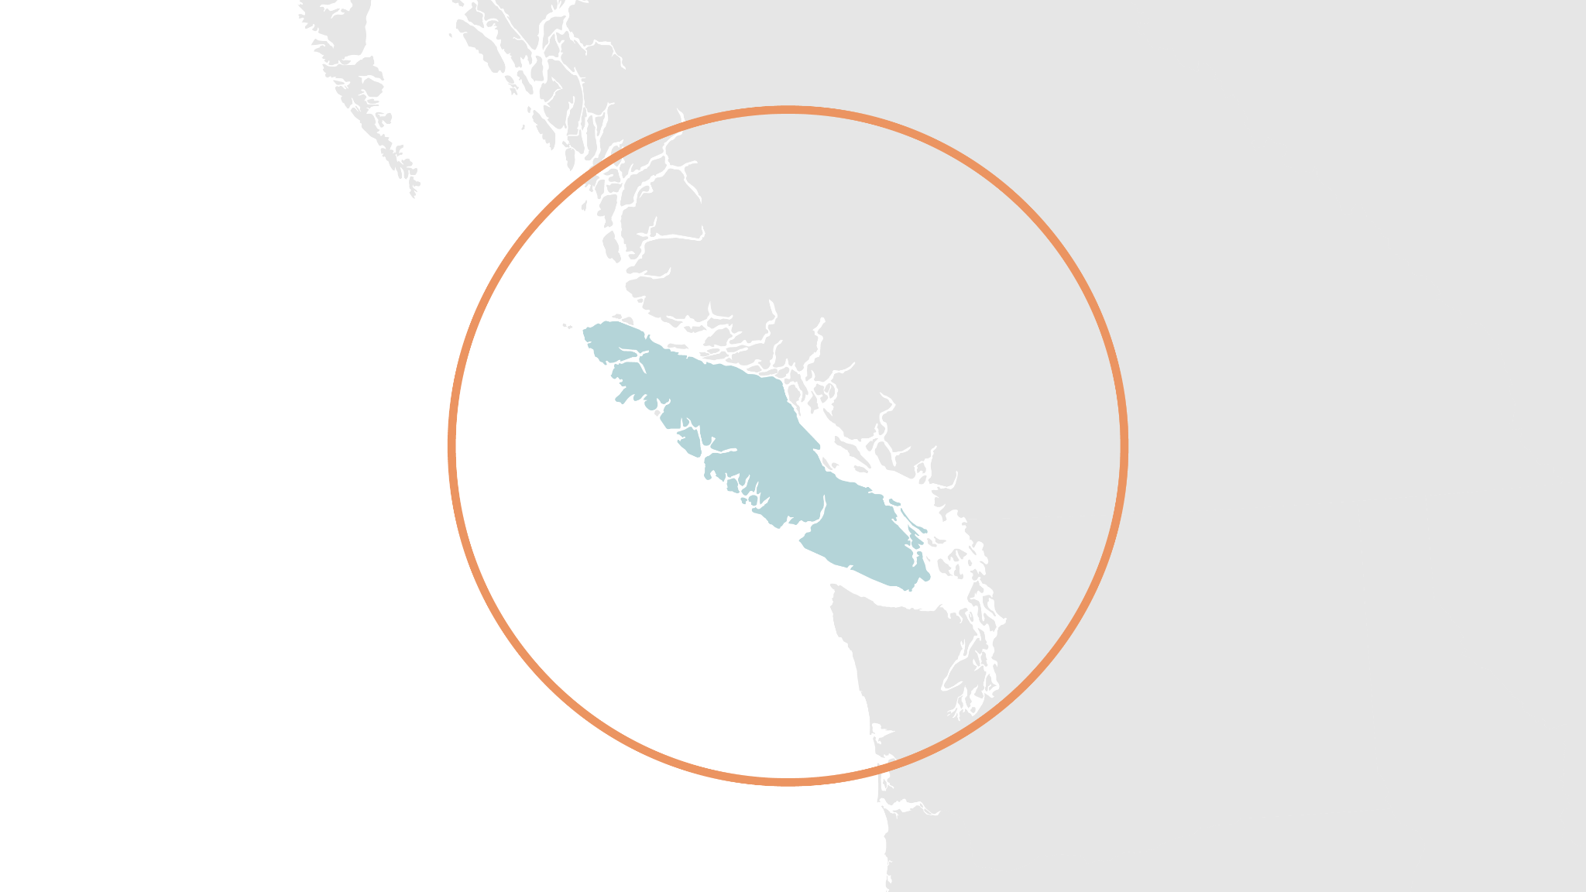
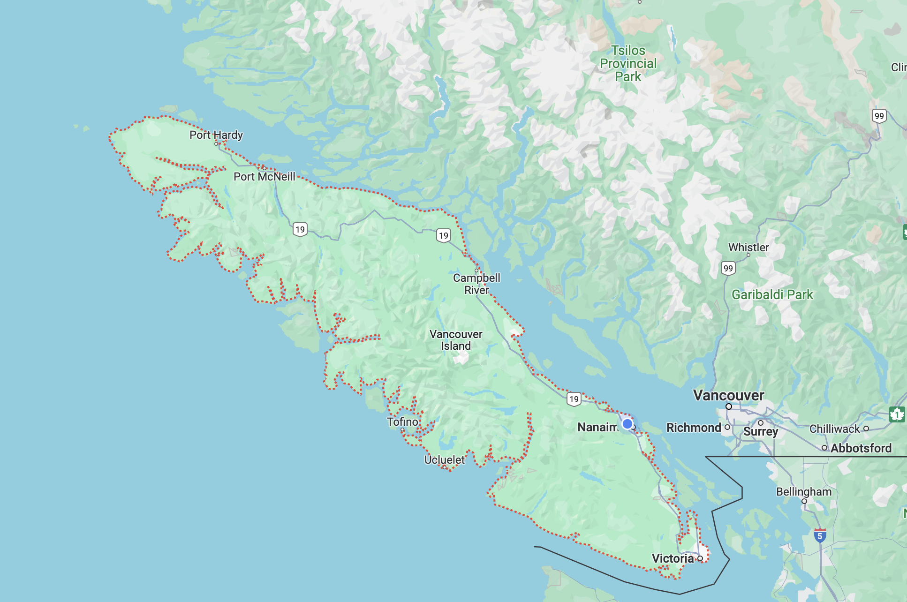
Notes:
Geo context (5 seconds)

Slide 5
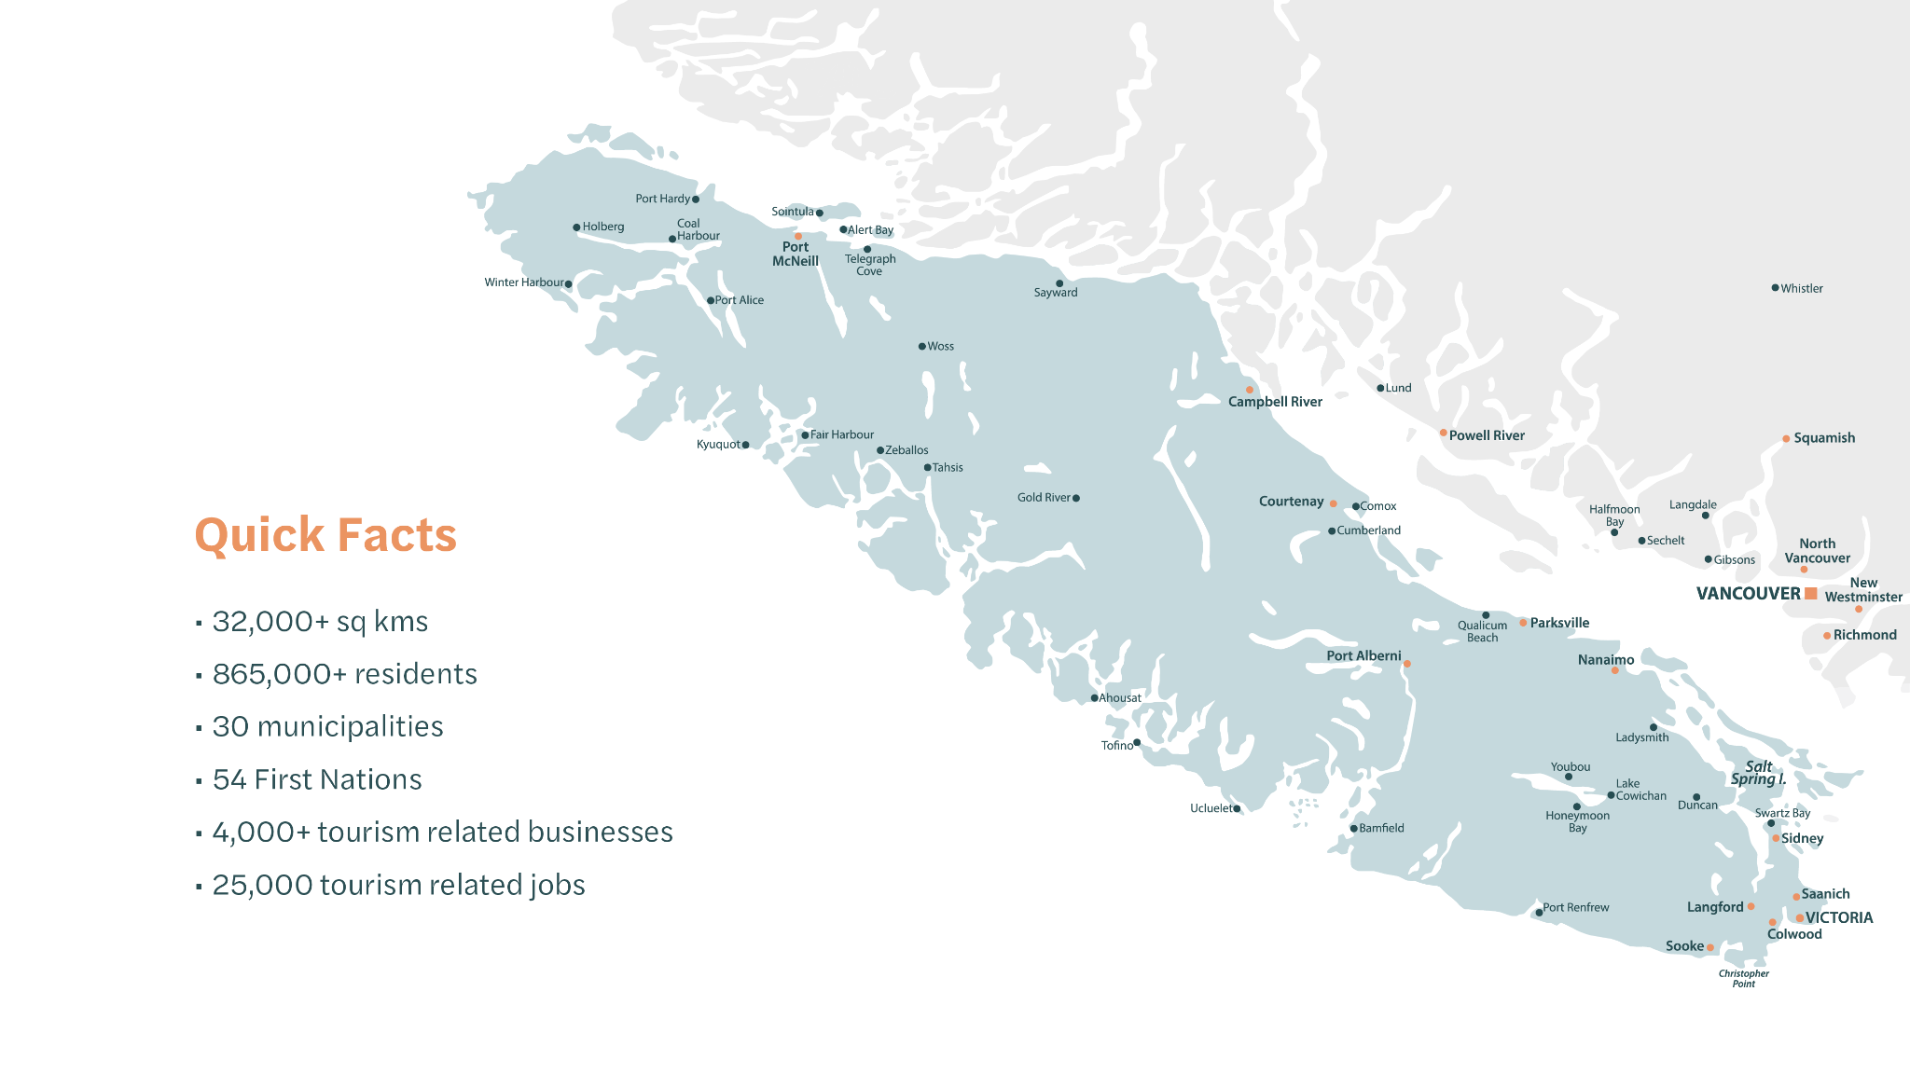
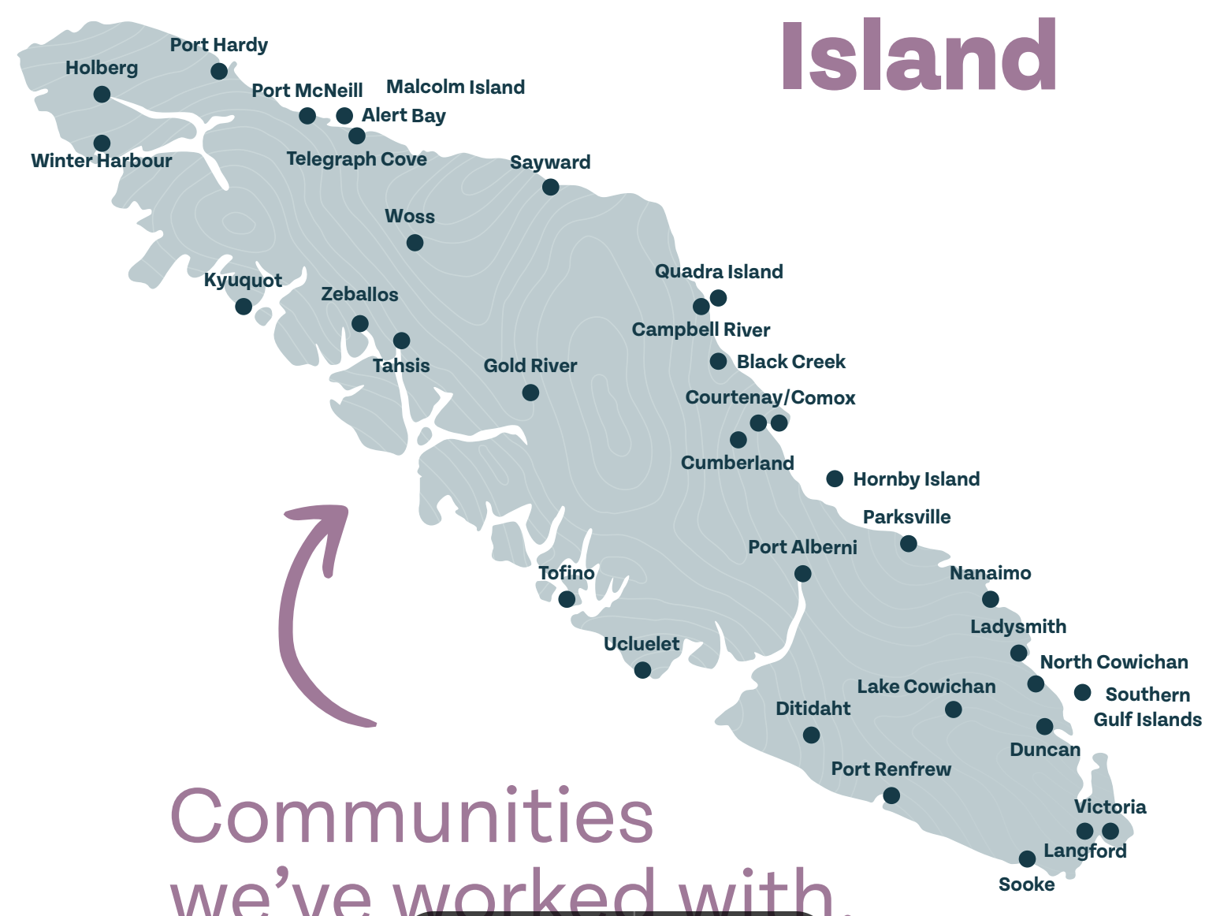
Quick Facts
32,000+ sq kms
865,000+ residents
30 municipalities
54 First Nations
4,000+ tourism related businesses
25,000 tourism related jobs
Notes:
Island context (15 seconds)

Slide 6
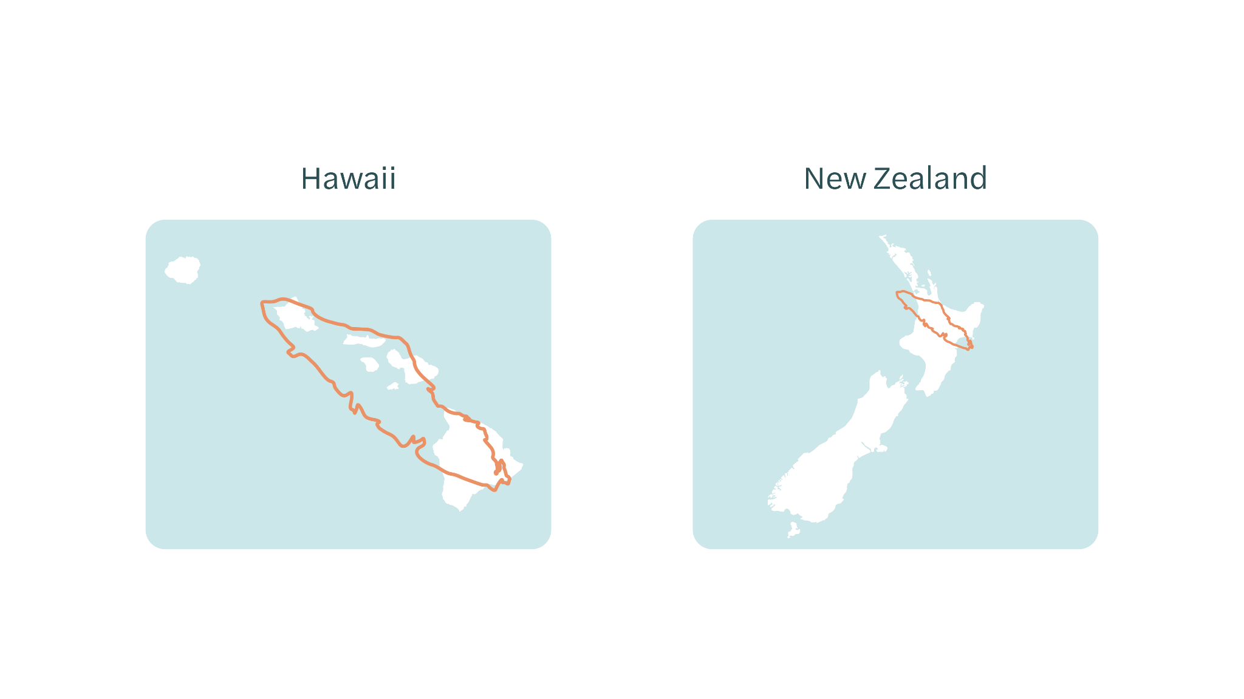
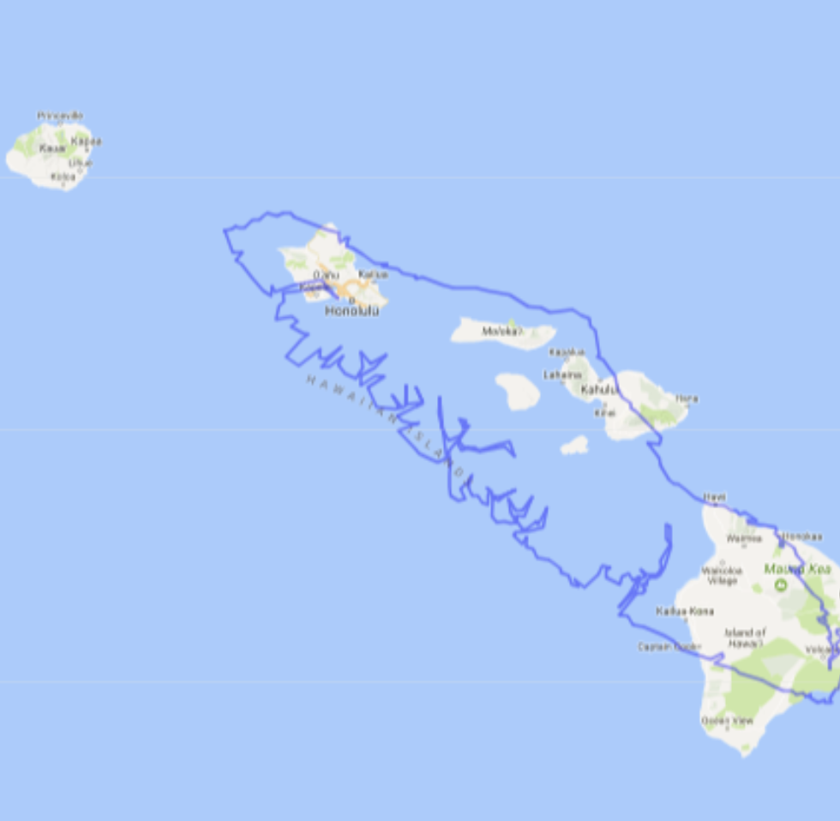
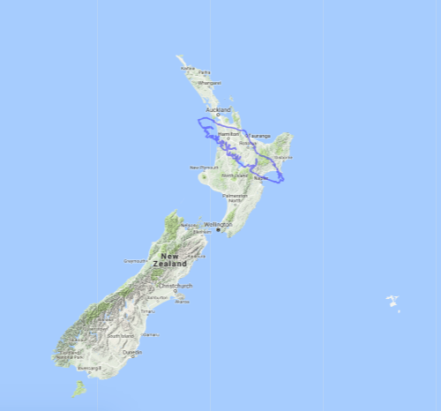
Hawaii New Zealand
Notes:
Map context (15 seconds)

Slide 7
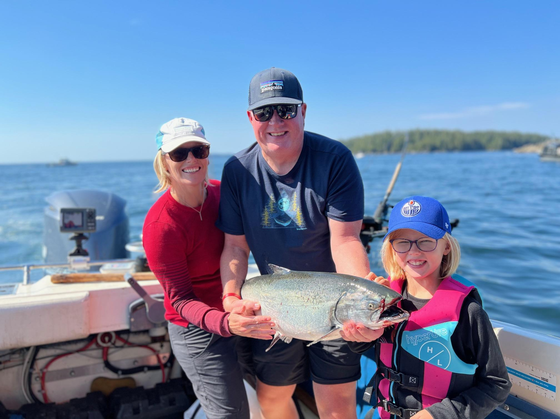

Slide 9
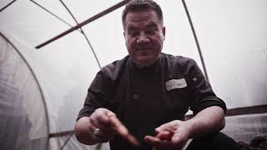

Slide 10
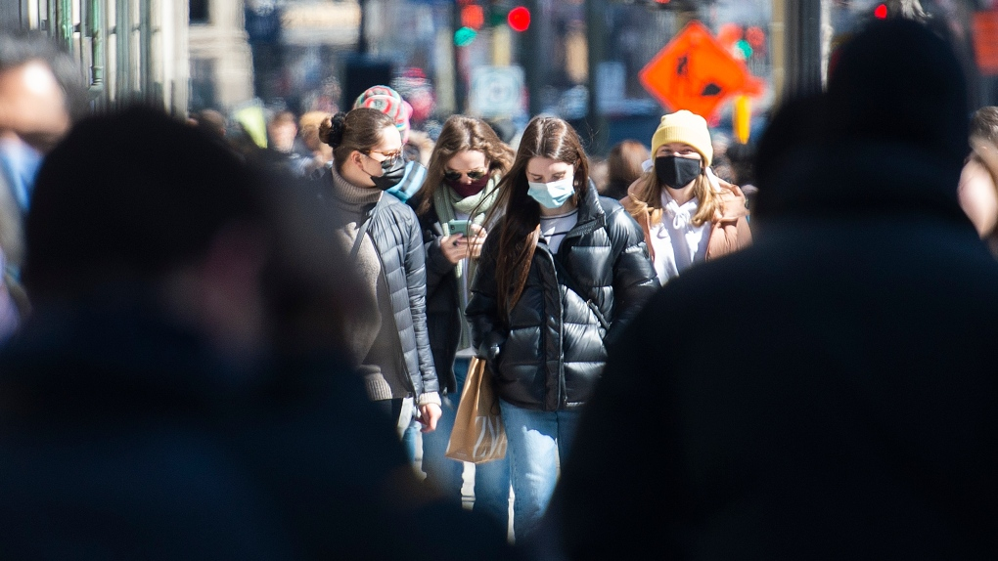
Notes:
Raise challenges of the pandemic

Slide 11
Notes:
Results of our response

Slide 12
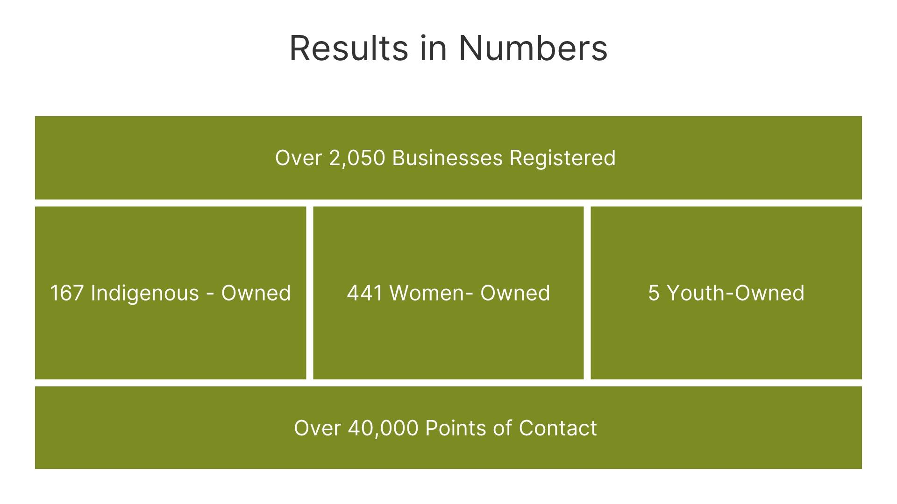
Notes:
Program participants

Slide 13
Our wake up CALL

Slide 14
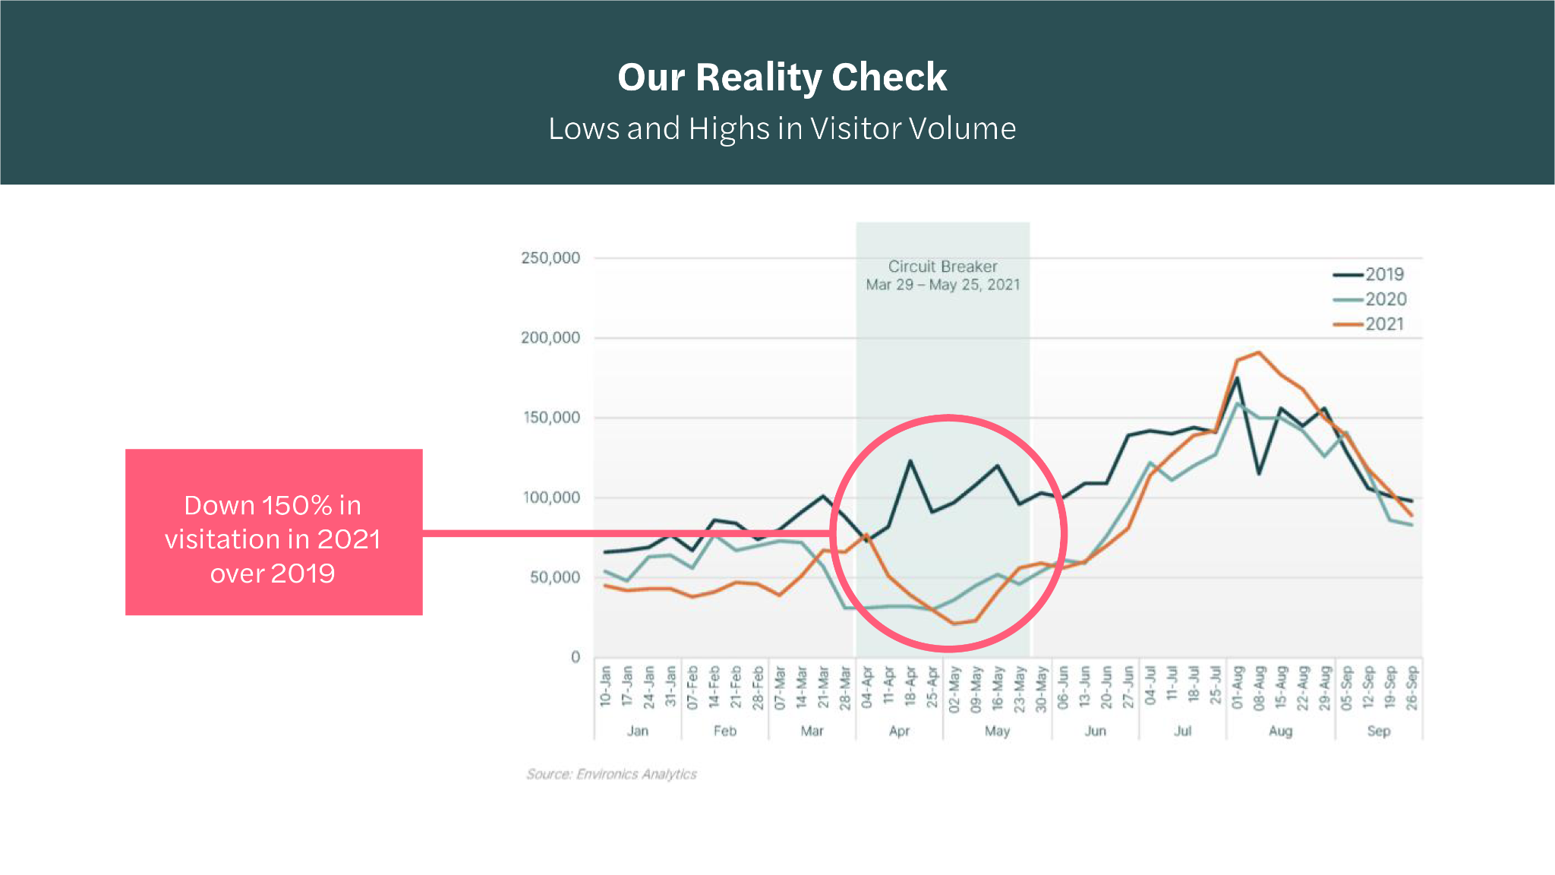
Our Reality Check
Lows and highs in visitor volume
Down 150% in visitation 2021 over 2019
Notes:
We experienced the lows and highs of visitor volume during the pandemic. During the spring of 2021, visitation dropped by 150 % over 2019. In the weeks leading up to this, businesses were preparing for a busy spring season by hiring staff and making significant business purchases

Slide 15
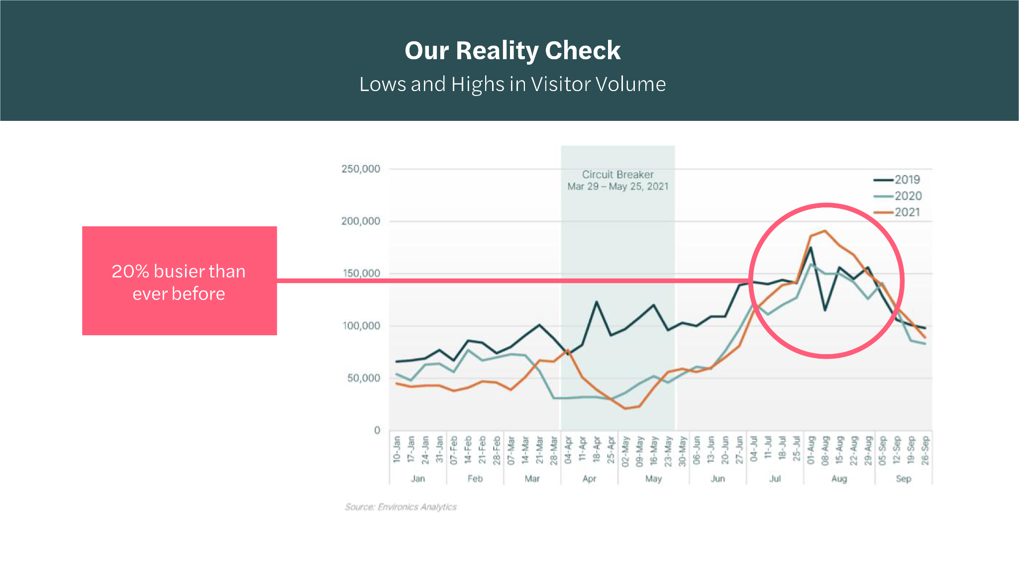
Our Reality Check
Lows and highs in visitor volume
20% busier than ever before
Notes:
Just 2.5 months later, visitation increased massively and the island was 20% busier than ever before. That put immense pressure on under staffed businesses, and we received major push back from residents as crowding impacted resident quality of life and negatively impacted visitor experience. Simply put - things were out of balance. We needed a new approach grounded in the needs of our communities, residents, businesses and culture.

Slide 16
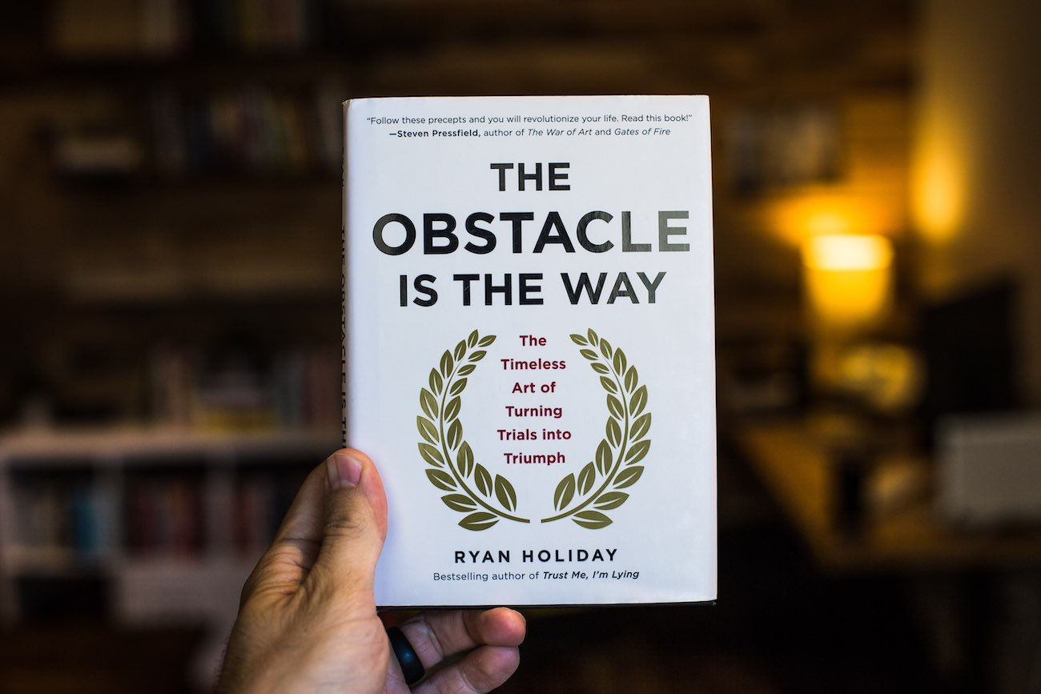

Slide 17
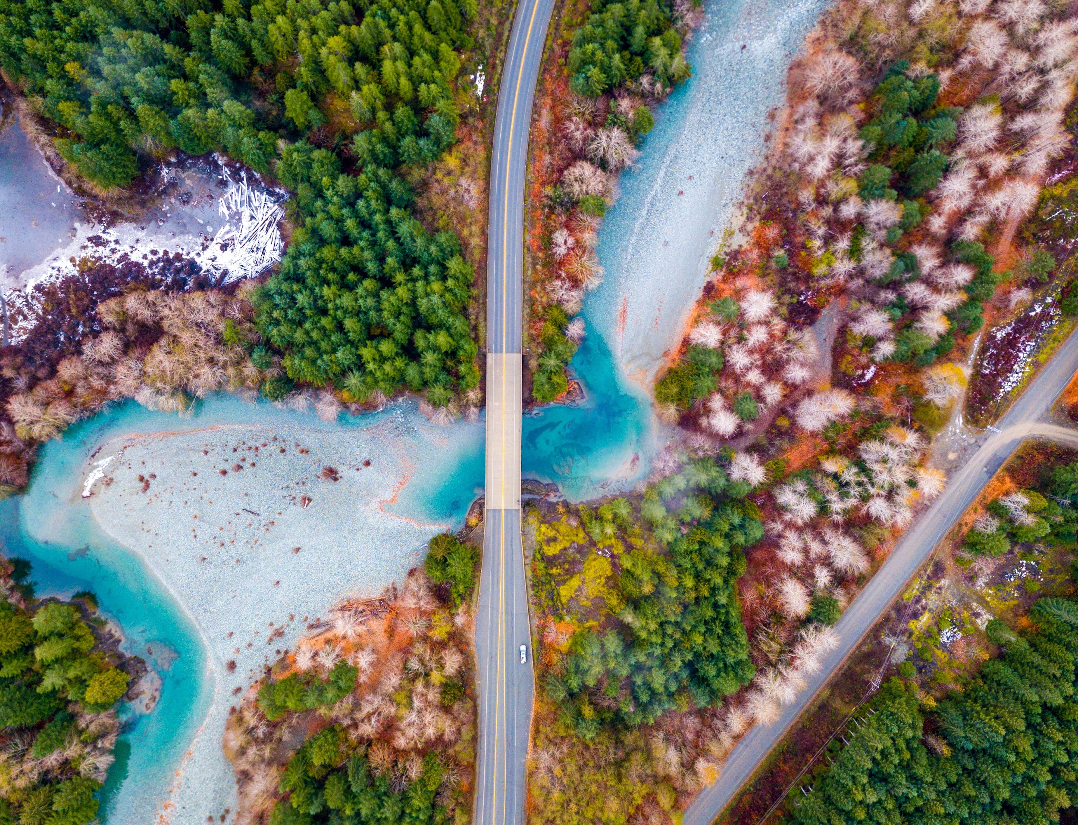
Our process of change.
1983: Incorporated as a stakeholder-led not for profit.
Our founding principles were rooted in helping businesses grow, gain exposure, and create an incredible traveller experience.
1983 - 2020: Decades of legacy building in destination marketing & destination development.
We saw successes, awards, year over year growth of visitation. And with it, an increase in jobs, community spirit, and tourism.
2020-2022: On the edge of a new era.
Traveller behaviour has changed, labour shortages continue to create challenges, and there is a lot of concern around climate change.
Now: Every discussion leads us back to the concept of balance.
We acknowledge the realities of our industry.
We translate our values into the work we do.
And it’s time for us to give back.
Notes:
We are a long standing organization with a long history of supporting our region…. Explain slides.

Slide 18
How our role
has evolved.
Social Responsibility
Destination Management
Destination Marketing
Notes:
Our evolution process.

Slide 19
Our new mission.
We’re in business
to ensure that
travel is a force for good
for Vancouver Island -
forever.
Notes:
mission

Slide 20
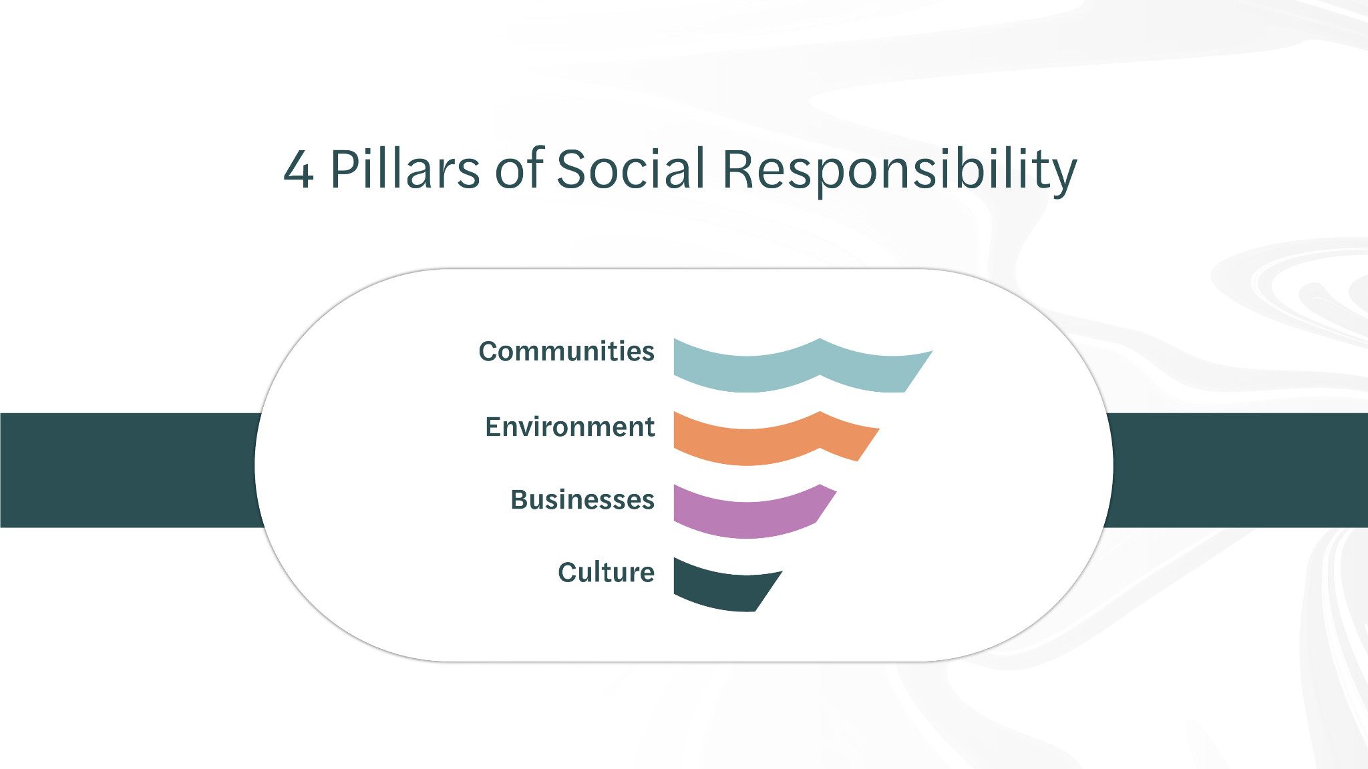
4 Pillars of
Social Responsibility
Notes:
Pillars

Slide 21
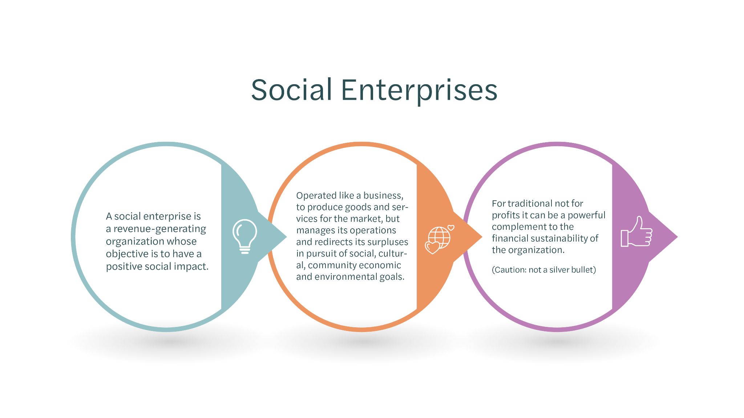
Social
Enterprises
A social enterprise is a revenue-generating organization whose objective is to have a positive social impact.
Operated like a business, to produce goods and services for the market, but manages its operations and redirects its surpluses in pursuit of social, cultural, community economic and environmental goals.
For traditional not for profits it can be a powerful complement to the financial sustainability of the organization. (Caution: not a silver bullet)

Slide 22
Regeneration in Action

Slide 23
Climate Action

Slide 24
The Glasgow Declaration
The Glasgow Declaration is a global initiative focused on committing to a decade of tourism climate action
Has been embraced and signed by hundreds of organizations around the world

Slide 25
4VI Carbon Audit
Conducted one of the largest and most comprehensive carbon emissions audits in North America
Worked with Synergy Enterprises to develop a best in class methodology that can be repeated in future years
This project has become a globally recognized case-study and lighthouse example of tourism stewardship in action

Slide 26
Notes:
2 million tons/ 540,000
VI only has a population of about 840,000, so really significant carbon emissions in comparison to the population
If you put all the flights end to end for people travelling here it would be the equivalent of 146,000 flights around the earth. We have a lot of visitors from Netherlands, Germany, Australia.
When we look at the breakdown of emissions by activity, transportation came in at 51% of emissions which was no surprise
Overwhelmingly, Changes in transportation emissions will have to do with the availability of technology and infrastructure development
For our biosphere commitment program and other programs, most early adopters are tour operators and accommodation
32.4% food and beverage, this has been a blind spot for us as a sector and in the coming months we’ll be looking at how we can better support and integrate them into our sustainability programs. Restaurants and vineyards on the Island that are really value aligned

Slide 27
Culture

Slide 28
First Nations Fee Program
System-change project to establish Indigenous-led fee collection program
Enables First Nations to generate revenue from visitors within their territory and to ensure the sustainable management of their lands
Over $1,000,000 collected and invested in community and environmental programs

Slide 29
Recreation

Slide 30
Recreation Mountain Bike Trail Enhancements
$350,000 invested Island-wide
Enhance recreation for visitors and residents
Support non-profit trail managers
Reduce environmental impacts
Cumberland

Slide 31
Culture
Notes:
Together we conducted research into the state of gender of equity on VI.

Slide 32
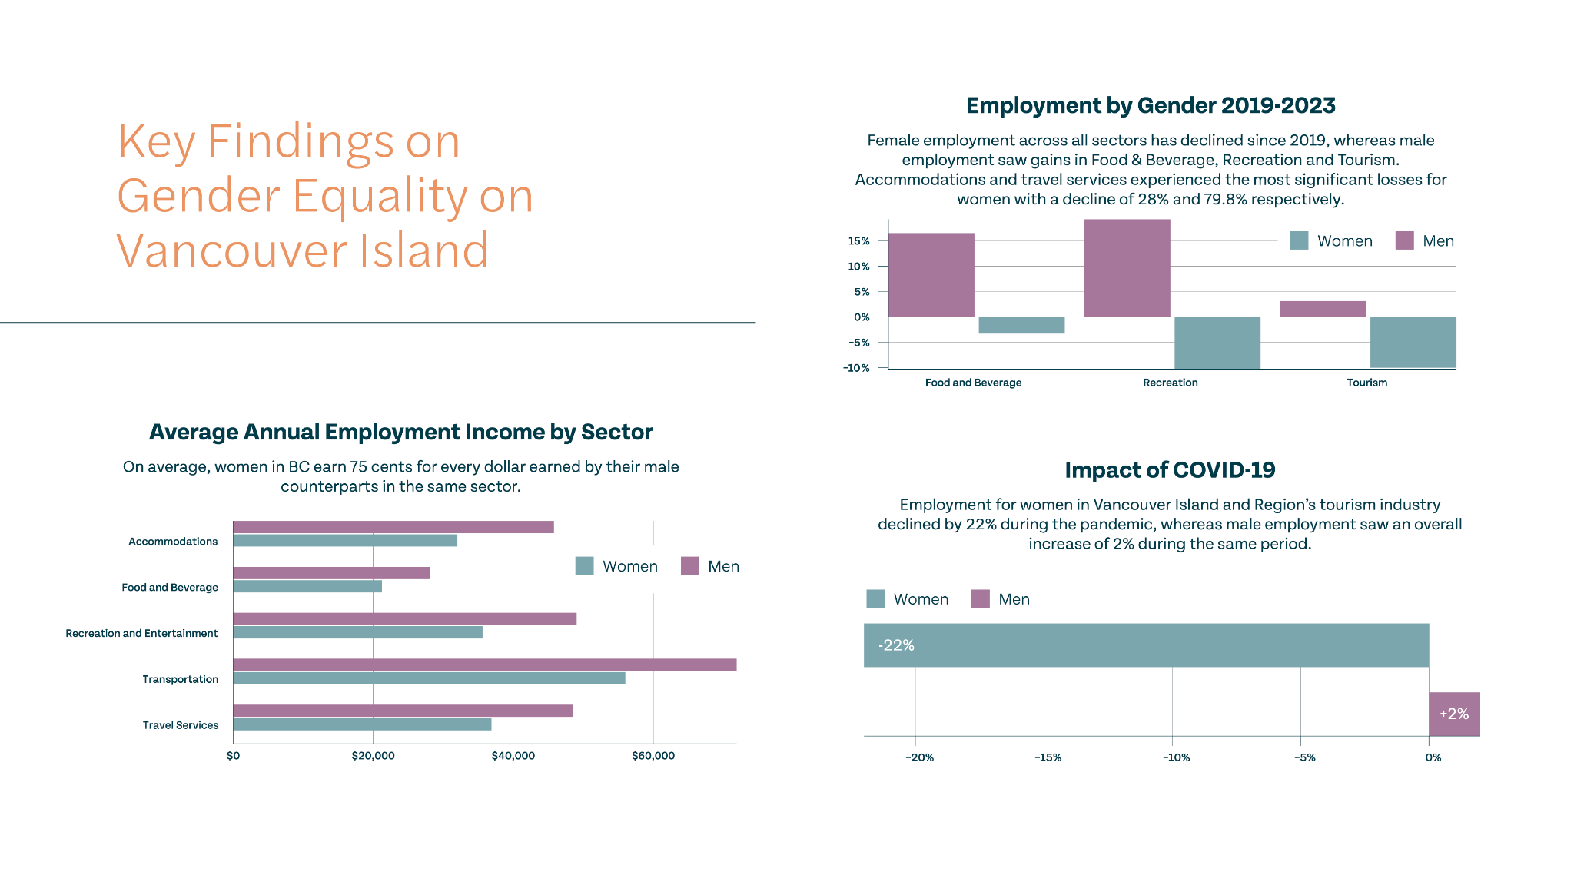
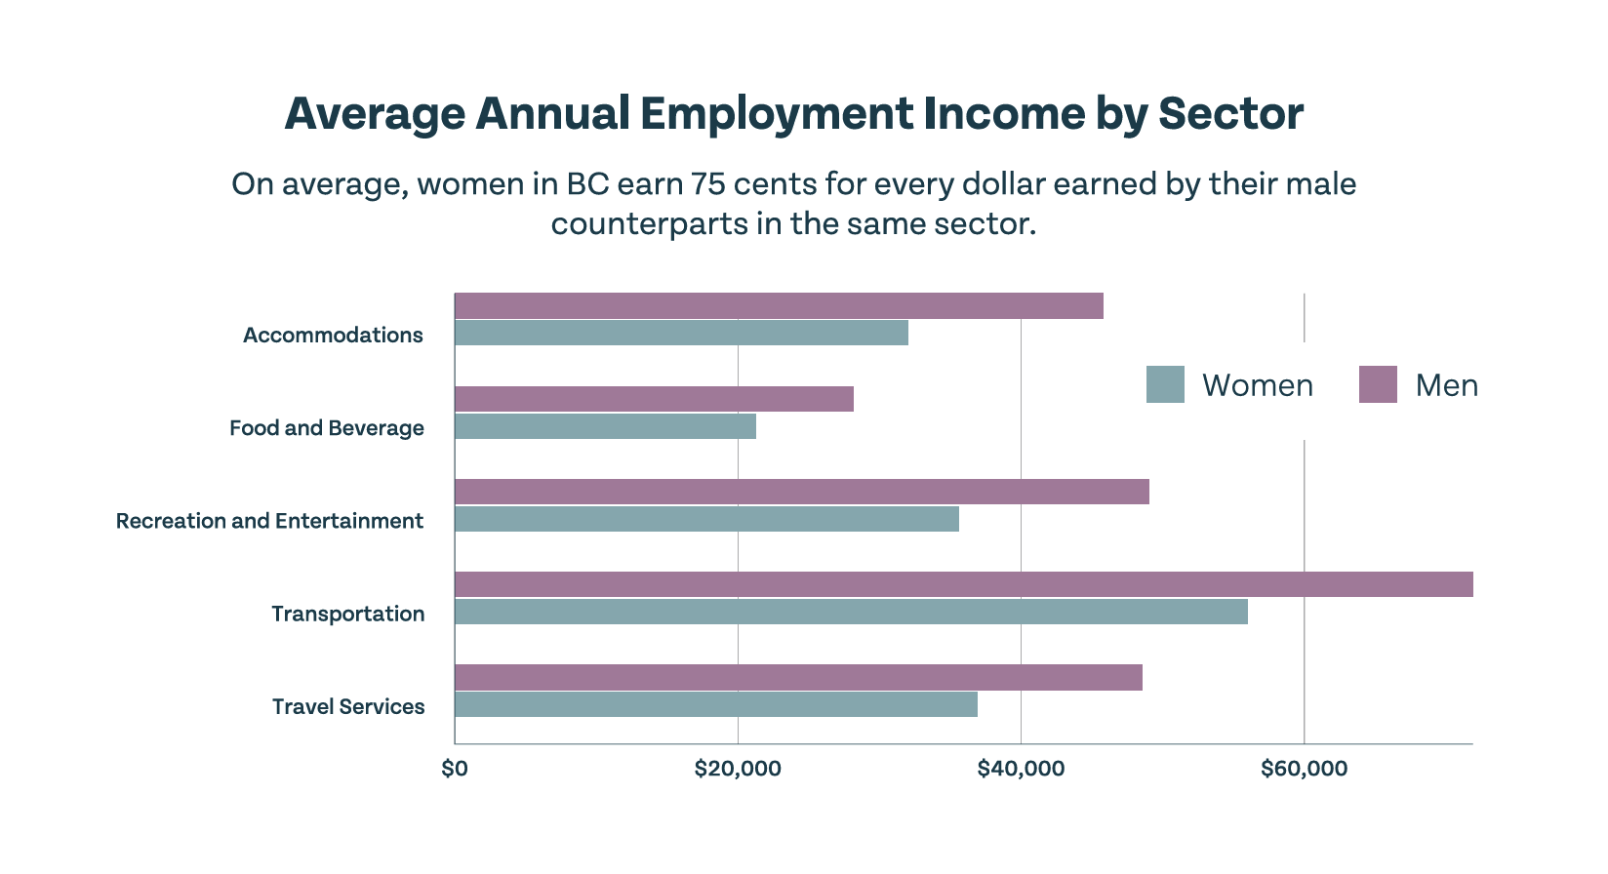
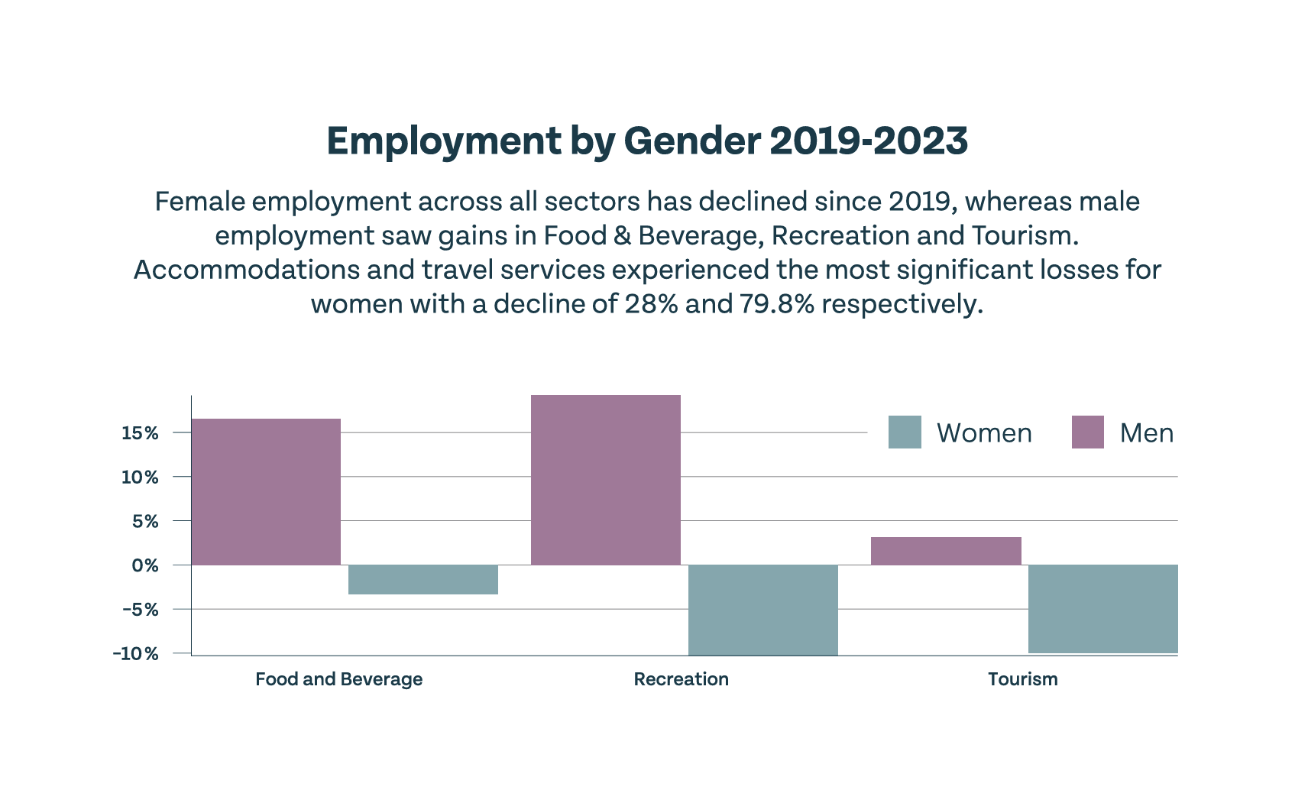
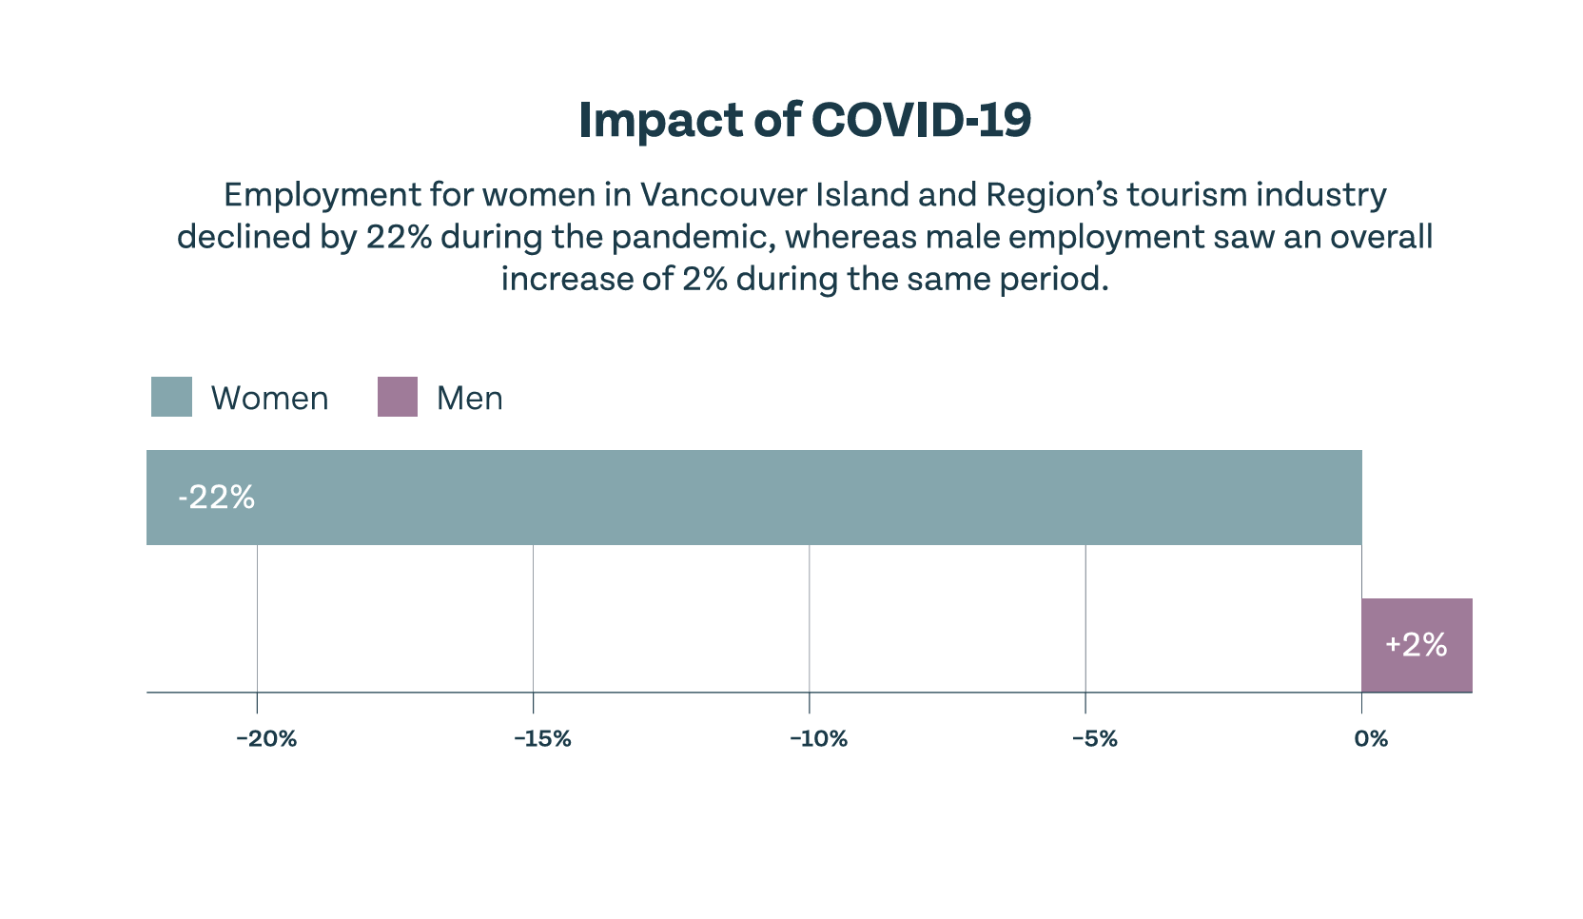
Key Findings on Gender Equality on Vancouver Island
Notes:
The report concluded with 10 recommendations for advancing women in tourism and we have just completed our first round of WORTH academy, a free 12 week leadership development program for women in tourism.

Slide 33
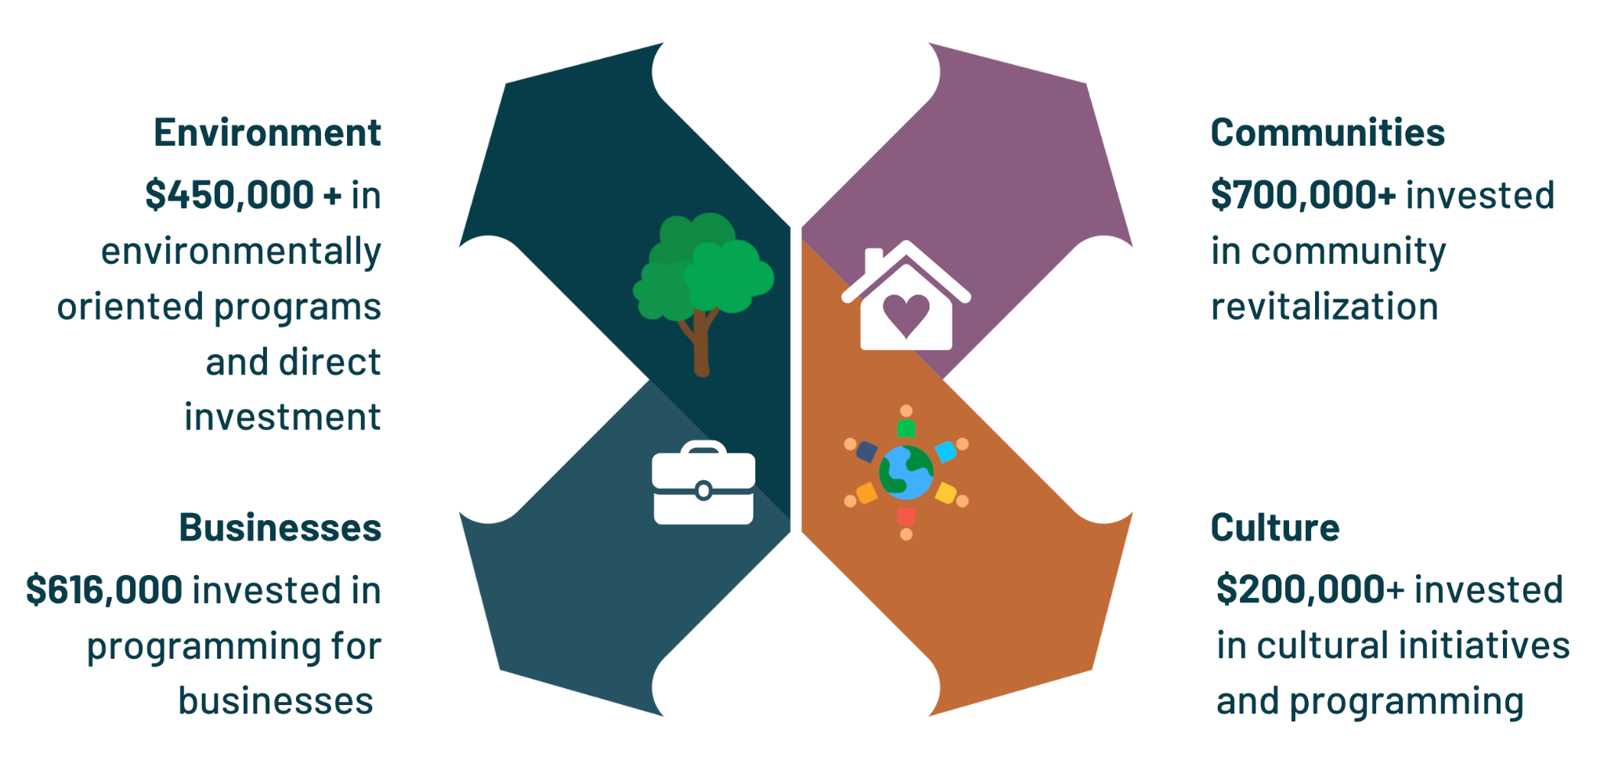
IMPACT OVERVIEW/Summary
4VI Contributions to Community Projects

Slide 34
Our Impact Goal
To contribute $10M to the stewardship of Vancouver Island by 2030 through:
Direct funding from 4VI to partner organizations
In-kind staff time
Third party grants secured by 4VI
Sponsorships and partnerships
$3.9M
$0M
$10M

Slide 35
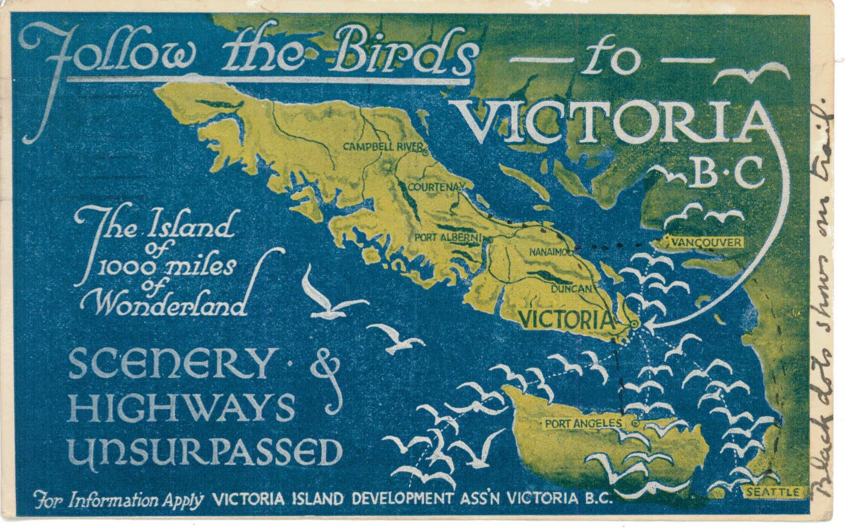
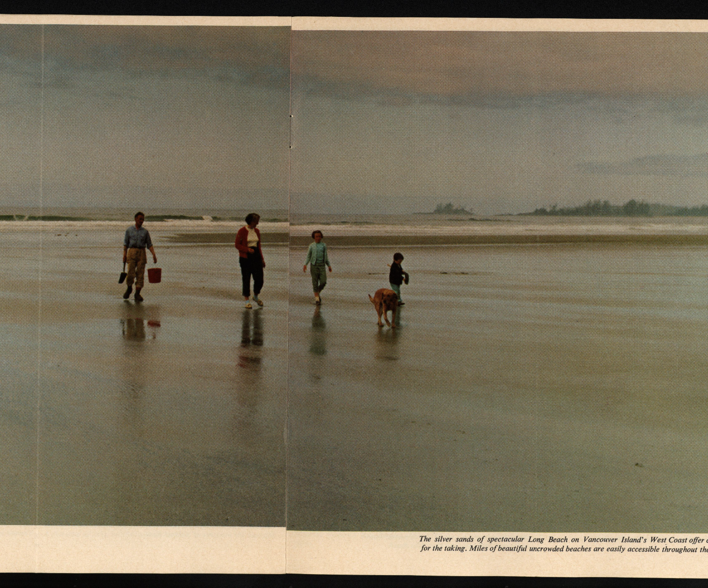

Slide 36
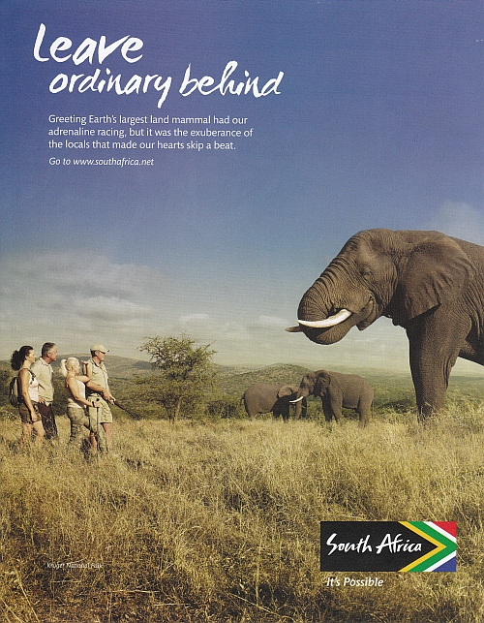
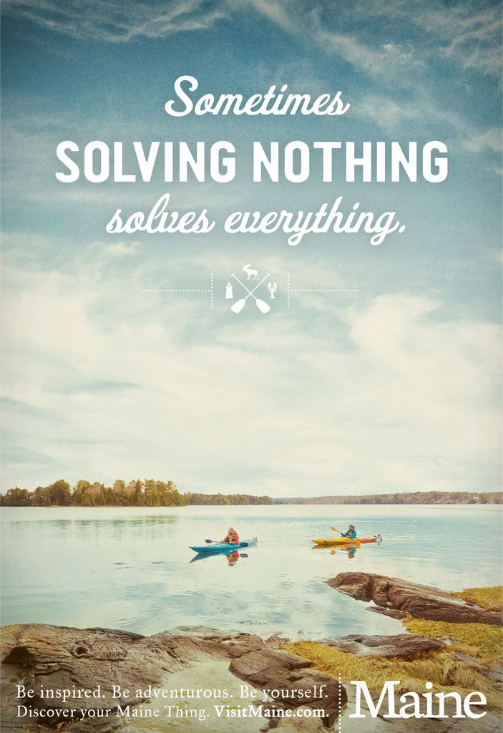

Slide 37
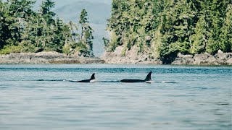

Slide 38
The 4VI Ecosystem
Our Regenerative Model

Slide 39
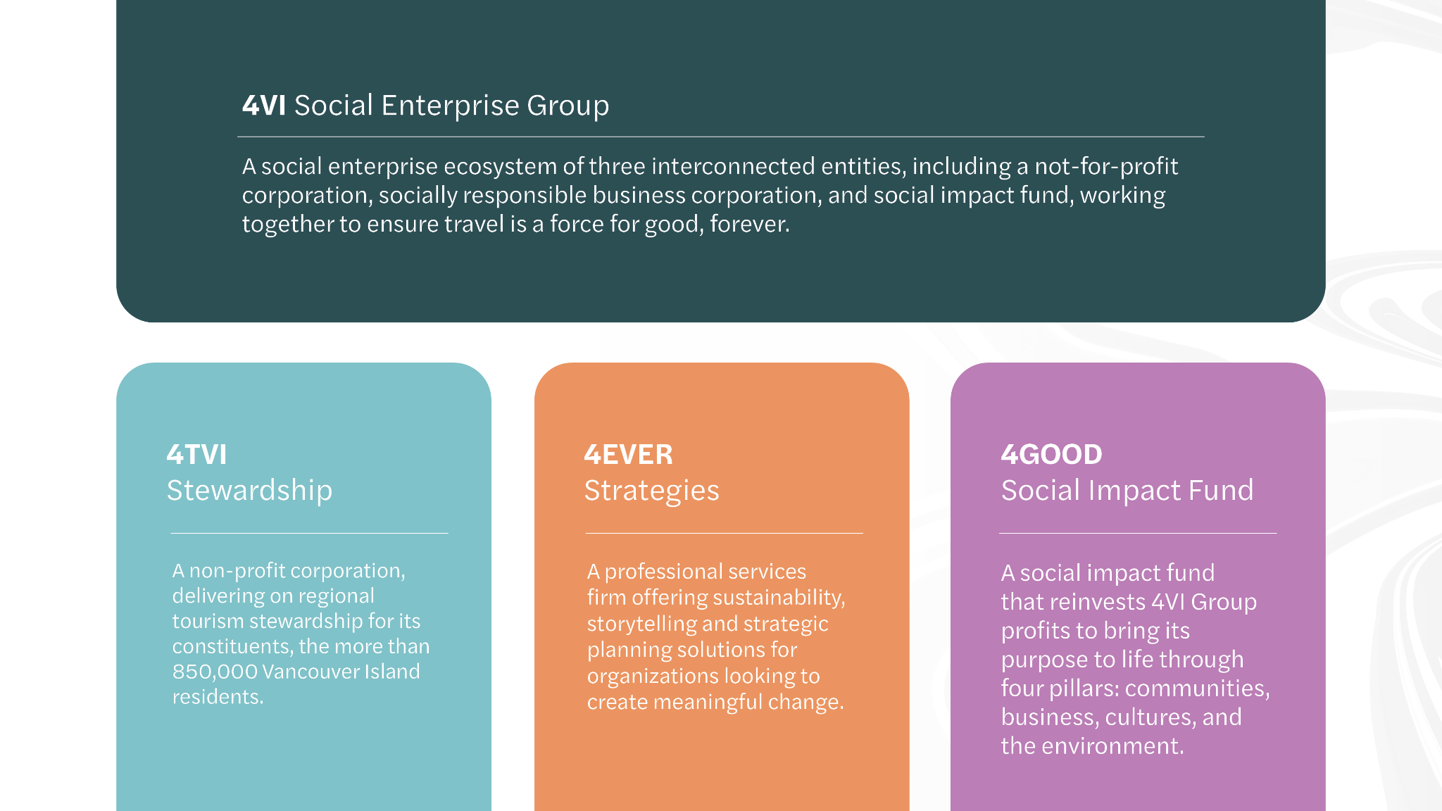
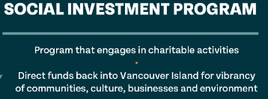
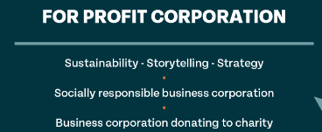

Slide 41
ƛ̓eekoo
Gliaks’la
Hy Ch q’u
Thank you
Notes:
Territory acknowledgement - acknowledgement of where I come from (1 min)
Add 4VI’s new statement

