Slide 1

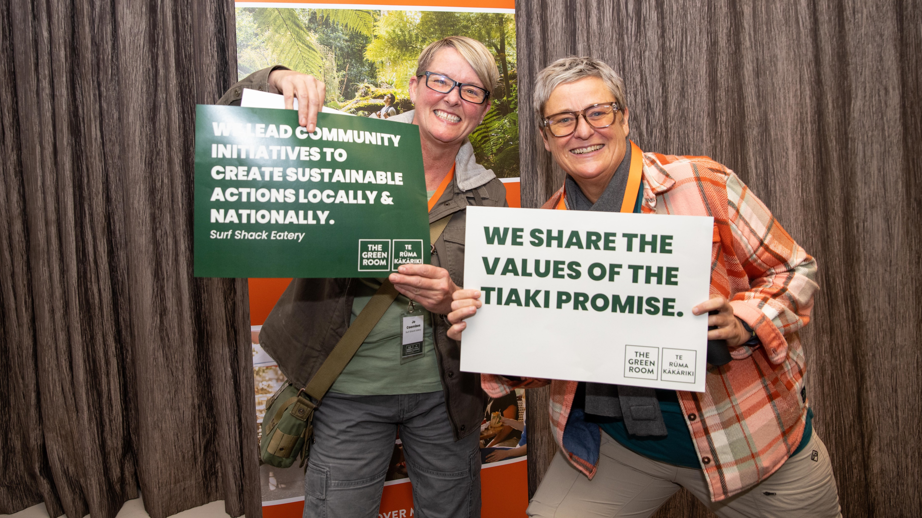


Tourism Bay of Plenty
The Green Room | Te Rūma Kākāriki

Slide 2
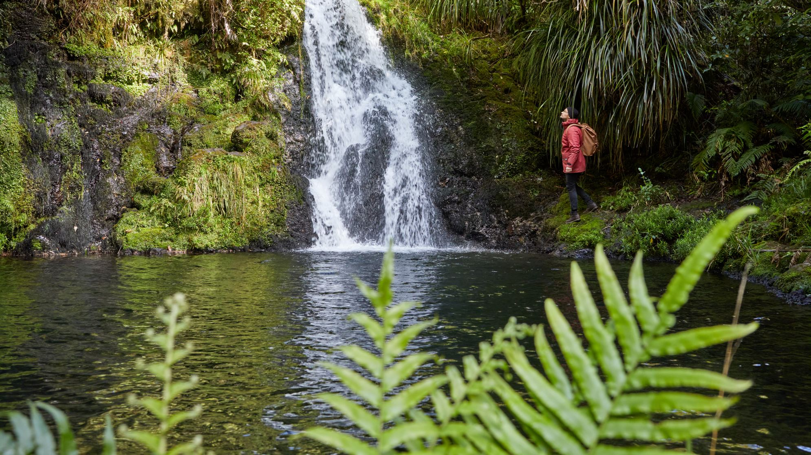


The Green Room | Te Rūma Kākāriki
Practical, tailored support for organisations to enable them to build their capability
A 12 week programme to encourage the Coastal Bay of Plenty’s visitor sector to work towards a zero carbon and regenerative future.
Holistic: Focused on environmental, economic, visitor and community sustainability
Funded by Bay of Plenty Regional Council, delivered by TIA and Envirohub, managed by TBOP

Slide 3
Programme Alignment
New Zealand Tourism Sustainability Commitment
Tiaki Promise
Tourism 2050
Supporting the goal of the Intergovernmental Panel on Climate Change (IPCC) to halve New Zealand’s CO2 emission levels by 2030
Supporting the Bay of Plenty Regional Council Climate Change Action Plan
Supporting Whakatāne District Council’s Climate Change Strategy
Inspiring faster action on carbon reduction plans formulated by Tauranga City Council and Western Bay of Plenty District Council by adopting a collaborative approach to this issue

Slide 4
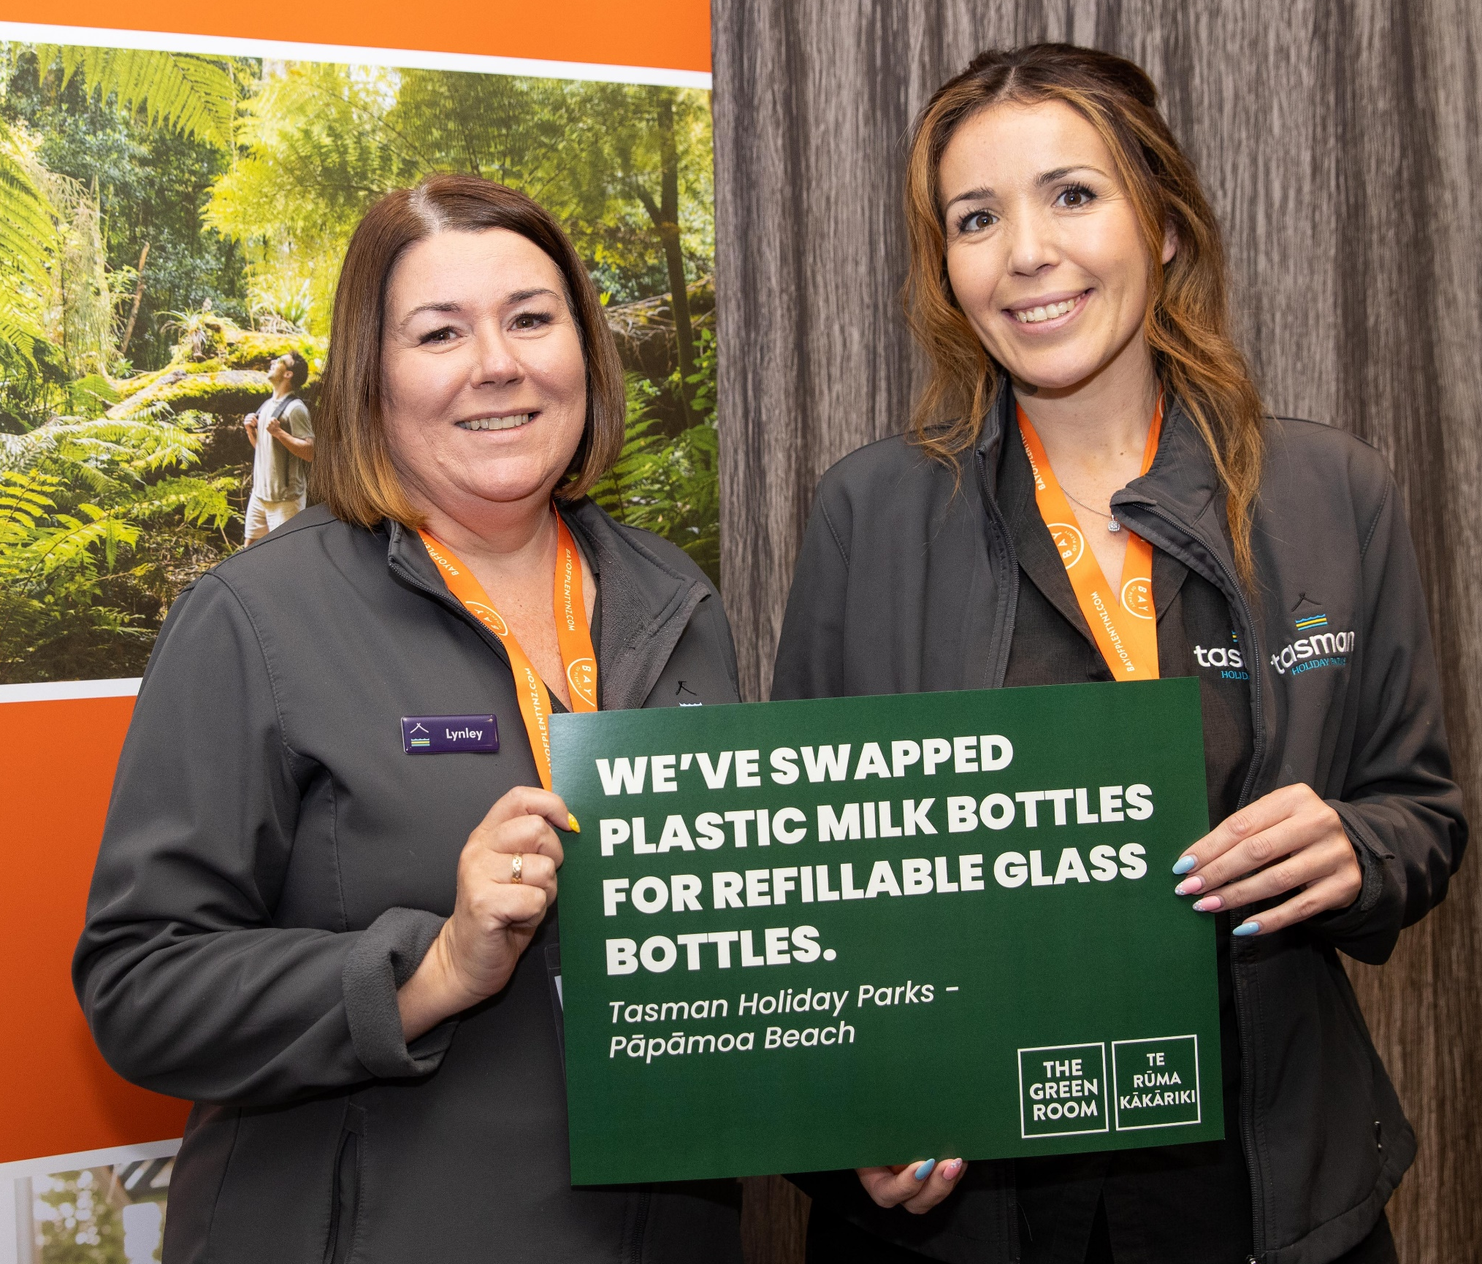
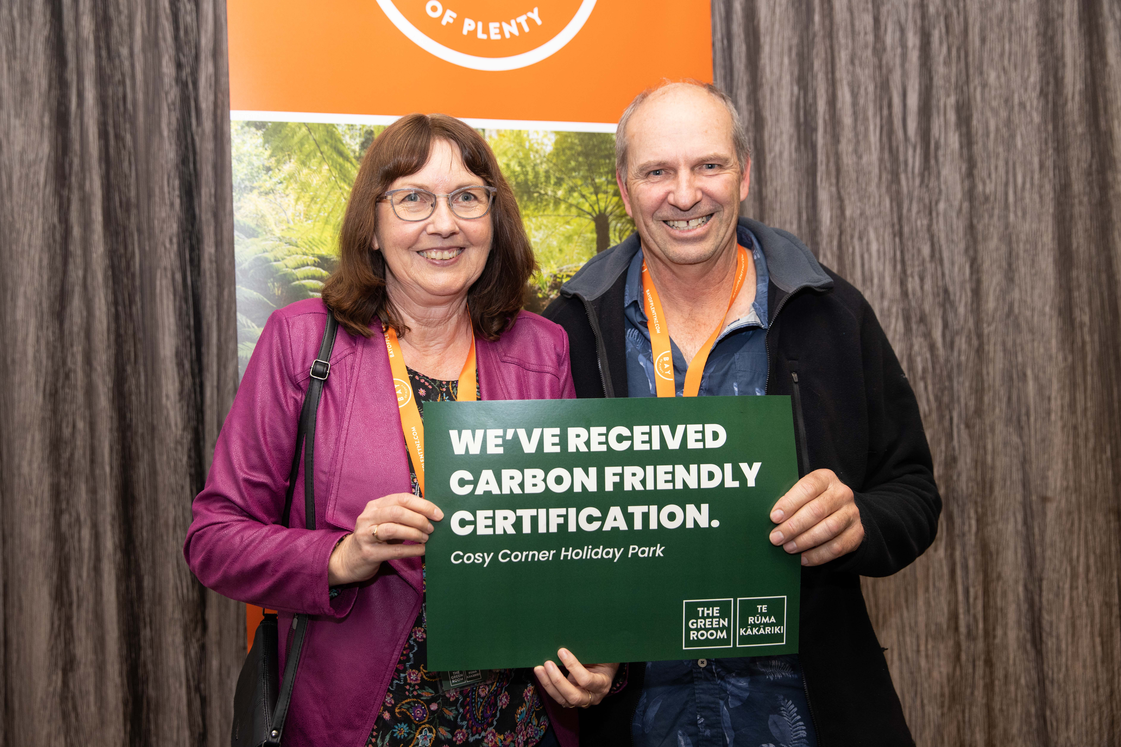
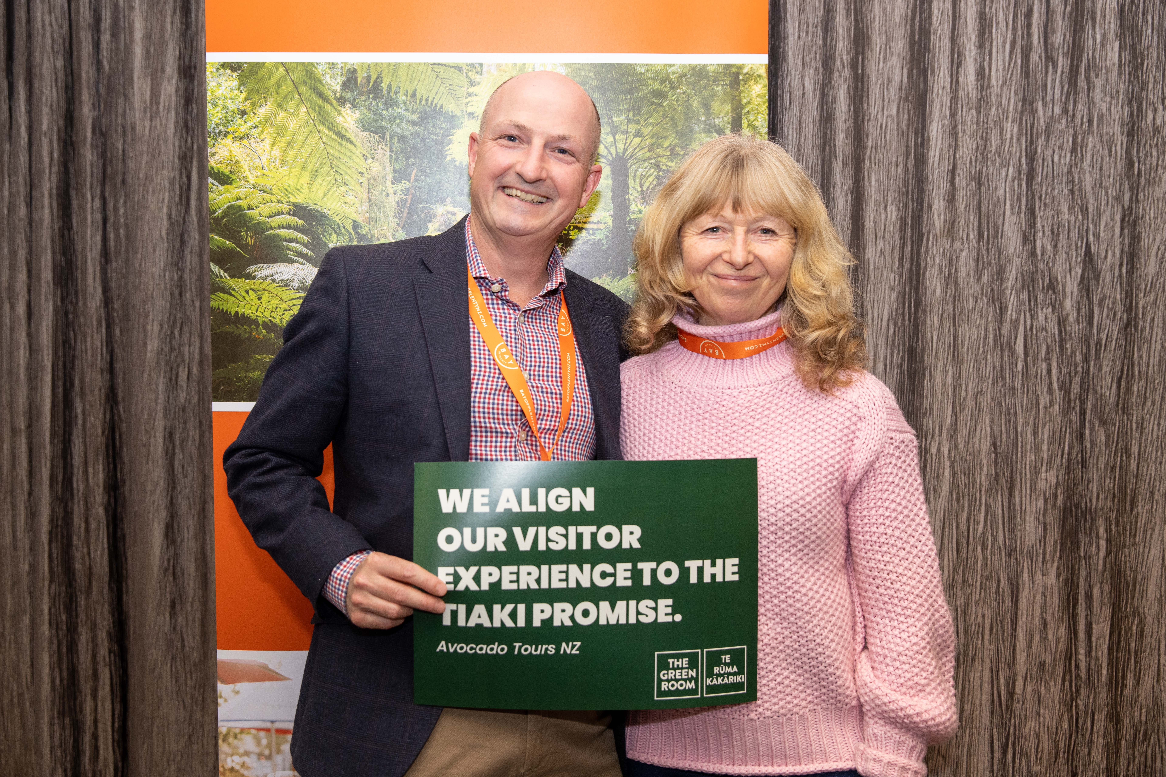
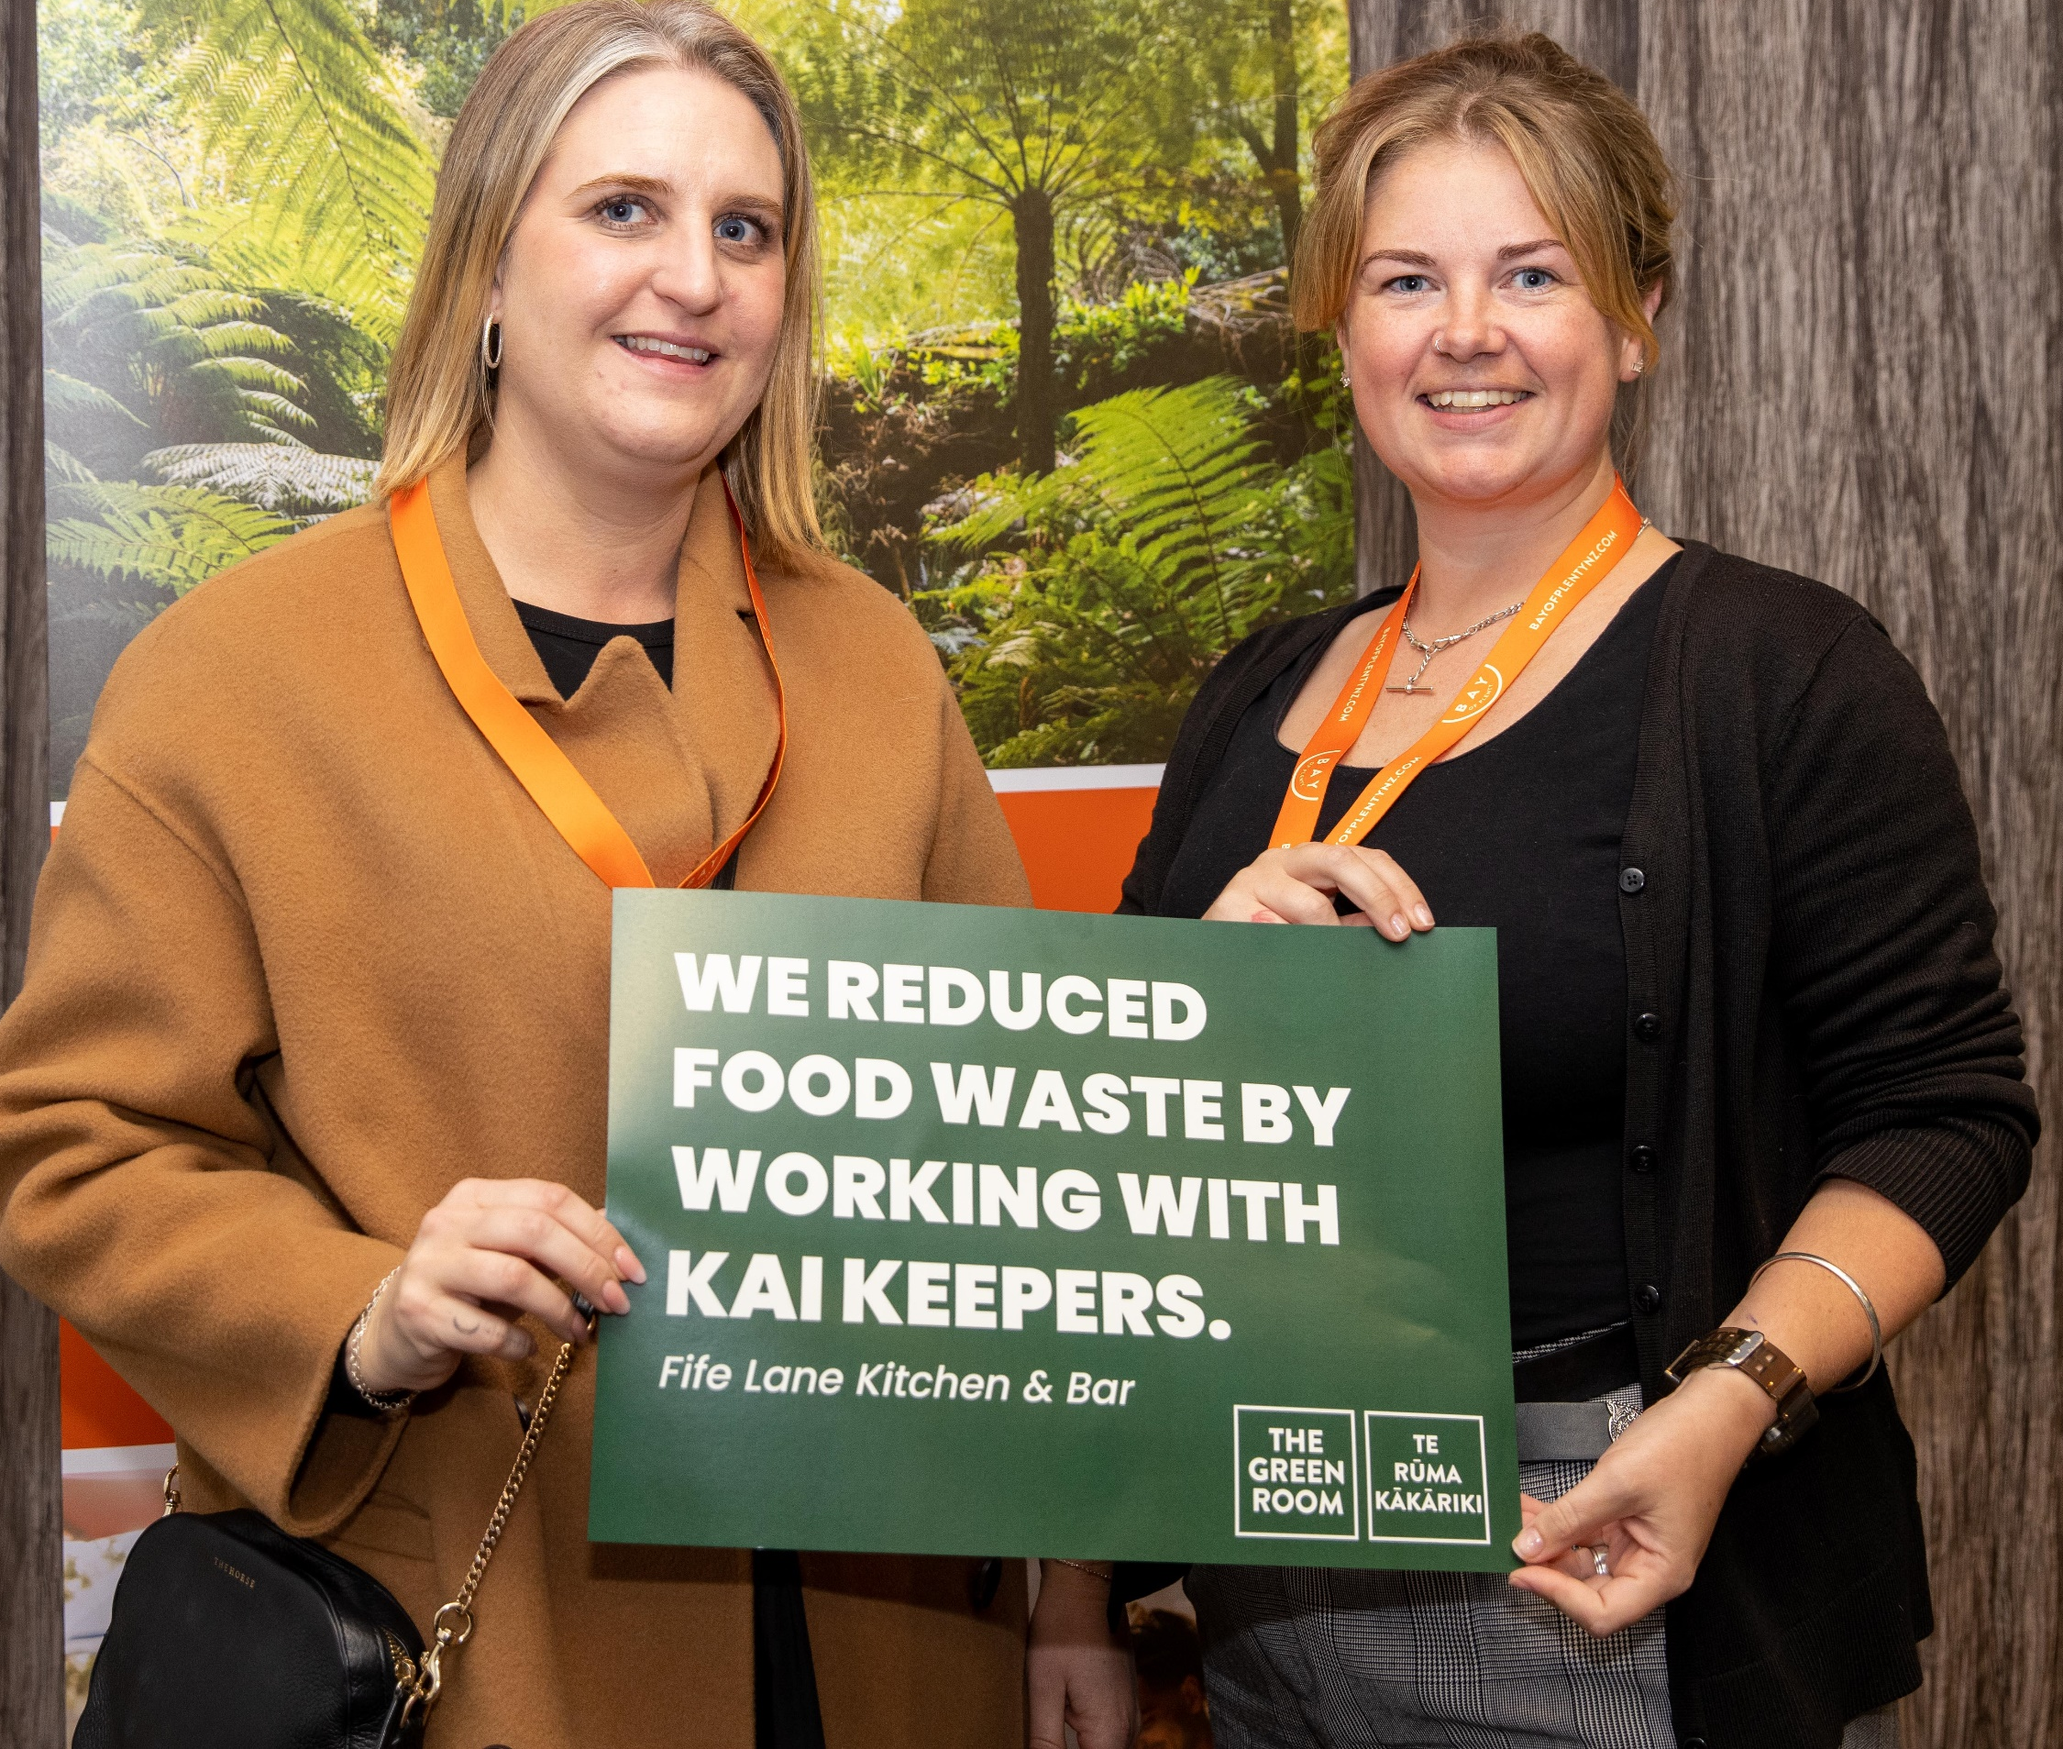
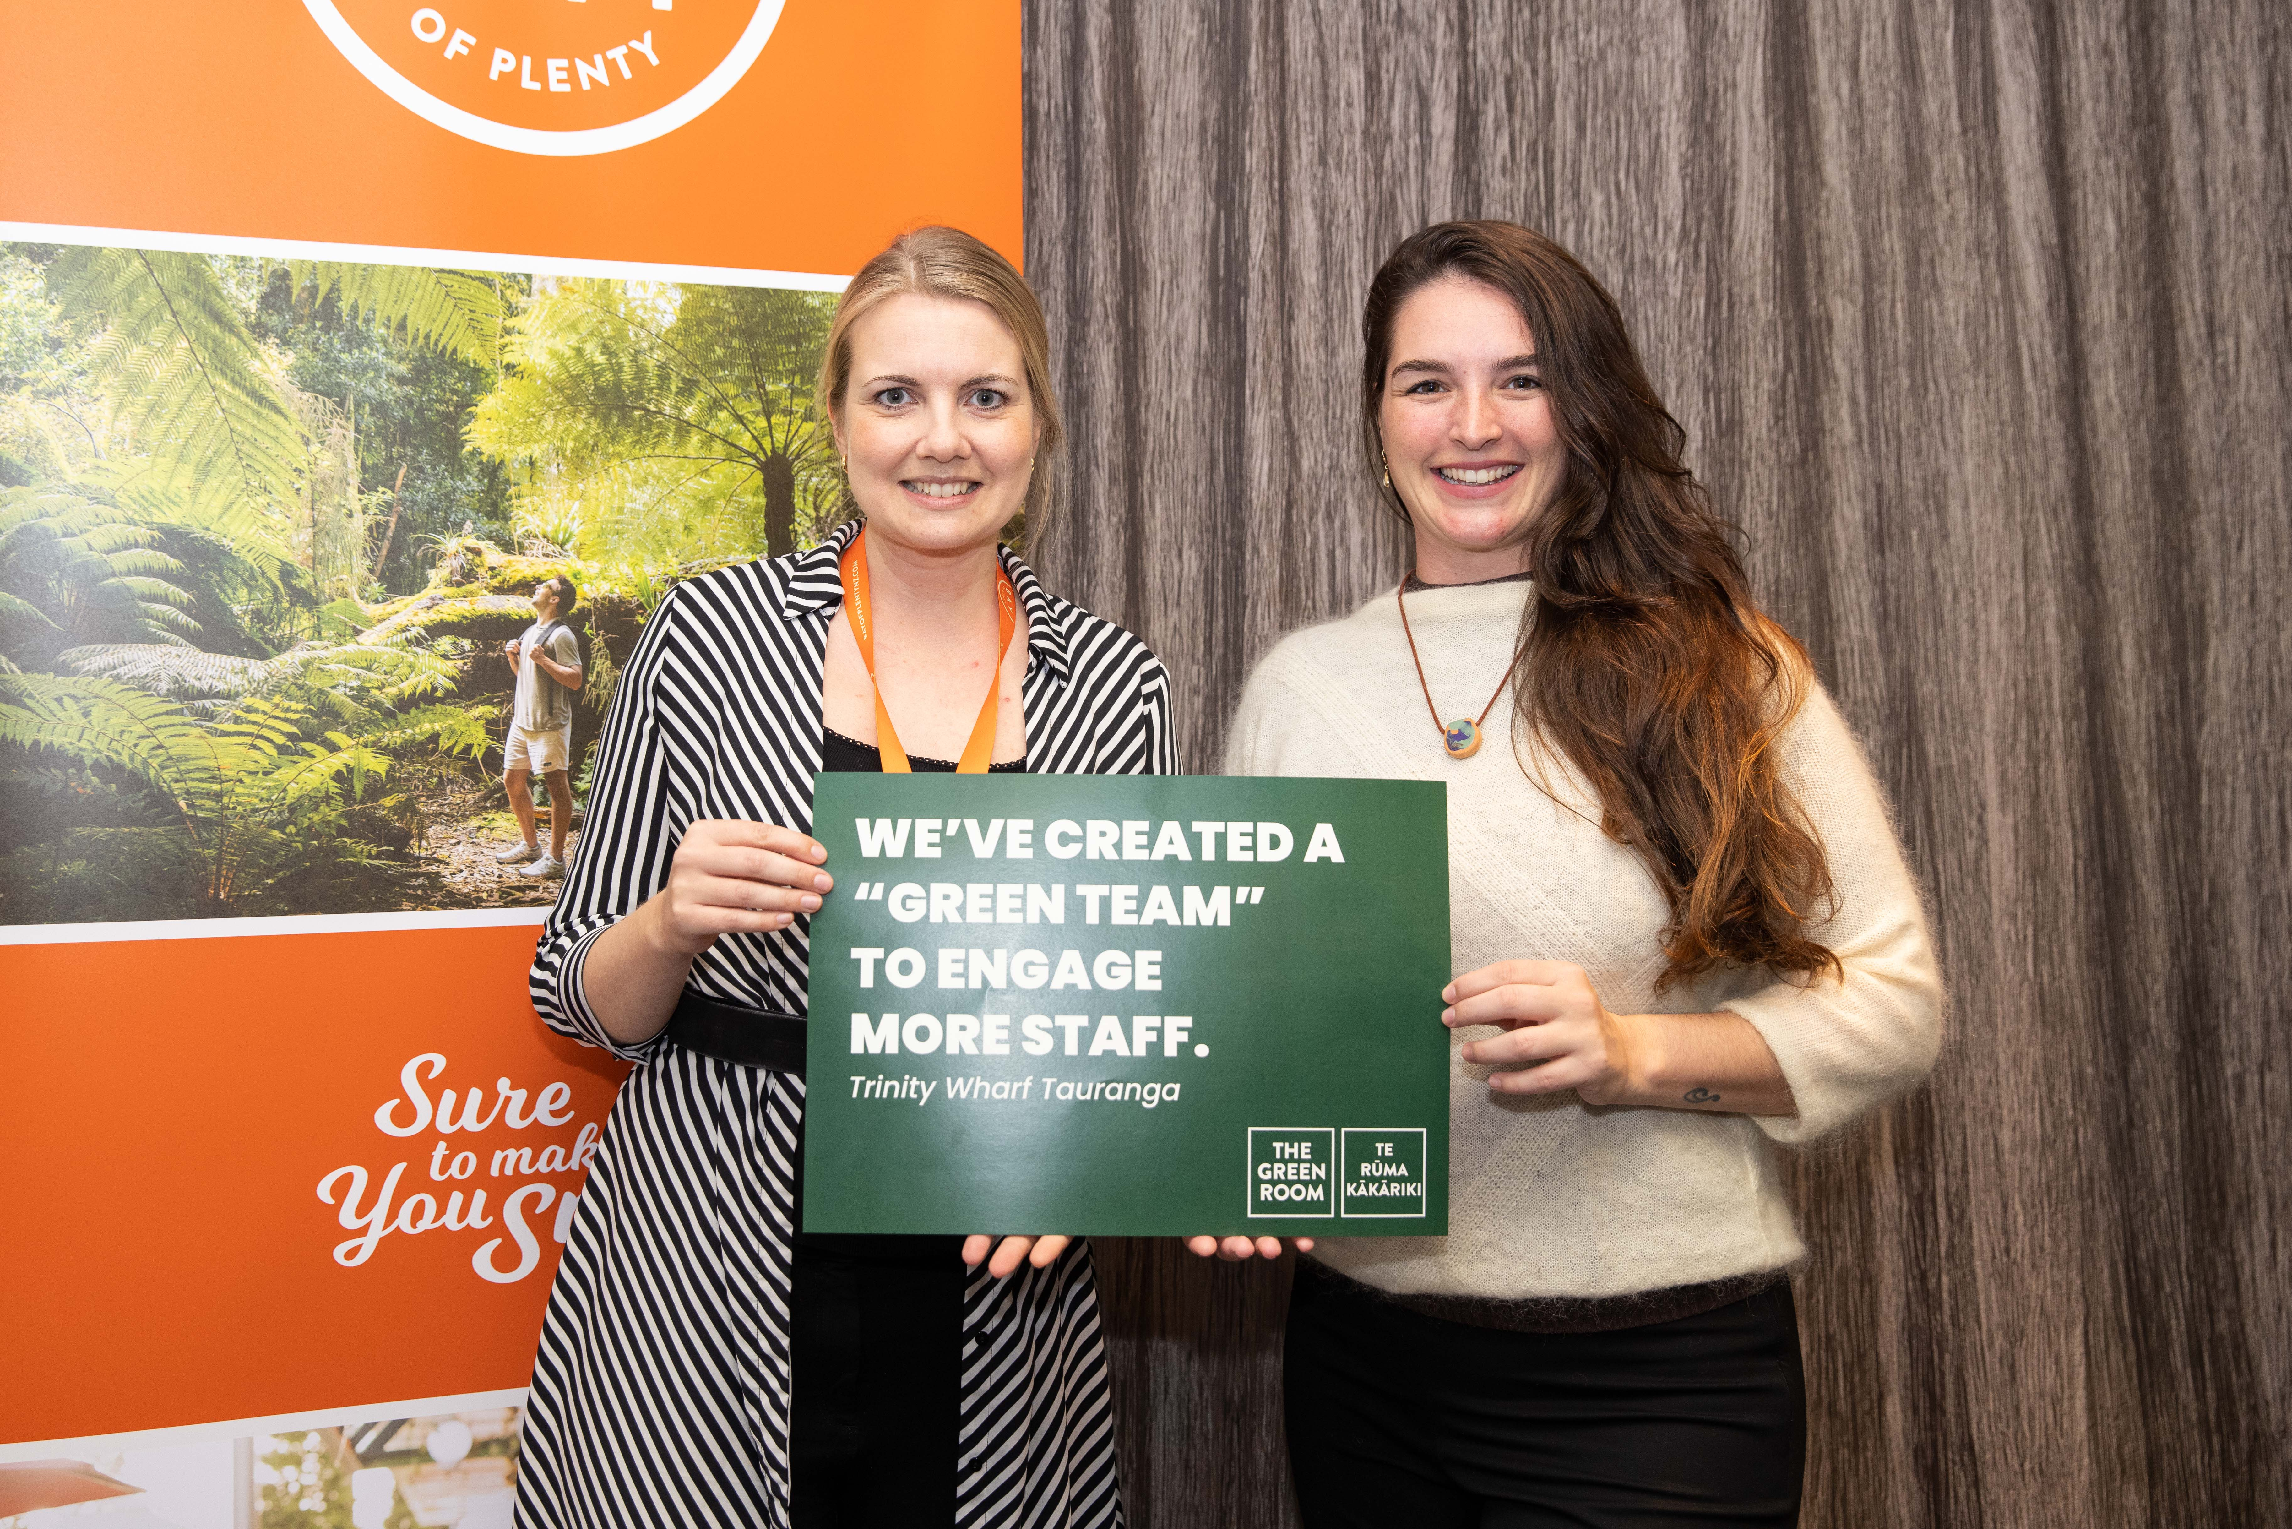
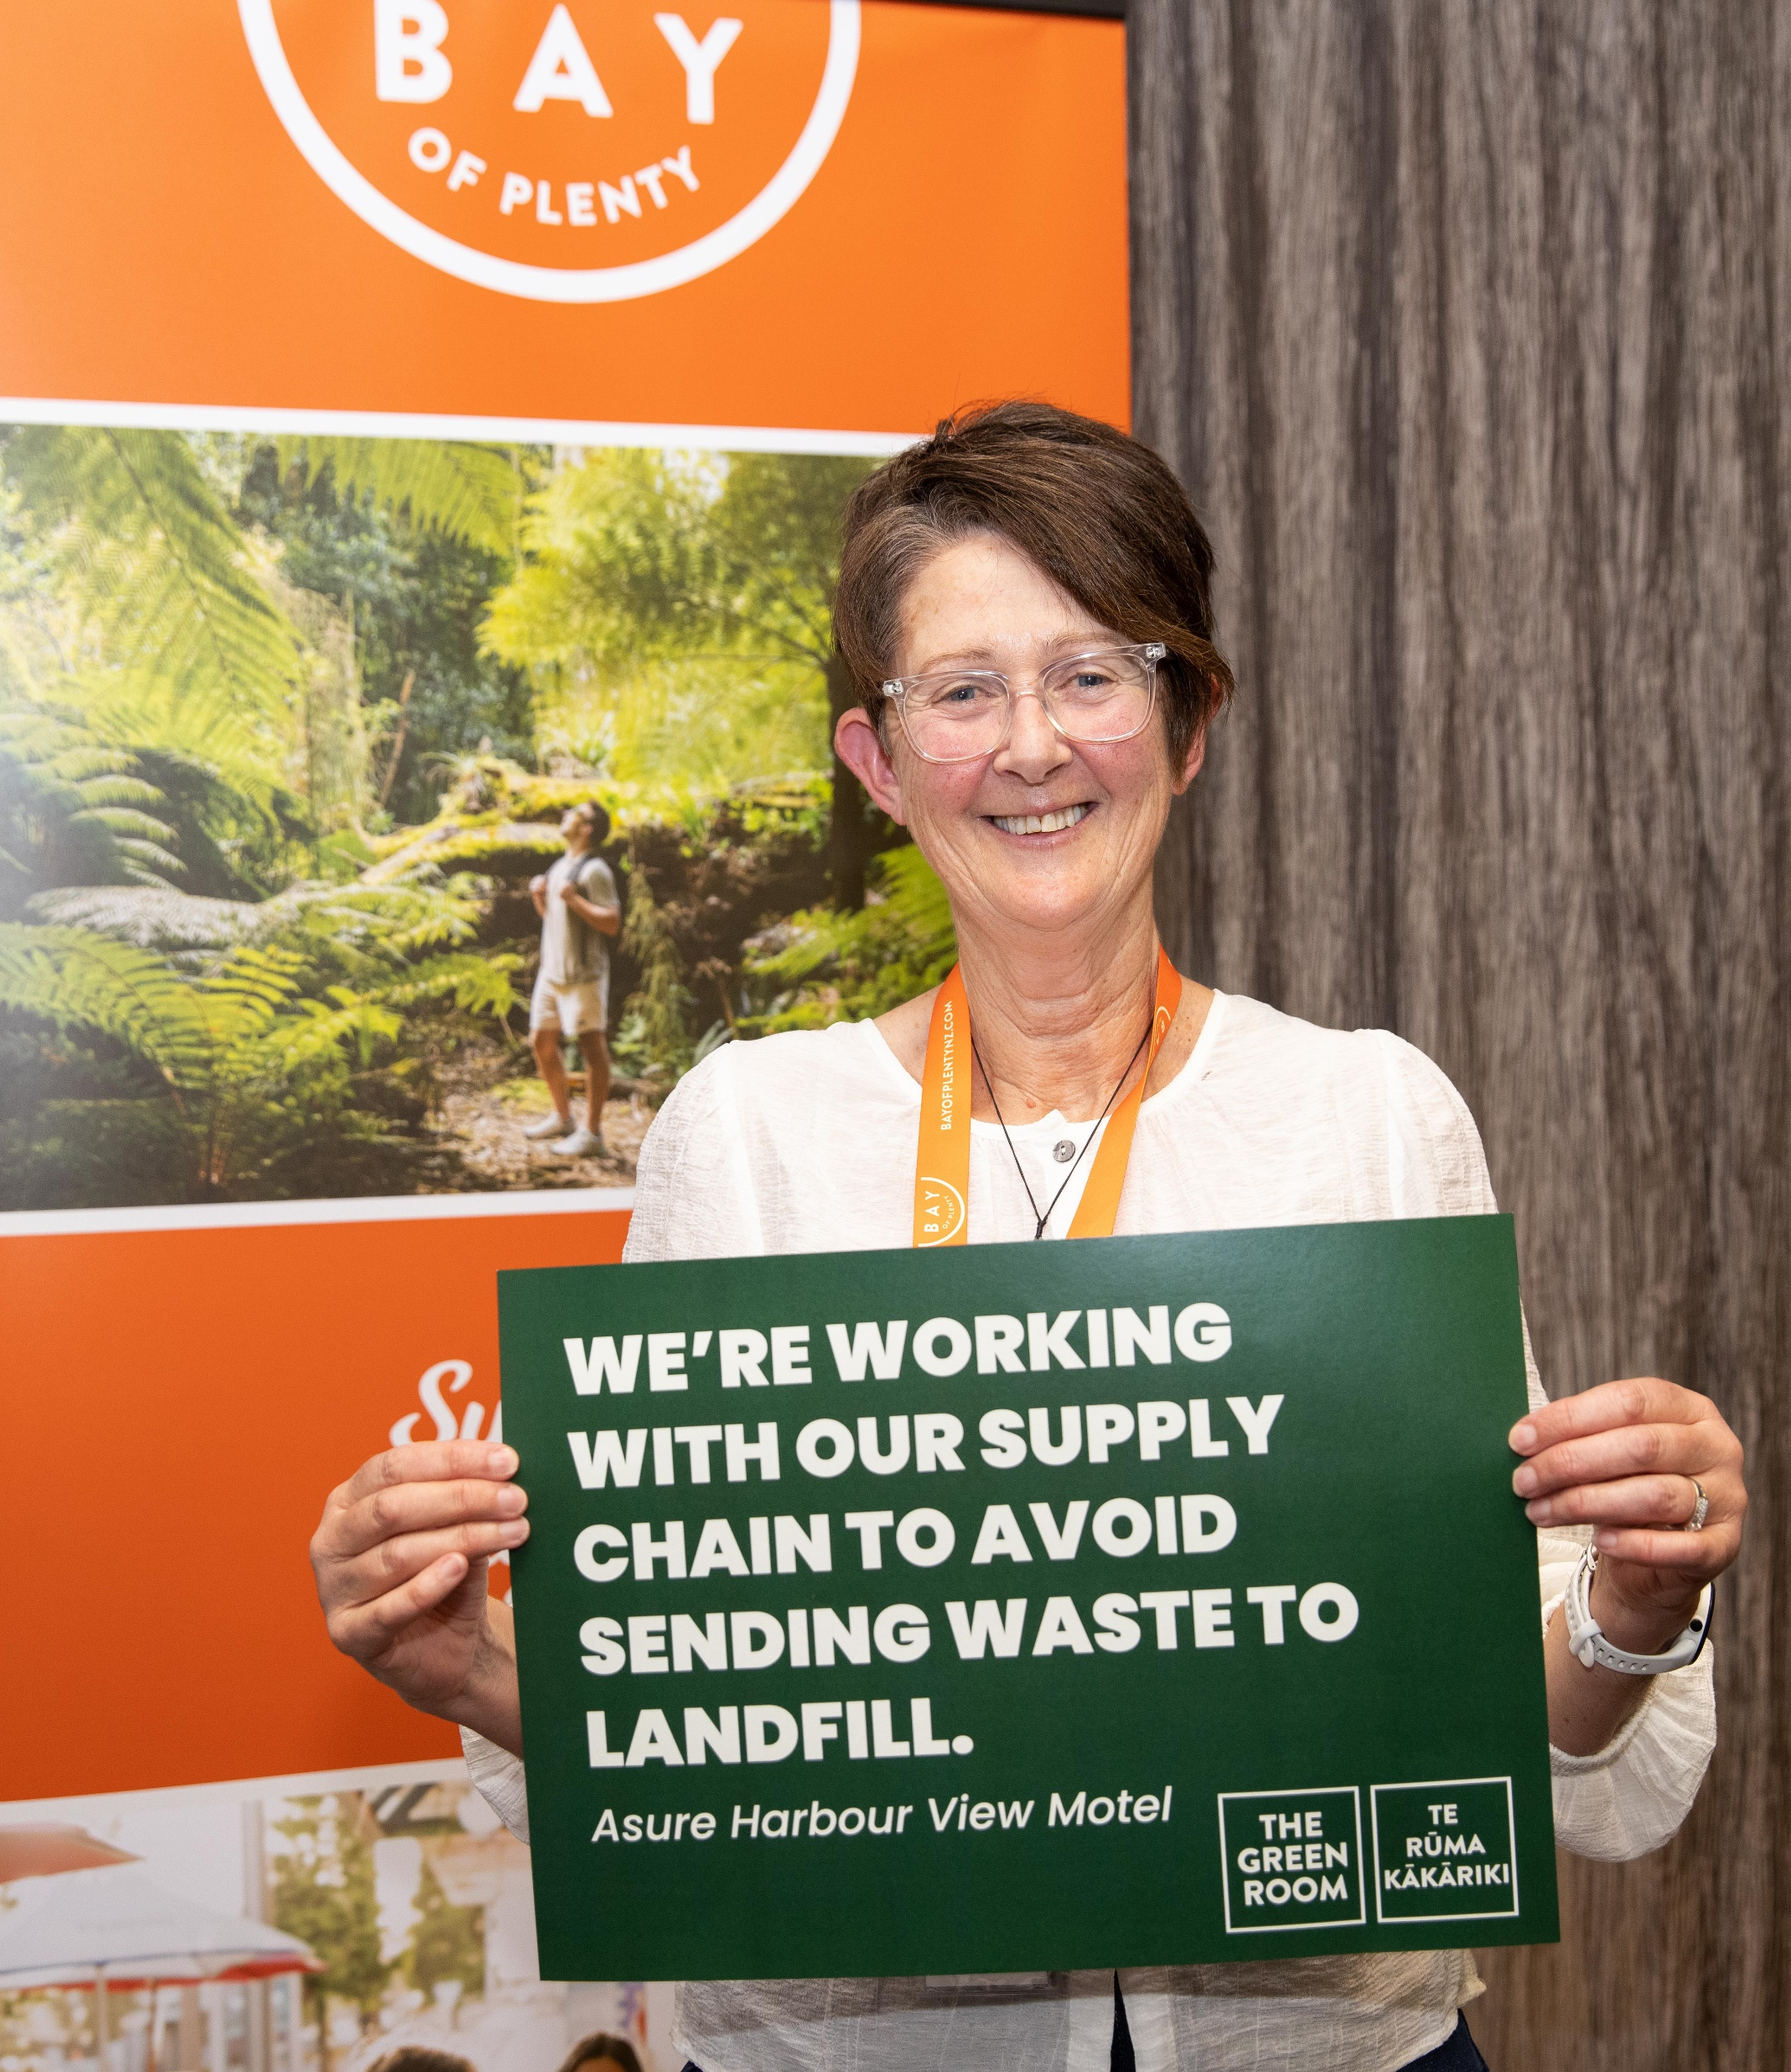
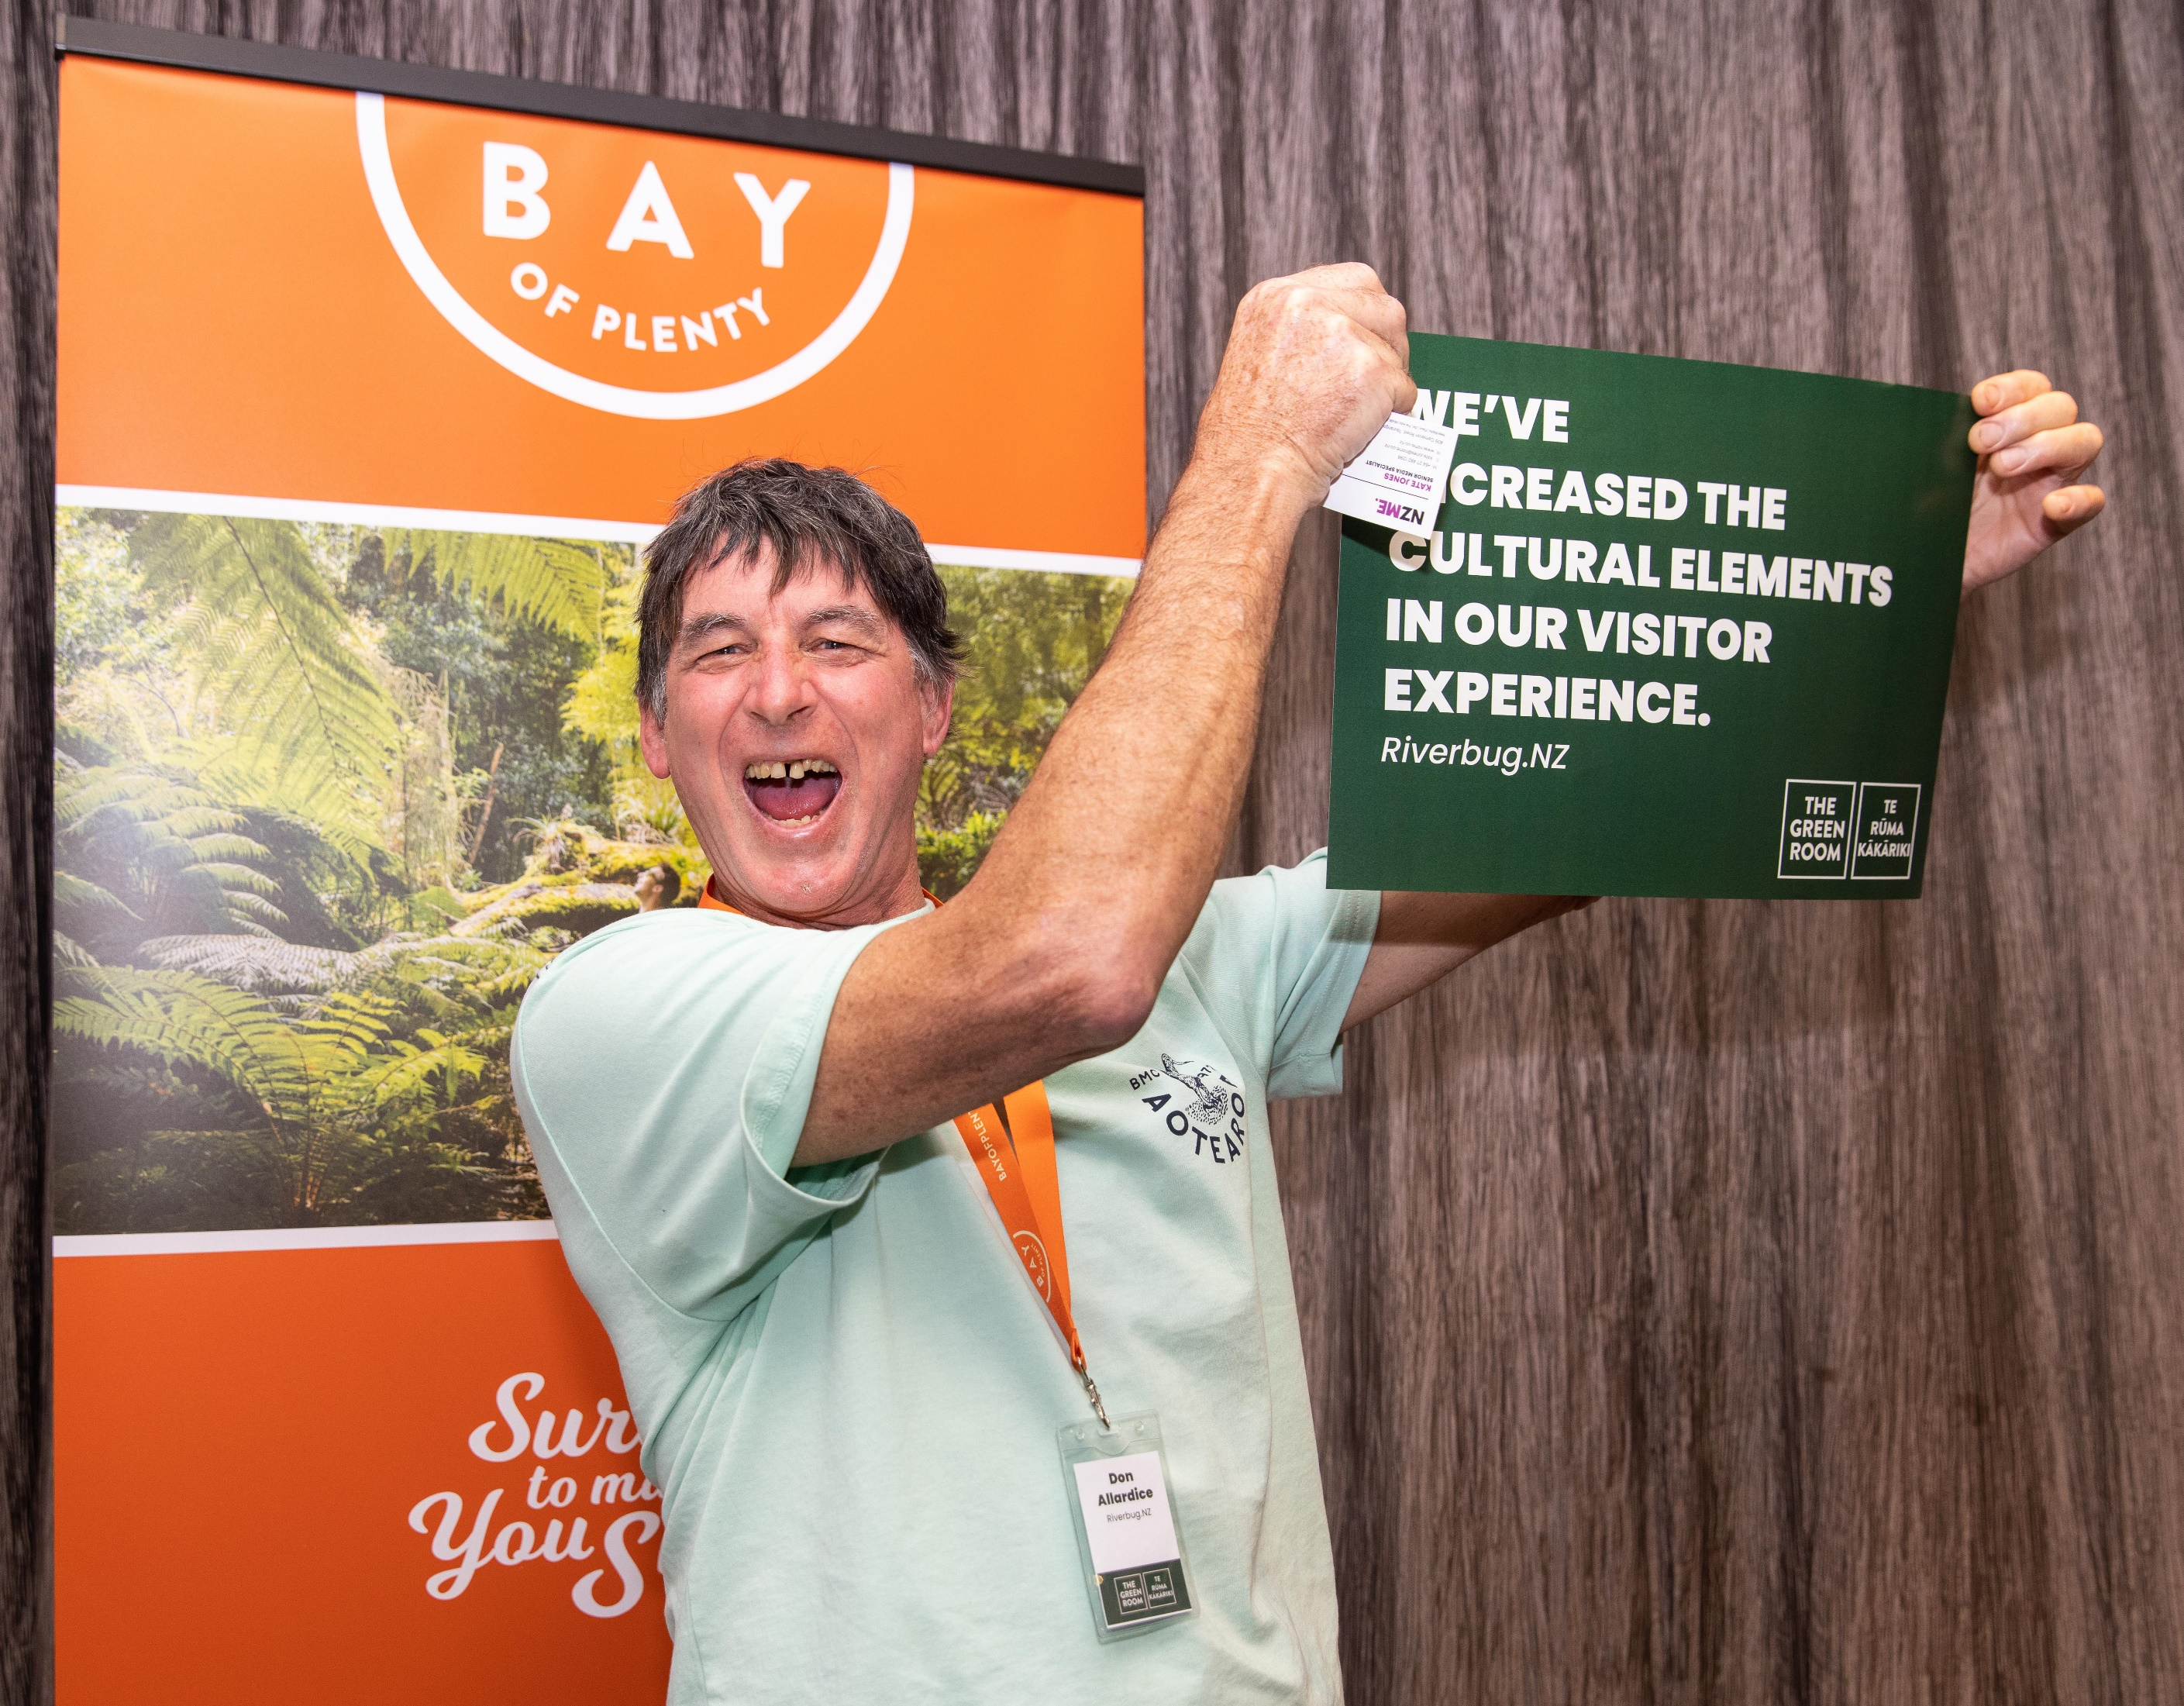
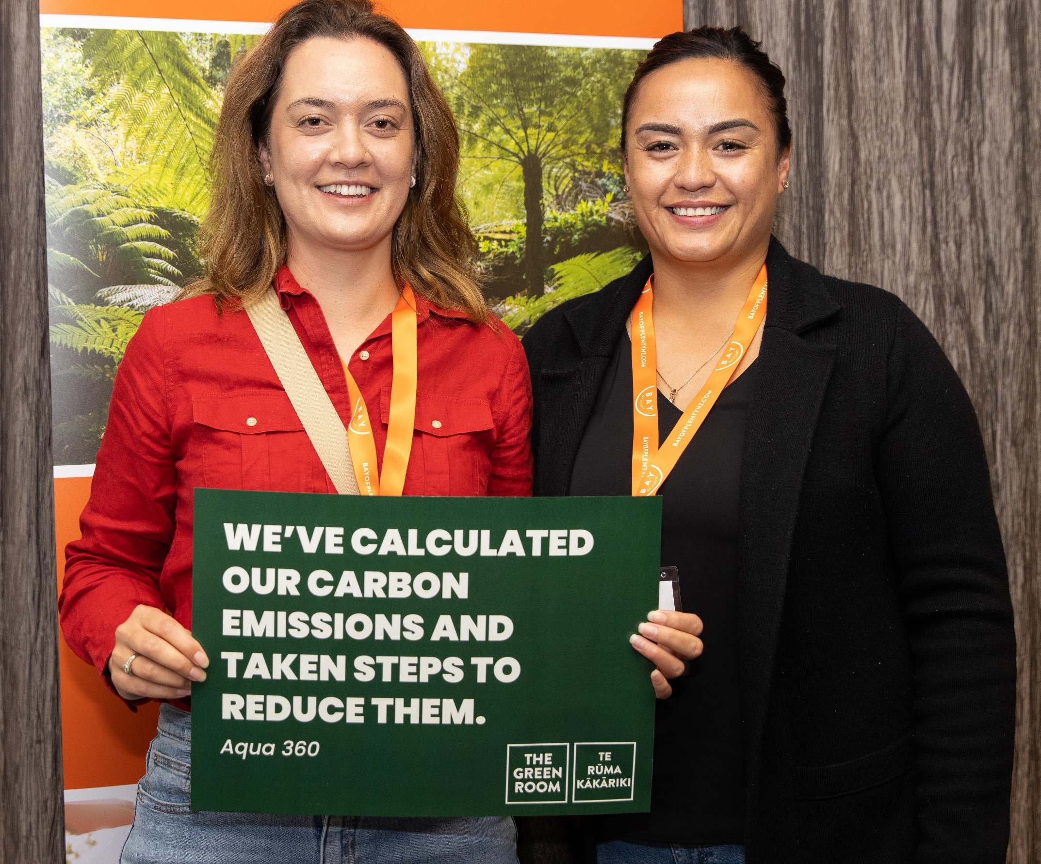
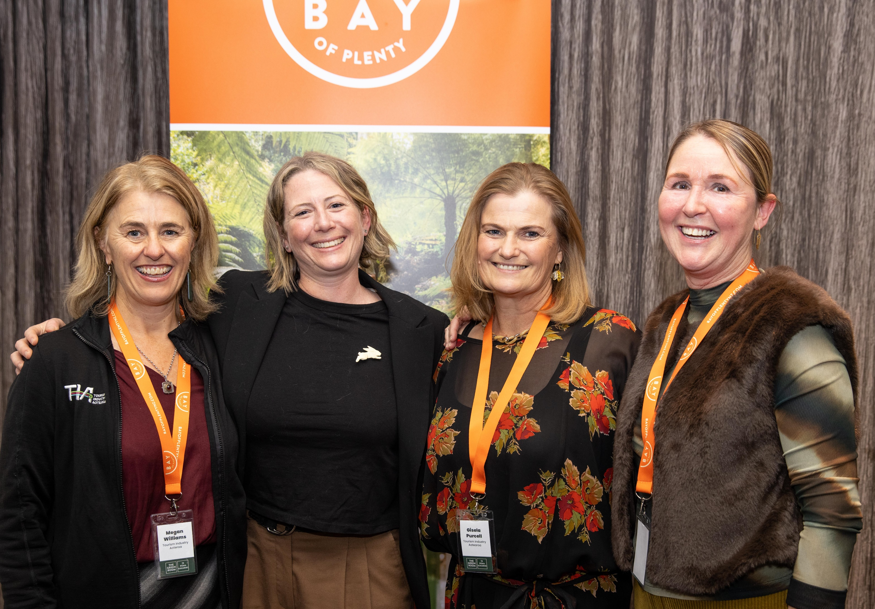
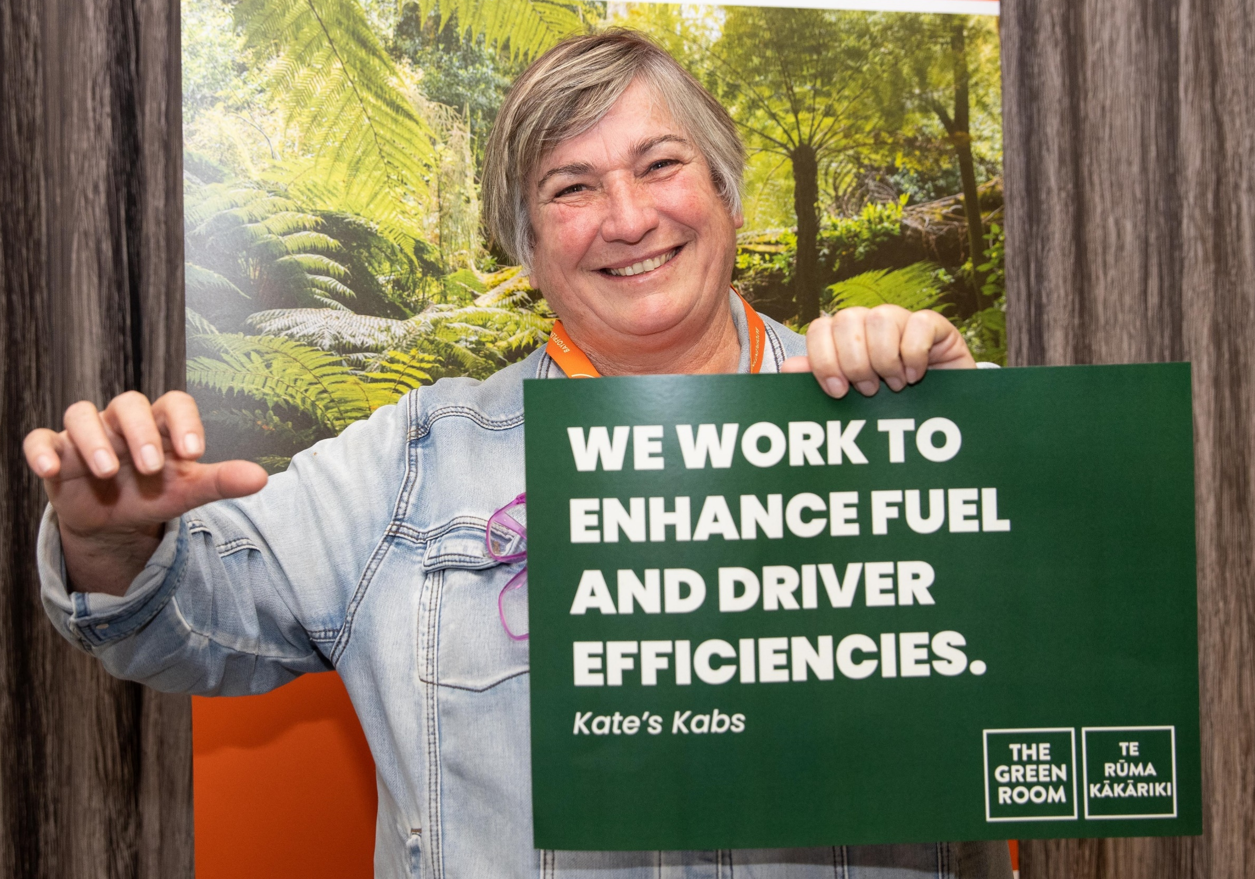
100 Graduates: Celebrating Success

Slide 5
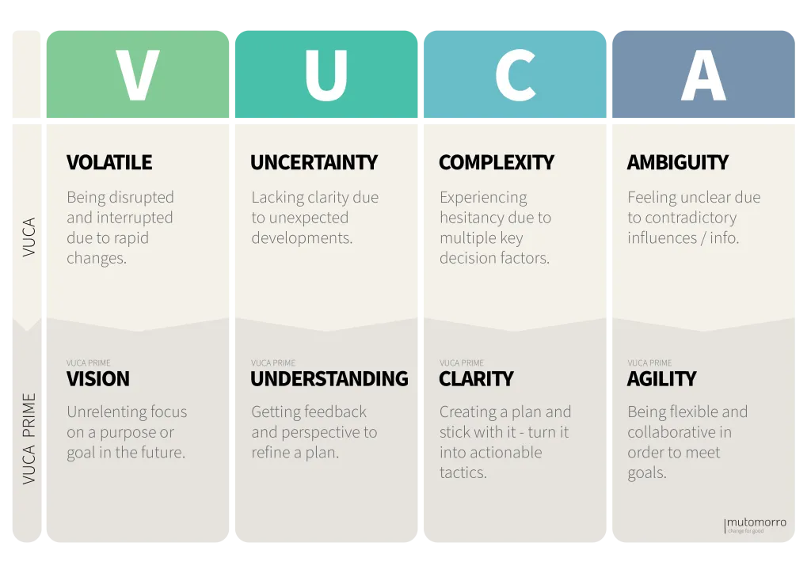

Key Learnings
When recruiting organisations to participate, understand the changing ‘VUCA’ conditions they are faced with. Lead with empathy to understand their priorities.

Slide 6
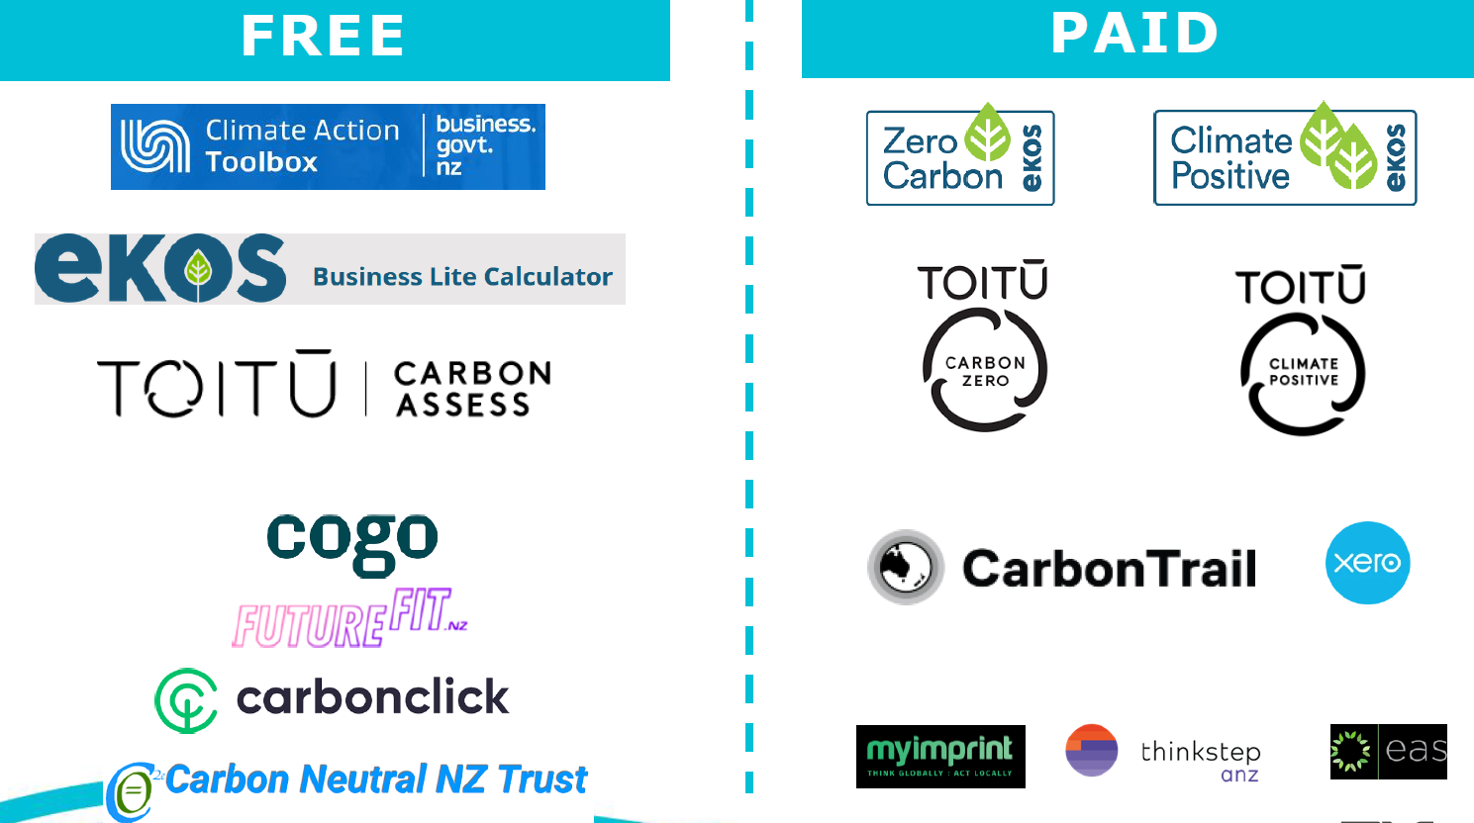
Key Learnings
Keep it simple!

Slide 7
100 Graduates: Now What?
Through strong alignment of national and local body strategies, TBOP has been able to secure funding from Tauranga City Council to continue the programme for another 12 months
The scope of participants will broaden to include relevant retail and hospitality businesses which are a key part of our visitor economy
The programme will be simplified to improve efficiencies between similar sector organisations (e.g. Retail)
Partnerships for the delivery of the programme will continue to be a key focus
Those organisations who have already graduated will continue to be supported and encouraged to influence other organisations to get involved

Slide 8
